Slide 1
Logic & Sets
Free course | Ella Rozenberg | 2025

Slide 2
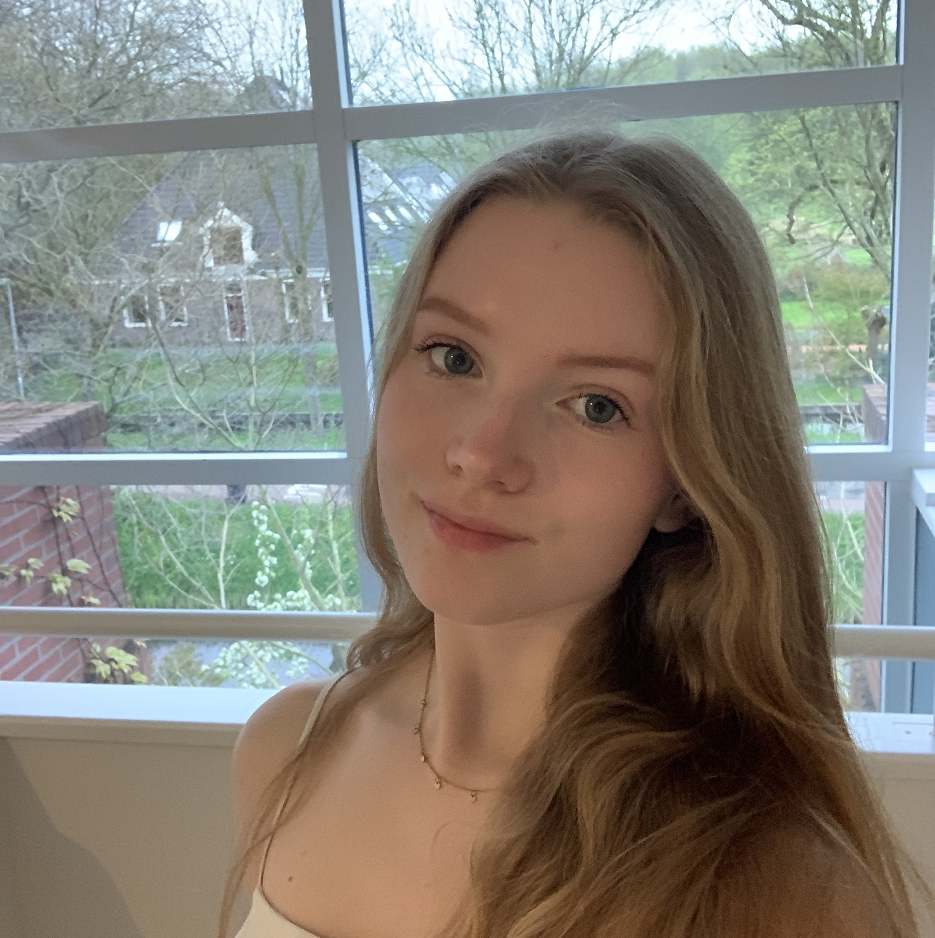
Welcome!
Bachelor AI (third year)
3 years of teaching experience
I love to travel
Ella Rozenberg

Slide 3

WhatsApp

Slide 4



Planning Day 1
Exam Analysis
Predicate Logic /Models
Functions
Introduction

Slide 5
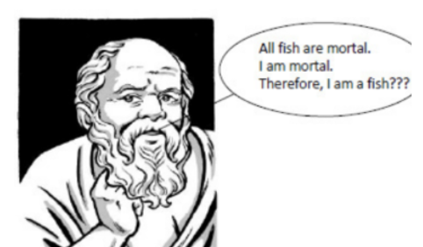
Is this familiar?
By the end of this session, you can answer the following question: Is Socrates a Fish?

Slide 6


Pro-active participation
Camera’s on!
Raise your hand to ask questions!
Be interactive
It is okay to make mistakes
Ask questions
Take notes
Slides will be send afterwards!

Slide 7

Structure

Slide 8

Planning Day 1
Exam Analysis
Predicate Logic /Models
Functions
Introduction

Slide 9
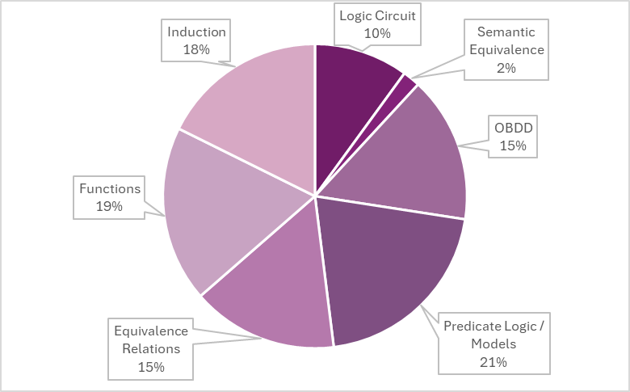
Exam
Exam Analysis 2019-2023

Slide 10
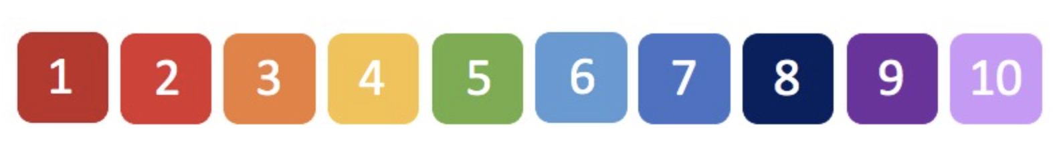
How much confidence do you have in your knowledge?

Slide 11
Planning Day 1
Exam Analysis
Predicate Logic /Models
Functions
Introduction

Slide 12

Models

Slide 13
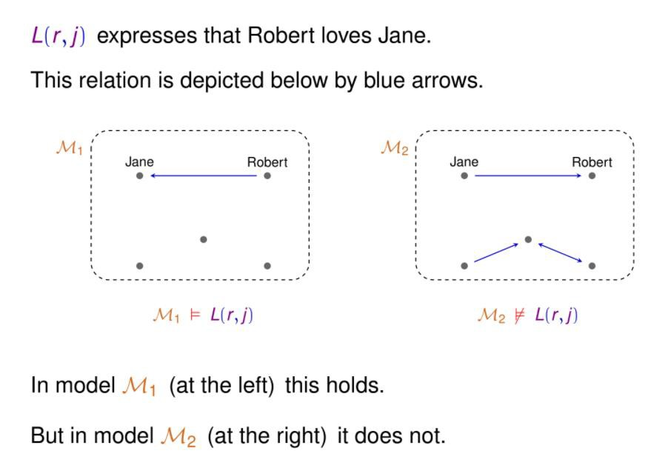
Models

Slide 14
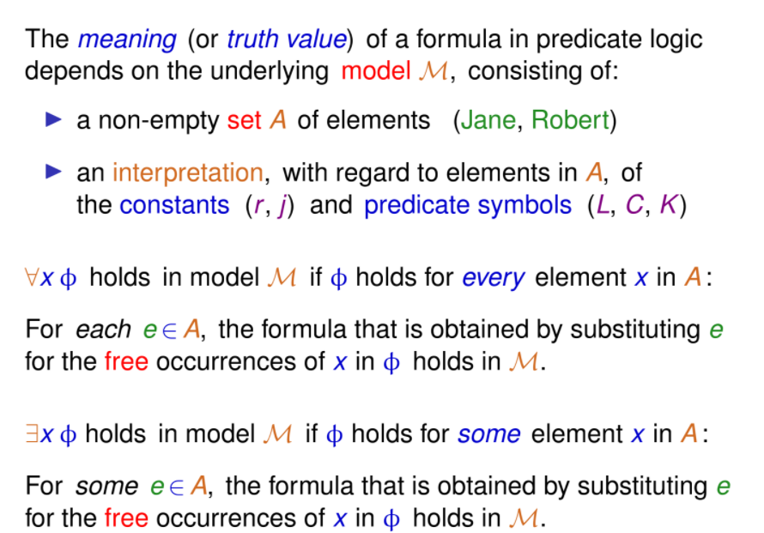
Models

Slide 15
Models

Slide 16
Models

Slide 17
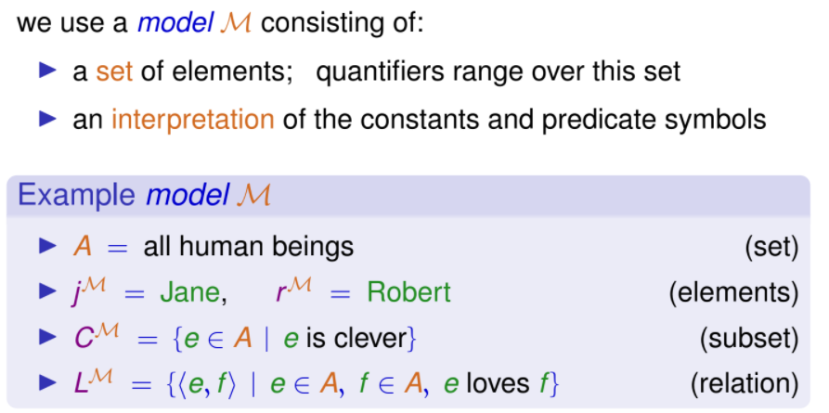
Models

Slide 18
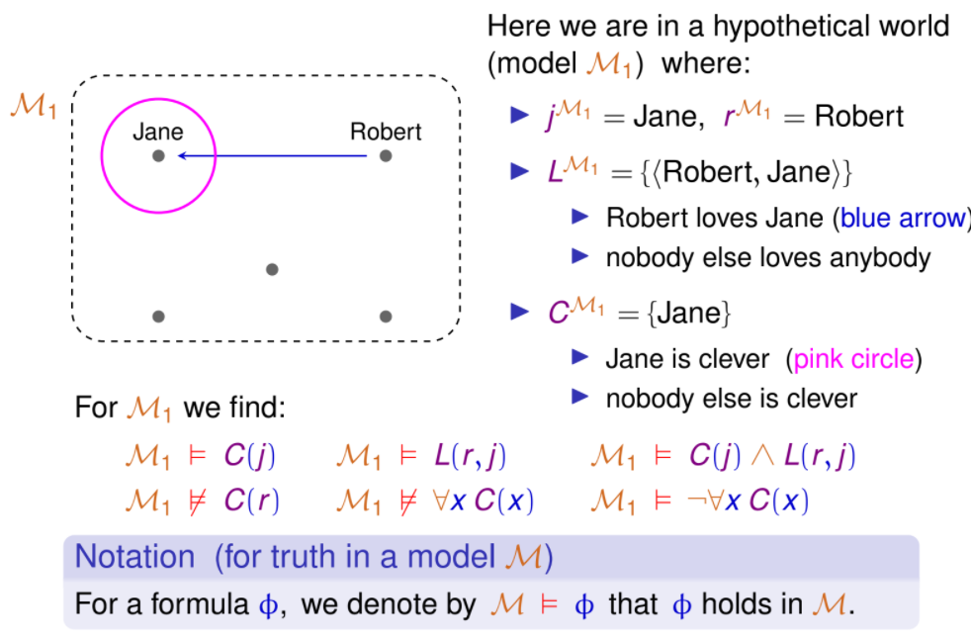
Models

Slide 19
Models

Slide 20
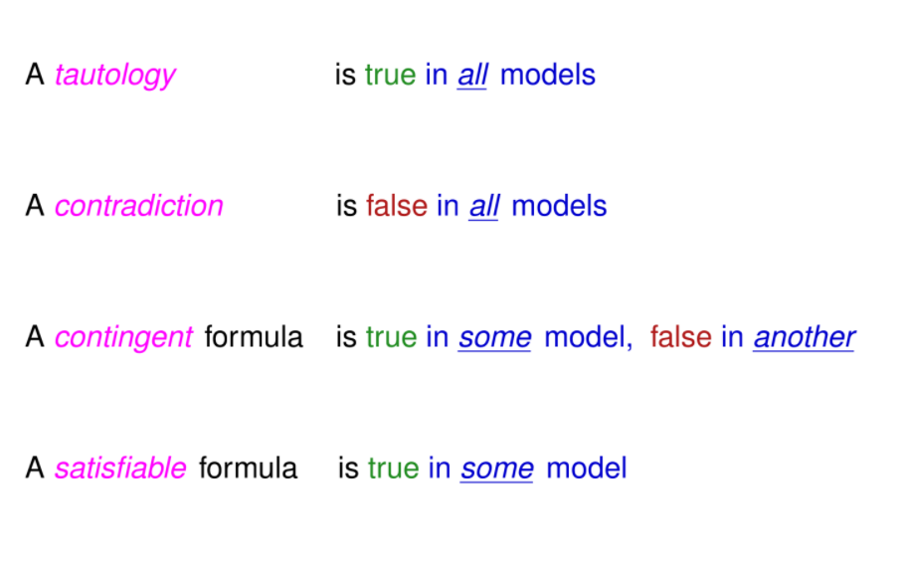
Models

Slide 21
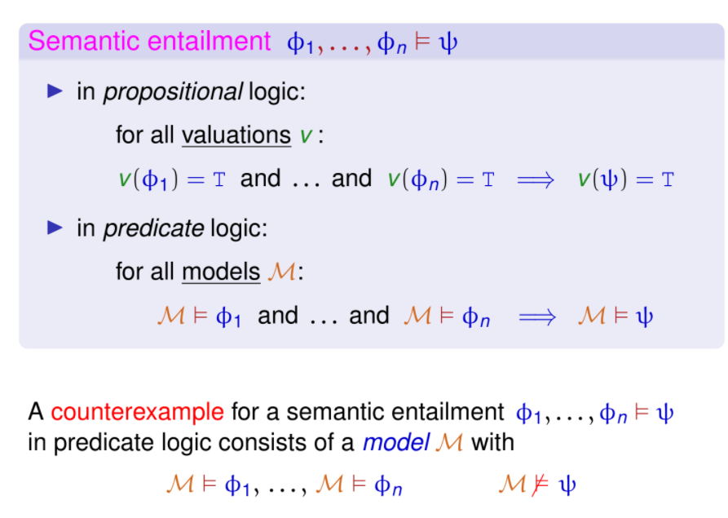
Models

Slide 22
Models

Slide 23
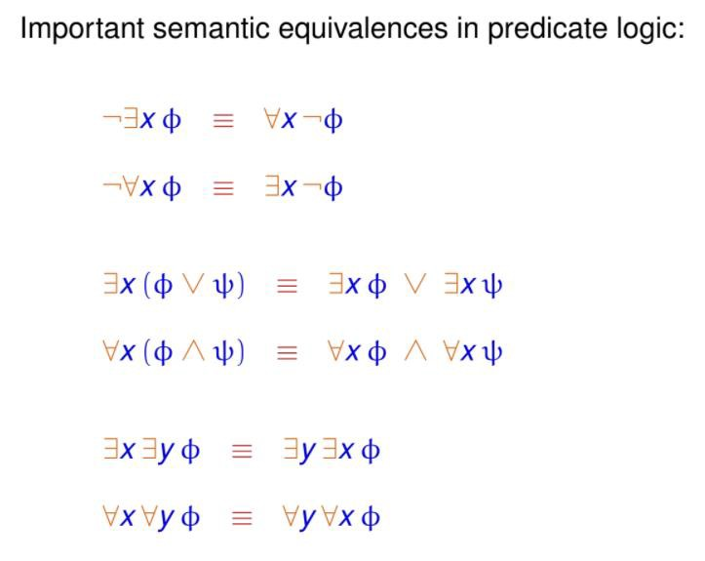
Models: Important sem. equiv.

Slide 24
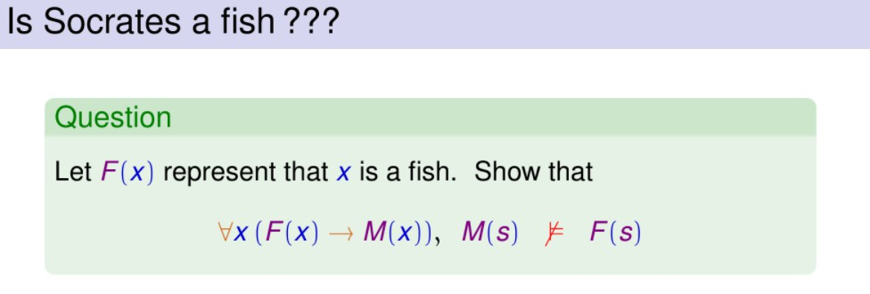
Models: Example

Slide 25
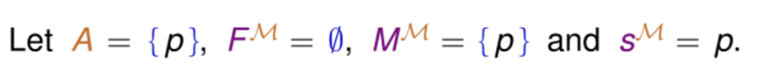
Models: Example

Slide 26

Models: Example

Slide 27

Models: Example

Slide 28
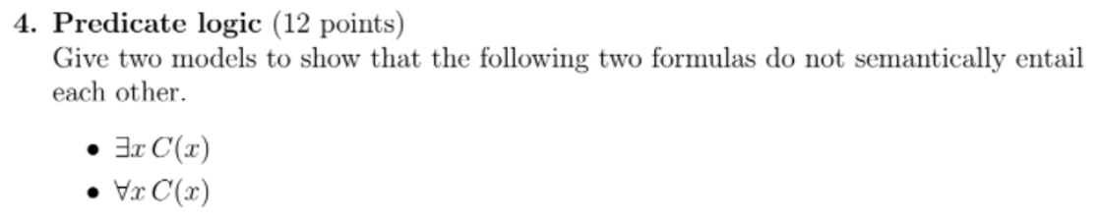

Models: Example
Exam Question: resit 2020

Slide 29
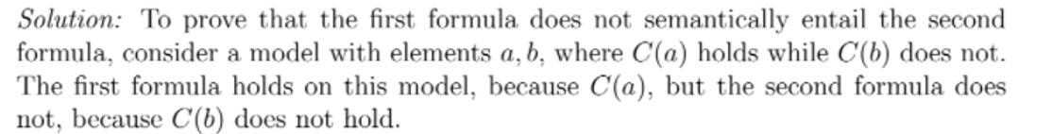
Models: Example
Exam Question: resit 2020

Slide 30
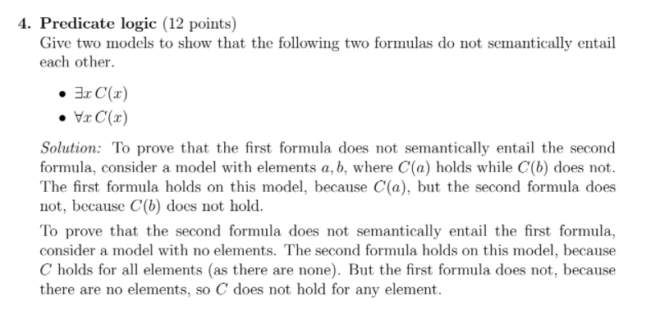
Models: Example
Exam Question: resit 2020

Slide 31
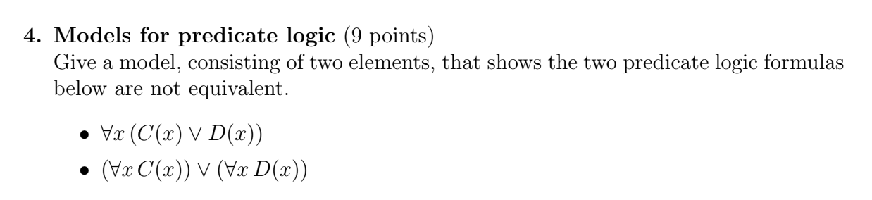

Models: Exercise
Exam Question: resit 2017

Slide 32
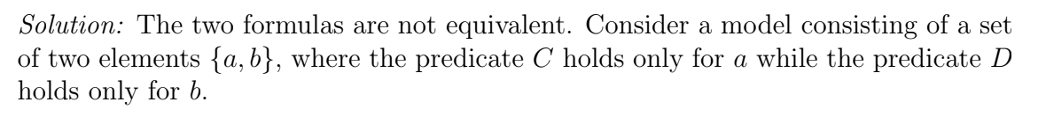
Models: Exercise
Exam Question: resit 2017

Slide 33
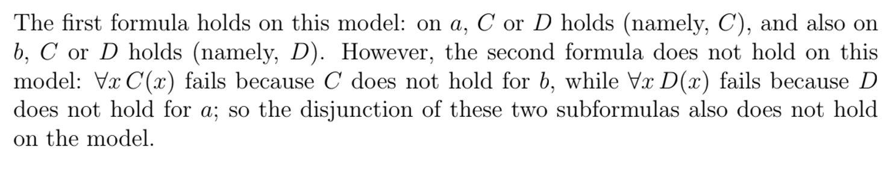
Models: Exercise
Exam Question: resit 2017

Slide 34
Planning Day 1
Exam Analysis
Predicate Logic /Models
Functions
Introduction

Slide 35

Break

Slide 36
Functions

Slide 37
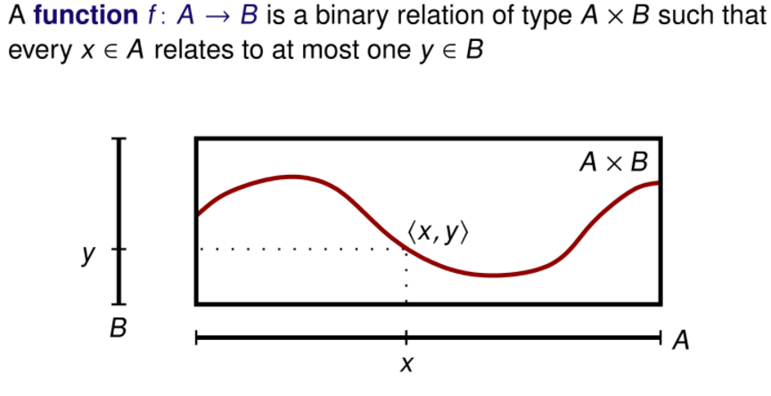
Functions

Slide 38
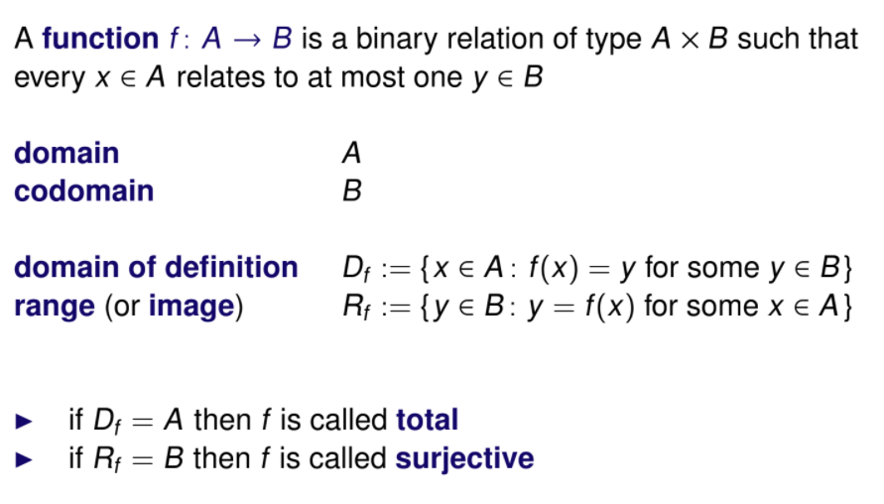
Functions

Slide 39
Functions

Slide 40
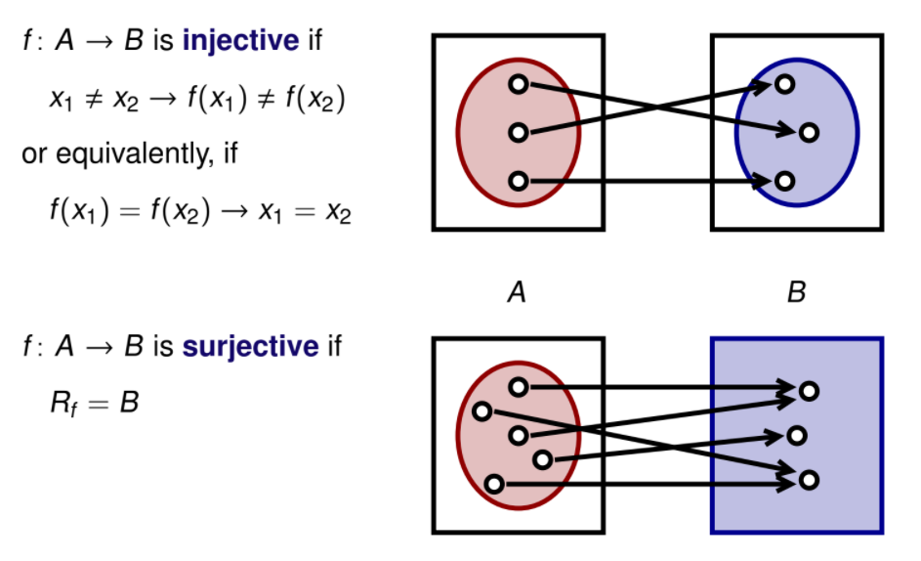
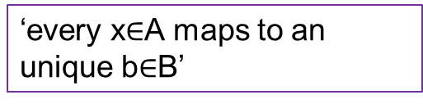
Functions

Slide 41
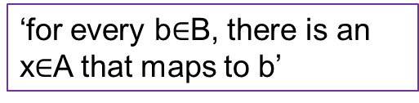
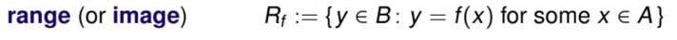
Functions

Slide 42
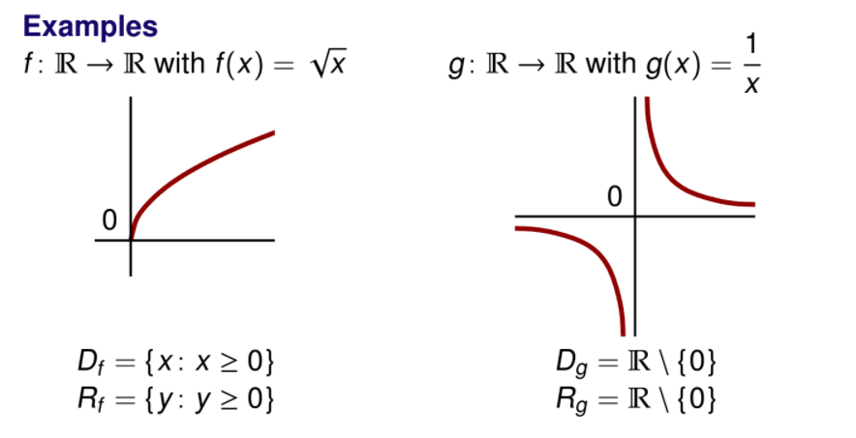
Functions: Example

Slide 43
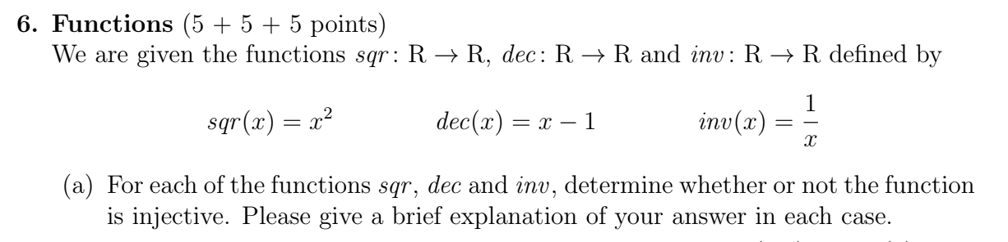
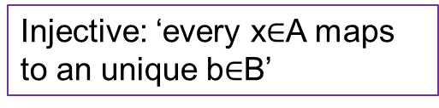
Functions: Exercise!
Exam Question: final 2019

Slide 44
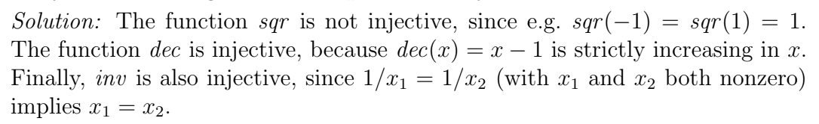
Functions: Exercise!
Exam Question: final 2019

Slide 45
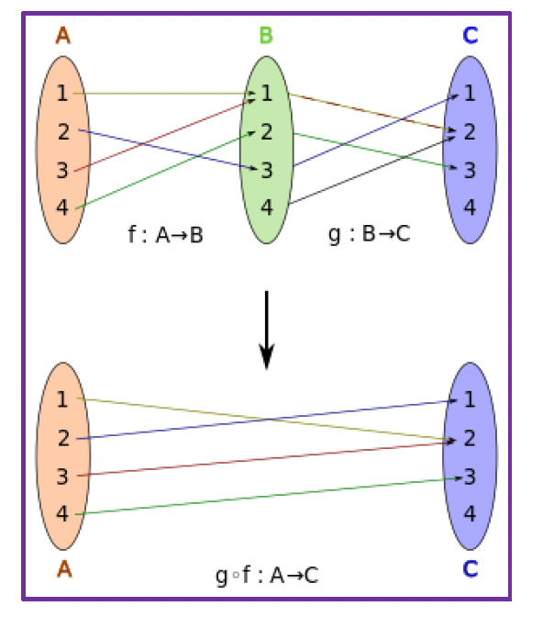
Functions
f(x) = y ∧ g(y) = z ⇒ (g ○ f)(x) = g(f(x)) = z

Slide 46
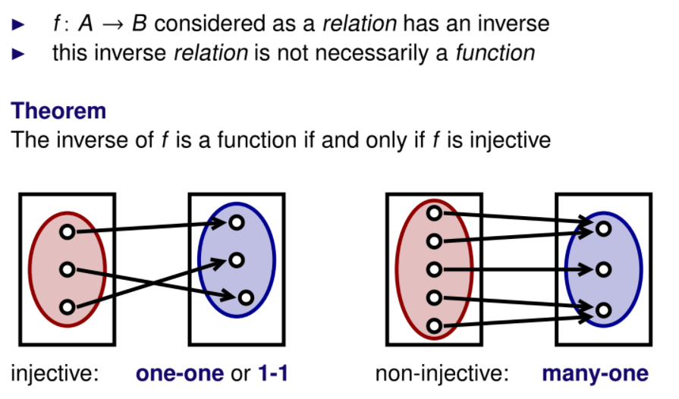
Functions

Slide 47
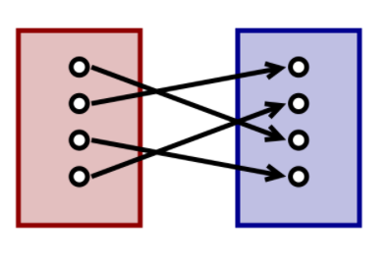
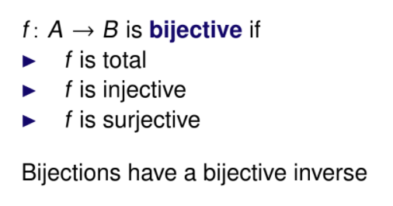






Functions

Slide 48
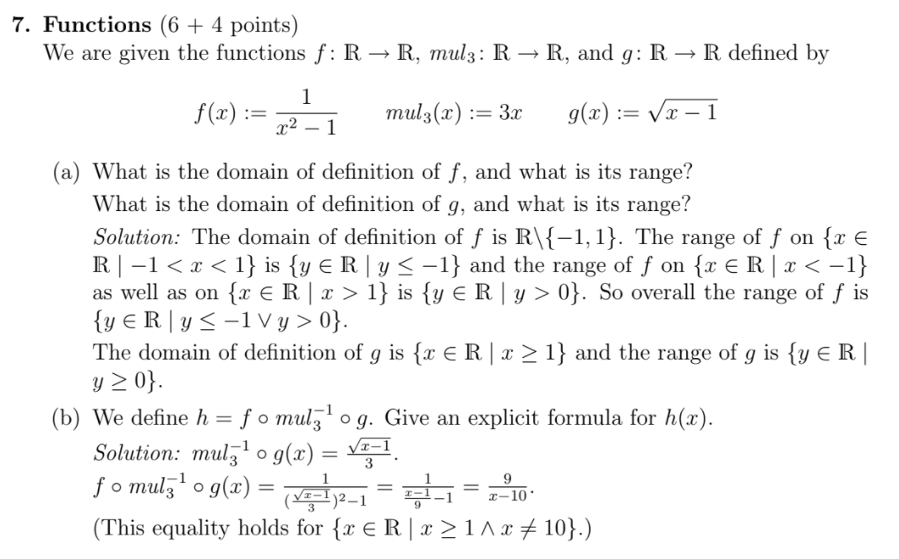
Functions: Example
Exam Question: resit 2020

Slide 49

Functions: Example
Exam Question: resit 2020

Slide 50
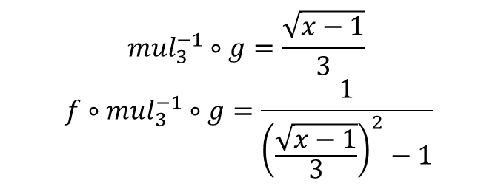
Functions: Example
Exam Question: resit 2020

Slide 51
How much confidence do you have in your knowledge?

Slide 52
Evaluation form

Slide 53
Free vs full

Slide 54
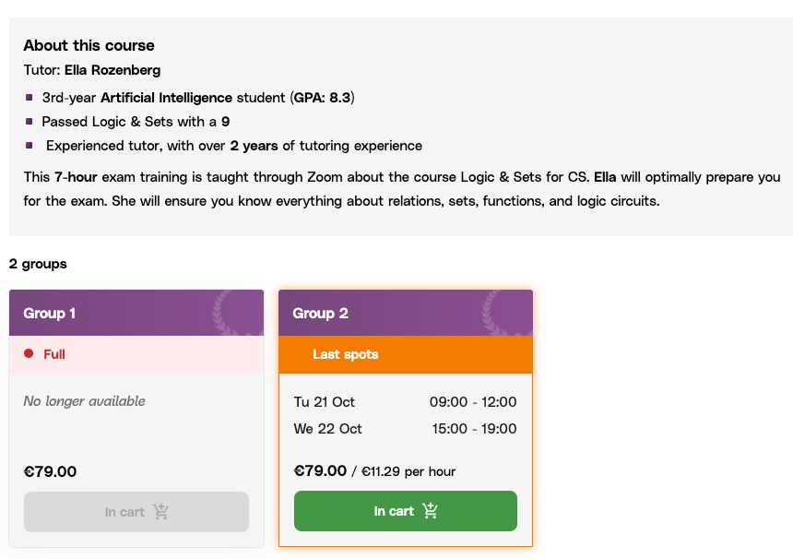
Full Course

Slide 55
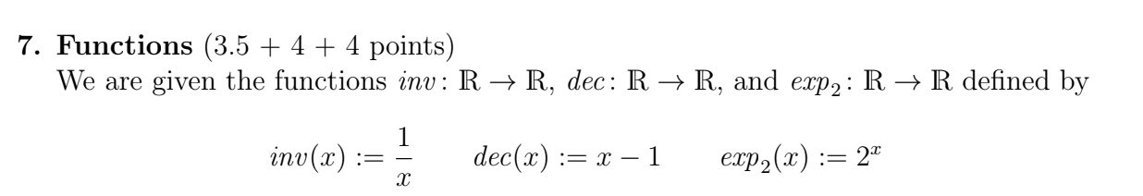
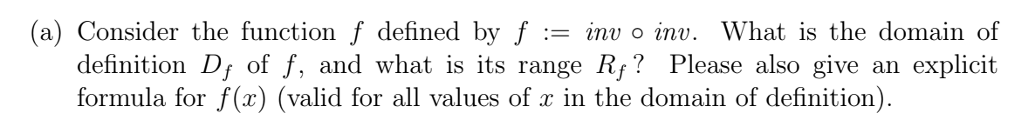
Functions: Exercise!
Exam Question: final 2020

Slide 56
Functions: Exercise!
Exam Question: final 2020

Slide 57
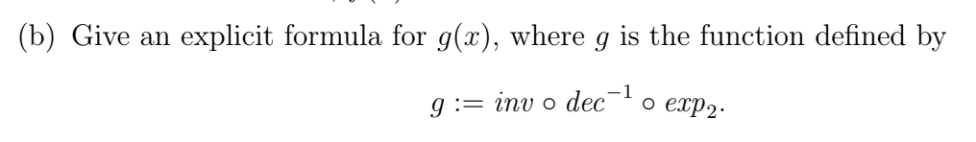
Functions: Exercise!
Exam Question: final 2020

Slide 58


Functions: Exercise!
Exam Question: final 2020

Slide 59
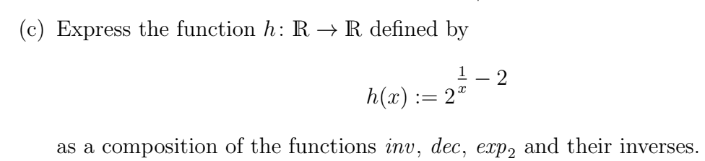
Functions: Exercise!
Exam Question: final 2020

Slide 60

Functions: Exercise!
Exam Question: final 2020

Slide 61
Planning Day 1
Exam Analysis
Predicate Logic /Models
Functions
Introduction

Slide 62
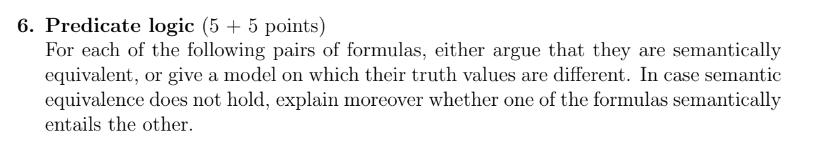
Extra
Exam Question: final 2020

Slide 63
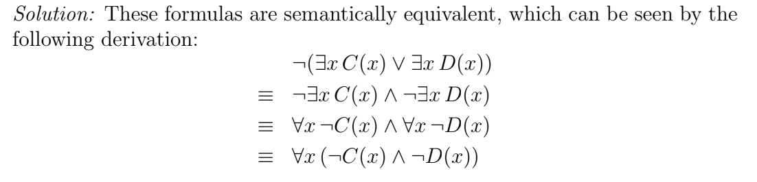
Extra
Exam Question: final 2020

Slide 64
Extra
Exam Question: final 2020

Slide 65
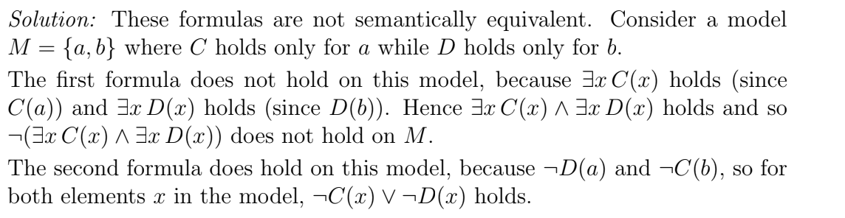
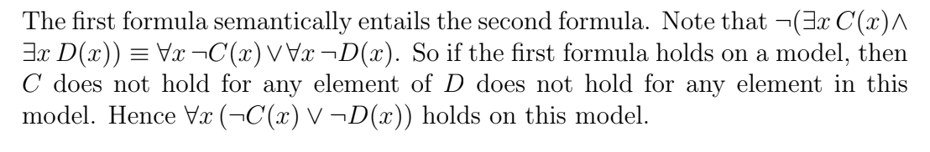
Extra
Exam Question: final 2020

