Slide 1

JASP Student Developers
Unit Testing for JASP Modules
13.05.2026 julian.wuth@student.uva.nl

Slide 2
Contents
Introduction to unit testing in JASP
Live-Walkthrough

Slide 3
Contents
Introduction to unit testing in JASP
Live Walkthrough

Slide 4
Intro to unit testing
Why unit testing?
Ensures that your code behaves as expected
Fewer bugs
Alerts you to unwanted changes later
Shows you where your code might need restructuring
Implement changes without worrying about breaking your code (robust code)

Slide 5
Unit testing in JASP
Prerequisites
Having jaspTools installed
JASP tools enables you to …:
… run JASP analyses from R
… test JASP analyses

Slide 6
Unit testing in JASP
Folder structure
ModuleName/
tests/
testthat/
_snaps/
(jaspfiles)
testthat.R
.github/workflows/unittests.yml

Slide 7
Unit testing in JASP
Creating a test file
Located in tests/testthat/
Naming convention is test-“analysisname”.R
Every analysis has a separate test file

Slide 8
Unit testing in JASP
Tests for tables
Use jaspTools::expect_equal_tables() inside testthat()
expect_equal_tables() has 3 arguments:
test: The new table output to be tested
ref: Table snapshot to be compared to. Generated with jaspTools::makeTestTable()
label: Label for the expectation

Slide 9
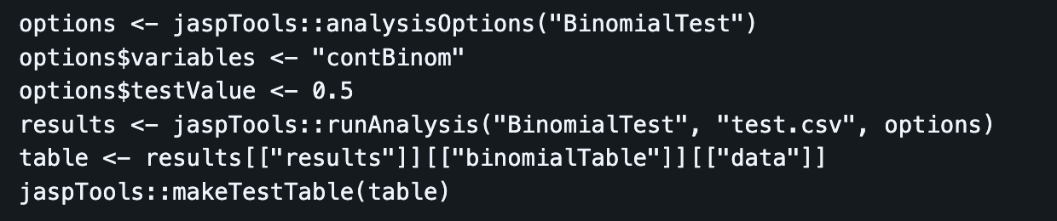
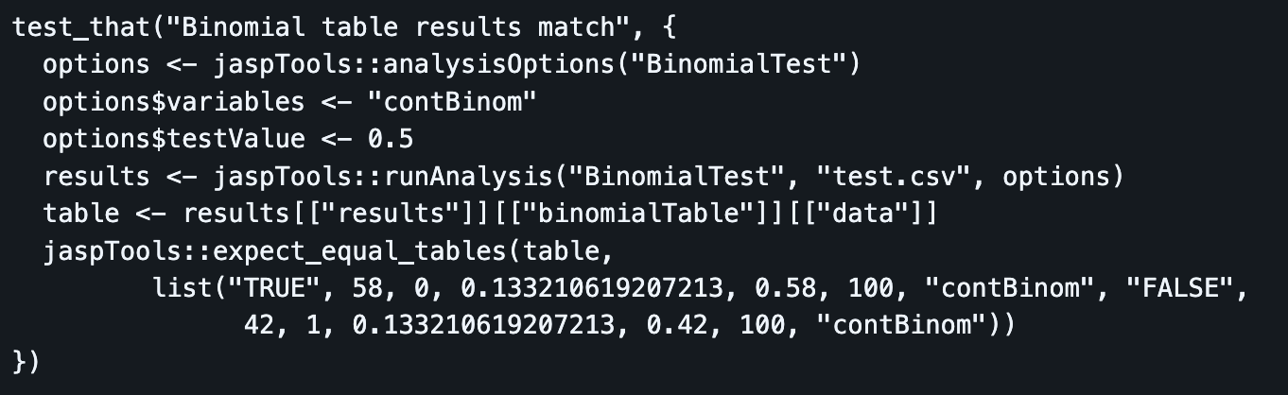
Unit testing in JASP
Tests for tables

Slide 10
Unit testing in JASP
Tests for plots
Use jaspTools::expect_equal_plots() inside testthat()
expect_equal_plots() has 2 arguments:
test: The new plot to be tested
name: Name the plot is/will be stored under in the snapshot folder
Creates an .svg file when the test is run for the first time using jaspTools::testAll() or jaspTools::testAnalysis()
This file serves as a reference for future tests

Slide 11
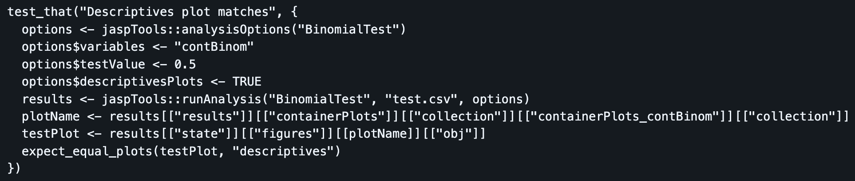
Unit testing in JASP
Tests for plots

Slide 12
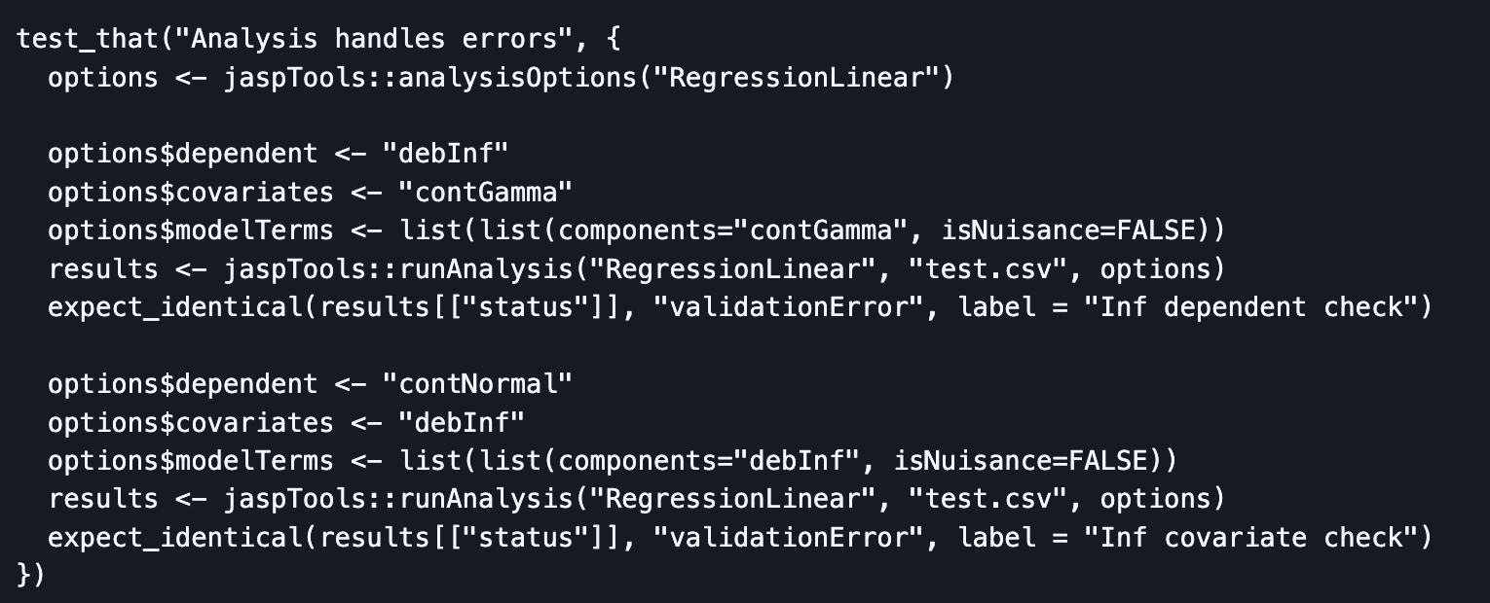
Unit testing in JASP
Testing error handling

Slide 13
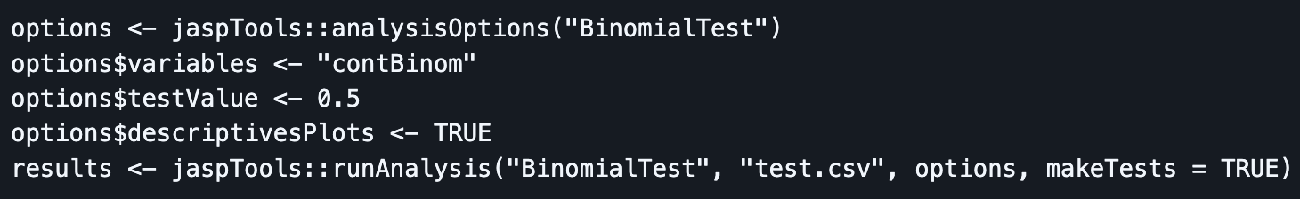
Unit testing in JASP
Creating tests automatically
Using jaspTools::runAnalysis() with makeTests = TRUE

Slide 14
Unit testing in JASP
Creating tests automatically
Auto-generate from JASP file(s)
Move JASP files to one of:
tests/testthat/jaspfiles/library/
tests/testthat/jaspfiles/verified/
tests/testthat/jaspfiles/other/

Slide 15
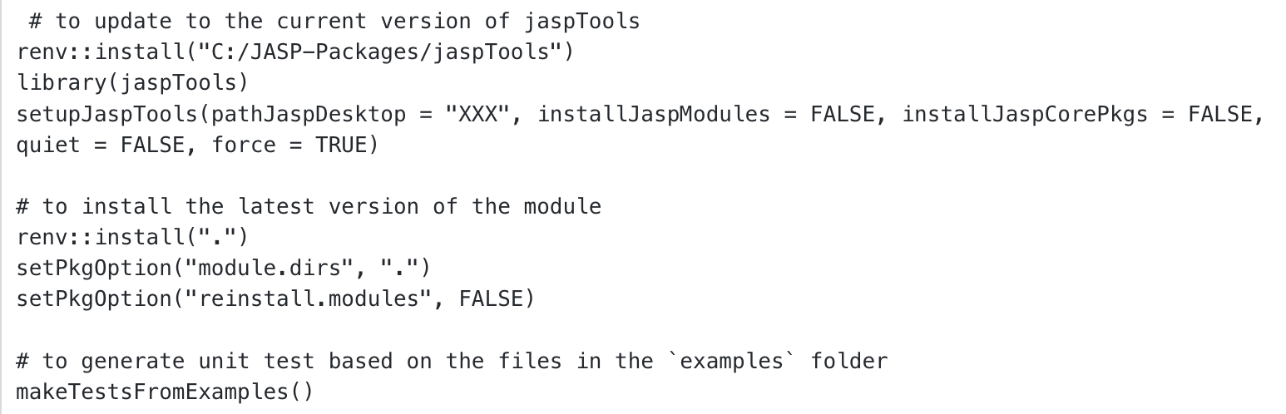
Unit testing in JASP
Creating tests automatically
Set up jaspTools and run jaspTools::makeTestsFromExamples()

Slide 16
Unit testing in JASP
Creating tests automatically
Finally, run jaspTools::testAll() to check that all tests pass

Slide 17
Contents
Introduction to unit testing in JASP
Live-Walkthrough

Slide 18
Live-Walkthrough
Creating unit tests for JASP modules
Let’s see how this works in practice
Clone this repo to follow along

Slide 19
See you next time!

