Slide 1

JASP Student Developers
Creating Plots in JASP
04.03.2026 julian.wuth@student.uva.nl

Slide 2
Contents
Quick recap
Plots
Coding challenge

Slide 3
Contents
Quick recap
Plots
Coding challenge

Slide 4
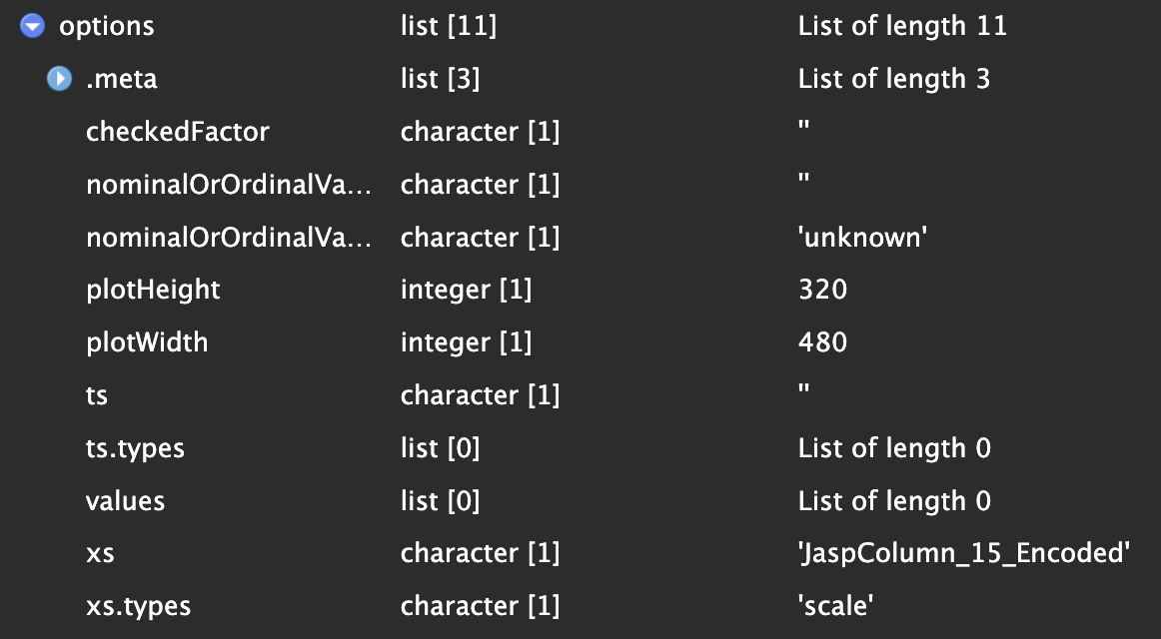
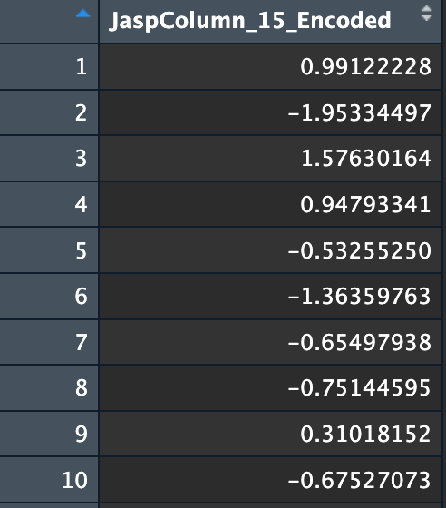
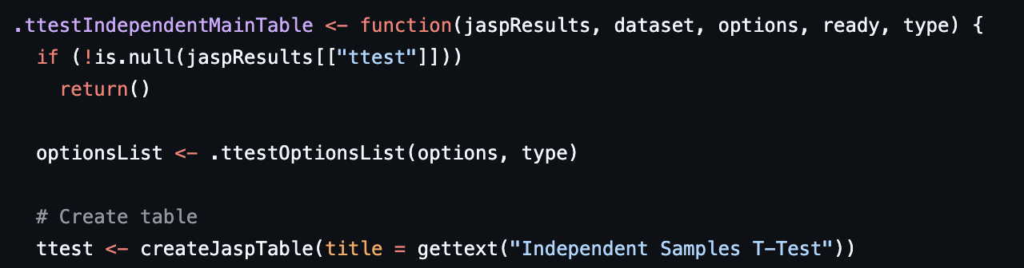
options
dataset

Slide 5
Contents
Quick recap
Plots
Coding challenge

Slide 6
Plotting in JASP
Step-by-step
Create the plot
Add plot to output
Fill the plot

Slide 7
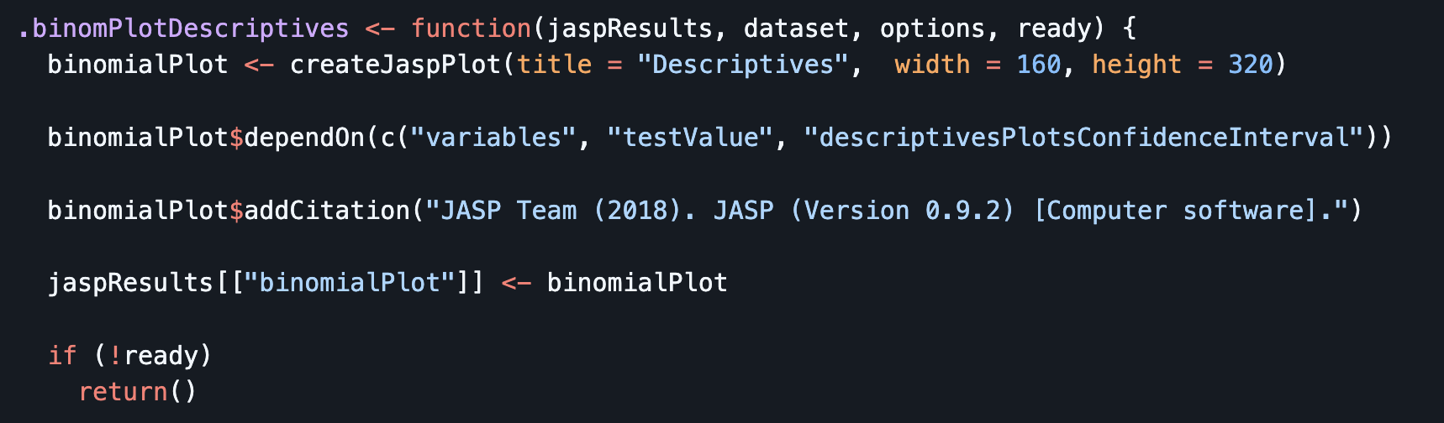
Plotting in JASP
R-code (steps 1&2)

Slide 8
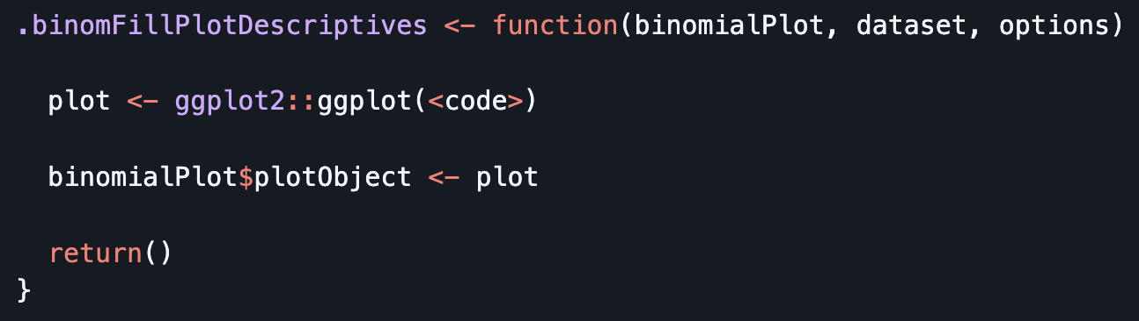
Plotting in JASP
R-code (step 3)
Like with tables, filling is usually handled by a separate function
The final plot is assigned to the plotObject property

Slide 9
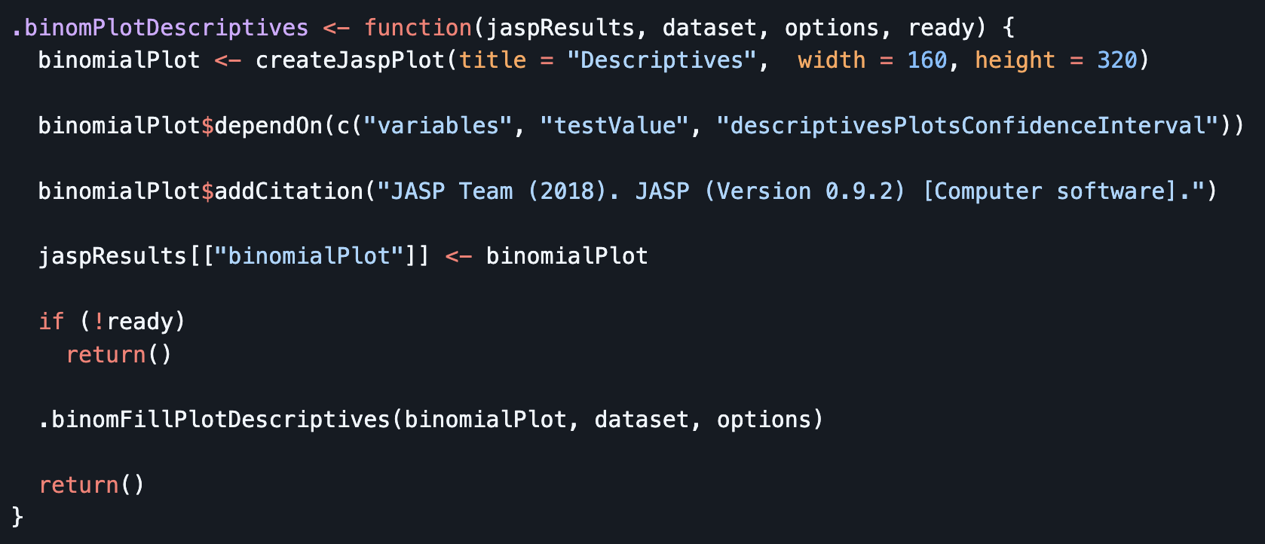
Plotting in JASP
Usage of filling function (step 3)
Filling function is then called within the function that creates the plot if analysis is ready (cf. output tables)

Slide 10
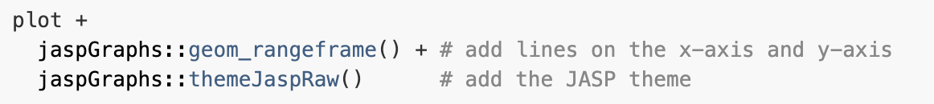
jaspGraphs
JASP’s own plotting package
Mainly used for applying JASP style to ggplot objects:
Also comes with complete plotting functions (e.g., jaspHistogram())
Only available on GitHub. E.g., via remotes::install_github("jasp-stats/jaspGraphs")
For a complete overview, see here.

Slide 11
jaspGraphs
Example styling of a ggplot
Before
After

Slide 12
Coding challenge
Creating a histogram in JASP
Clone this repository.
Go to R/histogram_skeleton.R
The file contains several TODOs for you to work on
If you need more information about creating plots in JASP, consult the documentation.
Two potential solutions can be found in R/histogram_jaspGraphs.R or R/histogram_solution.R

Slide 13
See you next time!

