Slide 1

JASP Student Developers
Introduction to QML for JASP
04.02.2026 julian.wuth@student.uva.nl

Slide 2
Contents
General structure of a module
QML files and QML coding
Coding challenges

Slide 3
Contents
General structure of a module
QML files and QML coding
Coding challenges

Slide 4
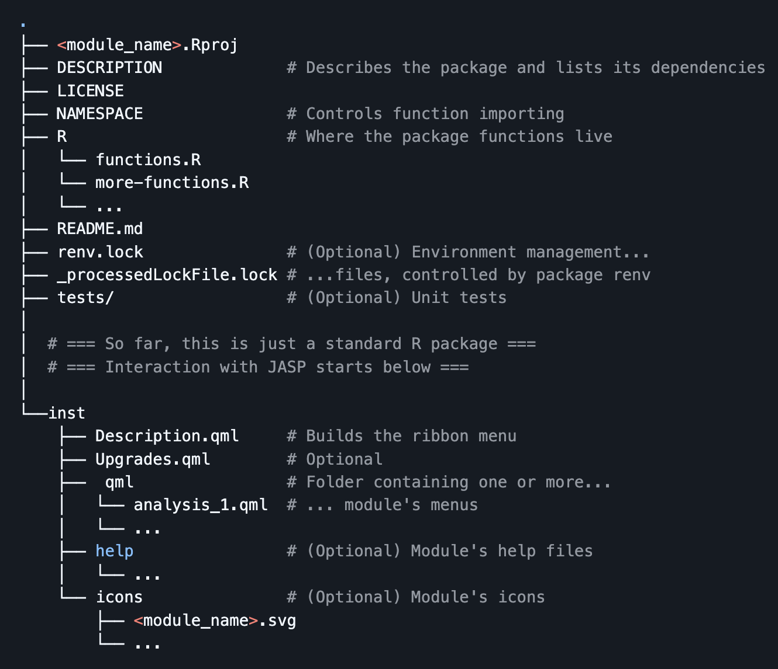
The JASP module
Folder structure
Today, we’ll focus on the inst folder
More information about the general structure can be found here.

Slide 5
Contents
General structure of a module
QML files and QML coding
Coding challenges

Slide 6
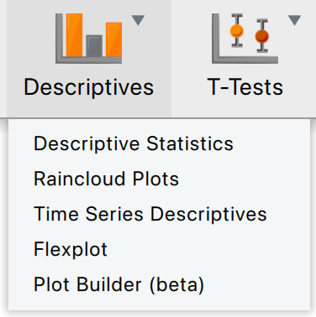
What’s the function of the files?
inst/Description.qml
Generates the ribbon menu
Coordinates the other files to create the final analysis/module
Assigns relevant R and QML files to the analyses
Let’s consider an example…

Slide 7
Objects in Description.qml
Description
Provides the module name, description and icon
Analysis
Name of the analysis, main R function and name of QML file for the analysis interface
GroupTitle and Separator
Specify a title and visually split your analyses

Slide 8
Challenge (1)
The groundwork for your own analysis
Fork the jaspModuleTemplate
Create a new analysis
Don’t worry about the analysis QML files and R functions for now.
Use a separator between the existing analyses and your new analysis
Your analysis should be preceded by a group title

Slide 9
What’s the function of the files?
inst/qml/…
Contains QML files for the analysis interfaces
The Description.qml file links to these filenames
You have a lot of freedom to tailor these files to your needs

Slide 10
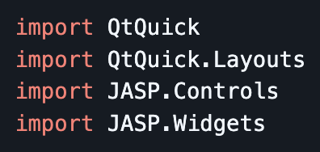
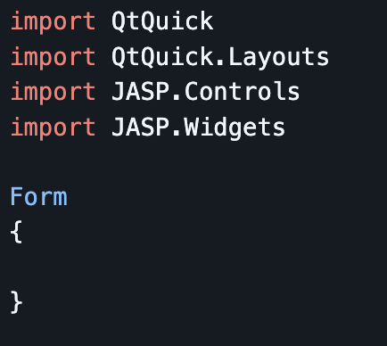
How to write an analysis interface?
First steps
Before you add QML components, your file needs imports…
… and a form that will contain the components
It is also customary to copy over the copyright statement (you can find it in other files)

Slide 11
How to write an analysis interface?
QML components
Three classes
General input (e.g., CheckBox)
Variable assignment (e.g., AvailableVariablesList)
Grouping components (e.g., Section)
A thorough guide for QML components can be found here.

Slide 12
Challenge (2)
Add the QML file for your analysis
Add a QML file for the analysis you added previously
Link it to the analysis through the Description.qml file
Add a checkbox to your interface

