Slide 1

JASP Student Developers
Introduction to R-Coding for JASP
11.02.2026 julian.wuth@student.uva.nl

Slide 2
Contents
The Main Analysis Function
Output Tables
Coding challenges

Slide 3
Contents
The Main Analysis Function
Output Tables
Coding challenges

Slide 4
The Main Analysis Function
This is the function you assign to the analysis in the Description.qml file
Arguments:
jaspResults
Contains results from the analysis for the JASP output
dataset
options
Contains interface options selected by the user

Slide 5
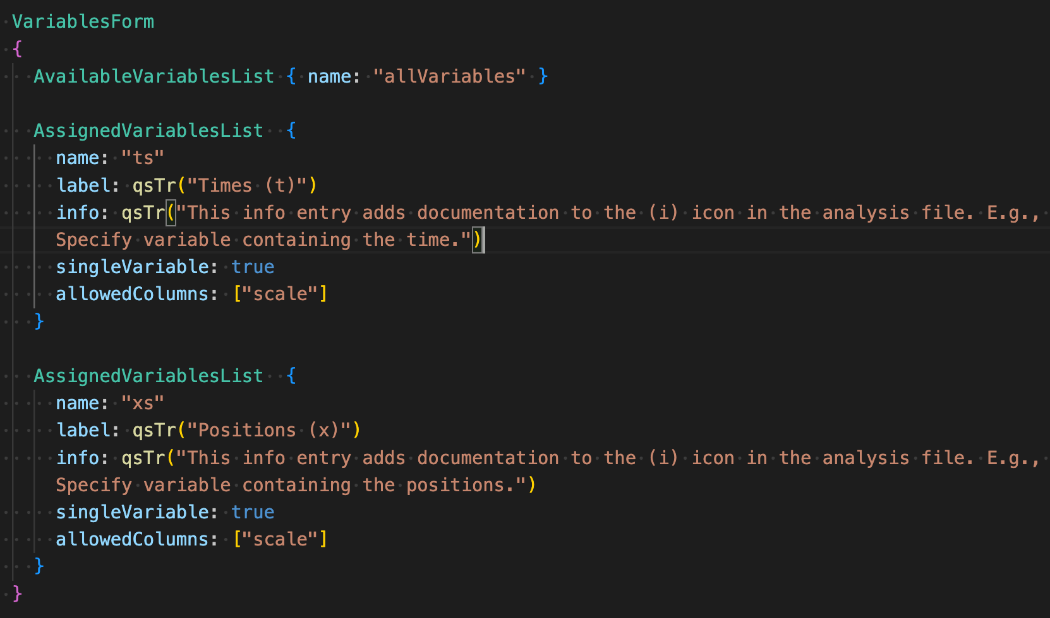
Dataset & Options
What do these actually look like?

Slide 6
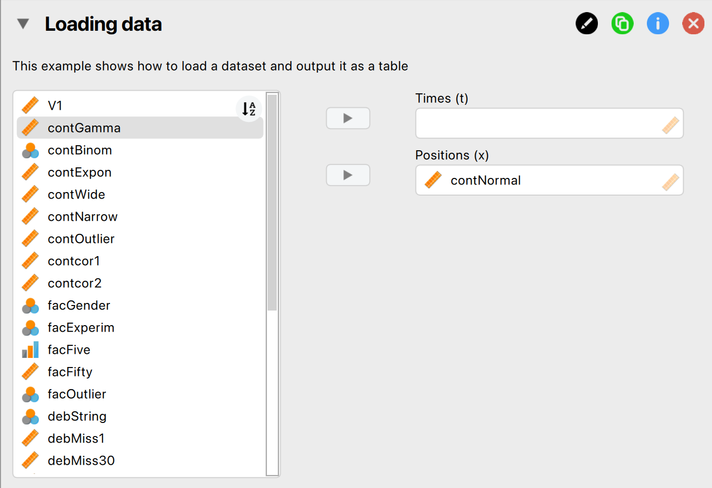
Dataset & Options
What do these actually look like?

Slide 7
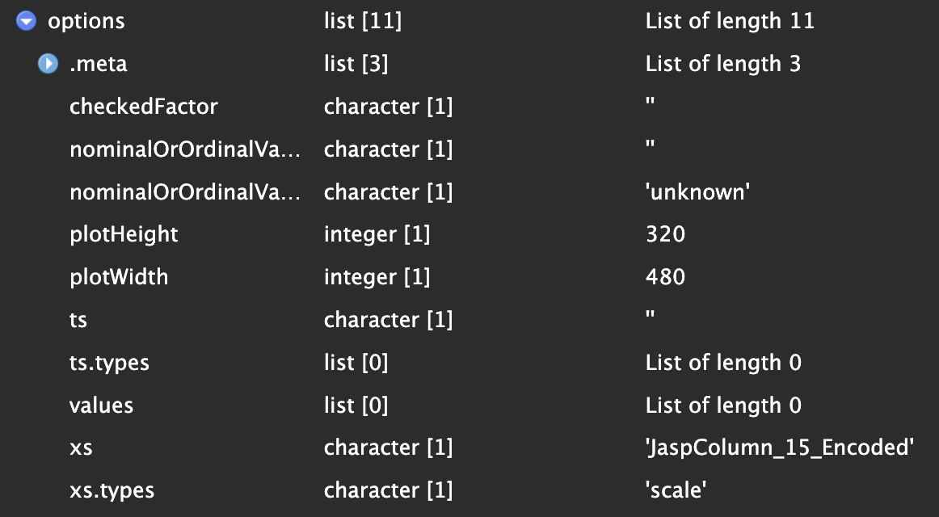
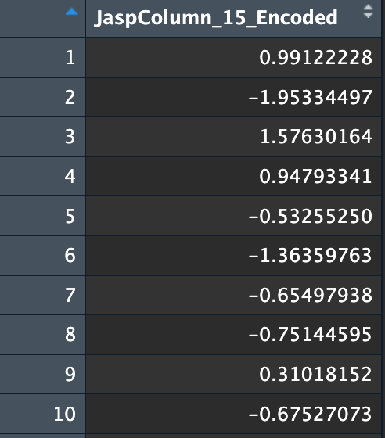
Dataset & Options in R
What do these actually look like?
options
dataset

Slide 8
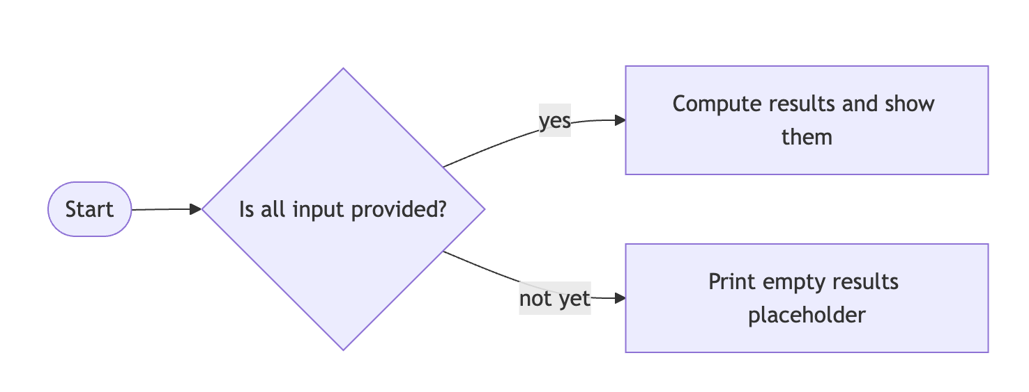
Writing the Main R-Function
Check if results can be computed
More information here.

Slide 9
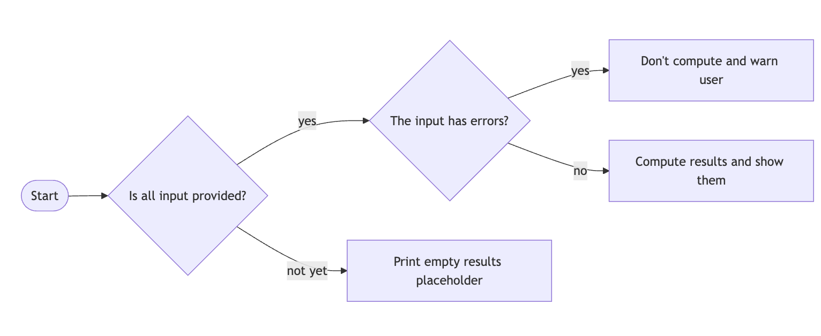
Writing the Main R-Function
Check for errors
More information here.

Slide 10
Contents
The Main Analysis Function
Output Tables
Coding challenges

Slide 11
Writing the Main R-Function
Output tables
Create table
Adding table to the output
Filling the table with results

Slide 12
Output Table
1. Creating the table
Usually you have a separate function that handles this
The createJaspTable() function from the JaspBase package creates the table object
You can give it a title that will be displayed above the table in JASP

Slide 13
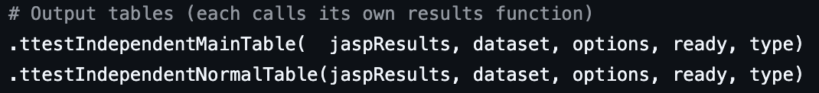
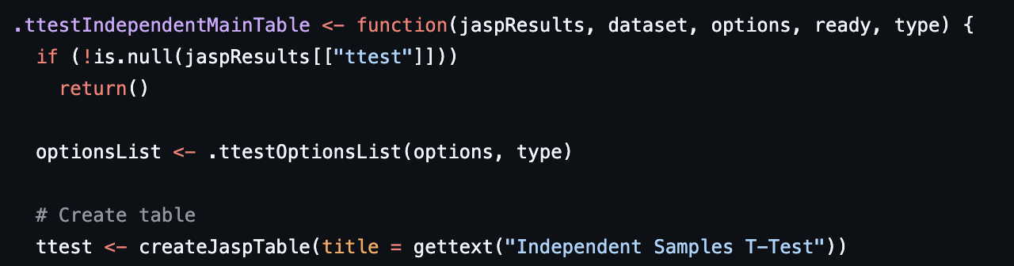
Output Table
1. Creating the table

Slide 14
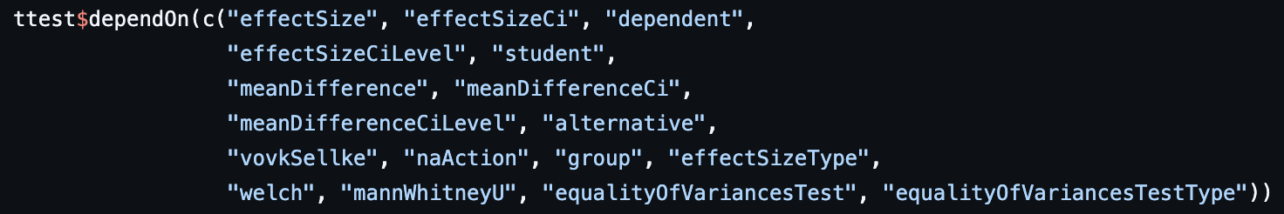
Output Table
1.1 Dependencies
Dependencies = analysis options (from the interface) causing object to recompute
Specified using someTableName$dependOn()

Slide 15
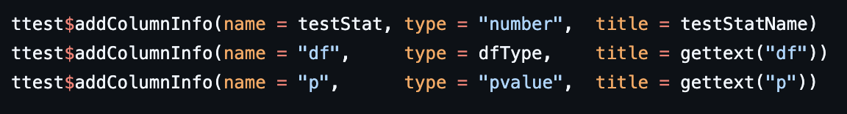
Output Table
1.2 Adding columns to the table
You can add columns using someTableName$addColumnInfo()
The addColumnInfo requires some arguments:
name: The name of the column (important for filling the table later)
type: Type of output that will be displayed in the column (string, number, integer, pvalue)
title: Column header displayed in JASP
Note: There are other (optional) arguments.

Slide 16

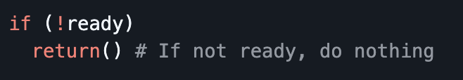
Output Table
2. Adding table to output
When you’re done creating the table, you have to add it to the jaspResults
Here you usually add an if-statement:
If results are NOT ready to be computed, return()
Else you want to fill the table with results

Slide 17
Challenge
Add an empty table to the JASP output
Fork the jaspModuleTemplate or sync your fork
Add an empty output table to the Loading data analysis
For example, add a table that will contain the mean of a variable
Within your local clone of the module template, locate the R folder, and then open the loadingData.R file
You do not need to fill the table with any output yet!

Slide 18
Output Table
3. Filling the table with results
For filling the table, you have two options
someTableName$addRows()
Expects list with names of the entries equal to the names of the columns that you defined when creating the table
someTableName$setData()
Can be used when you would like to add all rows at once
Accepts data.frames among others

Slide 19
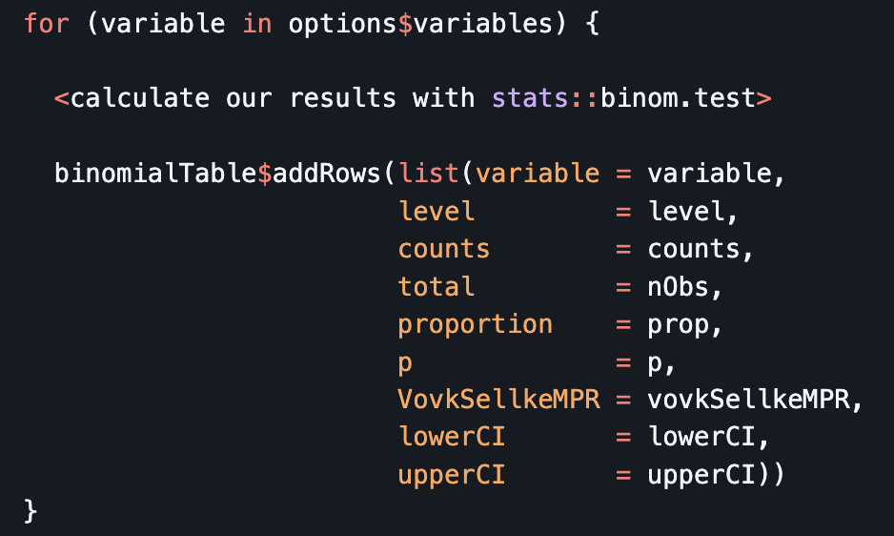
Output Table
3. Filling the table with results

Slide 20
Challenge
Fill your table with results
Fill the table you created previously with results (e.g., the mean of an input variable)
More details about R-coding for JASP can be found in the documentation.

