Slide 1

JASP Student Developers
03.12.2025
                julian.wuth@student.uva.nl

Slide 2
Contents
General introduction
Name for the group
Potential tasks
Live walk-through: Using Git from RStudio

Slide 3
Contents
General introduction
Name for the group
Potential tasks
Live walk-through: Using Git from RStudio

Slide 4
Ultimate Goal
Have a self-sufficient group of students who can teach each other how to contribute to JASP
Notes:
Will save time for the core developers
Create a pleasant learning environment for you

Slide 5
These sessions…
… give you pointers on where to start & what to do next
… allow you to define your own goals & pace
… are a place to collaborate
… allow you to ask questions to the experts
… should not be another lecture

Slide 6
We’re open for feedback!

Slide 7
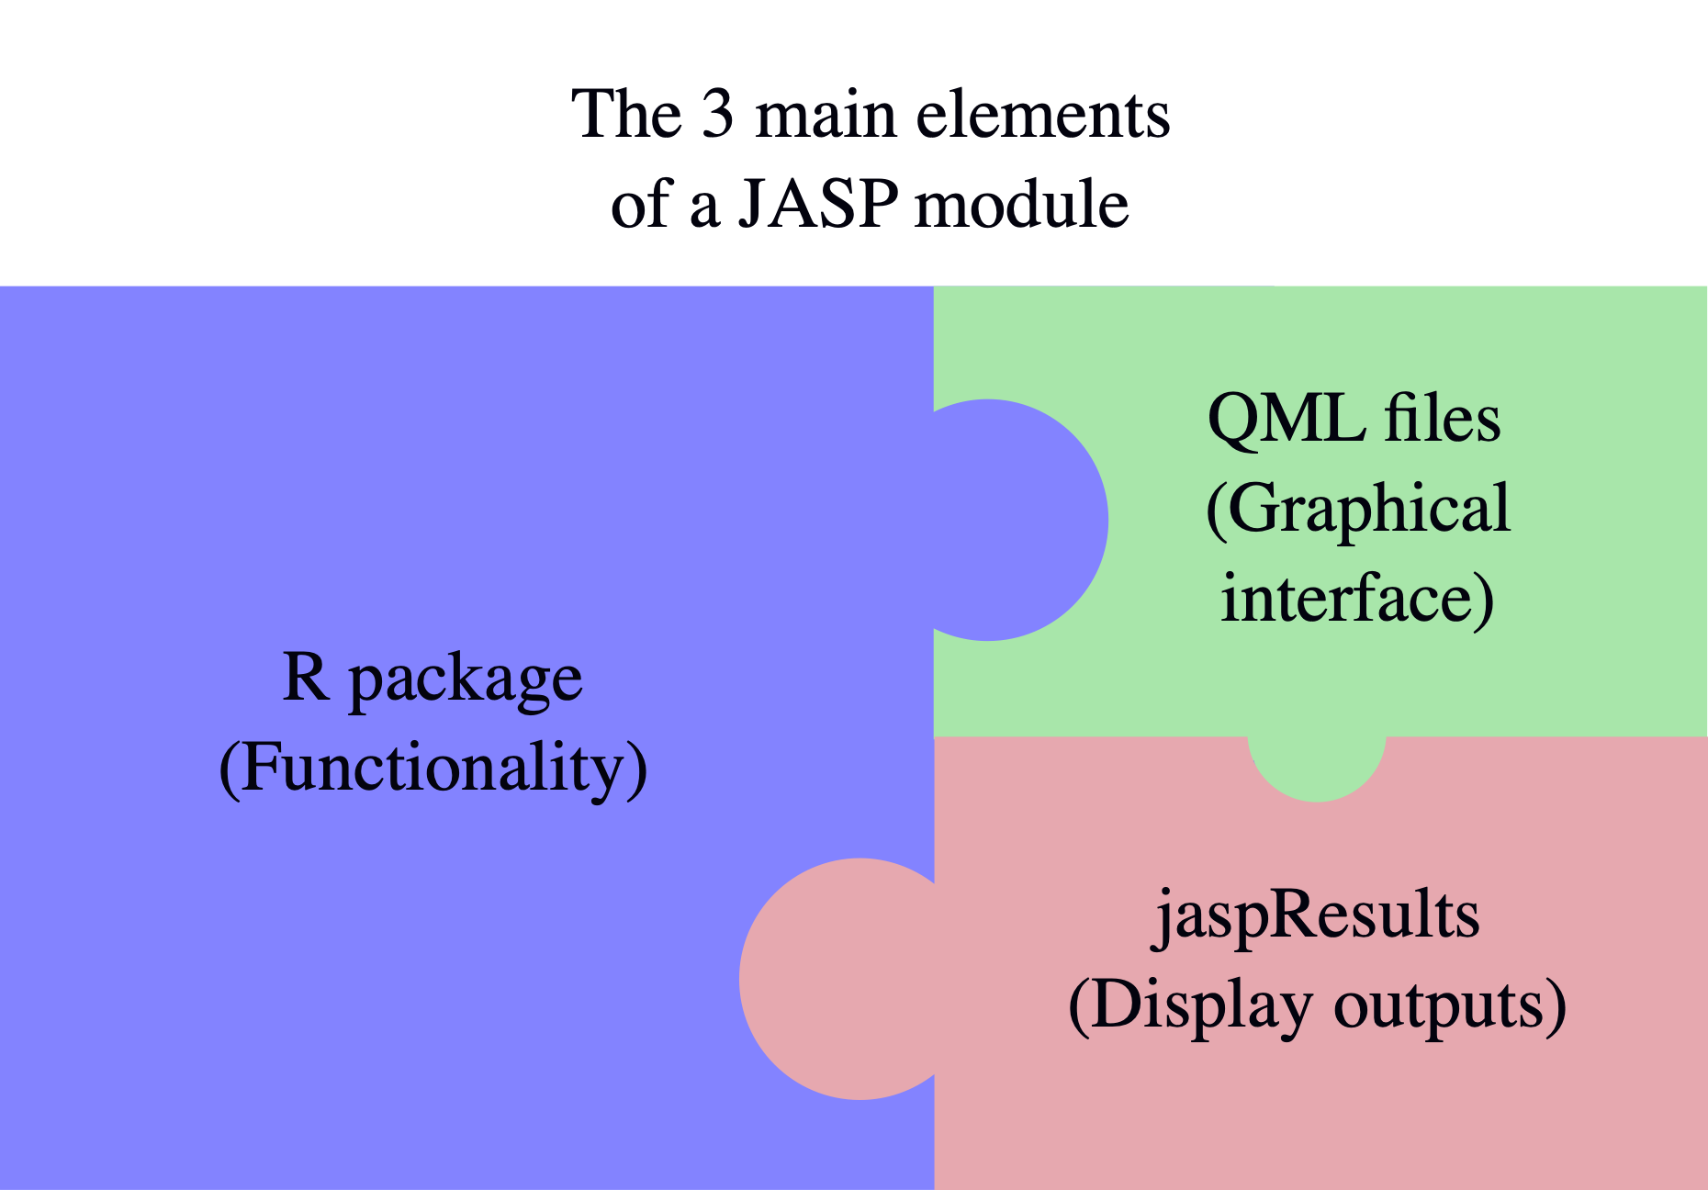
JASP under the hood
Notes:
3 pieces to the JASP puzzle
They all interact:
Interface: Select options
R code: Computations based on options
Display output
You can learn the skills to work with all of them here
Skills are also very useful for other areas

Slide 8
Contents
General introduction
Name for the group
Potential tasks
Live walk-through: Using Git from RStudio

Slide 9
Group name
JASP Student Developers?
JASP Incubator?
Click here to add your suggestion!

Slide 10
Contents
General introduction
Name for the group
Potential tasks
Live walk-through: Using Git from RStudio

Slide 11
Potential tasks
Working on JASP issues
JASP socials
Contributing your own module
  JASP Hackathon (Feb 16 - 17)
JASP verification project
Notes:
* Show how to find the first projects

Slide 12
Verification project
Verifying JASP analyses through comparison with other software
JASPifying two books:
  Lean Six Sigma in a Digital Era by Theisens
  Six Sigma in Practice by Schildmeijer & Suijkerbuijk
Reanalysing data examples in JASP (and showing them in the book)
Concrete plans to be discussed with the firms
  Students may join when we visit
If you’re interested, let me know!
Notes:
Searching for data sets & comparing results among softwares
Verification doc, data library and unit tests
Video library

Slide 13
Contents
General introduction
Name for the group
Potential tasks
Live walk-through: Using Git from RStudio

Slide 14
Live-Walkthrough
Using Git from RStudio
Prerequisites:
Have Git and RStudio installed
GitHub Account
You’ll learn how to…:
Create your own repository
Clone a repo to your local device
Edit/Add files in/to repo
Commit & push changes

Slide 15
But first…
… you need to set up your credentials
Go to https://github.com/ —> Your Profile icon —> Settings
Search for Developer settings on the left
Personal access tokens —> Tokens (classic)
Generate new token —> Generate new token (classic)
You need to check the “repo” scope to follow along
Keep this token in a safe place! (e.g., password manager)
Notes:
Push/pull requires you to verify your identity
Making sure that you are allowed to edit repo
Username and password is not enough

Slide 16
Open RStudio and run:
> install.packages(“gitcreds”)
> gitcreds::gitcreds_set()
R will prompt you to enter your PAT
You’re all set!
For more information, click here.

Slide 17
Live-Walkthrough
Create a repository
Go to https://github.com/ —> Your Profile icon —> Repositories
Click New on the top right
Enter repo name and proceed with Create repository
You’ll see a Quick setup section
  Make sure to select HTTPS
  Copy the link that has the form:
  https://github.com/USERNAME/REPONAME.git

Slide 18
Live-Walkthrough
Clone a repository
Open RStudio —> Project (top-right) —> New Project
Select Version Control —> Git
  You cannot see Version Control? Find help here or here.
Paste the HTTPS link under Repository URL
Enter directory name and select where to store it

Slide 19
Live-Walkthrough
Add a file, commit & push
Implement your changes (e.g., adding a README.md)
Open Git tab on the top-right
Stage relevant files by checking corresponding box
Press Commit —> Add message —> Press Commit again
Your commit should now be visible in the History
Press Push to push changes to GitHub

Slide 20
You’ve created your own repo and pushed changes to it!

