Slide 1
BIOREASONING CAPSTONE
From single-cell evidence
to auditable gene nominees
1
Derived tables
CellChat · DEG · cell counts
2
Grounded reasoning
Tool traces before any model answer
Midterm progress · Weeks 1–6
3
Gene ranking
LightGBM + scETM features
4
Portal
One interface, same evidence
WEEK 6 VERIFIED
Jasper Chen · BT-CAP
19 October 2026
Notes:
Open with the project goal: convert large single-cell tables into traceable evidence and ranked validation candidates.
The new contribution this week is the portal integration. It does not retrain the models; it exposes the already verified agent and ranker through one user interface.

Slide 2
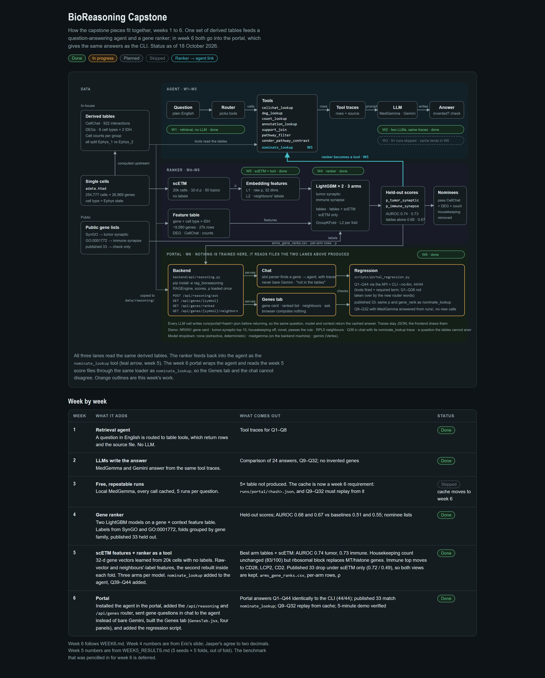
SYSTEM OVERVIEW
02
One evidence base now powers two analysis paths
DONE
Source: BioReasoning Capstone.html · verified 18 Oct 2026
BT-CAP · 18 OCT 2026
Notes:
Walk left to right: single-cell data and public gene lists feed derived tables and scETM features.
The upper lane answers questions with explicit table tools. The lower lane ranks genes with held-out LightGBM scores.
Week 5 linked the ranker back into the agent through nominate_lookup. Week 6 exposes both lanes through the portal.

Slide 3
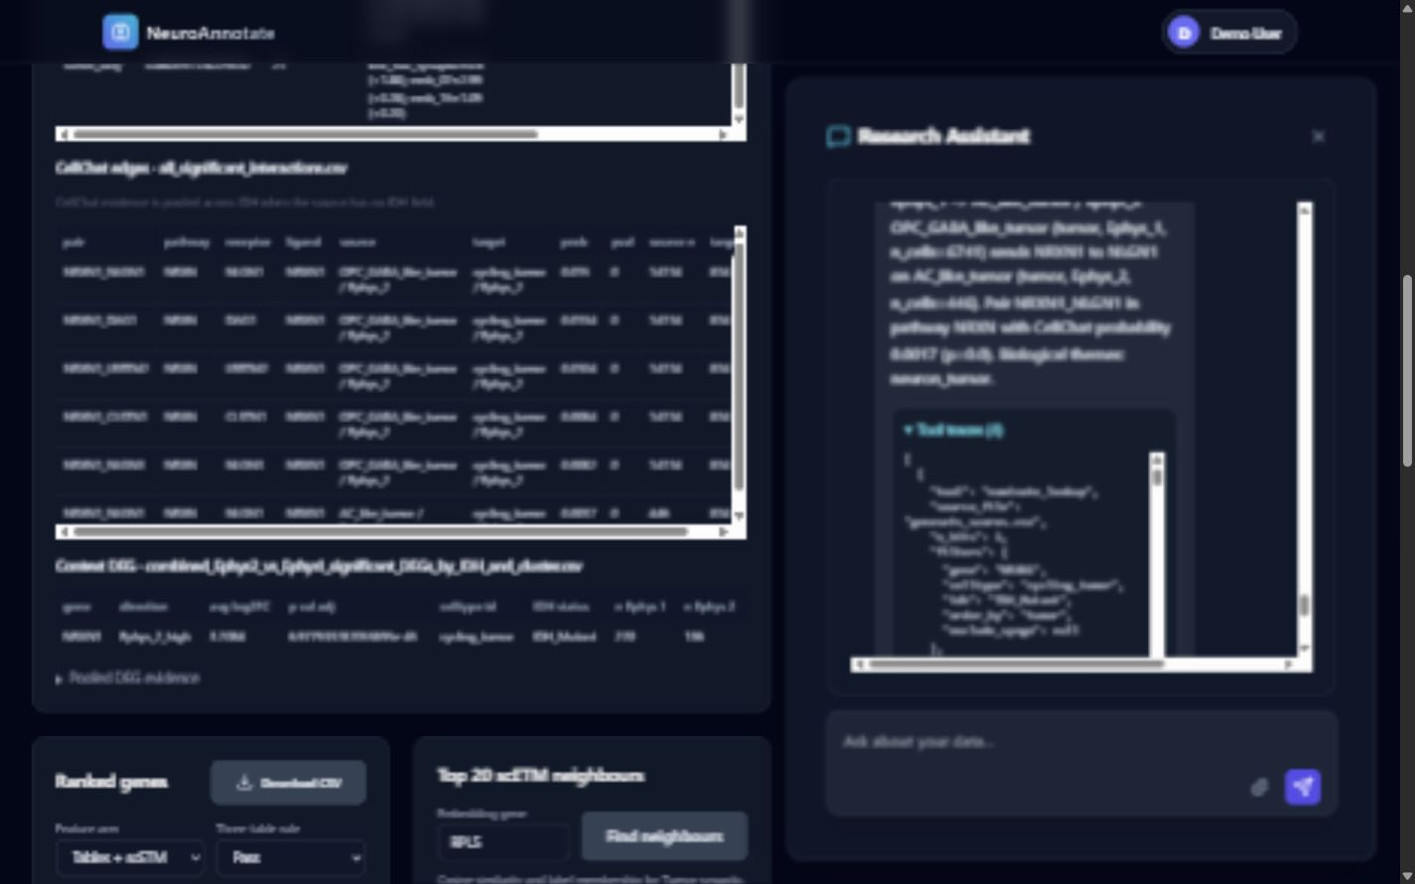
WEEKS 1–3 · GROUNDED REASONING
03
The model writes from retrieved evidence, not memory
1
Question
2
Router
3
Trace
4
Answer
Plain-English biological question
Selects CellChat, DEG, count, annotation, or rank tools
Rows, filters, and source file are preserved
Extractive or MedGemma response stays tied to the trace
Why this matters
The trace shows which lookup fired and what filters were used.
Cached MedGemma answers are replayed without a new provider call.
Unsupported questions return “not in the tables.”
Sources: fall_semester/questions.md · WEEK6_PORTAL_REPORT.md
BT-CAP · 18 OCT 2026
Notes:
The agent separates retrieval from generation. A model only receives the evidence returned by the tools.
This screenshot shows the Week 5 nominate_lookup tool firing inside the Week 6 chat.
Q9 through Q32 reused 24 cached MedGemma responses. Verification blocked provider entry points and observed zero calls.

Slide 4
WEEKS 4–5 · NOMINATION MODEL
04
scETM context improves both held-out gene rankers
0.742
0.725
5 × 5
32-d
tumor-synaptic AUROC
tables + scETM
immune-synapse AUROC
tables + scETM
seeds × grouped folds
out-of-fold scoring
gene embedding
20,381 cells
Feature stack
Nomination output
CellChat interaction probability and Ephys lean
NRXN1 · cycling_tumor · IDH_Mutant
p_tumor_synaptic
0.900521
DEG effect size, adjusted p-value, and IDH agreement
Tumor rank in context
#9
Group size safeguards from cell counts
Top drivers
scETM embedding and neighbor-label fractions
kNN synaptic · emb_07 · emb_15
Source: fall_semester/turnin/lgbm_scetm/WEEK5_RESULTS.md
BT-CAP · 18 OCT 2026
Notes:
The ranker uses gene-by-context rows. Cross-validation is grouped so a gene is never scored by a model trained on that gene.
Adding scETM features increased tumor AUROC from 0.675 to 0.742 and immune AUROC from 0.666 to 0.725.
The nominee tool returns probabilities, driving features, evidence flags, minimum cell count, and fold provenance.

Slide 5
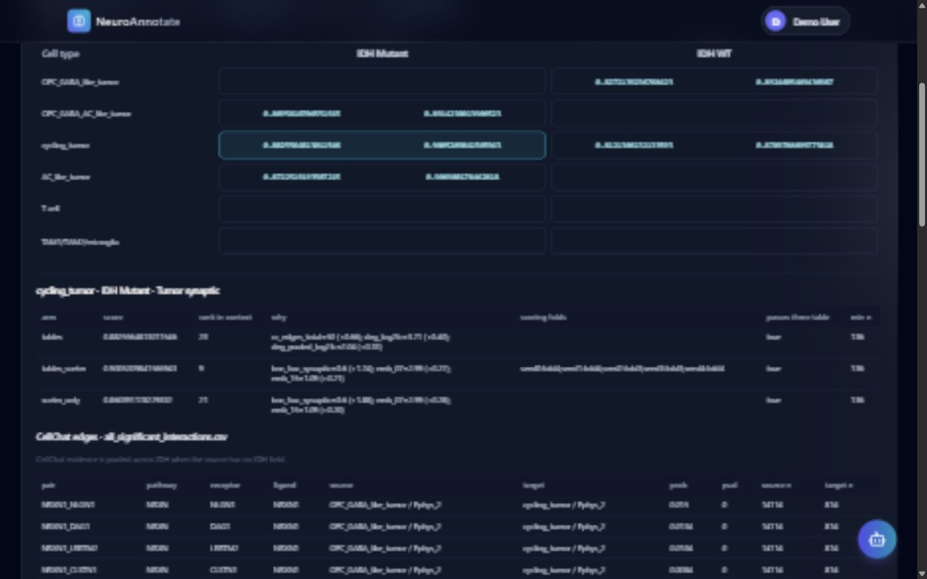
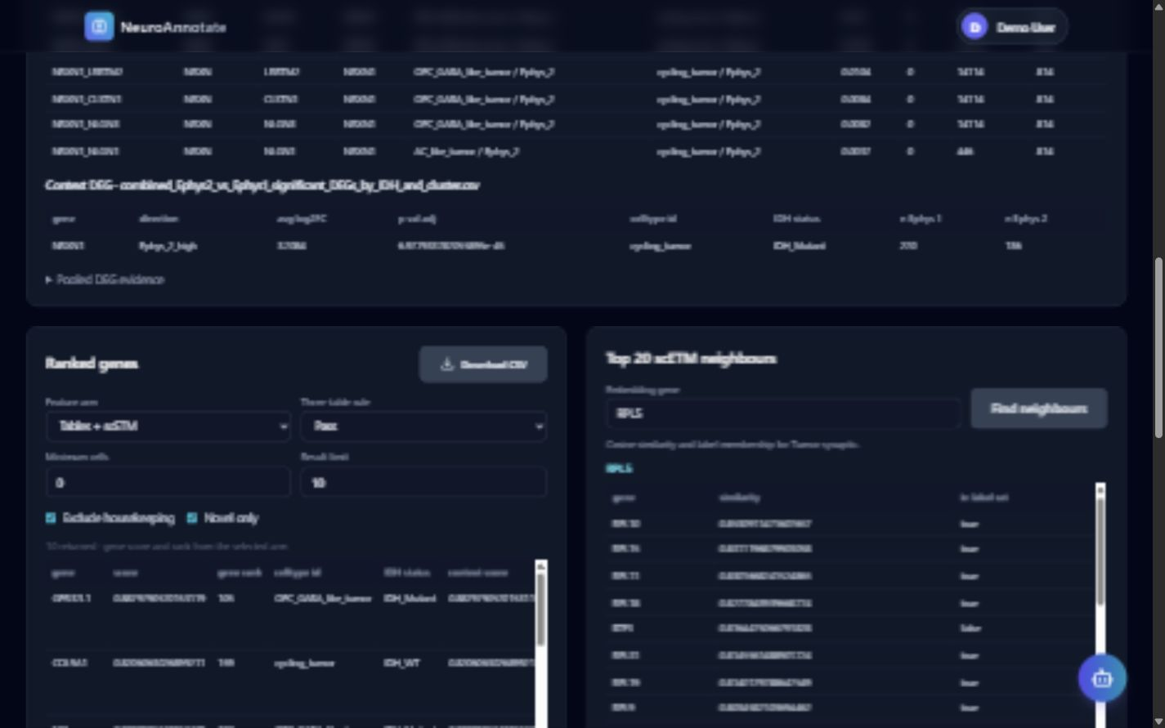
PRODUCT INTEGRATION
05
Week 6 turns the pipeline into an explorable portal
GENE CARD
Scores · evidence · interactions
NOVEL TOP 10
Filters · CSV export · neighbors
Both views load the same saved score files used by nominate_lookup, so chat and Genes cannot disagree.
Sources: frontend-react/src/components/GenesTab.jsx · backend/api/reasoning.py
BT-CAP · 18 OCT 2026
Notes:
The Genes tab adds four panels: a gene card, ranked list, scETM neighbors, and evidence tables.
The backend loads the reasoning engine, rank scores, and embeddings once and serves them through the new reasoning and gene endpoints.
The central consistency decision is that the portal and nominate_lookup share one loader and the same score files.

Slide 6
VERIFICATION RESULTS
06
The integrated portal passes every required check
44 / 44
24 / 24
310
294 + 8
questions matched
API ↔ CLI
MedGemma cache hits
zero provider calls
scored outputs checked
published-gene equality
Python + frontend
tests passed
Verification | What was compared | Result
Q1–Q44 regression | tools + required evidence terms + answer text | PASS
Published 33 | portal scores/ranks vs nominate_lookup | PASS
MedGemma replay | cache files unchanged; provider entry blocked | PASS
Portal build | Python tests, React tests, production build | PASS
Verified behavior, not biological validation
These checks establish software consistency and evidence provenance.
Source: fall_semester/turnin/week6_portal/WEEK6_PORTAL_REPORT.md
BT-CAP · 18 OCT 2026
Notes:
The 44-of-44 result requires equal tool sets, allowed tool combinations, and every required evidence group on both API and CLI sides.
The published-gene check covered 310 scored outputs. AXL was absent in both places and correctly returned no score.
These are integration and reproducibility checks. They do not replace experimental validation of the biological nominees.

Slide 7
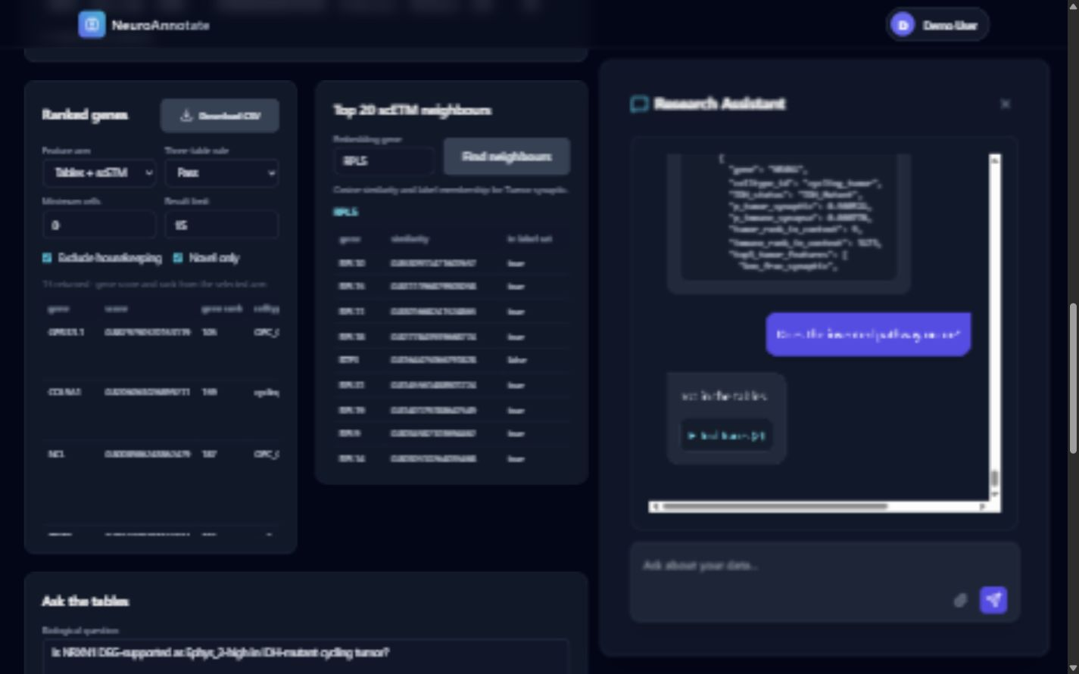
CONCLUSIONS AND NEXT STEPS
07
We can now move from evidence to reviewable nominees
What is complete
Grounded question answering across CellChat, DEG, annotation, and counts
Held-out tumor-synaptic and immune-synapse gene ranking
nominate_lookup connects ranker scores back to tool traces
Portal integration, caching, regression tests, and exportable tables
Guardrail
Next
Review top novel nominees with the team, then prioritize experimental validation.
If the evidence is absent, the portal says “not in the tables” instead of inventing a result.
Measured results through 18 Oct 2026 · experimental validation remains future work
BT-CAP · 18 OCT 2026
Notes:
The portal is now a review surface for the same evidence and rankings produced earlier in the project.
The screenshot demonstrates the grounding boundary: an invented pathway is rejected rather than answered from model memory.
The next scientific step is team review of high-scoring novel nominees and selection of candidates for experimental validation.

