Slide 1


Slide 2
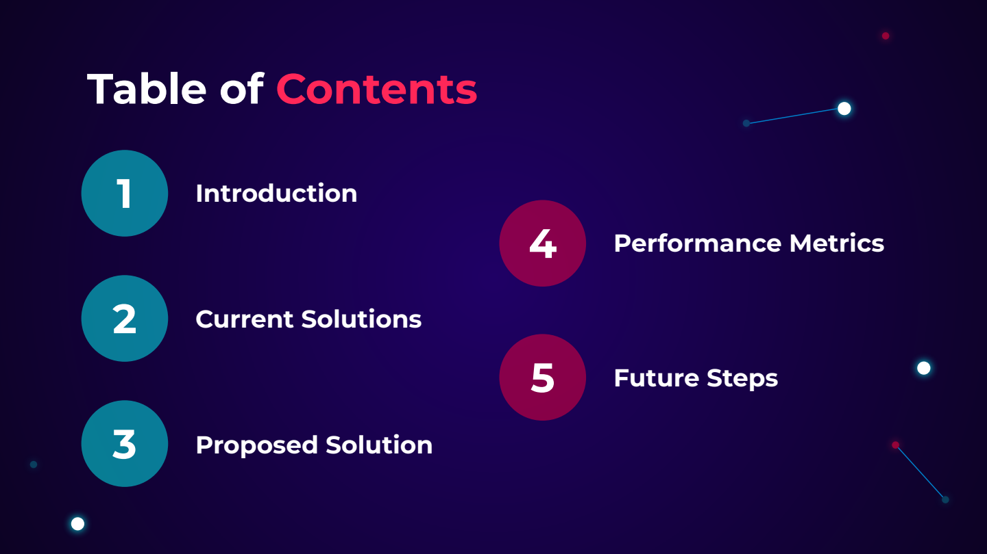

Slide 3


Slide 4


Slide 5
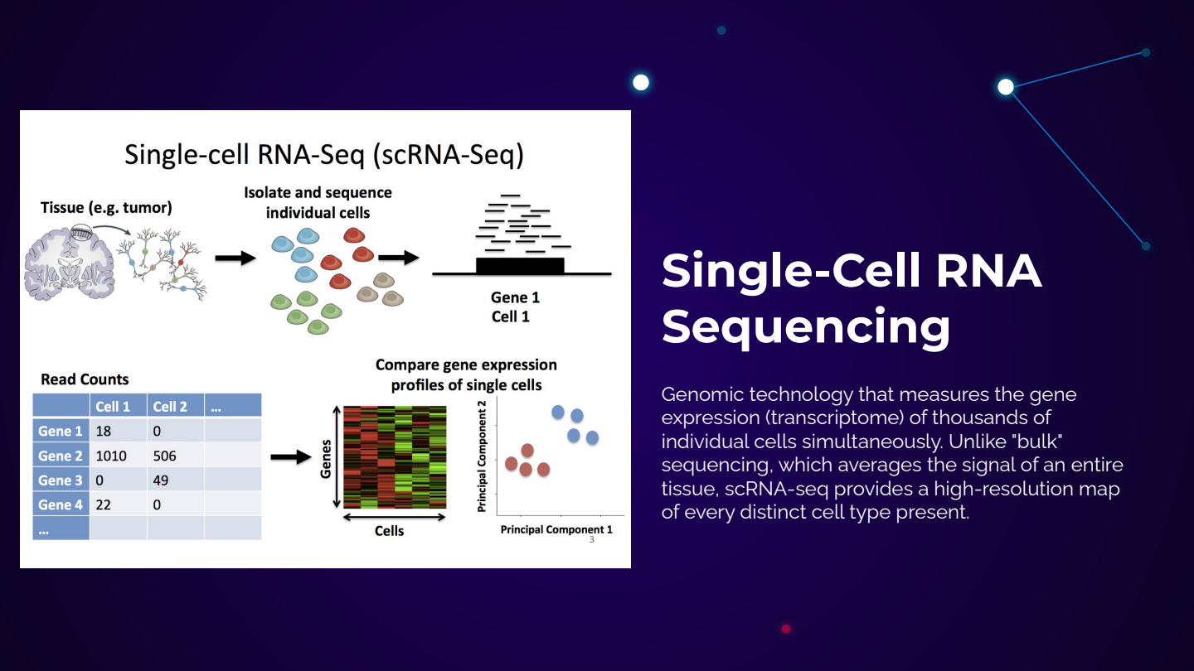

Slide 6
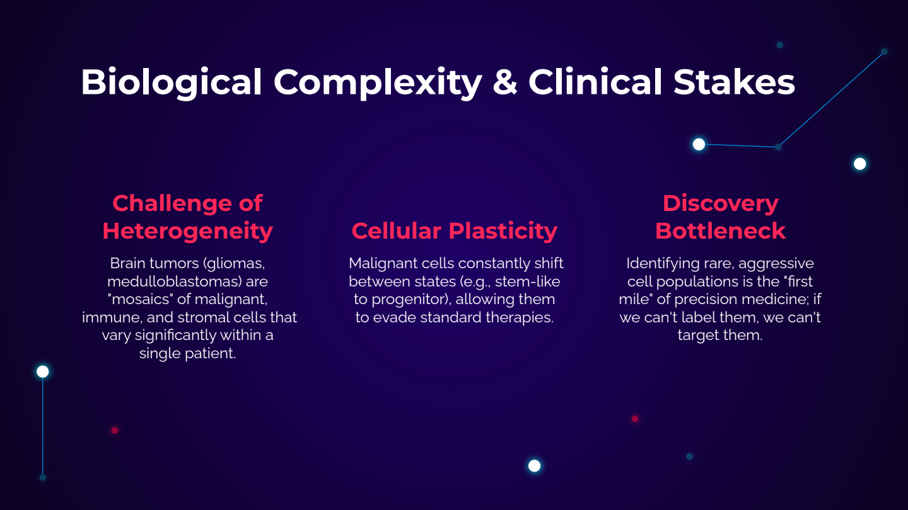

Slide 7


Slide 8


Slide 9
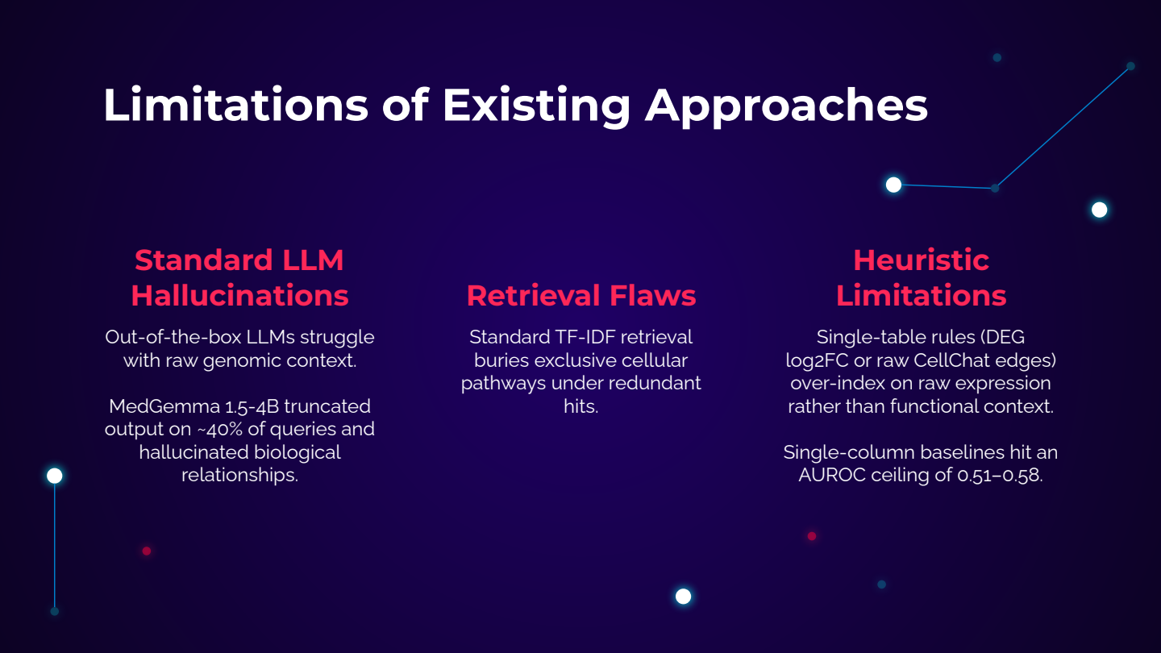

Slide 10


Slide 11
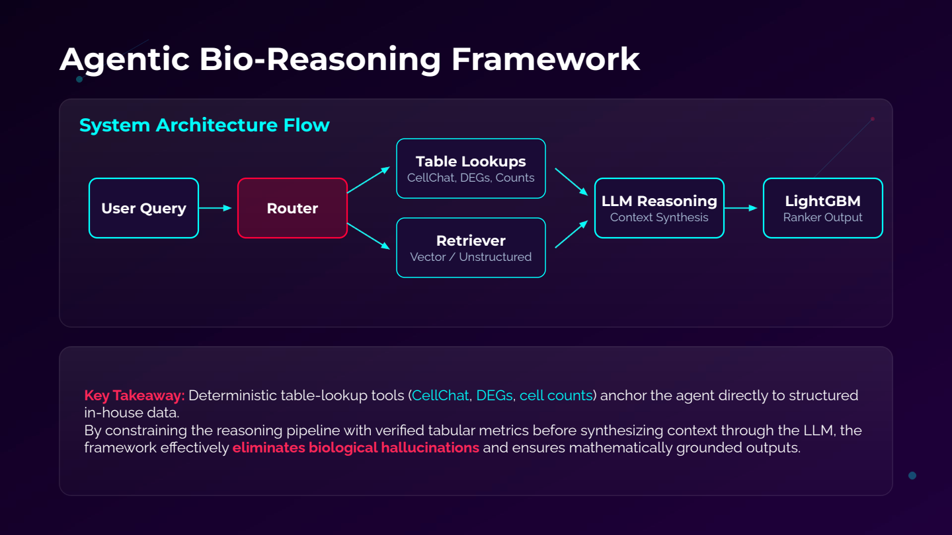

Slide 12
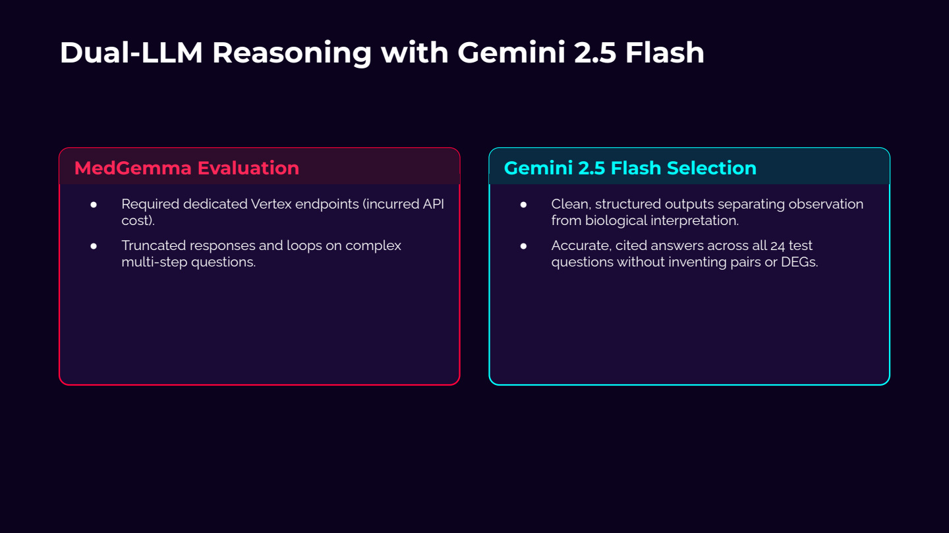

Slide 13
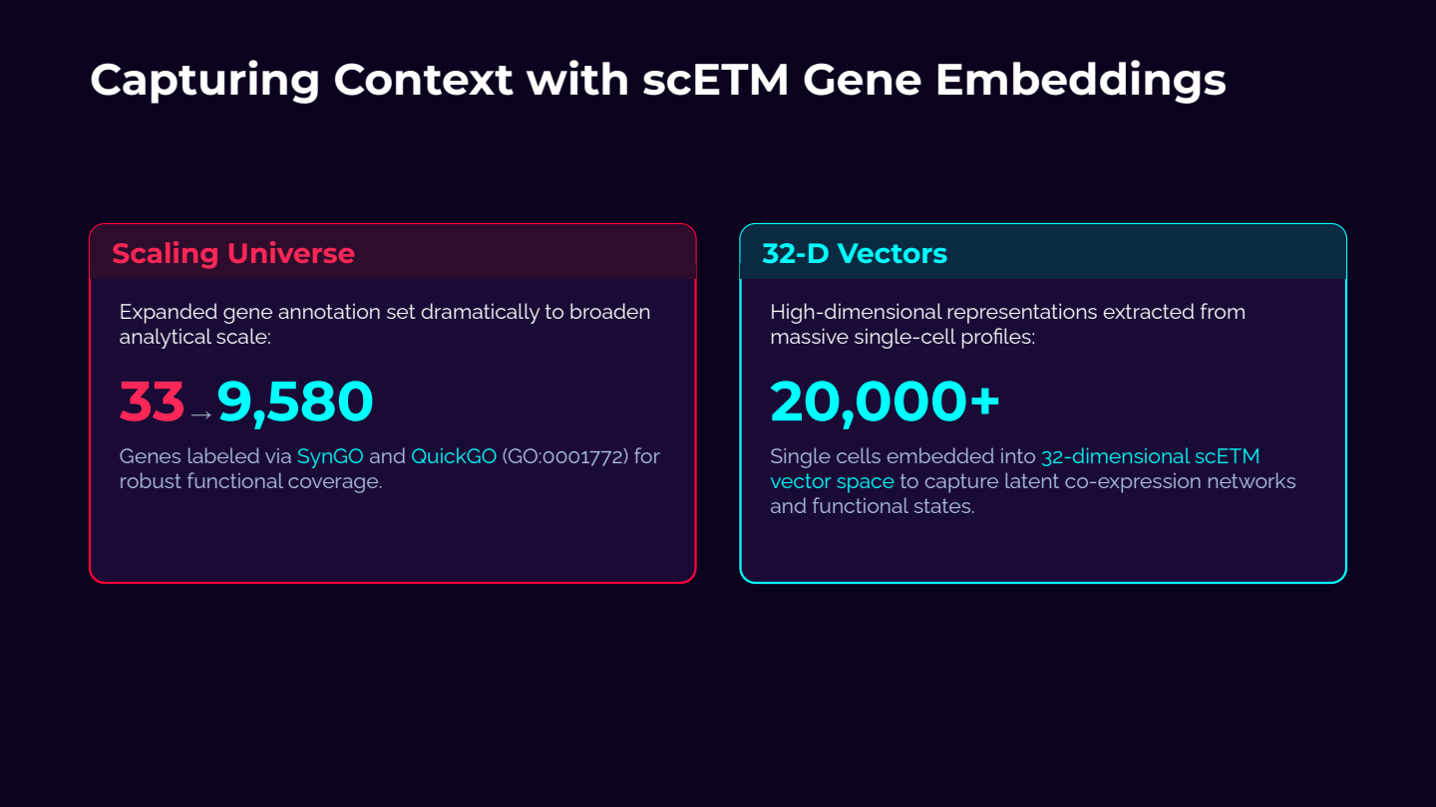

Slide 14


Slide 15
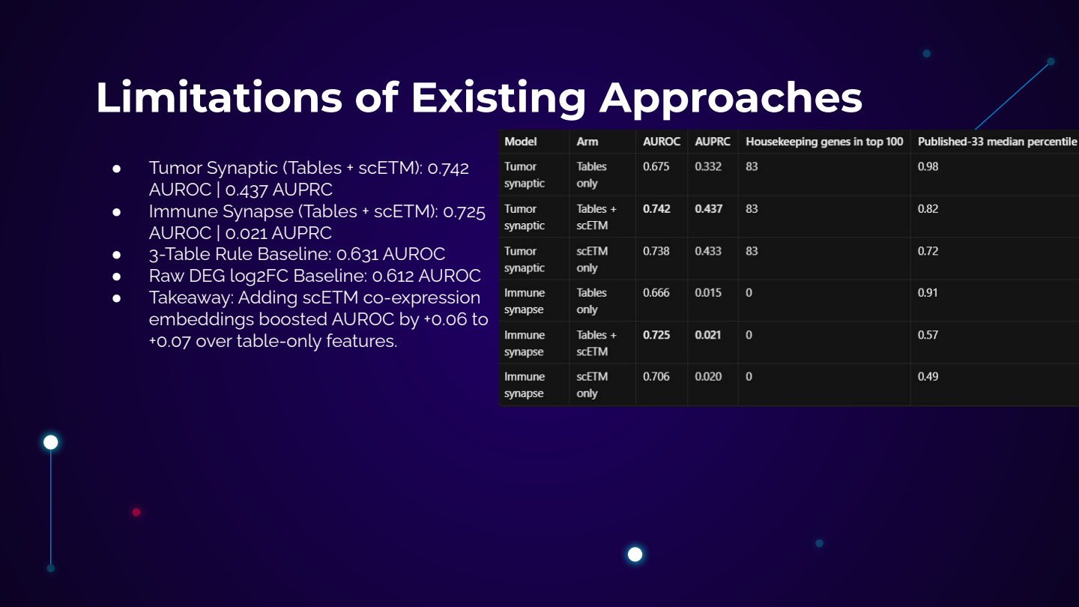

Slide 16
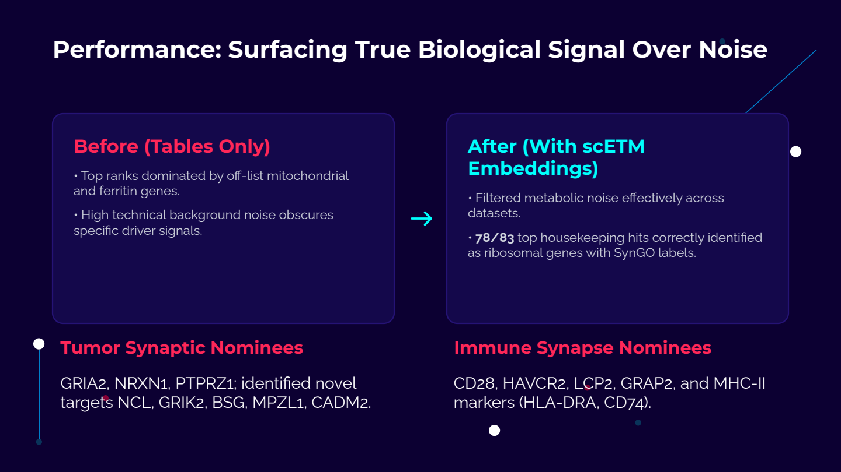

Slide 17
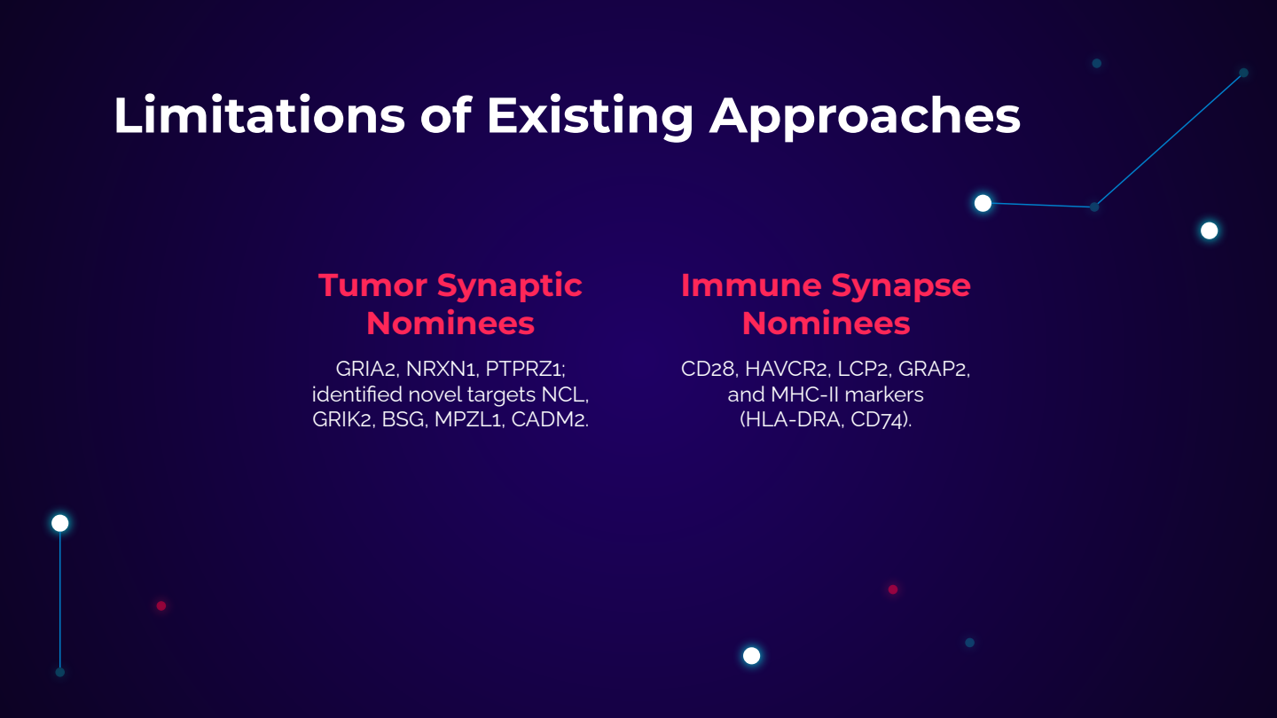

Slide 18
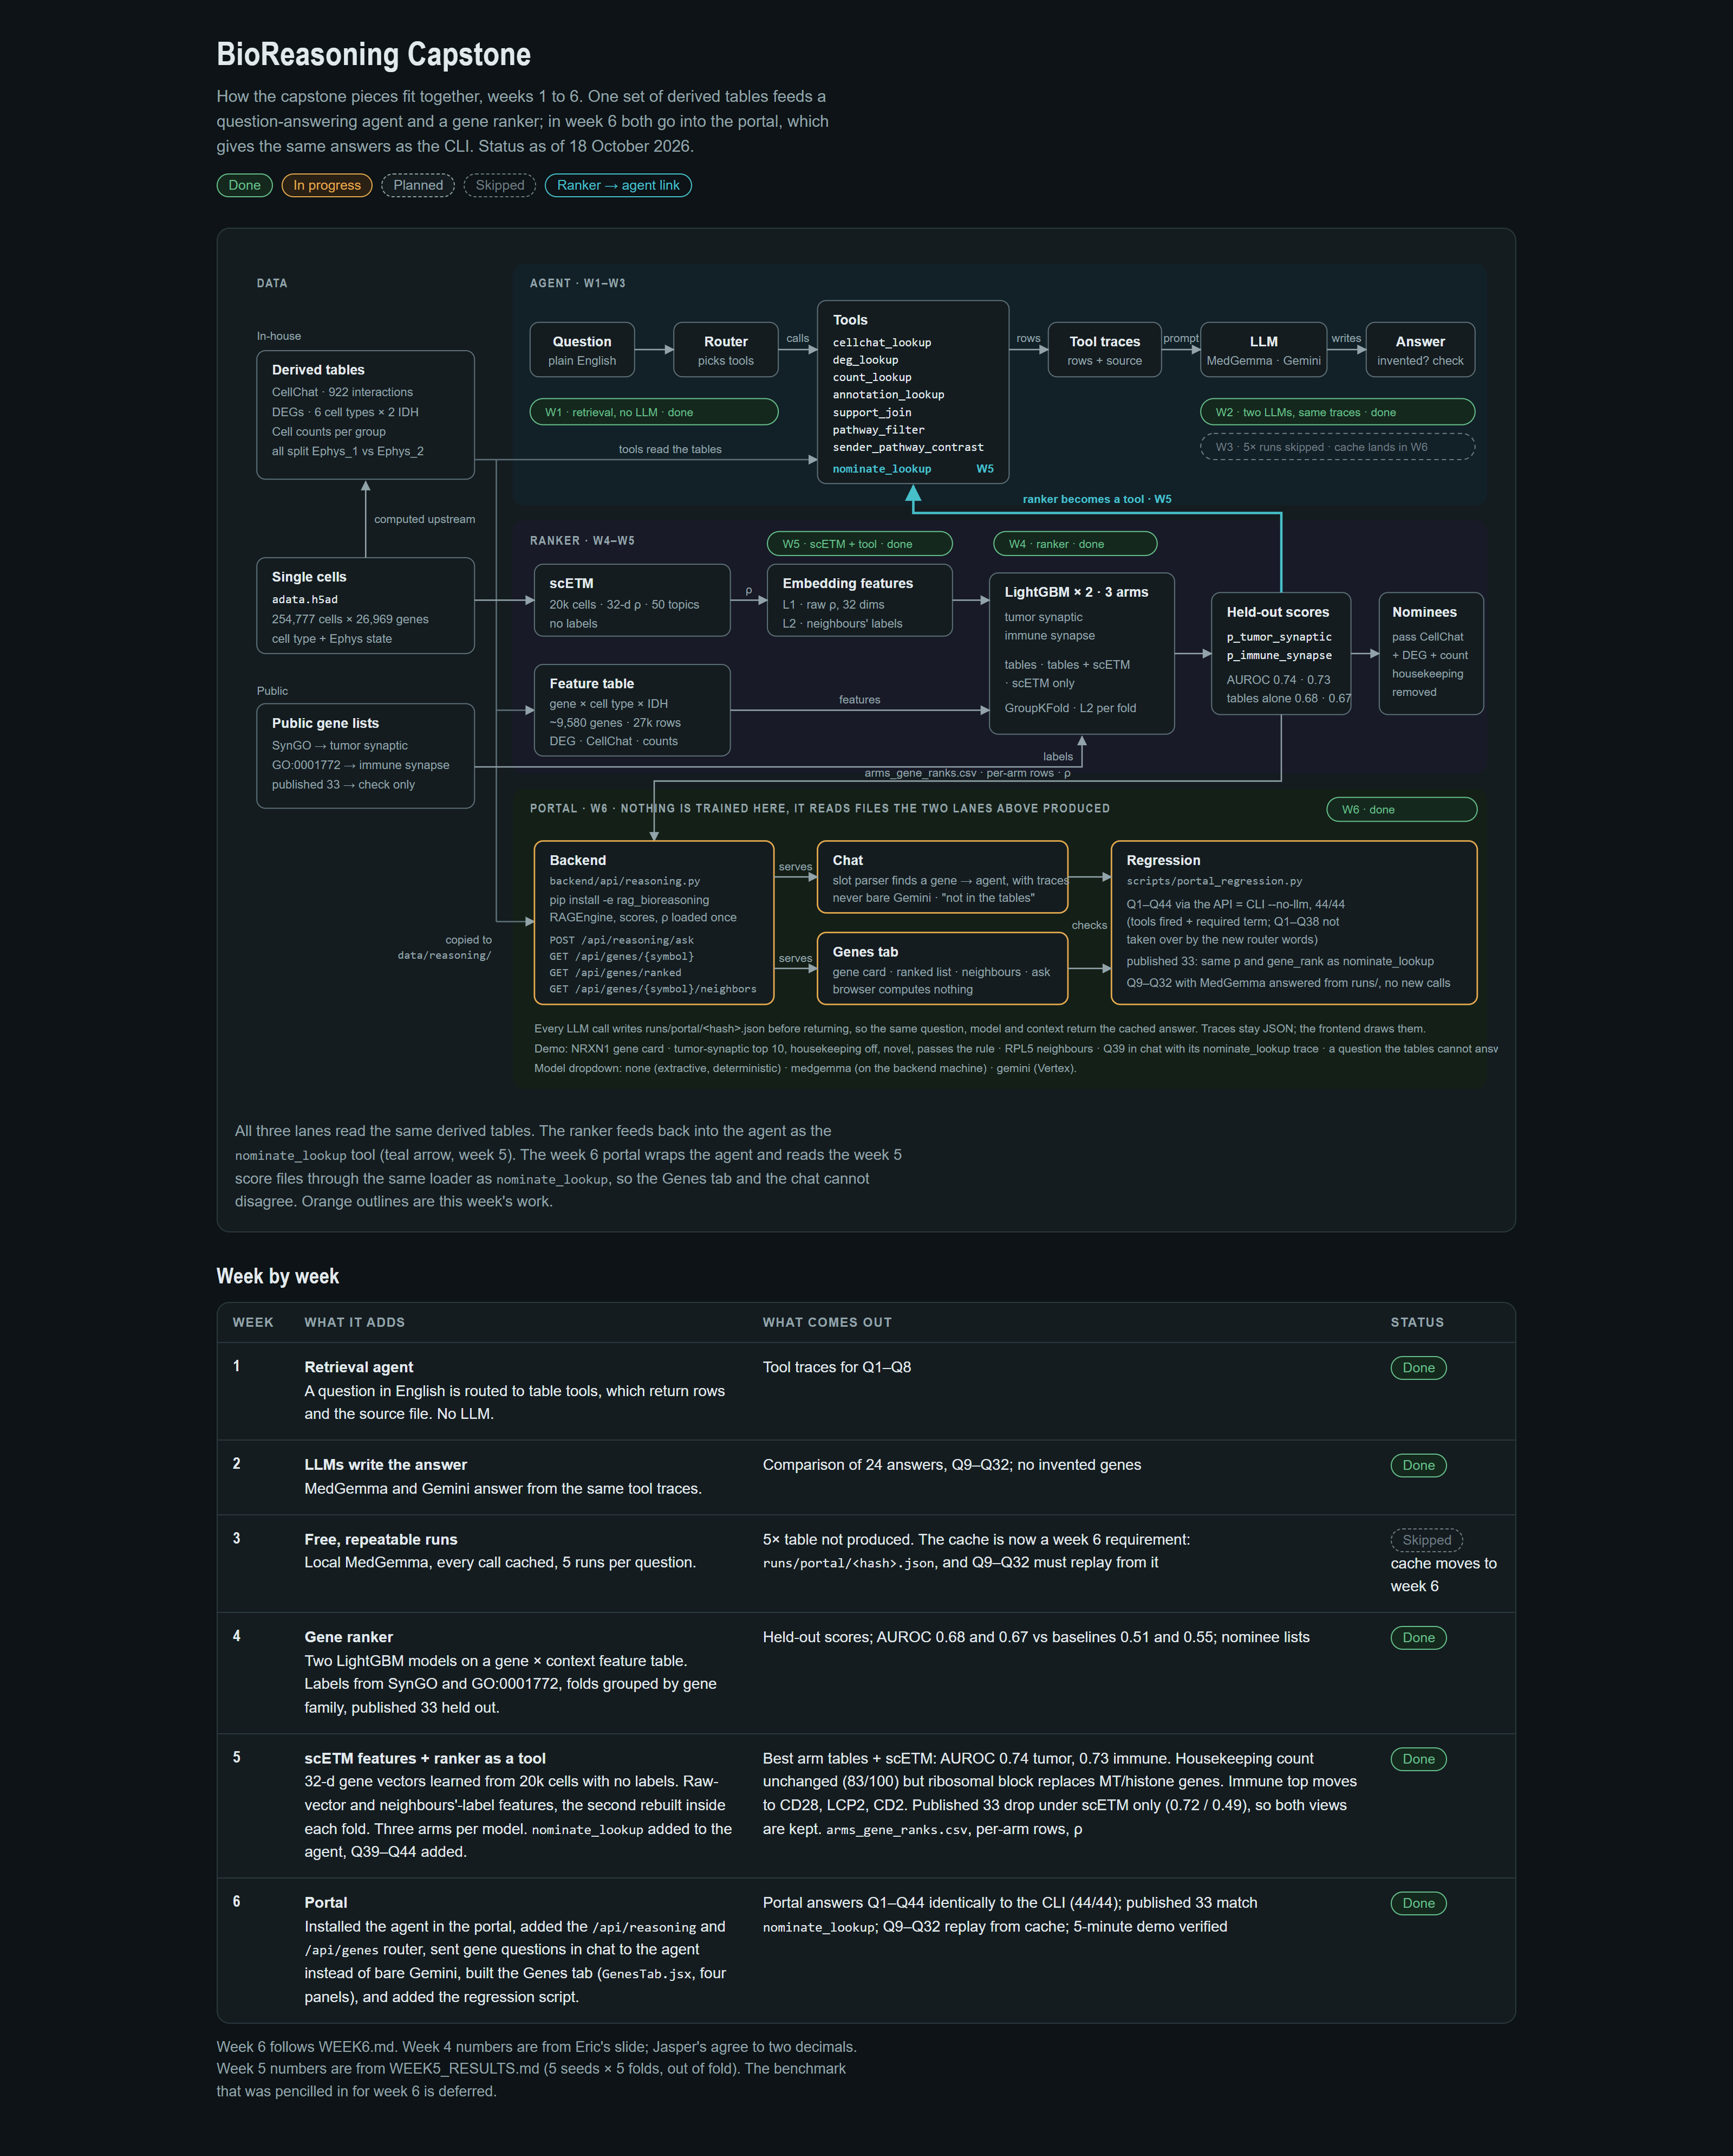
Portal Integration
Week 6 connects the grounded reasoning agent and gene ranker to the BT-CAP website.
Chat routes questions to the same CellChat, DEG, count, annotation, and nomination tools used by the CLI.
One shared evidence layer
The Genes tab reads held-out LightGBM scores, evidence flags, and scETM neighbors.
The chat and Genes views load the same rank files and reasoning tables, preventing conflicting scores or provenance.
The portal reads saved outputs from Weeks 1–5. It does not retrain either model.
Notes:
Week 6 wraps the reasoning agent and ranker in the existing BT-CAP portal.
The portal performs no training. It reads the derived tables, score files, and embeddings produced earlier in the project.
The same loader powers nominate_lookup and the Genes tab, so both views share the same held-out scores and evidence.

Slide 19
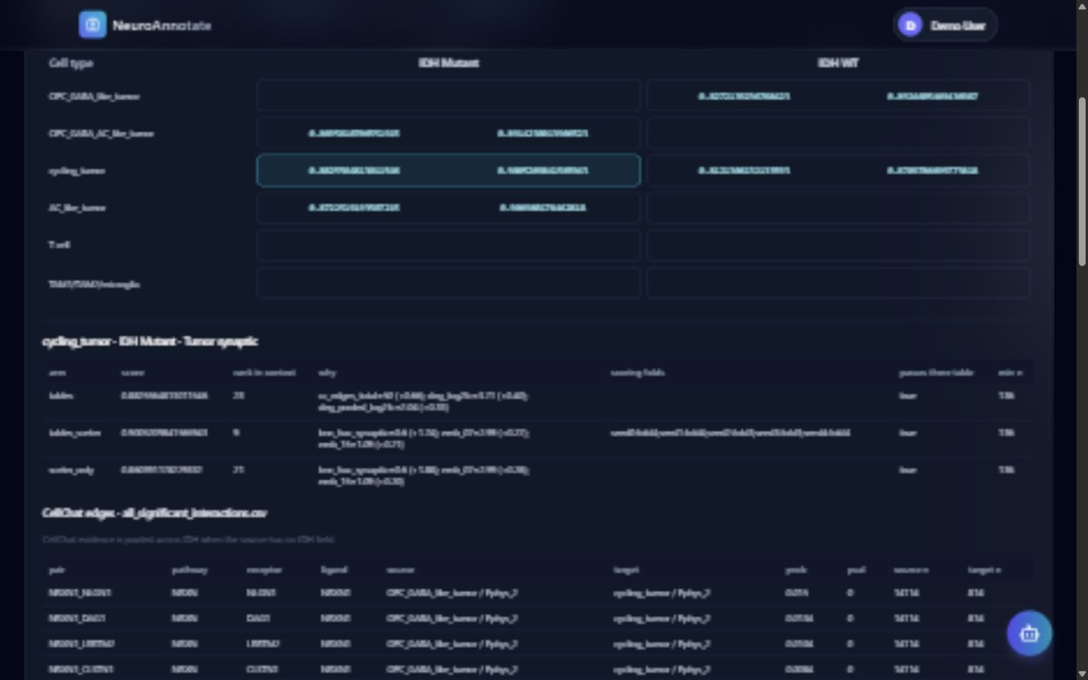
Auditable Gene Nomination
A gene score now links directly to its context, evidence, features, and cross-validation fold.
Each gene card reports
Tumor-synaptic and immune-synapse probabilities
The three features that drove the score
CellChat and DEG evidence with source rows
Minimum group size and the fold that scored the gene
Consistency rule
The gene card and chat use the same score loader, so NRXN1 receives the same result in both views.
Notes:
The Genes tab exposes the Week 5 nominate_lookup output as a visual gene card.
Users can filter ranked candidates, inspect CellChat and DEG support, review scETM neighbors, and export CSV tables.
The default ranked view enforces a minimum cell-group size of 50.

Slide 20
Portal Regression Results
The web interface now reproduces the verified command-line behavior across the full question set.
44 / 44
24 / 24
294
8
questions matched across API and CLI
MedGemma answers replayed from cache
Python and RAG tests passed
frontend tests plus production build
Check | Requirement | Result
Grounded Q1–Q44 | Same tools and required evidence terms | PASS
Published genes | Portal scores and ranks match nominate_lookup | PASS
MedGemma replay | Cached answers return without a provider call | PASS
Production portal | Backend, frontend, and build checks complete | PASS
These checks establish software consistency and evidence provenance. Experimental validation remains the next scientific step.
Notes:
All 44 required questions produced matching tool calls and required terms through the portal API and the command line.
All 24 saved MedGemma answers replayed from cache while provider entry points were blocked.
The test suite contains 294 Python and RAG tests plus eight frontend tests. The production frontend build also passed.
These results verify integration and provenance. They do not establish that a nominee will succeed experimentally.

Slide 21


Slide 22
