Slide 1
Proposed Project
Sketch-to-Sound Mapping Using Semi-Supervised Learning
Project Objective
Develop a sketch-to-sound model that allows musicians to create their own associations between sound and shape.
Shuoyang Zheng

Slide 2
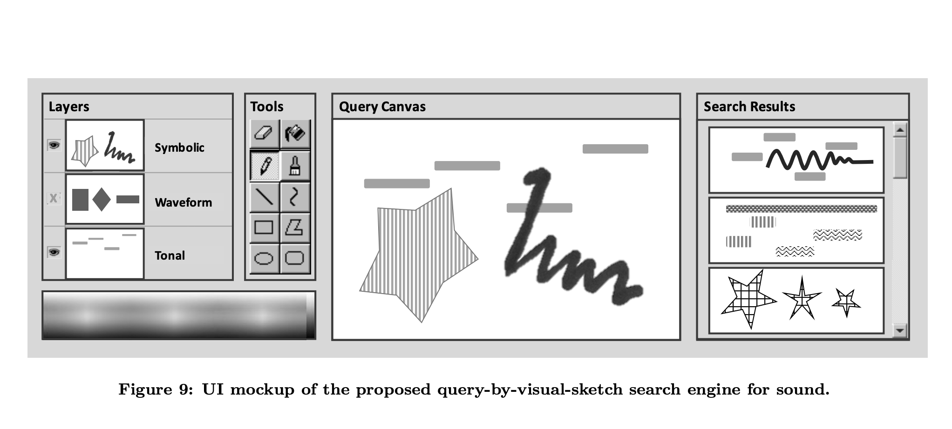
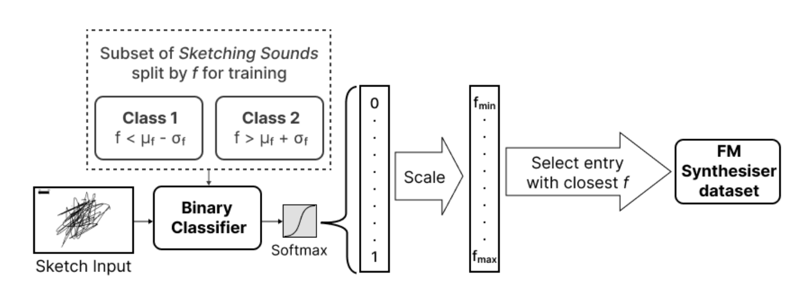
Related Works
Most sketch-to-sound mappings use supervised learning models trained on labelled datasets.
Knees and Andersen (2016) propose associating sounds and their graphical representations.
Löbbers et al.'s (2023) work uses
classification models that predict characters (e.g. calm or noisy) of a sketch (Löbbers, et al., 2021),
a mapping model that selects suitable sounds from a synthesis dataset annotated with a few semantic factors (e.g. sharpness and clarity) (Hayes et al., 2020).

Slide 3
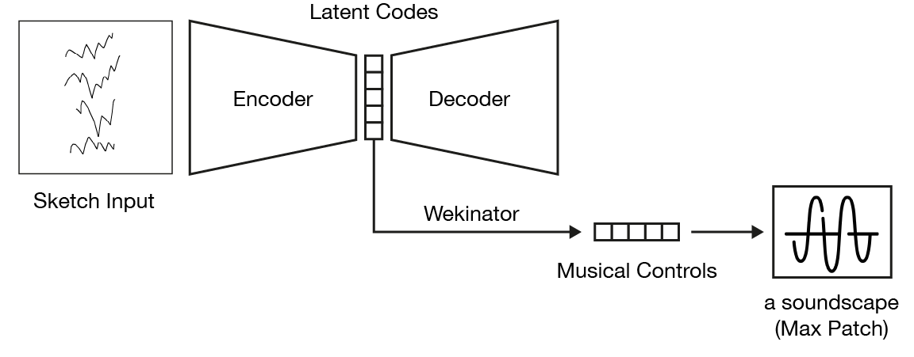
System Components
Sketch to latent codes
VAE model (unsupervised paradigm)
latent codes to musical controls
Wekinator (supervised paradigm)
Interaction Process: tweak, train, and perform.
Prompt the musician with a few example sketches, and let them tweak the musical controls according to example sketches.
Train the Wekinator model.
Start exploring the soundscape with new sketches.
Notes:
based on their own imagination
XAI: common grounding

