Slide 2
ROBOTS: AN INTRODUCTION

Slide 3
Table Of Contents
01
WHAT ARE ROBOTS?
02
TYPES OF ROBOTS
03
APPLICATIONS OF ROBOTS
04
FUTURE OF ROBOTICS
05
SUMMARY

Slide 4
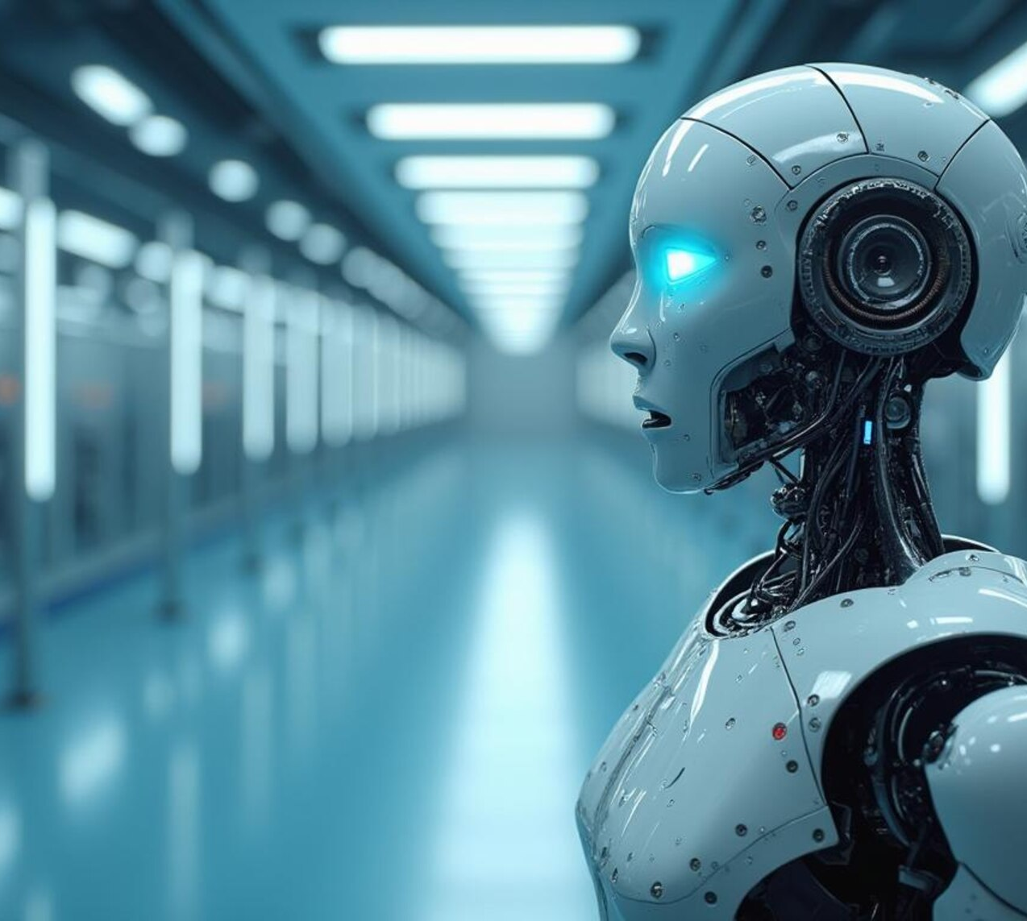
01
What Are Robots?
Robots are machines capable of carrying out complex actions automatically, often programmable by a computer.

Slide 5
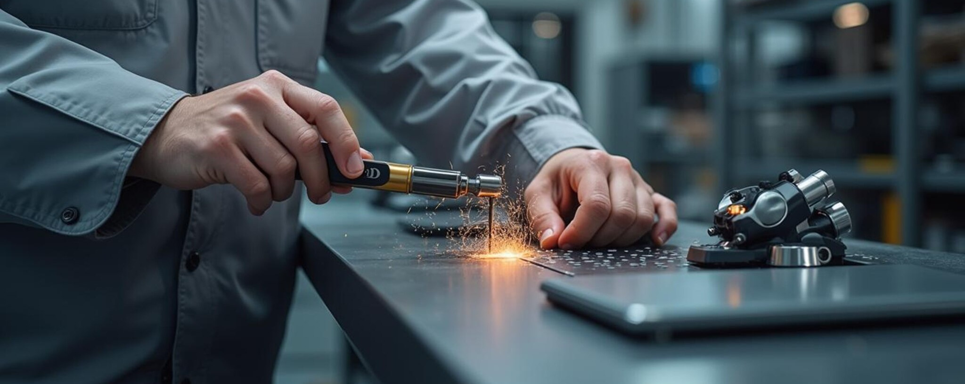

02
Types of Robots
INDUSTRIAL ROBOTS
Used in manufacturing.
SERVICE ROBOTS
Assist in daily tasks.

Slide 6
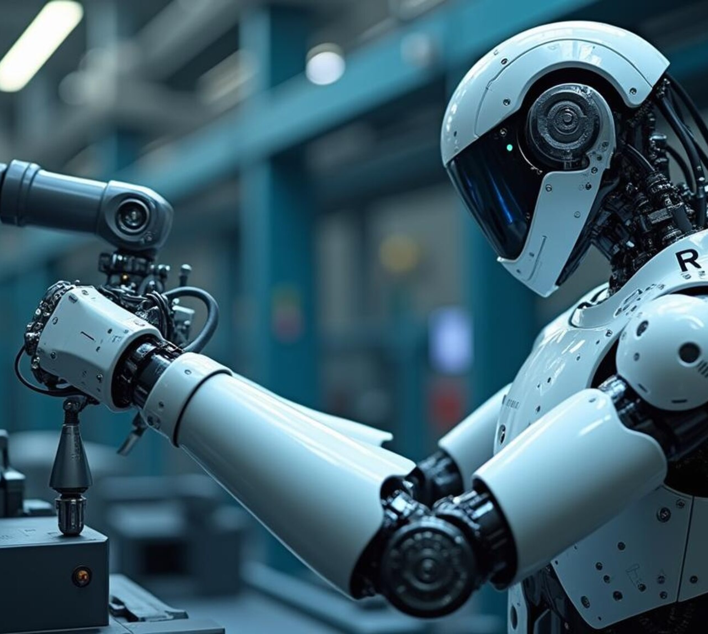
03
Applications of Robots
Robots are used in industries, healthcare, military, space exploration, and more for efficiency and precision.

Slide 7
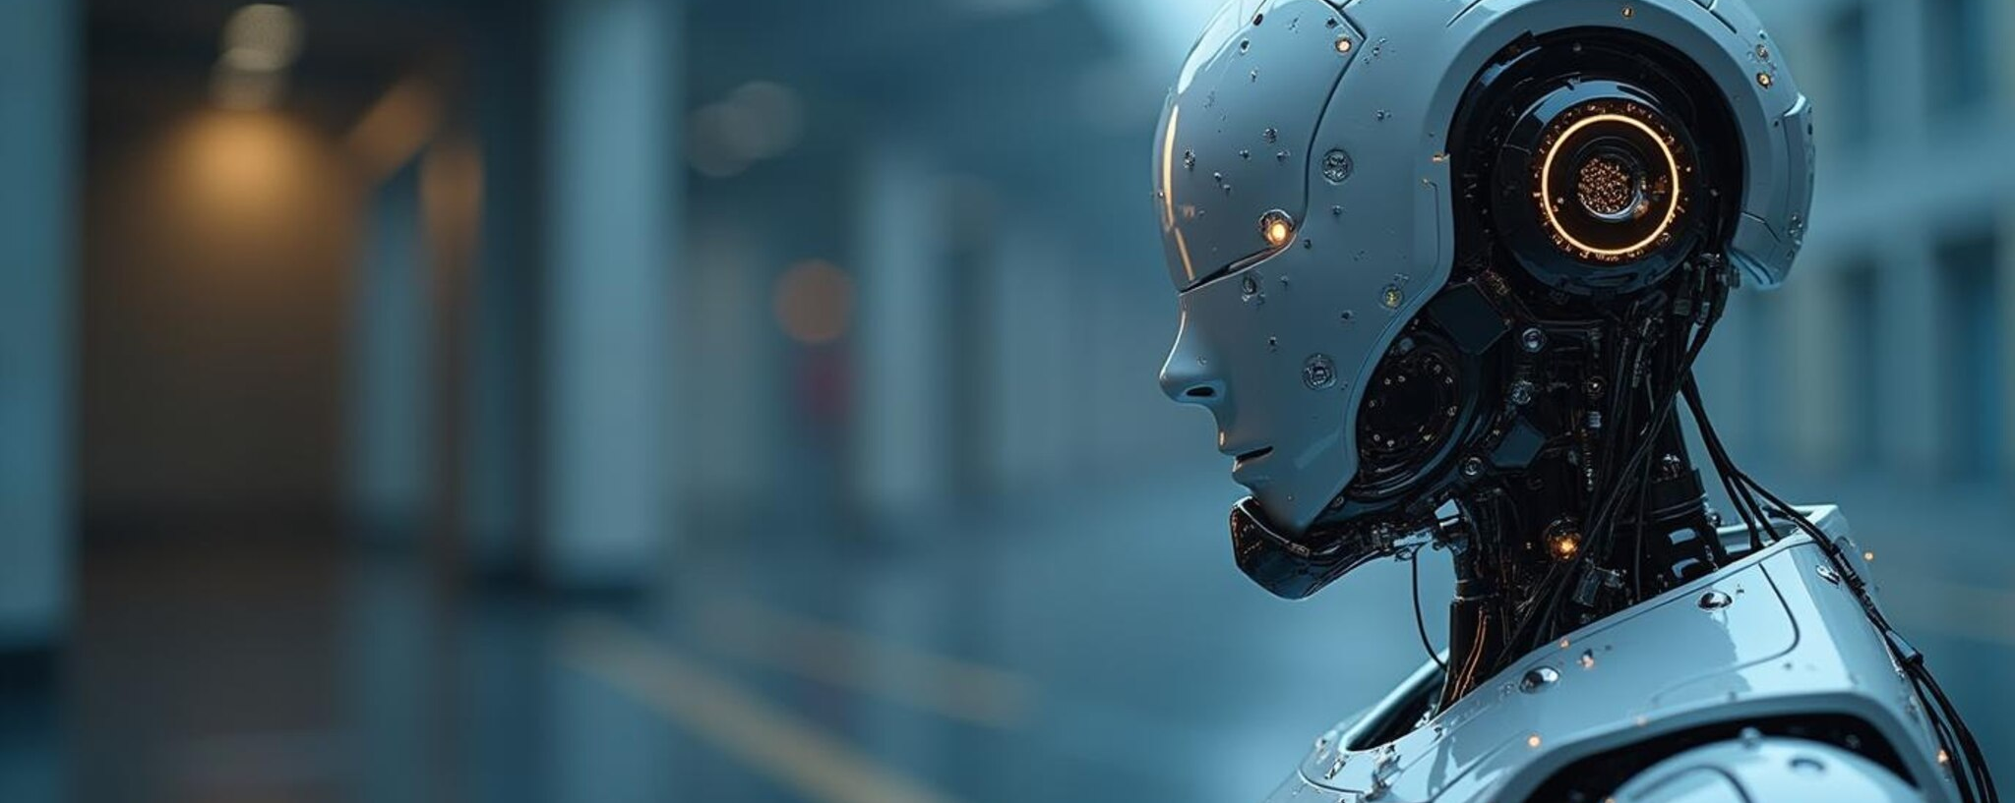

04
Future of Robotics
AI INTEGRATION
Smarter robots.
ADVANCED AUTOMATION
Increased roles in daily life.

Slide 8
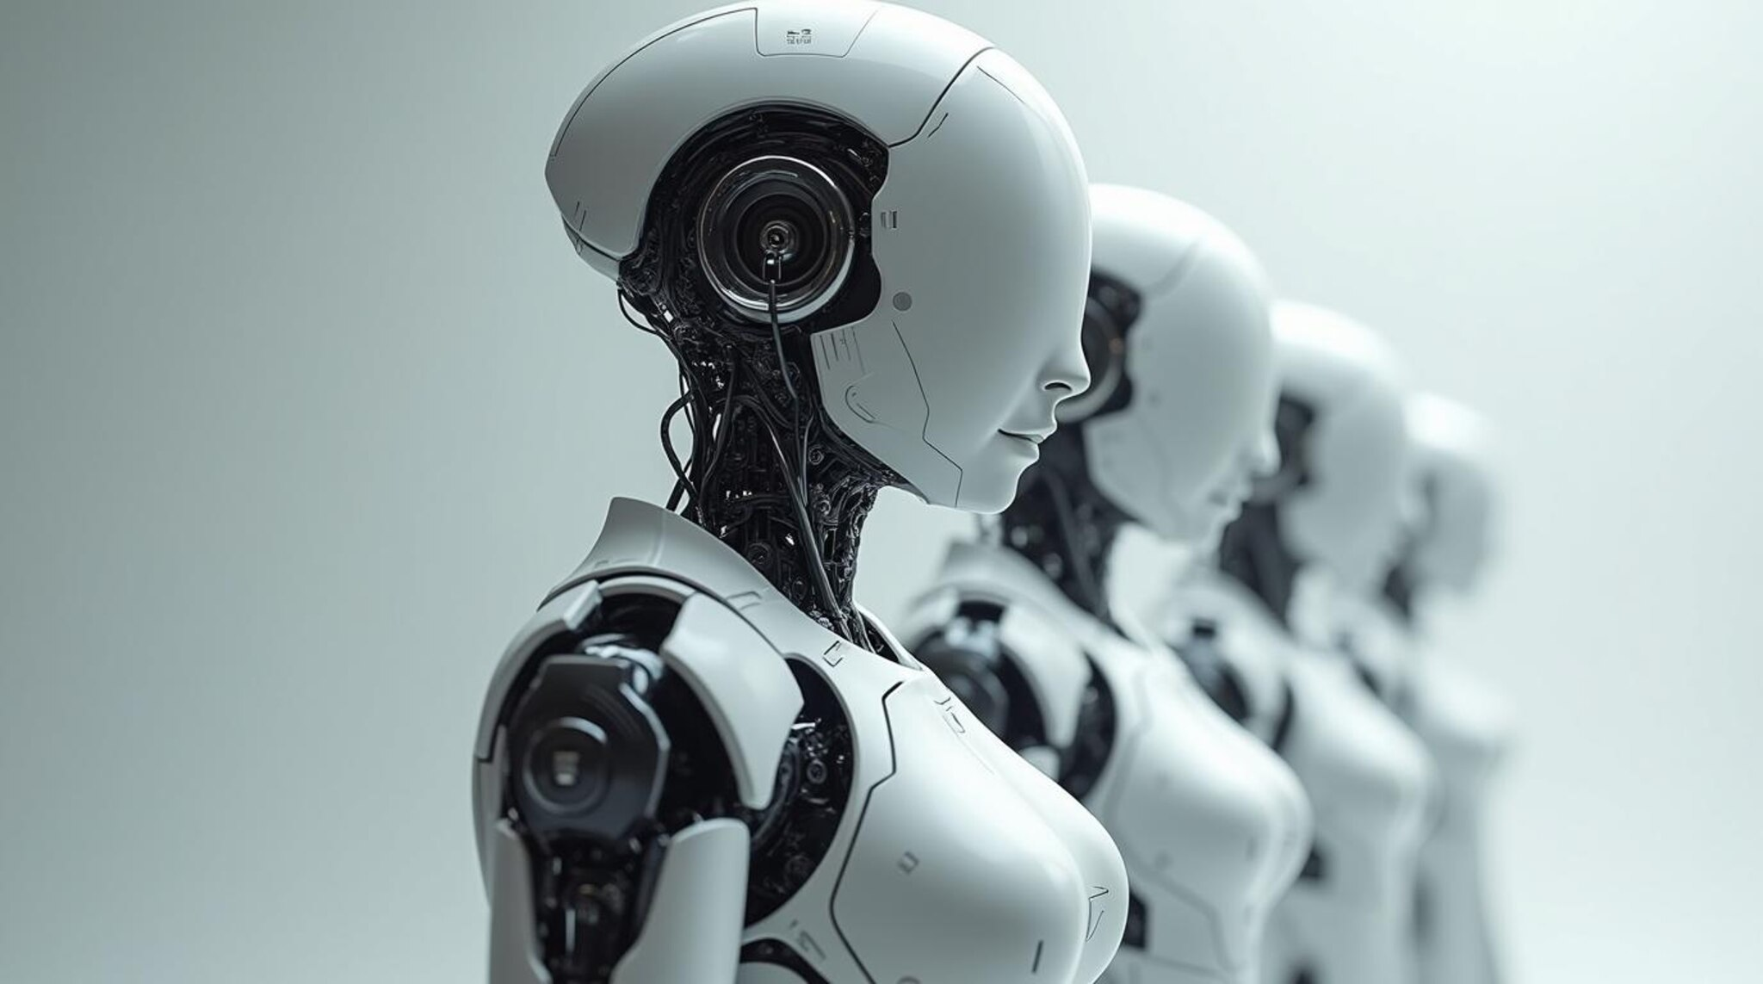
05
Summary
Robots perform complex tasks automatically.
They are essential in various sectors.
Future holds smarter and more integrated robots.
25

