Slide 1

ORACLE| AI Developer Experience
Total Recall: Agent Memory and Harness Engineering

Slide 2

WORKSHOP INSTRUCTIONS
workshopwaitingroom.com

Slide 3
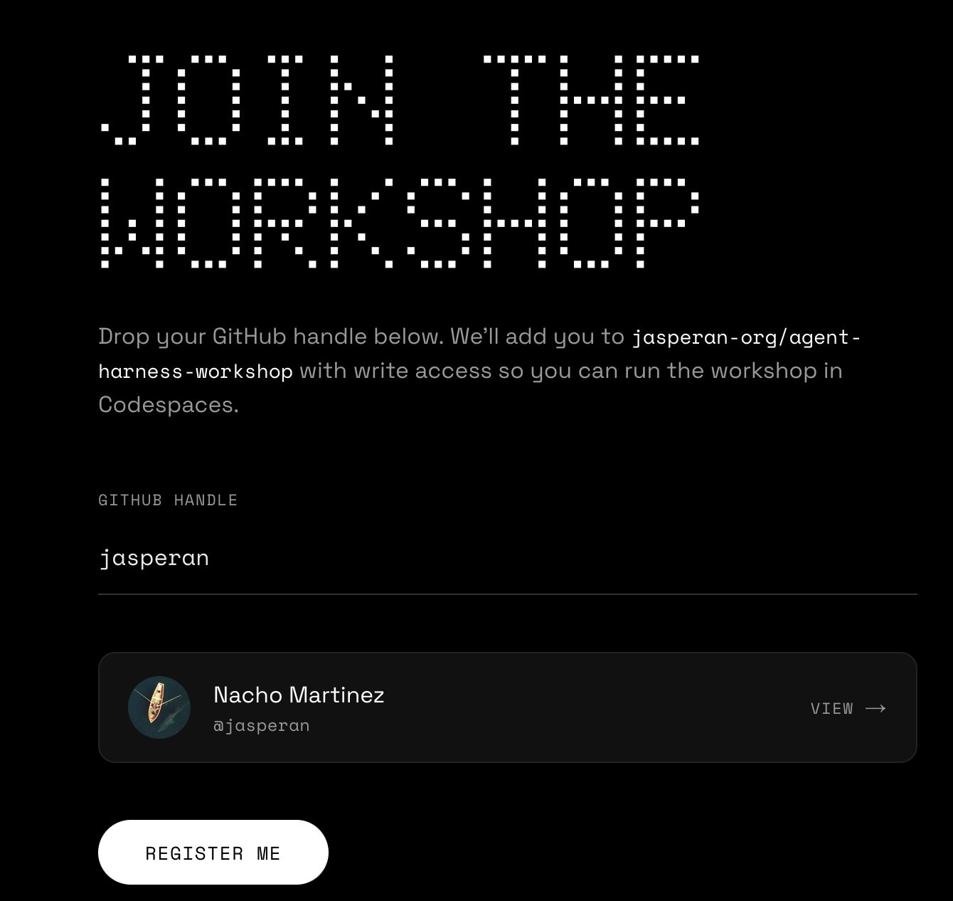

Slide 4
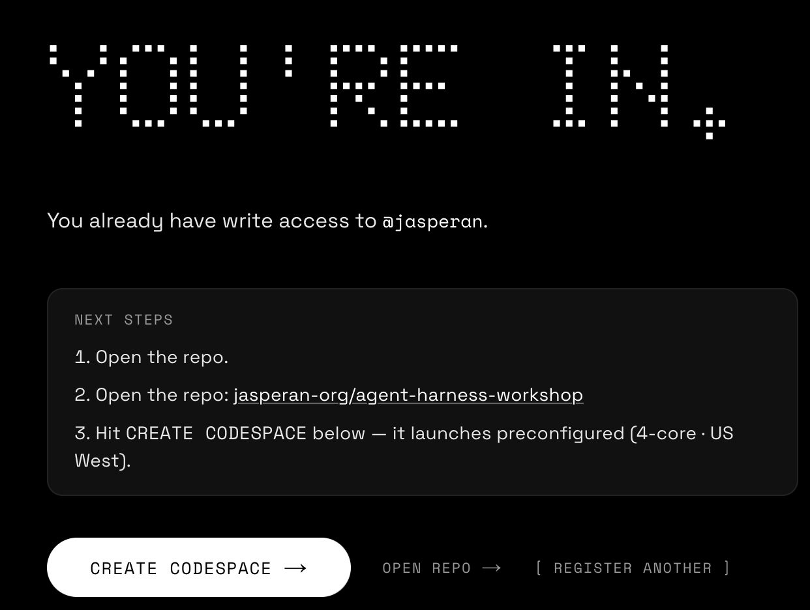

Slide 5
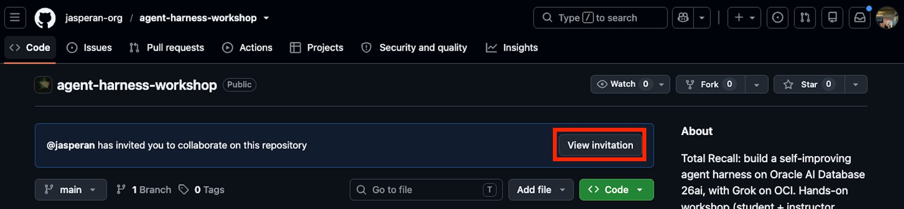
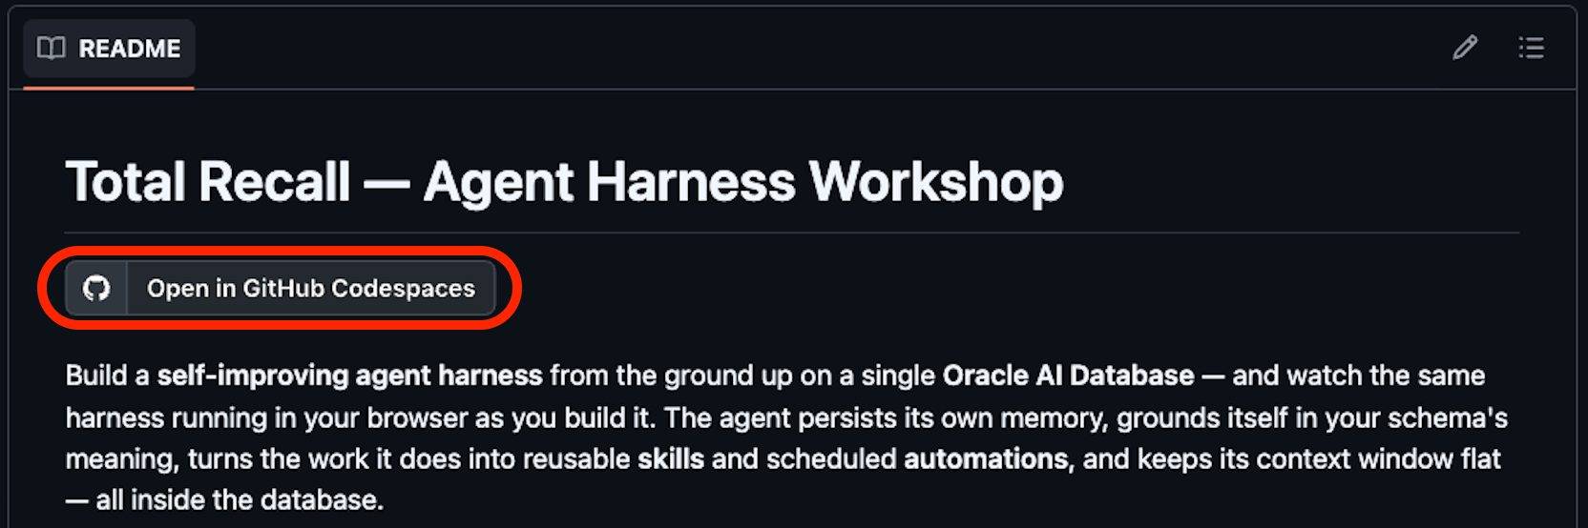

Slide 6
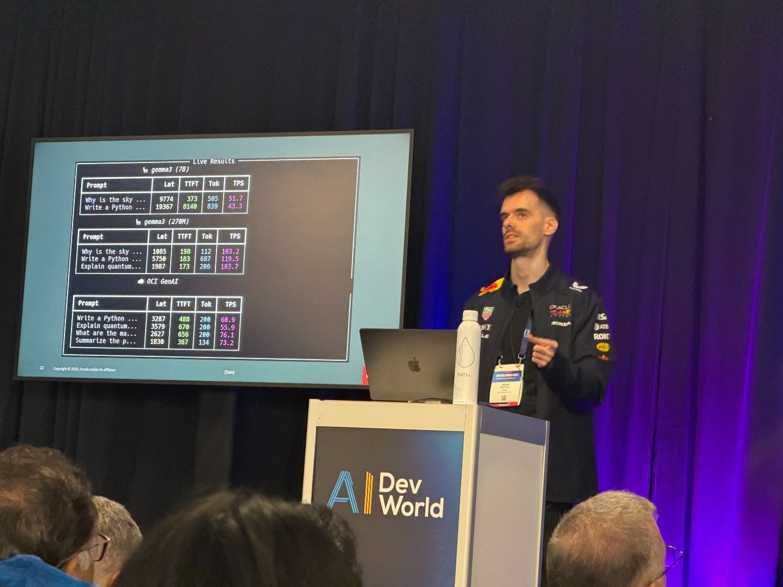
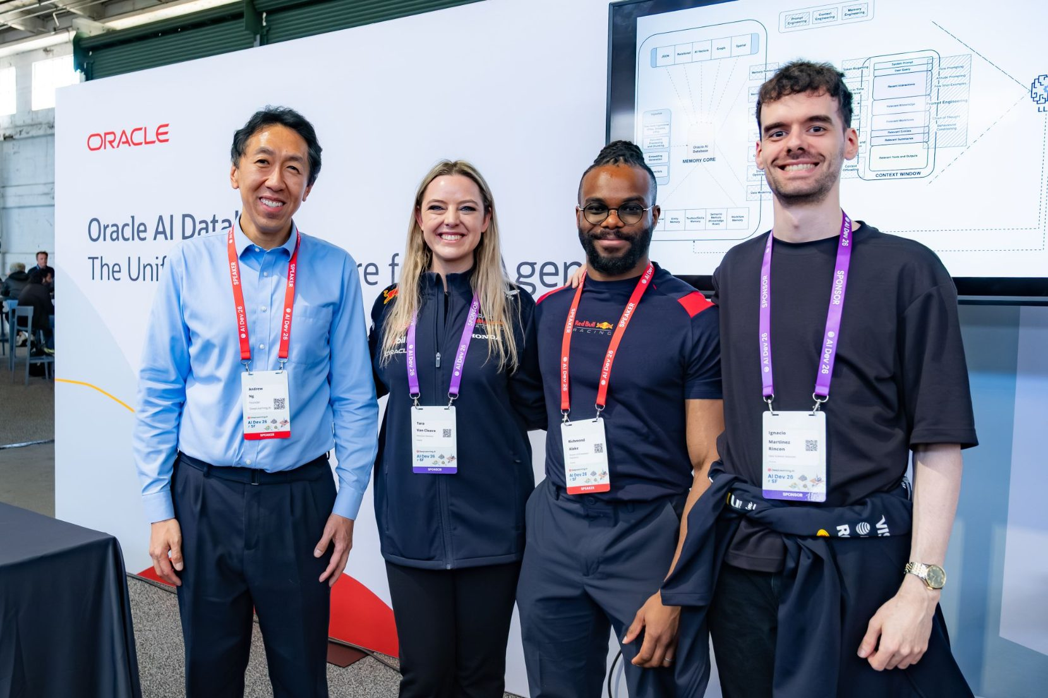

Who Am I?
ORACLE
Data Scientist Advocate @
Find my talks and projects on YouTube + GitHub
Launched two courses this year with Andrew Ng on Building Memory-Aware Agents
Notes:
Thesis: agent reliability is a harness problem, and memory is its non-negotiable core. Agent = Model + Harness. We dissect the harness layer by layer, then map every layer onto Oracle primitives.

Slide 7
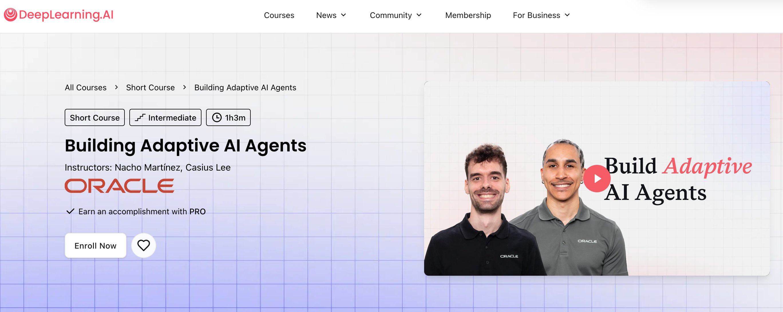
NbuildingAdaptive AI Agents
Notes:
Thesis: agent reliability is a harness problem, and memory is its non-negotiable core. Agent = Model + Harness. We dissect the harness layer by layer, then map every layer onto Oracle primitives.

Slide 8
AGENDA
WHAT WE'LL COVER
AGENDA
What we'll talk through.
01
The agent stack
06
Find it, recall it
APPLICATION TO COMPUTE
ENCODING, RETRIEVAL, MEMORY
02
The four shapes
07
Ground it, drive it, fit it
FORM FACTOR, EVOLUTION
SEMANTIC, LOOP, CONTEXT
03
What is an agent
08
Continual learning
MODEL + HARNESS = AGENT
WEIGHT, LATENT, TOKEN SPACE
04
Inside the harness
09
One substrate
THE LAYERS, ONE BY ONE
IT ALL RUNS ON ORACLE
05
The memory substrate
FILESYSTEM + DATABASE
Notes:
01 what the agent stack is and zoom into the data layer where memory lives. Then , shapes of AI apps, what an agent is, followed by the seven layers that make up an agent harness; finally talk a bit about continual learning, and how Oracle is uniquely positioned to help in the development of all of this.

Slide 9





SETTING THE CONTEXT
THE AGENT STACK
THE AGENT STACK
Application
the agent users interact with: the product surface
Data
memory, knowledge and retrieval: what the agent knows
Model
the reasoning core: the LLM that decides
Infrastructure
orchestration, serving and security: how it runs
Compute
GPUs and the database engine: the hardware underneath
Notes:
Every agent sits on five layers: Application (the product surface), Data (memory, knowledge, retrieval), Model (the reasoning LLM), Infrastructure (orchestration, serving, security), and Compute (GPUs and the database engine).
The application, model, infrastructure and compute layers are increasingly commoditised:
The data layer is where memory and reliability are won, and where we will focus today.

Slide 10
SETTING THE CONTEXT
THE AGENT STACK
THE AGENT STACK
Application
the agent users interact with: the product surface
Data
memory, knowledge and retrieval: what the agent knows
we are here
Model
the reasoning core: the LLM that decides
Infrastructure
orchestration, serving and security: how it runs
Compute
GPUs and the database engine: the hardware underneath

Slide 11






SETTING THE CONTEXT
INSIDE THE DATA LAYER
DOUBLE-CLICK THE DATA LAYER
The data layer, unpacked.
Double-click the data layer: an orchestrator drives the app, a gateway fronts it, and memory, meaning, retrieval and context sit under one security boundary.
Agent Orchestrator
Gateway & MCP
connectivity to tools and data
Memory Layer
episodic, semantic, working
Application
Data
Semantic Layer
what the schema means
Model
Retrieval Layer
keyword, vector, rerank
Security
Infrastructure
Context Layer
compaction and offloading
Compute
Tools & Skills
searchable memory
Notes:
the data layer is where the agent harness appears.
A Gateway and MCP Connectivity layer is the agent's door to tools and data.
Behind it sit the data layers
- Memory (episodic, semantic, working)
- Semantic layer (what the schema means)
- Retrieval (keyword, vector, rerank)
- Context (compaction and offloading)
- Tools and Skills as searchable memory

Slide 12
WHERE THE FIELD IS TODAY
Four shapes AI applications take.
LLM Chatbot
AI Application
RAG Applications
LLM-Driven Workflow (Automation)
AI Agents (Autonomy)
Notes:
AI applications take four shapes from passive to active: chatbot, RAG, workflow automation, agents. The frontier is the bottom two converging.
We see people talking about AI developers using agents to build automations rather than simply writing code lately – people are starting to build automations and workflows that can be reused over and over to maximize productivity

Slide 13
WHAT IS AN AGENT
WHAT THE AGENT DOES
What is an AI Agent
An autonomous computational entity whose cognitive functions are powered by a language model for reasoning, augmented by a database for memory, extended through tools for action , and grounded in inputs that let it perceive its environment.
Agent
Notes:
Four functions: reasoning (the model), memory (the database), action (tools), perception (inputs). Memory is the one most teams under-build.
Reasoning + memory + tools + perception

Slide 14

THE ANATOMY
REASONING, MEMORY, TOOLS, PERCEPTION
WHAT AN AGENT IS MADE OF
Reasoning, memory, tools, perception.
Agent
Reasoning
Memory
Tool use
Perception
the frontier LLM
what it knows & has done
how it acts
how it sees inputs
Frontier AI labs (the model)
Agent engineer / you (the harness, the infrastructure you build and own)
Notes:
An agent is reasoning + memory + tools + perception. Three of those (memory, tools, perception) are infrastructure the agent engineer owns; reasoning is the frontier labs' remit. The goal of harness engineering: reliable, predictable behaviour that survives a model swap.

Slide 15
FORM FACTOR, EVOLUTION
WHERE THE FIELD IS TODAY
Four shapes AI applications take.
LLM Chatbot
AI Application
RAG Applications
LLM-Driven Workflow (Automation)
AI Agents (Autonomy)
Notes:
AI applications take four shapes from passive to active: chatbot, RAG, workflow automation, agents. The frontier is the bottom two converging.

Slide 16
FORM FACTOR, EVOLUTION
WHERE THE FIELD IS TODAY
Four shapes AI applications take.
LLM Chatbot
AI Application
RAG Applications
LLM-Driven Workflow (Automation)
AI Agents (Autonomy)
Notes:
AI applications take four shapes from passive to active: chatbot, RAG, workflow automation, agents. The frontier is the bottom two converging.

Slide 17

AUTOMATION + AUTONOMY CONVERGE
WHERE THE FIELD HEADS
Automation and autonomy converge.
IN THE WILD
OpenAI Codex
AUTOMATION
delegated coding agent
The developer fixes the path. Reliable, repeatable, but rigid.
Claude Cowork
agentic knowledge work
Agentic systems
Claude Code
AUTONOMY
automate the routine, decide the rest
terminal coding agent
The model chooses the path. Flexible, general, but harder to trust.
OpenClaw
open-source personal agent
Hermes (Nous Research)
self-improving skills + memory
The frontier products are already here: agents that automate what is routine and decide what is not.
Notes:
Two forces converge.
Automation gives reliability; autonomy gives flexibility.
Agentic products sit at the meeting point: OpenAI Codex, Claude Cowork, Claude Code, OpenClaw (open-source personal agent), and Nous Research's Hermes (a self-improving skills-and-memory loop). Automate the routine, decide the rest.

Slide 18
DEFINITION
AGENT HARNESS
AGENT HARNESS
What is an agent harness
The engineering scaffolding around a model and its agent loop: the memory, retrieval, tools, context and control layers that turn a capable but stateless LLM into a system which produces reliable, repeatable outcomes , run after run.
Why it matters the model supplies raw capability; the harness is what makes that capability dependable.
Agent = model + harness.
Notes:
The agent harness is the engineering scaffolding around a model and its agent loop: memory, retrieval, tools, context and control. The model is capable but stateless and non-deterministic; the harness is what turns that raw capability into a system that produces reliable, repeatable outcomes across executions.
This is the core equation of the talk: agent equals model plus harness, and the harness is where the engineering lives.
MODEL ITSELF: NONDETERMINISTIC
HARNESS: DETERMINISTIC, RELIABLE, REPEATABLE

Slide 19
THE REFRAMING
THE REFRAMING
Components of a Dependable System
Agent
=
Model
+
Harness
Reasoning
Memory
Tool use
Perception
frontier AI labs · the part you rent
agent engineer / you · the harness you build and own
Reasoning is the part you rent. Memory, tools and perception are the harness you build, along with the other surfaces that support them (prompts, retrieval, sandbox, observability, and more).
Guidance. A good agent harness produces reliable, predictable output regardless of which model you swap in. Memory, tools, and perception are yours to engineer; reasoning is the part you rent.
Notes:
Agent = Model + Harness. Reasoning feeds the Model box, the part you rent from frontier labs. Memory, tools and perception feed the Harness box, the infrastructure you build and own, along with the other surfaces that support them. The model is one box; the rest is the harness, and where reliability is won or lost.

Slide 20
HARNESS, LAYER BY LAYER
SEVEN LAYERS, ONE CONTAINER
INSIDE THE HARNESS
We'll dissect it layer by layer.
AGENT HARNESS
everything inside is what you build and own
1
Model layer
the frozen reasoning core the harness is built around
2
Storage layer
where memory physically lives: files and the database
3
Encoding & retrieval
turn text into meaning, hand back the slice
memory engineering
4
Memory layer
episodic, semantic, working, procedural
memory engineering
5
Semantic layer
teach the agent what your schema means
memory engineering
6
Agent loop
the typed graph that drives every layer above
7
Context engineering
keep the window dense as the session grows
Notes:
The harness encapsulates seven layers, built bottom-up. The model sits at the core (shown dark): the one part you do not build, wrapped by everything you do.
Three layers, encoding and retrieval, memory, and the semantic layer, are the heart of memory engineering.
We return to this container at the end, mapped to Oracle primitives. ----- UNTIL HERE WE HAVE DONE AN INTRODUCTION TO WHAT AN AI AGENT IS, THE COMPONENTS OF A SYSTEM, ITS USE CASES. NOW WE DIVE DEEPER INTO AN AGENT HARNESS AND ITS COMPONENTS.

Slide 21
LAYER 1, MODEL
THE REASONING CORE
MODEL LAYER
The frozen reasoning core.
The frontier LLM is the reasoning engine, and the one part of the system we do not build. It is a frozen utility: identical from one turn to the next. Everything the harness does is built around it, and everything that makes the agent improve is the harness, not the model.
Reasoning, out over the network
One chat LLM, provider-toggleable, the only outbound call at runtime.
Two models, in the database
An embedder and a cross-encoder reranker run inside the engine (ONNX).
Frozen, by design
Weights never change at runtime; the harness is what learns.
On Oracle reasoning is hosted on OCI Generative AI; embeddings and reranking run in-database.
Notes:
The model layer is the reasoning core. Frozen between turns. That is the motivation for the harness, and later for continual learning in token space.
MOTIVATION TO SOLVE THIS FROZEN STATE -&gt; CONTINUAL LEARNING
WEIGHTS NEVER CHANGE 99.99999% TIME. BUT WAIT...

Slide 22
LAYER 2, STORAGE
FILESYSTEM VS DATABASE
STORAGE LAYER
Where does memory live?
THE FILESYSTEM CAMP
THE DATABASE CAMP
Matches what the model already knows
ACID by default
read, write, grep are everywhere in training data
concurrent writes cannot silently corrupt each other
One interface over many stores
Search beyond grep
notes, transcripts, tool output, all read the same way
vector, lexical and hybrid retrieval over the same data
Externalises state cheaply
Inside backups, security, audit
write the result, keep a short pointer in context
one boundary for everything that persists
It is not files versus database. It is files for what the agent sees, and the database for what persists.
Notes:
Both camps are right. Files match the model's instincts and are cheap; databases give safety and search. The resolution: use each for what it is good at.
(
Transactional consistency ACID
Hybrid search rather tan grepping
Backups, and many other database benefits not present in Operating Systems: data security too (kept inside the db: kept safe with one single point of entry) vs. In the OS: many attack vectors
)

Slide 23
LAYER 2, STORAGE
WHY AGENTS REACH FOR FILES
THE FILESYSTEM CAMP
Why so many agents reach for files.
LLMS ALREADY KNOW (OPEN / READ / WRITE / GREP)
FILESYSTEM ONLY
Blobs, files, scratchpads
Agent
+ POSIX semantics + Append-friendly + Cheap to start and scale + On-distribution verbs (the model already knows them)
File
Agent
MEMORY SUBSTRATE
No ACID
Agent
− No ACID − No queries, no indexes − Outside backups & access control
Notes:
Files are attractive: the model speaks them and they externalise state for free. The catch is concurrency, search, and being outside the database's guarantees.
FILES: Easy to write, hard to linearly scale too (no indexes and no structured query method)
The notebook shows two workers losing updates on a plain file.
Transactional consistency ACID
Hybrid search rather tan grepping
Backups, and many other database benefits not present in Operating Systems: data security too (kept inside the db: kept safe with one single point of entry) vs. In the OS: many attack vectors
DATA SECURITY VS. MANY ATTACK VECTORS

Slide 24
LAYER 2, STORAGE
WHAT THE DATABASE ADDS
THE DATABASE CAMP
What the database adds.
ACID + HA (Data Guard)
AI Vector Search
Relations + ranking
Scale, security, backup
ACID, DEMONSTRATED
Two workers, 500 increments each. Against a plain file the read-modify-write steps interleave and updates vanish; against the database a single atomic UPDATE ... SET n = n + 1 takes a row lock and every increment counts. The database is safe by default.
Notes:
What the database adds: durability and isolation, vector search, relations and ranking, enterprise scale and security. Isolation is the one that bites agents under concurrent tool calls.
ACID: Atomic, Consistent, Isolated, Durable
High Availability with my example: a couple of months ago I lost my whole cloud environment where I was coding 24/7 – had I had a system that would save my skills, workflows, etc… I wouldn’t have had to start all over again.
DEGENERATE LIKE ME
AGENTS + SUBAGENTS
WORKTREES -&gt; MERGE AT THE END

Slide 25
LAYER 2, STORAGE
MEMORY, THE SUBSTRATE
THE RESOLUTION
Oracle Database File System: the best of both worlds.
A filesystem interface agents already speak, backed by Oracle AI Database 26ai.
WHAT FILES GIVE YOU
WHAT THE DATABASE ADDS
On-distribution verbs
File interface
ACID + HA (Data Guard)
DBFS, POSIX, FUSE MOUNT
Legible & versionable
read
write
ls
grep
AI Vector Search
Agent-controlled I/O
Relations + ranking
Oracle AI Database 26ai
Hierarchical paths
SECUREFILES LOBS
Scale, security, backup
Hybrid in practice: a scratchpad on the filesystem holds short-term working memory; a scheduled pipeline promotes what is worth keeping into long-term memory in tables. One pipeline, one ACID boundary.
Notes:
DBFS puts a POSIX filesystem (compatible amongst different OS’s) inside the database on SecureFile LOBs. Agents get the verbs they know; you keep ACID, vector search, relations, security.
The file interface is posix compatible
Hybrid system works best: Short-term scratch lives in files; a scheduled pipeline promotes keepers into long-term tables.
WHAT HAPPENS WHEN YOU HAVE MULTIPLE AGENTS WORKING ON THE SAME CODEBASE? ->> WORKTREES!!!
+ TRANSACTION CONSISTENCY: ACID (POSITIVE DB)

Slide 26
LAYER 3, ENCODING & RETRIEVAL
WRITE PATH, READ PATH
ENCODING & RETRIEVAL
Turn text into meaning, hand back the right slice.
WRITE PATH, ENCODING
READ PATH, THE RETRIEVAL LADDER
Embeddings are produced inside the database by a loaded ONNX model, reached through OracleVS.
1
Keyword
Oracle Text CONTAINS, exact terms & identifiers
2
Vector
cosine over HNSW; query embedded in the same space
text
in-DB embed
vector table
3
Hybrid (RRF)
fuse keyword + vector; no weight tuning
One model, one vector space. Nothing leaves the engine to be vectorised.
4
Rerank
cross-encoder reads query & document together
Retrieval is progressive disclosure for tables: hand the model the few rows it needs, nothing more.
Notes:
Encoding computes embeddings in-database via OracleVS: one model, one vector space. Retrieval climbs a ladder: keyword, vector, hybrid RRF, cross-encoder rerank. Retrieval is progressive disclosure for tables.
LANGCHAIN-ORACLEDB
IN-DB SUPPORT
EMBEDDINGS INSIDE THE DATABASE! IMPORTANT BECAUSE DATA NEVER LEAVES.

Slide 27




LAYER 3, ENCODING & RETRIEVAL
EMBEDDER + RERANKER, TWO JOBS
EMBEDDER + RERANKER
Retrieve cheaply, then rerank precisely.
INDEXING TIME · ONCE PER DOCUMENT
→ one fixed vector per document
Documents
Bi-encoder
Vector index
facts to index
encodes each doc ALONE
HNSW, in Oracle
cosine NN
top-N
QUERY TIME · PER QUESTION
cheap, approximate
top-k
User query
Bi-encoder
Cross-encoder
Answer
the question
encodes query ALONE
reads query + doc TOGETHER
context
Bi-encoder separate + precomputed: fast nearest-neighbour over millions, but never compares query and document directly.
Cross-encoder joint, word-level: far more accurate, but runs once per candidate, so only on the shortlist.
Notes:
The embedder is a bi-encoder, the reranker is a cross-encoder, and they act at different times. At indexing time the bi-encoder encodes each document alone into one fixed vector, stored in the HNSW index. At query time the bi-encoder encodes the query alone, a cheap cosine nearest-neighbour pulls top-N candidates, and the cross-encoder then reads each query-document pair together to score relevance precisely, returning the top-k. Bi-encoder: separate and precomputed, fast over millions but approximate. Cross-encoder: joint and accurate but expensive, so only on the shortlist. The shape is the lesson: retrieve cheaply, then rerank precisely.

Slide 28

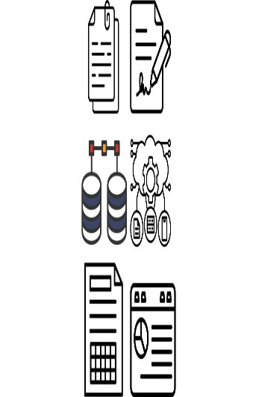
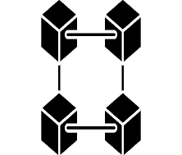
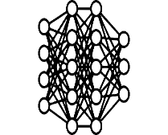
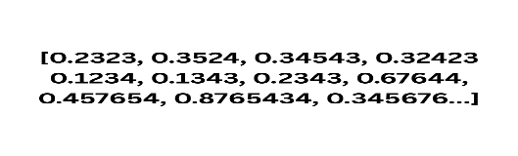
RAG APPLICATION: DATA INGESTION
Specialized Systems Require Dedicated Attention
Data objects are broken into chunks
"We find that retrieval-augmented generation significantly reduces hallucin…all Questions benchmark when using contriver-based retrieval."
Data Object
Relational
Data ingested into a Data Processing pipeline
Chunking
Chunks passed into an embedding model.
{ "paper_id": "2312.10997", "title ": " Benchmarking RAG for Factual Consistency ", "authors": [" Chen, Wei", "Patel, Anika", "Yamamoto, Kenji" ], "section ": " Results", "page":7, "chunk_index":42}
JSON
Data Deduplication
Embedding Generation
Data Sync Logic
Text Normalization
Data Sources
Entity extraction
Spatial
PII Redaction
Content Classification
Embedding Model
(:Paper {paper_id: "2312.10997", title: "Benchmarking RAG for Factual Consistency"})
Vector
-[:HAS_SECTION]→ (:Section {name: "Results"})
-[:CONTAINS_CHUNK]→ (:Chunk D_BY]→ (:Author {name: "Yamamoto, Kenji"})
Graph
Notes:
RAG APPLICATION: LOTS OF MAINTENANCE + ENGINEERING EFFORT

Slide 29
RAG APPLICATION: DATA INGESTION
We are seeing Increase in Cognitive Load
Anti Pattern
"We find that retrieval-augmented generation significantly reduces hallucin…all Questions benchmark when using contriver-based retrieval."
Data Object
Relational
Data ingested into a Data Processing pipeline
Chunking
Chunks passed into an embedding model.
{ "paper_id": "2312.10997", "title ": " Benchmarking RAG for Factual Consistency ", "authors": [" Chen, Wei", "Patel, Anika", "Yamamoto, Kenji" ], "section ": " Results", "page":7, "chunk_index":42}
JSON
Embedding Generation
JSON
Data Deduplication
Text Normalization
Data Sources
Entity extraction
Spatial
PII Redaction
Content Classification
Embedding Model
(:Paper {paper_id: "2312.10997", title: "Benchmarking RAG for Factual Consistency"})
Vector
-[:HAS_SECTION]→ (:Section {name: "Results"})
-[:CONTAINS_CHUNK]→ (:Chunk D_BY]→ (:Author {name: "Yamamoto, Kenji"})
Graph
Notes:
AI AGENTS NEED TO MAINTAIN ALL OF THIS
+ TOKENS + LATENCY + COMPLEXITY (UNNECESSARILY)

Slide 30
RAG APPLICATION: DATA INGESTION
Promoting and championing Cognitive Focus
Data objects are broken into chunks
"We find that retrieval-augmented generation significantly reduces hallucin…all Questions benchmark when using contriver-based retrieval."
Spatial
JSON
Data Object
Data ingested into a Data Processing pipeline
Graph
Chunks passed into an embedding model.
{ "paper_id": "2312.10997", "title ": " Benchmarking RAG for Factual Consistency ", "authors": [" Chen, Wei", "Patel, Anika", "Yamamoto, Kenji" ], "section ": " Results", "page":7, "chunk_index":42}
Operational
Chunking
Embedding Generation
Data Deduplication
Vector
Text Normalization
Data Ingestion
Data Sources
Entity extraction
PII Redaction
Content Classification
Embedding Model
(:Paper {paper_id: "2312.10997", title: "Benchmarking RAG for Factual Consistency"})
-[:HAS_SECTION]→ (:Section {name: "Results"})
Oracle AI Database
-[:CONTAINS_CHUNK]→ (:Chunk D_BY]→ (:Author {name: "Yamamoto, Kenji"})
Notes:
A converged database is a single database engine that natively supports multiple data models and workload types — relational, vector, graph, spatial, JSON, and key-value — without requiring separate systems for each.
BY HAVING DATA IN OUR DB, YOU WILL SAVE TIME AND HEADACHES: ALL REASONS EXPLAINED + SECURITY UPDATES.
ONE ENGINE, ONE QUERY INTERFACE, ONE DEV STACK.
Rather than forcing architects to stitch together a vector store for semantic search, a graph database for entity traversal, and a relational system for transactional records, a converged database handles all of these within one engine, one query interface, and one operational stack. The practical consequence for AI agent pipelines is significant: a single SQL statement can join across structured customer records, semantically retrieved policy documents, and graph-traversed relationship paths simultaneously, with full ACID guarantees spanning every data type.
This eliminates the data synchronisation tax — the per-inference latency, consistency risk, and engineering overhead incurred when an agent must coordinate reads and writes across multiple disconnected stores. Oracle AI Database is the canonical example, providing vector search, native graph traversal, spatial indexing, JSON storage, and relational querying within a single converged engine purpose-built for the demands of production AI workloads.

Slide 31

"We find that retrieval-augmented generation significantly reduces hallucin…all Questions benchmark when using contriver-based retrieval."
Spatial
JSON
Data Object
Data ingested into a Data Processing pipeline
Graph
Chunks passed into an embedding model.
{ "paper_id": "2312.10997", "title ": " Benchmarking RAG for Factual Consistency ", "authors": [" Chen, Wei", "Patel, Anika", "Yamamoto, Kenji" ], "section ": " Results", "page":7, "chunk_index":42}
Operational
Chunking
Embedding Generation
Data Deduplication
Vector
Text Normalization
Data Ingestion
Data Sources
Entity extraction
PII Redaction
Content Classification
Embedding Model
(:Paper {paper_id: "2312.10997", title: "Benchmarking RAG for Factual Consistency"})
-[:HAS_SECTION]→ (:Section {name: "Results"})
Oracle AI Database
-[:CONTAINS_CHUNK]→ (:Chunk D_BY]→ (:Author {name: "Yamamoto, Kenji"})
User Query
Embedding passed as query vector for semantic retrieval
Natural language response grounded in domain specific data
Embedding
Reranked Documents + User Query
Top k documents matched against query vector via Vector Search (or Hybrid)
Large Language Model
Reranking Model

Slide 32









REFERENCE ARCHITECTURE
IT ALL RUNS IN THE DATABASE
HOW THE PIECES CONNECT
Oracle is the engine, not a step.
ORACLE AI DATABASE
ingestion, embeddings, vector search and rerank, one engine
Data sources
Data object
Processing
Embedding
Grounded
pipeline
model
response
chunk · clean · redact
STORED AS
Spatial
JSON
Graph
Ops
Vector
User query
Vector search
Reranking
LLM
(top-k)
model
Only the model (OCI Generative AI) and the I/O sit outside. Everything else is the database.
Notes:
WE CAN BE THE ENGINE IN YOUR AI APPS.
The encapsulation point: Oracle is the engine, not a step in a pipeline. The container holds the ingestion pipeline, the embedding model, vector search and the reranker. Only the data sources, the user query, the LLM (OCI Generative AI) and the grounded response sit outside. Sources land as a data object, are chunked, cleaned and redacted, embedded in-database, and stored as spatial, JSON, graph, operational and vector. A query is embedded, vector-searched top-k against the same store, reranked, then handed to the LLM for the grounded answer.

Slide 33
LAYER 4, MEMORY
AGENT MEMORY
AGENT MEMORY
What is agent memory
The conceptual description of the mechanisms and systems that enable an agent to retain, reuse, refine, and recall information, for adaptability and continual learning .
Why it matters: without memory, an agent has amnesia. Memory is what turns a stateless model into a persistent entity.
Notes:
(Agent memory: the persistent, governable store of what the agent knows and has done, kept outside the model so it survives restarts.)
WE INTERACT WITH AI AGENTS EVERYDAY
We wanna REUSE this data (and refine it in the process) so next time we observe a problem, this problem becomes easier for our AI Agents.

Slide 34
AGENT MEMORY
THE FULL TAXONOMY
EVERY KIND, AND WHERE IT LIVES
Agent memory is not one thing.
Short term is ephemeral, long term persists across sessions, and shared memory spans agents. Naming the types tells you where each kind should live.
Semantic Cache
Short term
Working Memory
LLM Context Window
Conversational history every turn, per thread
Episodic
Tool logs (with timestamps) ordered, replayable
Summaries compacted past episodes
Agent
Workflow memory recipes that recorded their outcome
Memory
Long term
Procedural
Toolbox memory tools, retrieved by meaning
Skillbox memory SKILL.md, versioned by SHA
Persona memory who the agent is, how it behaves
Semantic
Knowledge base durable domain documents
Entity memory people, things, the schema catalog
Shared Memory (special)
Notes:
Short term is ephemeral, long term persists across sessions, and shared memory spans agents. Naming the types tells you where each kind should live.
SHORT TERM = SCRATCHPAD, IDEAS IN SHORT BUFFER LIKE HUMANS
LONG TERM <- SHORT TERM AFTER SOME TIME
LONG TERM MEMORY NEEDS TO PERSIST ACROSS SESSIONS / HUMAN DAYS
Muscle memory
THINGS LIKE: IF I HIT THESE 4 MUSCLE GROUPS IN THE GYM, I GET A GOOD WORKOUT. -> WORKFLOW MEMORY. SKILLS EXECUTED IN THE SAME ORDER (LIKE SKILL.MDS)
ENTITY / PERSONA MEMORY: WHO I AM
SKILLBOX / TOOLBOX MEMORY

Slide 35
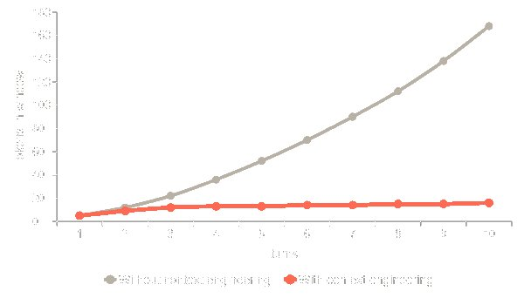
KEEP THE WINDOW DENSE
CONTEXT ENGINEERING
A bigger window is not the fix.
Context rot. Model quality slips before the advertised limit, and the relevant fact gets harder to attend to as inputs grow. Attention, not capacity, is the budget, so you compact aheadof the limit, not at it.
Compaction replace a long history with a faithful summary (the OAMP context card).
Offloading move a large payload out of the window, leave a pointer; substrate-aware (table or file).
Measured, not asserted: flat context versus blow-up.
Notes:
A bigger window is not the fix: context rot. Two techniques, compaction (the OAMP context card) and offloading, keep token growth flat. Measured, not asserted.
In fact, LLM context window scales attention matrix quadratically on attention based models which makes values in the attention matrix less relevant vs. having a smaller context window. Mentions ome papers that study the degradation in performance between 256k and 1M and it’s quite appalling for some use cases.
CONTEXT ROT + ATTENTION MATRIX DEGRADATION
I TALK TO YOU FOR 8 HOURS: BEGINNING OK, AFTER 8 HOURS YOU WANT TO PUNCH ME

Slide 36

DEFINITION
MEMORY ENGINEERING
MEMORY ENGINEERING
What is Memory Engineering
The discipline of designing, building, and operating the systems that give an agent memory : the schemas, indexes, retrieval, lifecycle, and governance that let it retain, recall, and refine knowledge reliably at scale.
Why it matters most teams build a model and a prompt, then bolt memory on. Memory engineering treats it as a first-class discipline, not an afterthought.
Notes:
Memory engineering is the discipline of building and operating the systems that give an agent memory: schemas, indexes, retrieval, lifecycle, governance. It is the name for treating memory as engineering, not a bolt-on. The next three layers (encoding and retrieval, memory, semantic) are its core.
RETAIN RECALL REUSE REFINE

Slide 37
LAYER 4, MEMORY
MEMORY MANAGER, THE DISCIPLINE
MEMORY LAYER
Agent memory is a discipline.
Schemas, indexes, lifecycle, retrieval, governance: the harness manages all of it.
SCHEMAS
INDEXES
LIFECYCLE
RETRIEVAL
GOVERNANCE
Memory types
Make it findable
Write, evict, refresh
Read in context
Scope by identity
episodic · semantic
vector · lexical
expiry · summarisation
top-k · fusion
user · agent
procedural · working
graph · hybrid
compaction
rerank
thread · RLS
Notes:
Memory is five surfaces: schemas, indexes, lifecycle, retrieval, governance. OAMP is Oracle's managed answer: durable memory, scoped threads, and a scratchpad.
Different memory types: short term, long term… each one with their own use – we have different types of retrieval and types of data we store, we have ways to manage the context like summarization and compaction – we have retrieval strategies in place, etc.

Slide 38
LAYER 4, MEMORY
MEMORY MANAGER, THE DISCIPLINE
MEMORY LAYER
Agent memory is a discipline.
Schemas, indexes, lifecycle, retrieval, governance: the harness manages all of it.
SCHEMAS
INDEXES
LIFECYCLE
RETRIEVAL
GOVERNANCE
Memory types
Make it findable
Write, evict, refresh
Read in context
Scope by identity
episodic · semantic
vector · lexical
expiry · summarisation
top-k · fusion
user · agent
procedural · working
graph · hybrid
compaction
rerank
thread · RLS
ORACLE'S ANSWER, OAMP
01
02
03
Oracle AI Agent Memory Package
memory
thread
scratchpad
facts, corrections, events
scoped conversations
ephemeral working state
pip install oracleagentmemory
Notes:
Memory is five surfaces: schemas, indexes, lifecycle, retrieval, governance.
OAMP is Oracle's managed answer: durable memory, scoped threads, and a scratchpad.
OAMP IS THE MANAGED ANSWER TO INTERACT AND WORK WITH AGENT MEMORY.

Slide 39


CONTEXT ENGINEERING
WHAT THE CONTEXT CARD ABSORBS
WHAT OAMP ABSORBS
One line instead of a memory subsystem.
WITHOUT OAMP · YOU CARRY THE LOAD
WITH OAMP · ONE CALL
Decide when to summarise
mem.context_card(thread_id)
Write a summariser: keep signal, drop filler
OAMP
Rank + retrieve relevant memories per turn
absorbs this
BOUNDED, PROMPT-READY BLOCK
Extract durable facts from chatty turns
Topics
Summary
Glue summary + memories + recent into a prompt
Relevant memories
Recent turns
Bound it all to a token budget
The developer writes one line instead of a memory subsystem.
The agent spends attention on the task, not on housekeeping its own memory.
Notes:
The context card is not just convenience: it absorbs a whole category of cognitive load. Without OAMP you decide when to summarise, write a summariser that keeps signal and drops filler, rank and retrieve relevant memories per turn, extract durable facts from chatty conversation, glue summary, memories and recent turns into a prompt, and bound it all to a token budget. With OAMP it is one call, mem.context_card(thread_id), returning a bounded, prompt-ready block: topics, summary, relevant memories, recent turns. The payoff is twofold: the developer writes one line instead of a memory subsystem, and the agent spends its attention on the task instead of housekeeping its own memory. That is the promise of memory engineering: make the hard, easy-to-get-wrong parts of remembering a solved, reusable component.
WE WANNA REDUCE THE COGNITIVE LOAD OF YOU, AS AN AI DEVELOPER OR AI ENGINEER
LOTS OF DECISIONS TO MAKE (LEFT). BUT, OAMP SOLVES ALL OF THEM FOR YOU.

Slide 40

CONTEXT ENGINEERING
OAMP WORKING MEMORY
THE CONTEXT CARD
Compaction by construction.
A capability of the Oracle AI Agent Memory Package (OAMP)
ONE CALL RETURNS FOUR PARTS, PROMPT-READY
WHY IT EARNS ITS PLACE
CONTEXT CARD
Typed memory
fact, preference and episodic, weighted correctly
1 Topics
Open-loop tracking
a semantic fingerprint of the thread
it flags the question that is still unanswered
2 Summary
Compaction by construction
a running recap, plus where it points now
never dump the full history into the prompt
3 Relevant information
Bounded and durable
typed + timestamped: facts, preferences, memory
sized by knobs, stored and governed in Oracle
4 Recent messages
One call, prompt-ready
the last turns, verbatim with role
assembled once per user turn
mem.context_card(thread, recent=6, relevant=4) # OAMP's prompt-assembly primitive
Notes:
The context card is OAMP's prompt-assembly primitive: one call returns four parts, ready for the next turn. Topics give a semantic fingerprint; the summary is a recap plus current intent; relevant information is typed and timestamped (a fact is truth, a preference shapes the answer, an episodic memory tracks task state, including the open, unanswered question); recent messages are the last turns verbatim. It compacts by construction, bounds prompt size, and lives in Oracle.

Slide 41
CONTEXT ENGINEERING
A REAL CARD, ANNOTATED
THE CONTEXT CARD
What the agent actually reads.
WHAT EACH PART IS DOING
<context_card>
<topics> q3 growth · outdoors · business risk </topics>
<topics>
<summary>
A semantic fingerprint of the thread: cheap orientation and routing.
Reviewing Q3 performance. Growth driven by
Outdoors, +12% QoQ. User now asks the main
risk to that driver.
</summary>
<relevant_information>
<fact> Outdoors drove Q3, +12% QoQ </fact>
<summary>
<preference> prefers metric units </preference>
A running recap that also captures the current intent, not just history.
<memory> risk question asked, unanswered </memory>
</relevant_information>
<recent_messages>
user What drove Q3 growth?
assistant The Outdoors category, +12% QoQ.
user What is the main risk to that?
<relevant_information>
</recent_messages>
Typed and timestamped. A fact is truth; a preference (metric units) shapes the answer; an episodic memory flags the question is still open.
</context_card>
<recent_messages>
The last turns verbatim, with role, for local coherence.
Notes:
- Topics orient the model
- the summary compacts the thread and states the current intent of the agent
- relevant information is typed (fact, preference, episodic memory) and timestamped, so the model treats truth, styling rules, and task state differently,
- the episodic memory explicitly tracks the open, unanswered question
- recent messages give verbatim local context.
All of it assembled by one call

Slide 42
MEMORY, AND BEYOND
MEMORY + SEMANTIC, TOGETHER
THE LAYERS, REVISITED
Memory and the semantic layer, together.
AGENT HARNESS
1
Model layer
2
Storage layer
3
Encoding & retrieval
4
Memory layer
work
5
Semantic layer
together
6
Agent loop
7
Context engineering
Memory recalls what happened. The semantic layer explains what the data means. Together they ground the agent: the unsaid becomes searchable, and recall lands in context.
Notes:
Revisit the stack. Memory (layer 4) recalls what happened; the semantic layer (layer 5) explains what the data means. They work together: the semantic layer makes the unsaid searchable, and memory recall lands in the right context. That pairing is what grounds the agent.

Slide 43
DEFINITION
SEMANTIC LAYER
SEMANTIC LAYER
What is a semantic layer
A machine-readable description of what your data means : comments, annotations, trusted joins, business views and real workload, scanned into a searchable catalog so the agent reasons about your schema instead of guessing column names.
Why it matters it is the agent's map of the territory, and it is kept fresh on a schedule so it tracks drift.
Notes:
The semantic layer is the machine-readable meaning of your schema, scanned into a searchable catalog and refreshed on a schedule.

Slide 44


MEMORY, AND BEYOND
UMWELT, VON UEXKÜLL
GROUNDING
Grounding: the agent'sUmwelt.
Reality
The agent's Umwelt
Semantic lens
all the data, all the detail
filter to what matters
only what is relevant, seen as it is meant to be seen
Humans do not see the world as it is. The brain filters perception by experience and relevance, so we act on what matters, not on everything at once.
Umwelt (Jakob von Uexküll). Every organism perceives only its own subjective slice of reality, shaped by its senses; vast parts of the objective world simply do not exist for it. The semantic layer is the agent's Umwelt: its lens onto your data.
Notes:
Grounding gives the agent a surface lens onto its reality, so it filters and acts only on what matters. The analogy: humans do not see the world as it is; the brain filters by experience and relevance. The named concept is Umwelt, coined by Jakob von Uexkull: each organism perceives only its own relevant slice of reality. The semantic layer is the agent's Umwelt.

Slide 45

MEMORY, AND BEYOND
WHAT MEMORY CAPTURES
THE UNSAID
Memory captures the said. But theunsaid?
The said
The unsaid
Every interaction with the agent: what was asked, answered, corrected, and preferred. All of it captured in memory.
But most of what your organisation knows was never typed into a chat. It lives in the systems, not the conversation.
The hard part is not remembering the conversation. It is everything the conversation assumes.
Notes:
Memory captures the said: every interaction with the agent. But most organisational knowledge was never typed into a chat. The hard part is not remembering the conversation, it is everything the conversation assumes.

Slide 46


MEMORY, AND BEYOND
INSTITUTIONAL, TRIBAL, DOMAIN
THE UNSAID
The unsaid is yourrealknowledge.
Institutional knowledge
Tribal knowledge
Domain context
the rules, definitions and decisions the organisation runs on
what the team just knows, rarely written down anywhere
what the numbers and entities actually mean in your business
It lives where the data does:
how data is modelled
how queries are executed
metadata in infrastructure artefacts
Schemas, views, comments, query logs, annotations: the unsaid is already in your database, waiting to be read.
Notes:
The unsaid is the real knowledge: institutional (the rules and definitions), tribal (what the team just knows), and domain context (what the data means). It lives in how data is modelled, how queries are executed, and the metadata in infrastructure artefacts. It is already in the database.

Slide 47
THE SEMANTIC LAYER
GROUNDING THE AGENT
WHERE GROUNDING COMES FROM
Meaning the agent can trust.
The schema's own meaning, both declared and observed, becomes a searchable catalog. Joined with memory, it grounds every answer.
IN THE DATABASE
INSTITUTIONAL · DECLARED, SHARED
THE SEMANTIC LAYER
A scanner runs on a schedule, inside the database, reading the dictionary, the foreign keys and the live V$SQL workload, and embedding each finding.
Viewscorrect joins, pre-named
scan
Commentsfree-text meaning
THE AGENT
→ a searchable catalog:the agent's entity memory
Annotationsmachine-readable intent
GROUNDED RESPONSE
correct joins and formulas, real column meaning, anchored in what it remembers
Domainsvalue-type contracts
assembles the catalog and memory into one context window, then reasons over both
Foreign keysjoins to trust
THE MEMORY LAYER · OAMP
episodic · semantic facts · working memory what the agent already knows about the user, the domain and the live task
TRIBAL · OBSERVED IN V$SQL
V$SQL workloadwhat's really queried
Notes:
Where the agent's grounding comes from. In the database, schema meaning exists in two flavours. Institutional knowledge is declared and shared: business views (correct joins and formulas, pre-named), column and table comments, machine-readable annotations, use-case domains (value-type contracts) and foreign keys (joins the agent can trust). Tribal knowledge is observed, not declared: the live V$SQL workload reveals which columns and joins people actually use. A scanner runs on a schedule inside the database, reads the dictionary, the foreign keys and the V$SQL workload, and embeds each finding into a searchable catalog, which is the agent's entity memory. Separately, the memory layer (OAMP) holds episodic, semantic and working memory: what the agent already knows about the user, the domain and the task. The agent assembles both the semantic catalog and memory into one context window and reasons over them, producing a more grounded response: correct joins and formulas, real column meaning, anchored in what it remembers.

Slide 48
DEFINITION
AGENT LOOP
AGENT LOOP
What is the agent loop
The control structure that drives an agent: assemble context, call the model, run the tools it asks for, persist what happened, and decide whether to continue , under an explicit budget.
Why it matters the loop is the component that turns a frozen model into something that acts, recovers, and improves.
Notes:
The agent loop is the driver: assemble, call, dispatch, persist, repeat under a budget.
It is what makes a model an agent.

Slide 49
LAYER 6, AGENT LOOP
THE DRIVER
AGENT LOOP
The graph that drives every layer.
OBSERVE
REASON
__start__
assemble_context
call_model
persist
stop
__end__
tools
dispatch_tools
ACT
tool results re-enter context · loops under an iteration + wall-clock budget
Dynamic recall skills + recipes pulled in every turn
Failure recovery transient errors retried, not fatal
Human gate side-effecting tools need approval
Notes:
The real compiled graph. __start__ enters assemble_context (OBSERVE); call_model (REASON) decides; persist saves state every turn; then a conditional edge: stop ends at __end__, or tools routes to dispatch_tools (ACT), whose results re-enter assemble_context on the next iteration. It loops under an iteration and wall-clock budget. Dynamic recall every turn, retry-based recovery, and a human gate on side effects.

Slide 50
CONTEXT ENGINEERING
TOOLS AS SEARCHABLE MEMORY
THE TOOLBOX PATTERN
Only the tools that fit the turn.
WRITE PATH, REGISTER A TOOL
Tool fn
Enrich
VECTOR_
agent_tools
+ metadata
syn · when · examples
EMBEDDING
(HNSW)
READ PATH, EVERY USER TURN
User turn
Embed
Top-k by
k tool schemas
query
cosine
to the model
The registry grows past 30 tools without bloating the prompt. Each tool is stored with an enriched document (synonyms, when-to-use, examples) and its embedding; the callable stays in Python, only the schema and vector live in the database.
Notes:
IN CONTEXT ENGINEERING, ONLY USE THE TOOLS THAT WILL BE USEFUL IN THE ITERATION OF THE LOOP.
REEVALUATE EVERY ITERATION

Slide 51





CONTEXT ENGINEERING
MODEL CONTEXT PROTOCOL
ORACLE MCP SERVERS
Tools and MCP servers
July 2026
Oracle's first MCP server, shipped in July
MILESTONE
~30 sample servers
MySQL · HeatWave · JDBC · OCI cost, Terraform
ONE REPO
Two server shapes
OCI-managed, or HTTPS streaming self-run
CLOUD & ON-PREM
Federated identity
OAuth 2 across Entra ID · Okta · Auth0
OCI-MANAGED
Identity in the session
roles reach the session, redaction still applies
DEEP DATA SECURITY
The agent is just another client — and it queries as a regular user (and inherits its roles & permissions)
Notes:
Oracle's first MCP server shipped in July for the database - a real product milestone. One GitHub repo now holds around thirty sample servers: MySQL on-prem and HeatWave, JDBC debugging for Java developers, OCI cost estimator and Terraform stacks. New servers land monthly.
Two server shapes: OCI-managed, with OAuth 2 and identity federation (Azure Entra ID, Okta, Auth0), running across Oracle Cloud and Oracle at hyperscaler on AWS and GCP; and HTTPS streaming for on-prem customers who manage their own servers.
Security is two layers: the MCP layer authenticates to the web service, then the database's own security applies. Because OAuth 2 identity - roles and user info - propagates into the database session, rules like role-based redaction still hold for an agentic query. That bundle is Deep Data Security.
Setup cost: federation takes system administrators a couple of days; end users do a one-time OAuth login.
Coverage: all currently supported releases, 19 and 26, including the free downloadable edition and the Docker containers. oracle.com/mcp.

Slide 52
MODEL CONTEXT PROTOCOL
TRUSTED REPORTS AS TOOLS
REPORTS, NOT RAW SQL
Let agents run reports, not queries
NATURAL LANGUAGE → SQL
TRUSTED REPORTS AS TOOLS
A different query every time
Upload what analysts wrote
the same question comes back as another statement
existing reports, hard-coded queries and all
Relationships get guessed
The agent selects, then binds
joins and grain are inferred from names, not known
pick the report, supply the inputs, run it
Prompt engineering as upkeep
The same answer, every turn
every schema change becomes a prompt change
consistent results the business signed off on
Reports = established, robust queries
MCP is how a tool arrives. The toolbox is how it gets chosen
Notes:
The standard flow is natural language to SQL, and it is brittle: the same question compiles to a different query on a different turn, table relationships get inferred rather than known, and you maintain prompts instead of queries.
Oracle's differentiator: upload the reports your analysts already wrote - hard-coded queries included - into the MCP server. The agent selects a report and binds the inputs rather than authoring SQL. Consistent, trustworthy, and it reuses work that already exists.
Pain points worth naming: security anxiety about agents loose in the database, and integration fatigue from wiring the same thing into every data platform - set it up once, at the database. And demos are easy, production is not, so pick a pressing, painful problem first.
A report is just a tool - which is exactly how it enters the registry we retrieve from. That is the segue into the toolbox pattern.

Slide 53



CONTEXT ENGINEERING
SKILLS AS SEARCHABLE MEMORY
THE SKILLBOX PATTERN
Distil once, recall on demand.
AUTHOR A SKILL
Workflow
Distil (LLM)
SHA + embed
agent_skills
(did it once)
to SKILL.md
(HNSW)
TWO-LEVEL RETRIEVAL
Level 1 a one-line name: description manifest, retrieved every turn so the agent knows which skills exist.
Level 2 load_skill pulls the full SKILL.md body, only when the agent decides to use it.
SHA-256 versions each skill: refresh from a source only when the hash changes, and promoting a workflow retires it from recall so the agent never sees both.
Notes:
Skillbox = skills as searchable memory. A workflow is distilled by the LLM into a SKILL.md (frontmatter + When-to-use + Steps), SHA-256 versioned, embedded, stored in agent_skills (HNSW). Retrieval is two-level: a compact manifest every turn, the full body on demand. SHA gates refresh; promotion retires the raw workflow.

Slide 54
CONTEXT ENGINEERING
LEARNED SKILLS, SURFACED AUTOMATICALLY
DYNAMIC SKILL DISCOVERY
Re-discovered every turn.
Semantic catalog
vector_search
Skillbox manifest
Assembled system prompt
build_skill_manifest
assemble_context
Workflow recipes
runs every turn
call_model
recall_workflow
Context card
OAMP working memory
Each turn queries the skillbox against the latest user message. A newly learned skill shows up automatically on the very next relevant turn, no redeploy.
Notes:
Dynamic skill discovery lives in assemble_context, which runs every turn. It queries the semantic catalog, the skillbox manifest, proven workflow recipes, and the OAMP context card against the latest user message, assembles them into the system prompt, and calls the model. So a skill learned this session surfaces on the next relevant turn automatically.

Slide 55
CONTEXT ENGINEERING
TOOL OFFLOADING
GET LARGE TOOL RESULTS OUT OF THE WINDOW
Keep the windowflat.
Inside dispatch_tools, every tool result passes through one gate. Small results stay inline; large ones are parked in Oracle and replaced by a short handle, recoverable on demand.
maybe_offload
< 1200
kept inlinereturned unchanged
small results bypass the stores
CONTEXT WINDOW
the write-path gate on every tool result
what the model sees: a short reference handle, never the payload
≥1200 · { [
agent_tool_log
SIZE GATE
embed in-DB
id · tool · payload CLOB · embedding VECTOR(384) · HNSW
[tool_log:<id>]
VECTOR_EMBEDDING · 384-d
len(result)
vector-searchable in-DB
~40–60 chars
≥ 1200 ?
in place of thousands
≥1200 · else
/tool_out/<tool>_<md5>.txt
md5 hash names each payload
ScratchFS file · SecureFile LOB · deterministic name
[file:/tool_out/…]
sliceable: read_file / grep_files
READ PATH
fetch_tool_outputis a registered tool, retrieved by meaning like any other, so the model decides when to pull the full data back. It dispatches on the handle prefix: [tool_log:id] → SELECT payload ·[file:…] → read_file
Notes:
Tool offloading keeps the context window flat. It sits in the agent loop's dispatch_tools node: after a tool runs, its raw string result passes through maybe_offload before being wrapped in a ToolMessage, so whatever maybe_offload returns is what the model sees. The size gate: if the result is under 1200 characters it is returned unchanged and stays inline, with no indirection cost. Otherwise a deterministic md5 hash names the payload (same payload, same name), and a type router checks whether the result begins with a brace or bracket. Structured results (JSON) are embedded in the database with the same 384-dimension ONNX model and inserted into the agent_tool_log table (id, tool, payload CLOB, embedding VECTOR(384), HNSW index), so past tool outputs stay vector-searchable; the model gets back the handle [tool_log:&lt;id&gt;]. Blobs are written to a ScratchFS file at /tool_out/&lt;tool&gt;_&lt;md5&gt;.txt on a SecureFile LOB (a deterministic name, so the same blob overwrites the same file, a natural dedup), and the model gets the handle [file:/tool_out/...], sliceable later with read_file, tail_file or grep_files. Recovery is fetch_tool_output, itself a registered tool retrieved by meaning, so the model decides when to pull the full data back: it dispatches on the handle prefix, SELECT payload for a tool_log id, read_file for a file path. Net effect: a 120-row result of several thousand characters becomes a forty-to-sixty character handle in context, a large reduction that is fully recoverable. This is the tool-output twin of the context card: the card compacts the conversation, offloading compacts tool results, and both keep the window flat while the full data stays durable in Oracle and retrievable on demand.

Slide 56
DEFINITION
CONTINUAL LEARNING
CONTINUAL LEARNING
What is continual learning
The ability of a system to keep getting better from experience after training : acquiring skills, updating beliefs, and correcting mistakes, without a full retrain.
Why it matters it is the biggest gap between today's agents and human intelligence. The question is where the new knowledge is stored.
Notes:
Continual learning: getting better from experience after training, without a full retrain. The interesting question is the storage location of the new knowledge.

Slide 57
BEYOND THE LAYERS
HOW A FROZEN MODEL IMPROVES
CONTINUAL LEARNING
How does a frozen model get better?
The model's weights never change at runtime. Yet the agent improves. The trick is to choose where new knowledge lives: in the weights , in the representations, or in the context the model reads.
Notes:
Pivot. How does the agent get better when the model is frozen? By choosing where new knowledge is stored.

Slide 58
CONTINUAL LEARNING
THREE STORAGE LOCATIONS
WHERE KNOWLEDGE LIVES
Continual learning branches three ways.
Continual learning
Weight space
Latent space
Context / token space
PARAMETRIC MEMORY
REPRESENTATIONAL MEMORY
NON-PARAMETRIC MEMORY
Knowledge in the model's parameters.
Knowledge in learned representations.
Knowledge outside the model, injected as tokens.
EXAMPLES
EXAMPLES
EXAMPLES
fine-tuning · LoRA / PEFT · instruction tuning · RLHF
embedding training · contrastive learning · alignment · latent memory
RAG · memory systems · in-context learning · tool outputs
CHARACTERISTICS
CHARACTERISTICS
CHARACTERISTICS
changes the model · generalises · risk of catastrophic forgetting · expensive
changes how information is represented · improves retrieval & similarity · adds no facts directly
no weight updates · add immediately · easy to audit · bounded by window & retrieval
Knowledge → weights
Knowledge → representation
Knowledge → tokens
Notes:
Continual learning branches by where knowledge is stored: weight space (parametric, fine-tuning), latent space (representational, embedding training), and context/token space (non-parametric, RAG and memory). Our agent learns in the third: non-parametric memory.

Slide 59
CONTINUAL LEARNING
PARAMETRIC, REPRESENTATIONAL, NON-PARAMETRIC
A MORE COMPLETE TAXONOMY
One taxonomy, three memories.
Continual learning =
parametric memory
+
representational memory
+
non-parametric memory
(weights)
(latents)
(tokens / retrieval)
Our agent lives in the third column: non-parametric memory.
Notes:
The common taxonomy: weight space (parameter updates), latent space (representation adaptation), token/context space (external memory), and hybrid combinations. Equivalently, continual learning is parametric plus representational plus non-parametric memory. Our agent is non-parametric.

Slide 60
CONTINUAL LEARNING
WORKFLOWS VS SKILLS IN THE WINDOW
TOKEN-SPACE LEARNING
Two ways to fill the window.
context window
context window
WITH RAW WORKFLOWS
SYSTEM, SKILLS MANIFEST
- analyse_revenue: net revenue by region
recipe: pull orders, join customers, group by region,
- build_automation: schedule a refreshed view
filter nulls, compute net_revenue, sort desc, take 10 ...
- triage_incident: find and summarise failures
recipe: same steps re-derived again next session ...
recipe: verbose, low-priority text, retrieved each time ...
load_skill(name) -> full SKILL.md body, on demand
recipe: ...
lower-priority text, verbose, re-derived each time
compact, system-layer, body only when used
Same knowledge, different home. Skills are distilled once and recalled as a compact, high-priority manifest; workflows are raw recipes pulled in each time. This is continual learning in token space.
Notes:
Two ways to fill the window. Left: raw workflow recipes, verbose and re-derived, retrieved as lower-priority text. Right: a compact skills manifest in the system layer, with the full body loaded on demand. Same knowledge, different home. Skills win on compactness and priority.

Slide 61
CONTINUAL LEARNING
WORKFLOW → SKILL PROMOTION
PROMOTE TO A SKILL
Distil a recipe( workflow memory) into reusable skills
Raw recipe retired
Workflow recipe
Worth promoting?
LLM distils → SKILL.md
save_skill
promoted='Y'; recall skips it
yes
intent · steps · tools · wins/losses
recurring + reliable (wins > losses)
frontmatter + when-to-use + steps
SKILL.md + SHA + embedding → skillbox
Injected first
no
malformed?
top of system prompt → more weight
Stays a candidate
Deterministic fallback
still recalled into context
always a valid skill
The two outcomes on the right are the point. The raw recipe is retired so the agent does not spend attention on both, and the skill is injected at high authority, so the same knowledge counts for more at inference.
Notes:
promote_workflow_to_skill turns a one-off trajectory into a reusable skill. A captured workflow recipe is checked: worth promoting only if it recurs and is reliable (successes beat failures). If not, it stays a candidate recipe, still recalled into context. If yes, the LLM distils it into a proper SKILL.md (frontmatter, when-to-use, steps); a deterministic fallback guarantees a valid skill even if the JSON is malformed, so the pipeline never breaks. save_skill stores the SKILL.md, its SHA and embedding in the skillbox. Then two things happen, and they are the point: the raw workflow is marked promoted='Y' so recall_workflow skips it (the skill is now the canonical version), and in Part 7 the skill is injected first in the system prompt. Why does that earn more weight? Instruction hierarchy: system-level instructions outrank ordinary conversation, so a skill in the system prompt counts for more than the same steps buried in past turns. And attention is a budget: a short, curated skill is higher-signal per token and, placed near the top, counters lost-in-the-middle decay. This is continual learning in token space: not changing the weights, changing how much weight a piece of knowledge gets at inference.
This is one of the things we teach in the new deeplearning.ai course

Slide 62
CONTINUAL LEARNING
WHY SKILLS RANK HIGHER
INSTRUCTION HIERARCHY
Skills sit in the system layer.
INSTRUCTION HIERARCHY
System / platform
Trained to obey a hierarchy
skills load here (highest authority)
Frontier models prioritise system instructions over user messages, and both over tool and retrieved content.
OPENAI, INSTRUCTION HIERARCHY & MODEL SPEC
Developer
app instructions
authority
Skills load into the system prompt
decreases
A SKILL.md's metadata is placed in the system prompt at startup, so skills carry system-level authority.
User
ANTHROPIC, AGENT SKILLS
the request
Priority improves reliability
Tool outputs & retrieved docs
Models trained to follow privileged instructions are more steerable and robust; well-structured system prompts follow instructions better.
raw workflow text, RAG (lowest)
OPENAI, INSTRUCTION HIERARCHY
Put durable, must-follow knowledge in skills (system layer); keep volatile data in retrieval (lower layer).
Notes:
Why skills rank higher: frontier models are trained to follow an instruction hierarchy, system &gt; developer &gt; user &gt; tool/retrieved content.
A SKILL.md loads into the system prompt, so it carries system-level authority, above ad-hoc retrieved workflow text. Prioritising privileged instructions also improves steerability and reliability. Implication: must-follow knowledge belongs in skills; volatile data belongs in retrieval.

Slide 63
REFERENCE ARCHITECTURE
THE FULL SYSTEM, BOTTOM-UP
TOTAL RECALL WORKSHOP
The whole harness, one engine.
Read bottom-up, the order we build it. Only the chat model leaves the database.
ORACLE AI DATABASE
user turn
PART 7 · Agent Loop
dynamic recall · failure recovery · HITL gate · budgeted loop
assemble_context
call_model
dispatch_tools
persist
Chat LLM
over network
tools · the only way to act
read / write · how it remembers
6
Skills & Automations
4
Cognitive Memory (OAMP)
toolbox + skillbox, harvester, HITL automations
episodic, semantic, working, workflow recipes
8
Context Engineering
3
Retrieval · read path
compaction (context card), offload to table or file
keyword, vector, hybrid RRF, cross-encoder rerank
5
Semantic Layer
3
Encoding · write path
schema meaning, a searchable catalog (scheduled)
OracleVS, embeddings computed in-database
2
Memory Substrate
one ACID / security / backup boundary: vector & relational tables + in-DB scratch filesystem (SecureFile LOBs)
1
Foundation
the database · a least-privilege AGENT user · chat LLM + ONNX embedder + ONNX reranker loaded in-DB
Notes:
The architecture at a glance, read bottom-up, the order we build it. Foundation (1): the database, a least-privilege AGENT user, the loaded models. Substrate (2): one ACID boundary holding vector and relational tables plus an in-database scratch filesystem. Write side: encoding (3) turns text into in-database vectors; read side: retrieval (3) climbs the keyword, vector, hybrid, rerank ladder. The semantic layer (5) is the searchable map of the data's meaning. Cognitive memory (4) is OAMP: episodic, semantic, working and procedural. Context engineering (8) keeps the window flat. Skills and automations (6) are the toolbox and skillbox. The agent loop (7) ties it together. Two arrows carry the story: tools down the left (the only way to act) and read/write down the right (how it remembers). Every box lives in the one Oracle AI Database; only the chat model is reached over the network.

Slide 64
ORACLE AI DATABASE · AGENT MEMORY ARCHITECTURE
Prompt
→
Context
→
Memory
The memory core is the last line of defence
engineering
engineering
engineering
MEMORY CORE
Oracle AI Database
MEMORY OPS
CONTEXT WINDOW
assembled per call
CONVERGED DATA MODEL
Memory retrieval
Context engineering token budgeting · JIT retrieval · context
retrieval · compose & order · offloading
JSON
Relational
AI vectors
Graph
Spatial
Prompt engineering role · attitude · few-shot · chain of
thought · behavioural conditioning
Memory indexing
System prompt
Oracle AI Database
LLM
Memory storage
User query
MEMORY MANAGER
INGESTION
Recent interactions
Transformer
Decay & forgetting
Raw ingestion
Document processing
Embedding
(files, streams, APIs)
& chunking
generation
Connectors
Relevant knowledge
STATELESS
TYPED MEMORY
Retrieval optimisation
Relevant workflows
swappable, remembers nothing
Conversational
Entity
Toolbox
Semantic
& skills
(knowledge base)
Workflow
Relevant entities
Storage optimisation
Relevant summaries
Durable, governed, queryable. One engine for every shape memory takes, not a vector store bolted on.
Data modelling
Relevant tools & outputs
Raw output → refined output, written back to memory. The agent learns.
ORACLE| AI Developer Experience
Memory engineering · the agent harness

Slide 65
ONE SUBSTRATE
THE HARNESS, ENCAPSULATED ON ORACLE
THE HARNESS ON ORACLE
Every layer maps to an Oracle primitive.
AGENT HARNESS ON ORACLE
Model
OCI Generative AI (hosted frontier models) + in-database ONNX embedder & reranker
Storage
In-database POSIX filesystem (SecureFiles LOBs) + relational / vector tables, one ACID boundary
Encoding & retrieval
OracleVS + in-DB embeddings, AI Vector Search (HNSW), Oracle Text, hybrid RRF, rerank
Memory
Oracle AI Agent Memory Package (OAMP)
Semantic
Comments + annotations + use-case domains + views + V$SQL, catalog (DBMS_SCHEDULER)
Skills & automations
Toolbox / skillbox tables (HNSW), SHA-versioned SKILL.md, DBMS_SCHEDULER automations
Agent loop
LangGraph state graph + Oracle-backed checkpoints
Context engineering
OAMP context card (compaction) + substrate-aware offloading, row-level security
Notes:
The bookend. The same container from earlier, every layer now a concrete Oracle primitive. The model is OCI Generative AI (with embedder and reranker in-database); everything else is Oracle products and packages, inside one engine.

Slide 66

Join the Oracle AI Developer Discord Channel to ask questions about Agent Memory and the Oracle AI Agent Memory Package
Notes:
The bookend. The same container from earlier, every layer now a concrete Oracle primitive. The model is OCI Generative AI (with embedder and reranker in-database); everything else is Oracle products and packages, inside one engine.

Slide 67

Oracle AI Developer Hub
Notes:
The bookend. The same container from earlier, every layer now a concrete Oracle primitive. The model is OCI Generative AI (with embedder and reranker in-database); everything else is Oracle products and packages, inside one engine.

