Slide 1
Writing Efficient MCP Servers
OraViz: a minimal, visualization-first MCP server for Oracle AI Database
Nacho Martinez · github.com/jasperan
September 2026 · results deck

Slide 2
Agents pay for tools with context
• Tool schemas are read once per session, before any work starts.
• Tool results are read on every call and stay in the conversation.
• General-purpose servers ship big schemas and return unbounded rows.
• Faithful formats (CSV, text tables) grow linearly with the data.
2,139
tokens of tool schemas — official SQLcl MCP
844
tokens of tool schemas — OraViz (60.5% fewer)
The server author decides what the agent must read. That is a design surface.
OraViz MCP · github.com/jasperan/oraviz-mcp
2

Slide 3
Design rules for efficient MCP servers
• One tool, one question — narrow schemas, unambiguous choice.
• Declare budgets and enforce them — cost set by config, not data.
• Report truncation honestly — row counts and explicit markers.
• Summarize by value type — vectors, binary, long text.
• Profile before you plot — aggregate in SQL, chart the result.
• Substitute modality — a picture can answer at constant text cost.
• Time-box execution — a statement timeout, not a hung call.
The context contract
preview cap: 25 rows
hard cap: 500 rows
cell limit: 500 chars
statement timeout: 60 s
result cost bounded, independent of table size
OraViz MCP · github.com/jasperan/oraviz-mcp
3

Slide 4
Architecture: one validated query per call
MCP client
(agent)
Validation
guard, identifiers, caps
python-oracledb
thin mode, timeout
Oracle AI Database
26ai Free
Renderer: compact markdown · profile · chart PNG (+ preview)
Every result re-enters the conversation under the contract: bounded rows, bounded cells, honest truncation markers, or one image.
OraViz MCP · github.com/jasperan/oraviz-mcp
4

Slide 5
Benchmark: identical questions, same database
• OraViz (7 tools) vs. official SQLcl 26.1 MCP server (sql -mcp).
• Same Oracle AI Database 26ai Free container and demo data (96 rows).
• Five questions: list objects, describe, aggregate, sample 10, full dump.
• Counted per question: tool schemas + tool results, tiktoken cl100k.
• Chart images excluded from text accounting, reported separately.
Reproducible
benchmarks/run_benchmarks.py
benchmarks/results/*.json
paper/paper.pdf
Deterministic: static database, text-only accounting
OraViz MCP · github.com/jasperan/oraviz-mcp
5

Slide 6
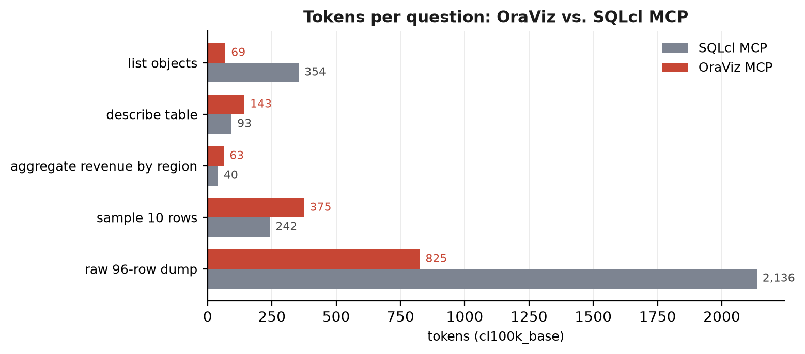
Per-question tokens
-80.5%
schema discovery
-61.4%
wide 96-row dump
Small result sets cost ~55% more framing tokens (markdown vs CSV) - bounded by design.
OraViz MCP · github.com/jasperan/oraviz-mcp
6

Slide 7
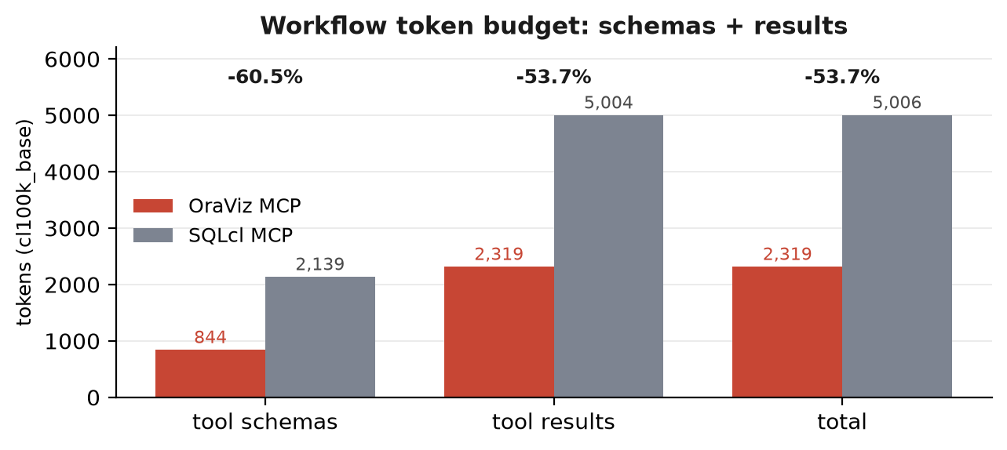
Workflow totals
-60.5%
tool schemas (844 vs 2,139)
-53.7%
tool results (2,319 vs 5,004)
-53.7%
total (2,319 vs 5,006)
o200k_base agrees within one point (53.6% total savings).
OraViz MCP · github.com/jasperan/oraviz-mcp
7

Slide 8
The honest edges
Where minimalism loses
And where structure wins
• Small results: markdown framing costs ~55% more than CSV.
• But that overhead is bounded by columns and caps, not row count.
• Unbounded formats grow with the data; bounded ones do not.
• Charts: the aggregate rendered to PNG costs 123 text tokens.
• No chart tool exists in the official server (capability add-on).
• Truncation markers keep the agent in control of its budget.
OraViz MCP · github.com/jasperan/oraviz-mcp
8

Slide 9
How the result was produced
Design
contract
budgets + 7 tools
Build
artifact
~630 statements
Test
suite
146 unit + 9 live
Agent
integration
stdio MCP client
Benchmark
vs SQLcl
tiktoken accounting
Paper
+ site
results & repro
97.9% line coverage, CI-gated at 90% · container image on GHCR · live Oracle integration tests · review-driven hardening before the benchmark (bounded discovery, statement timeout, health checks, silent secrets).
OraViz MCP · github.com/jasperan/oraviz-mcp
9

Slide 10
Takeaways
• MCP server design is context engineering: schemas and results are budgets you control.
• A bounded contract turns result cost into configuration, not data size.
• Minimal surfaces + visualization answer questions at a fraction of the text.
• Measure honestly: report the stages where the lightweight server loses, and why they stay bounded.
Server: github.com/jasperan/oraviz-mcp
Benchmark: benchmarks/ · Paper: paper/paper.pdf · Site: jasperan.github.io/oraviz-mcp
OraViz MCP · github.com/jasperan/oraviz-mcp
10

