Slide 1

Dagger.io for defining generic pipelines
Jasper Fülle, Nico Guldin, Göktug Özdemir
Notes:
Introduction: Entstehungsgeschichte von CI/CD

Slide 2






Software
Software

Slide 3
Agenda
CI/CD Background
Technical background of Dagger.io
Dagger Pipeline Example
Integrating Dagger.io
Advantages & Disadvantages of Dagger.io

Slide 4


Theoretical foundations of CI/CD
Source
Build
Test
Production
More efficient transition from development to production
Tailored to specific requirements
Enhanced Feedback Loops
Improved Code Quality
Reduced Time-to-Market
Continous Integration
Continous Deployment
Continous Delivery
Notes:
Presenting theoretical foundations of CI/CD for a better understanding what CI/CD pipelines even are and what makes dagger unique.
CI/CD Pipelines enable a more effecicient transition from development to production.
It does that by automationg the relevant steps, that had to be done manually before.
The Triggers on when the Pipeline should be executed can be self-defined. Can be for example on a push on the default branch.
Continous Integration (CI): Automation of building and testing (Unit, integration, and other automated tests)
Continous Deployment/Delivery (CD):
Continous Deployment: Includes automated release into production upon successful testing
Continous Delivery: typically has an Automated deployment to a production-like setting with optional manual quality assurance.
Also performance tests are popular to meet disred efficency, speed and resource usage.
Each Pipeline is tailored to the specific requirements of the project.

Slide 5
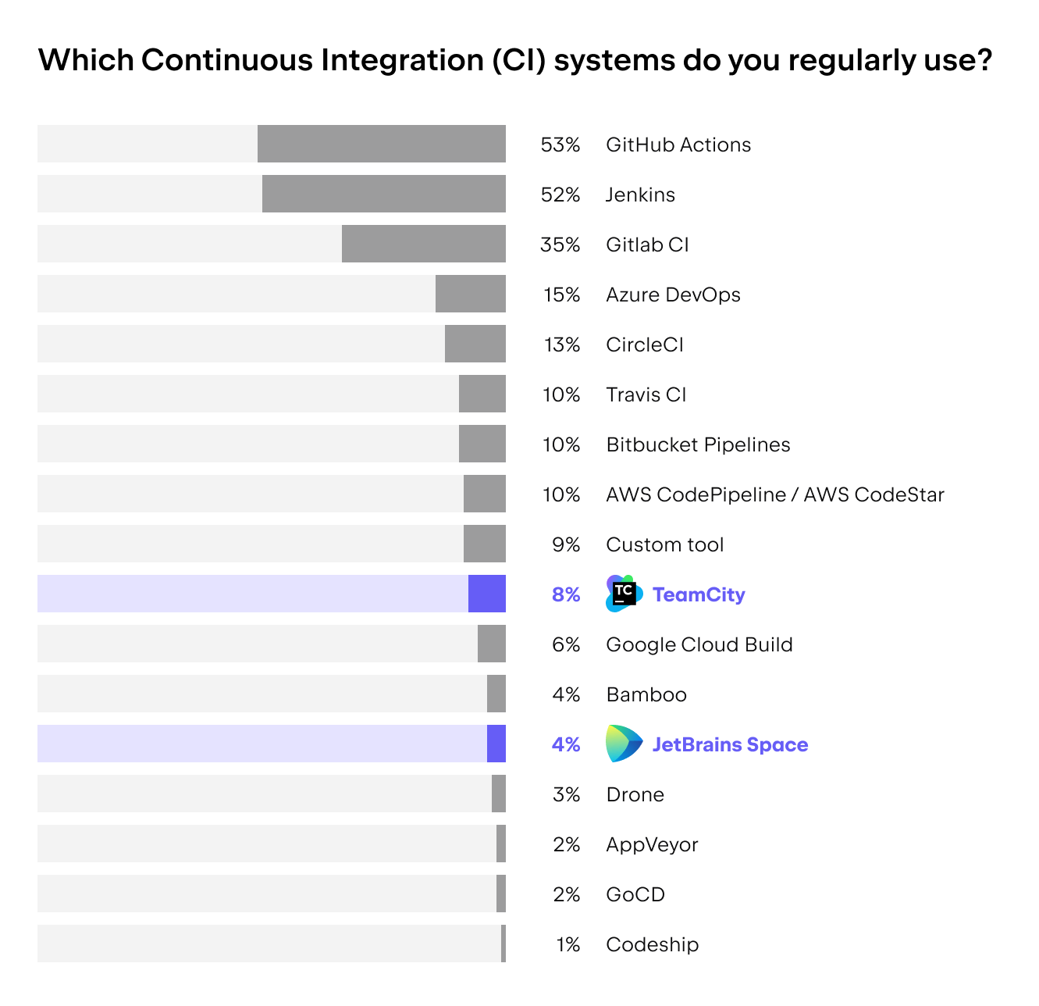
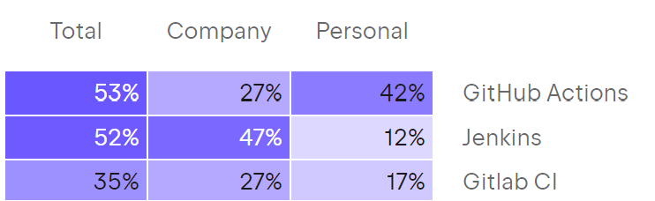
https://blog.jetbrains.com/teamcity/2023/07/best-ci-tools/

Slide 6


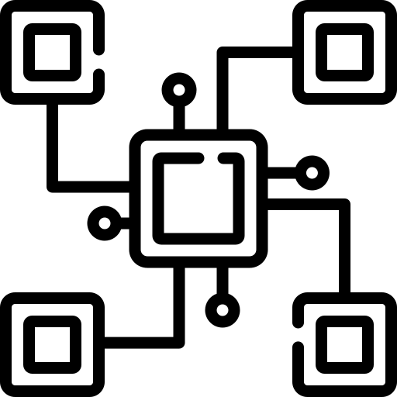

Challenges in Pipeline Migration
Differences in Configuration Syntax
Compatabilities of Plugins and Extensions
Integration with external Services
Learning curve of CI/CD tool

Slide 7
Dagger.io
Open-source platform
Programmable CI/CD pipelines
Based on the Open Container Initiative (OCI)
High-level technical view:
Dagger Engine
Dagger SDKs
Dagger Cloud

Slide 8
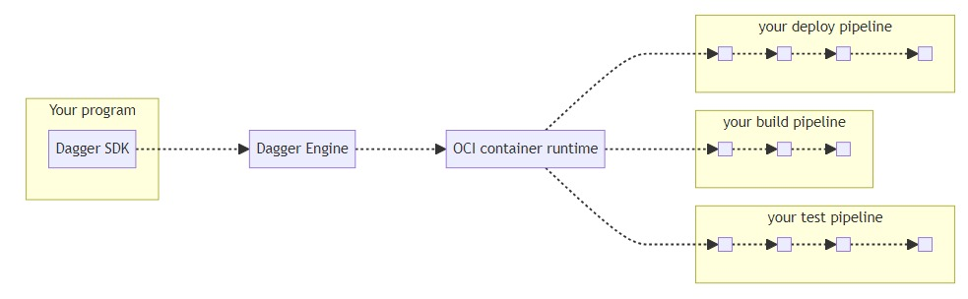
Dagger.io
https://docs.dagger.io/quickstart/319191/basics

Slide 9
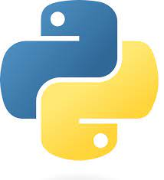
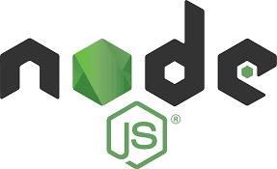

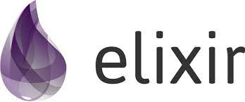
Dagger.io
Dagger SDKs:
Dagger Engine:
Instant local testing
Portability
Superior caching

Slide 10
Dagger.io Pipeline Example in Python
1/2
2/2
import sys
import anyio
import dagger
async def main():
config = dagger.Config(log_output=sys.stdout)
async with dagger.Connection(config) as client:
# use a node:16-slim container
# mount the source code directory on the host
# at /src in the container
source = (
client.container()
.from_("node:16-slim")
.with_directory(
"/src",
client.host().directory(
".", exclude=["node_modules/", "ci/",
"build/"]),
)
)
# set the working directory in the container
# install application dependencies
runner = source.with_workdir("/src").with_exec(["npm", "install"])
# run application tests
test = runner.with_exec(["npm", "test", "--", "--watchAll=false"])
# build application
# write the build output to the host
build_dir = (
test.with_exec(["npm", "run", "build"])
.directory("./build")
)
await build_dir.export("./build")
e = await build_dir.entries()
print(f"build dir contents:\n{e}")
anyio.run(main)
set working directory to mount point & install dependencies
create Dagger connection
run tests
initialize container from base image
build the application & write output to host directory
mount source code directory on the host

Slide 11
Integrating Dagger.io into other CI/CD tools 1/2
Github Actions
Gitlab CI
name: dagger
on: push: branches: [main]
.yaml file
.yaml file
.docker: image: python:3.11-alpine services: - docker:${DOCKER_VERSION}-dind variables: DOCKER_HOST: tcp://docker:2376 DOCKER_TLS_VERIFY: '1‘ DOCKER_TLS_CERTDIR: '/certs‘ DOCKER_CERT_PATH: '/certs/client‘ DOCKER_DRIVER: overlay2 DOCKER_VERSION: '20.10.16'
define trigger condition
jobs: build: name: build runs-on: ubuntu-latest steps: - uses: actions/checkout@v3 - uses: actions/setup-python@v4 with: python-version: '3.11‘ - name: Install deps run: pip install . - name: Install Dagger CLI
define Docker image configuration
create build job
.dagger: extends: [.docker] before_script: - apk add docker-cli curl - cd /usr/local && { curl -L
install dependencies
define Dagger configuration & install dependencies
run: cd /usr/local && { curl -L https://dl.dagger.io/dagger/install.sh | sh; cd -; } - name: Run Dagger pipeline run: dagger run python main.py
https://dl.dagger.io/dagger/install.sh | sh; cd -; }
build: extends: [.dagger] script: - pip install . - dagger run python main.py
run Dagger
run Dagger

Slide 12
Integrating Dagger.io into other CI/CD tools 2/2
Jenkins
Jenkins file
pipeline {
agent { label 'dagger' }]
specify Agent
stages {
stage("dagger") {
steps {
sh '''
pip install .
cd /usr/local && { curl -L https://dl.dagger.io/dagger/install.sh | sh; cd -; }
dagger run python main.py
'''
}
}
}
}
install dependencies & run Dagger

Slide 13
Operable on any system with Docker installed
Seamless Infrastructure Transition
Code-Based Pipelines
Extensive Language Support, with more to come
Caching
Multi-File structure
Not many community extensions
GitHub Actions > 21.000
Jenkins Plugins > 1.800
dagger.io universe = 14
Extensions via CueLang
Technology Adoption Risk

Slide 14
Notes:
Promising tool
Schaun wer mal was wird.

Slide 15

Questions & Answers

