Slide 1

Sprocket Central Pty Ltd
Data analytics approach
[Peiqing Lian]

Slide 2
Agenda
Introduction
Data Exploration
Model Development
Interpretation

Slide 3
Introduction
Customers Exploratory Analysis by Segmentation
Purchase behavior by Age & Gender
Top Selling Products (Class & Line)
Purchase behavior in Job Industry
Purchase behavior by Brand
Seasonality

Slide 4
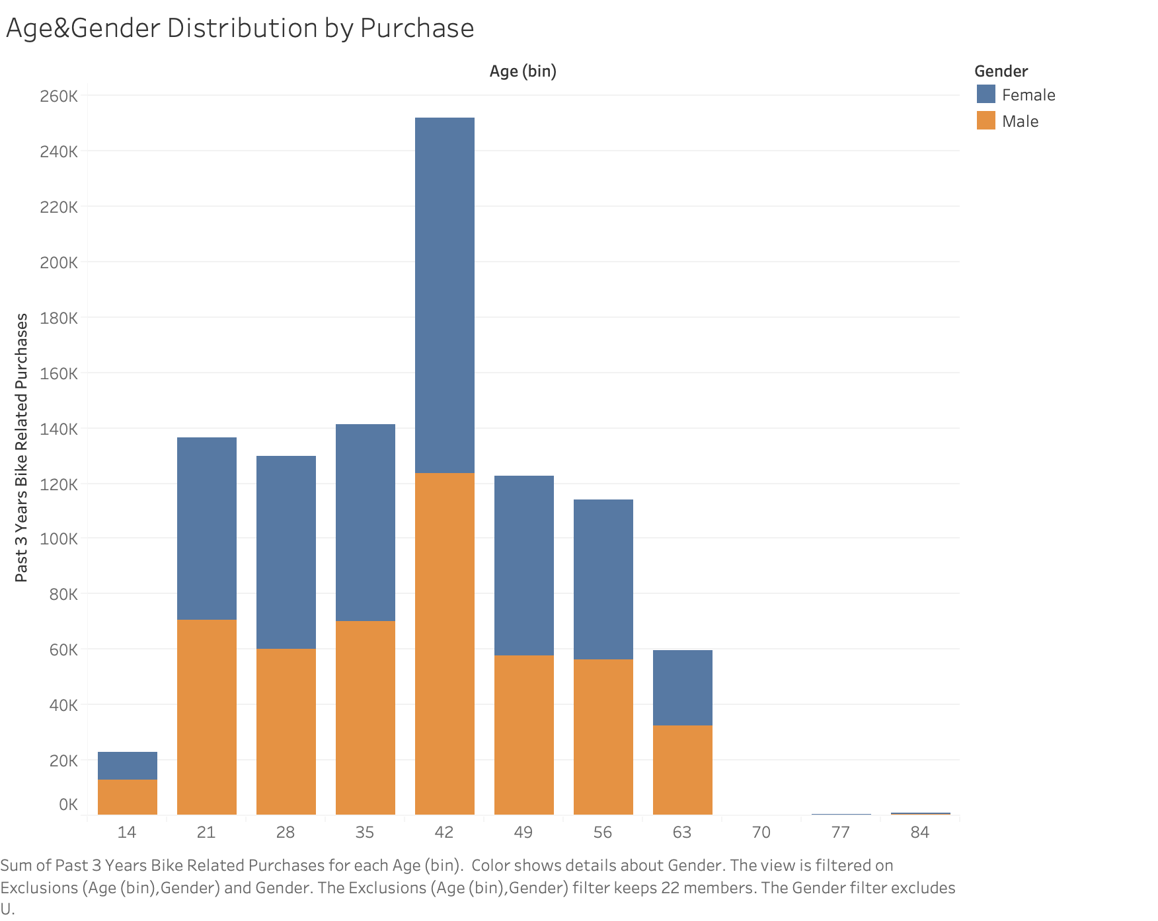
Data Exploration
Purchase Behavior by Age & Gender
No significant distinction among gender in terms of purchase
Fewer purchase happens below age 20 and above 63
Place any supporting images, graphs, data or extra text here.

Slide 5
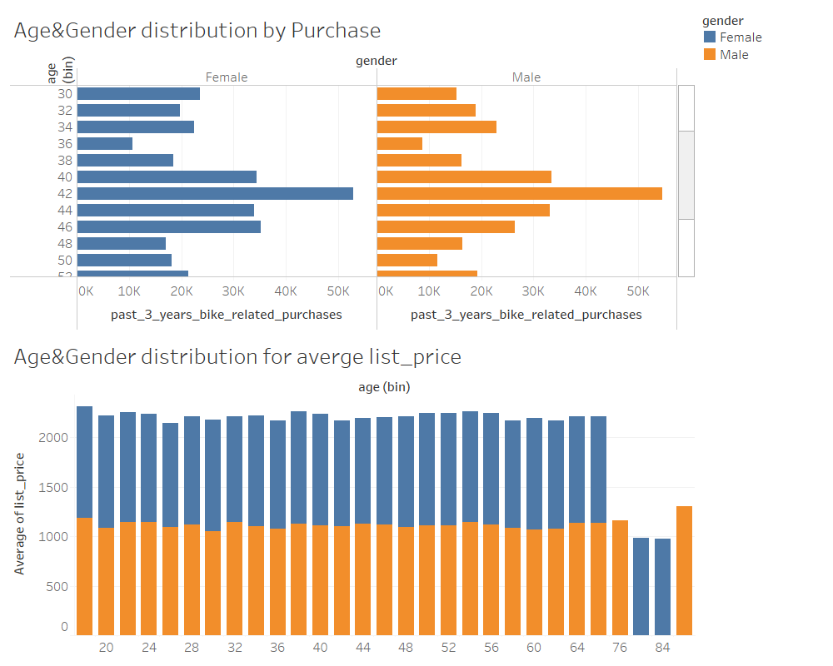
Data Exploration
Purchase behavior by Age & Gender
Ages backet between 40-46 has the most intendacy to buy the product.
Age and Gender have little impact on change of list price
Place any supporting images, graphs, data or extra text here.

Slide 6
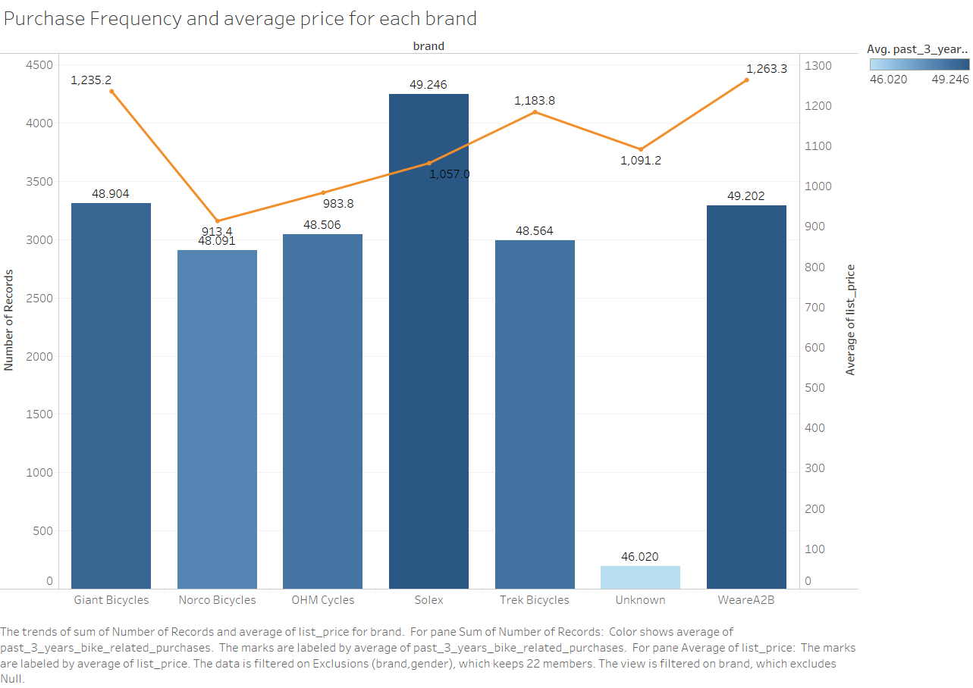
Data Exploration
Purchase Behavior by Brand
Solex is the most popular brand in the past 3 years in terms of purchase volume (49/yr)
Average purchase price of Giant and WeareA2B is ranked as NO.1 and NO.2; higher than Solex
Place any supporting images, graphs, data or extra text here.

Slide 7
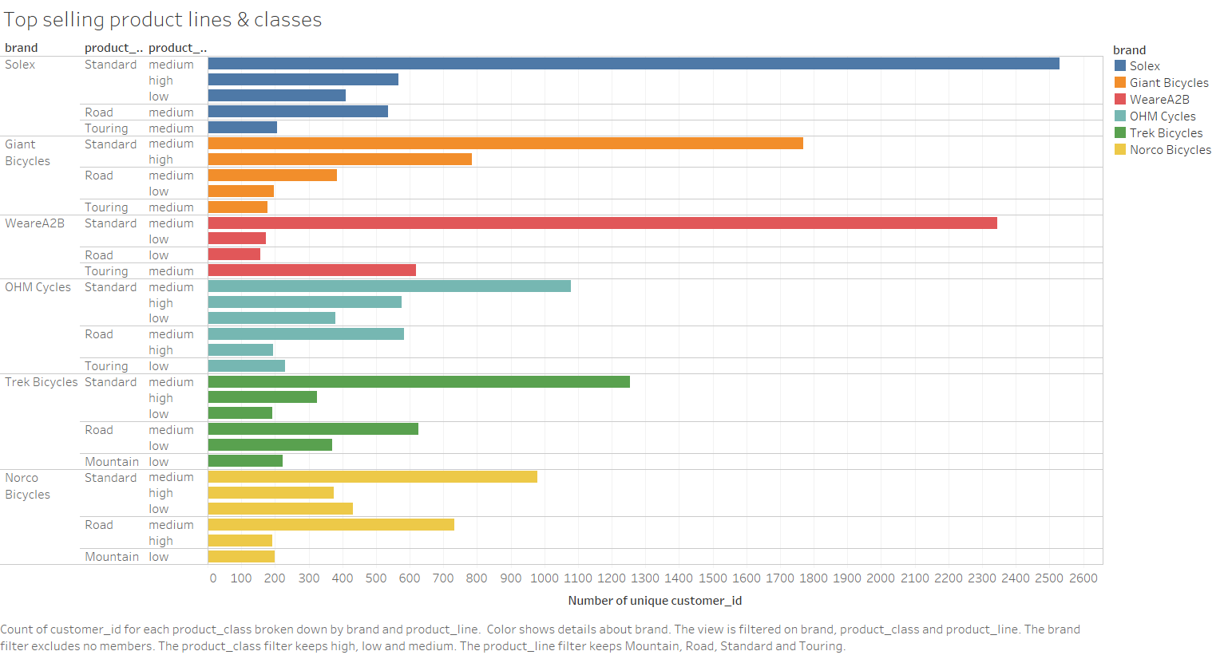
Data Exploration
Top Selling Products (Class & Line)
Overall, Standard class medium line product has the most selling record
Place any supporting images, graphs, data or extra text here.

Slide 8
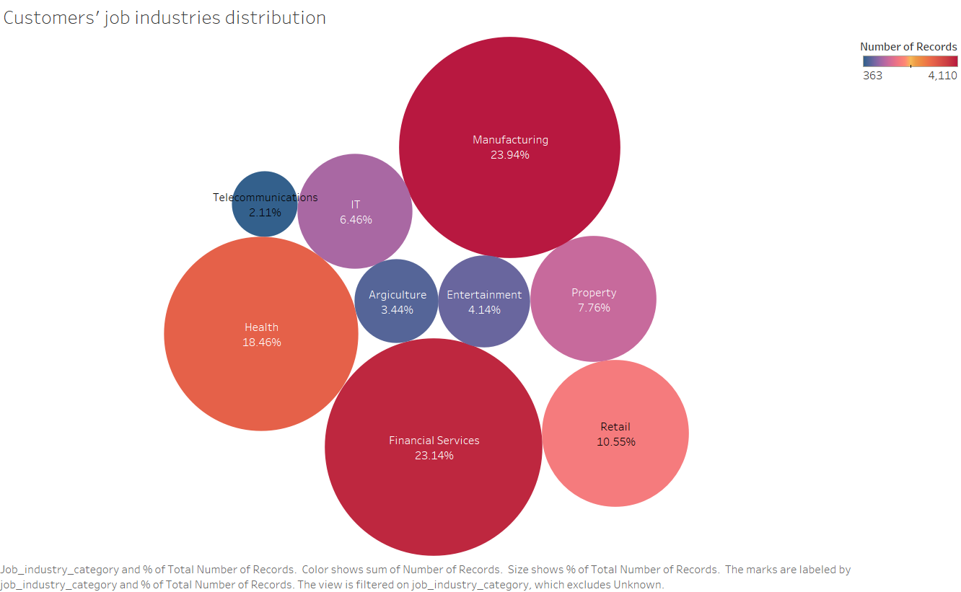
Data Exploration
Purchase Behavior in different Job Industries
Top 3 Industry(Prime Customer group)
Manufacturing(23.94%),
Financial Services(23.14%),
Health(18.46%).
Occupy 65.54% in total
Place any supporting images, graphs, data or extra text here.

Slide 9
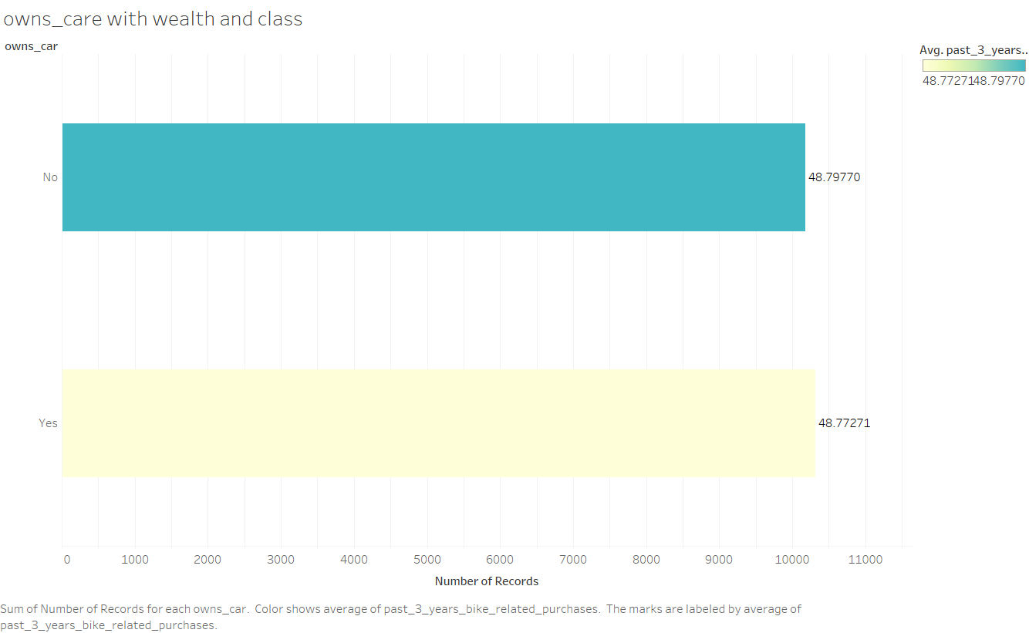
Data Exploration
Whether owning a car impacts the purchase behavior.
Owning cars has little impact on purchasing frequency
Place any supporting images, graphs, data or extra text here.

Slide 10
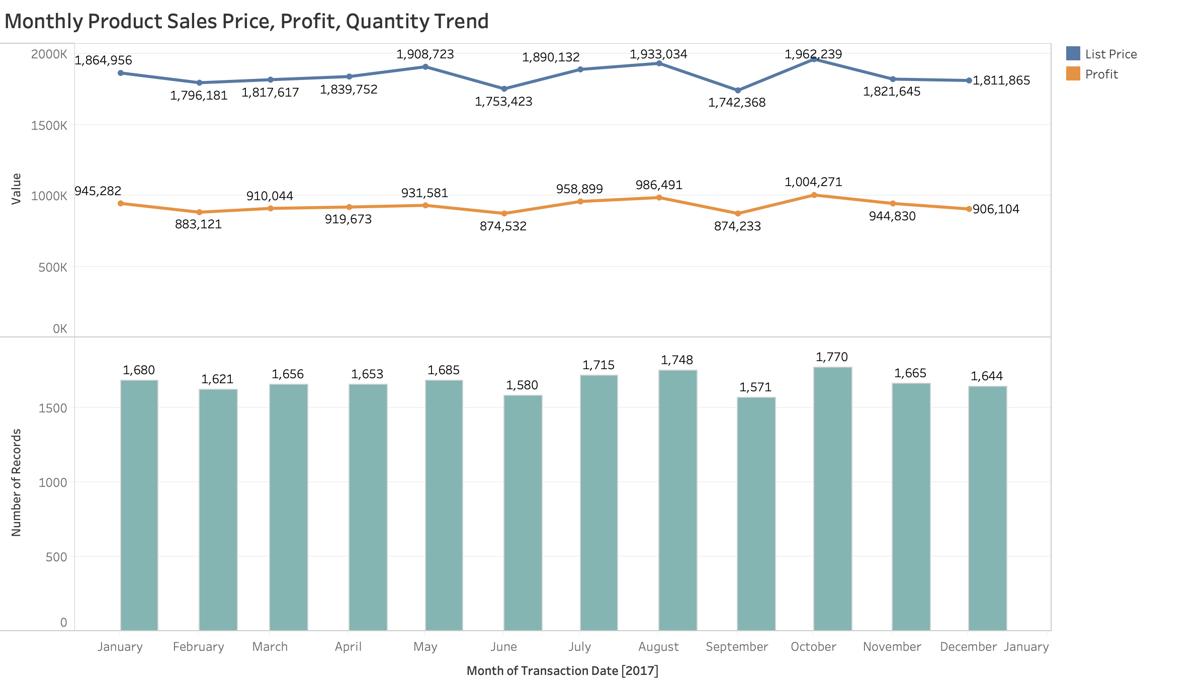
Data Exploration
Monthly Sales Price, Profit, Quantity
Price
July, August, and October are 3 peaks among the year, rest of month don’t show any significant fluctuations
Profit
Quantity

Slide 11
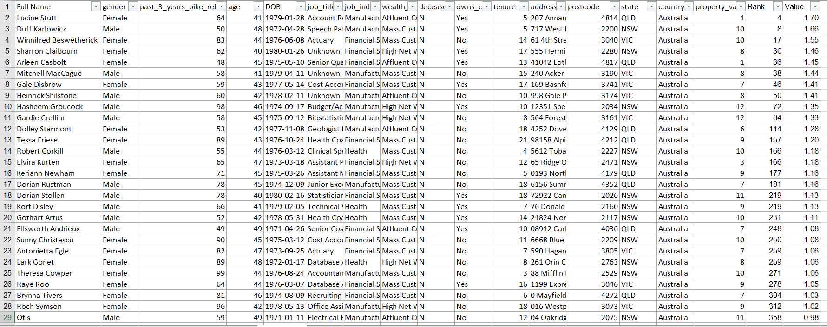
Model Development
Segmentation Results
After analyzing the data by different segmentation(age, job industry, product, etc),
The total number of our targeted HIGH-VALUE customers is 72 from 1000
For validation purposes, the hypothesis testing is carried in the next step

Slide 12
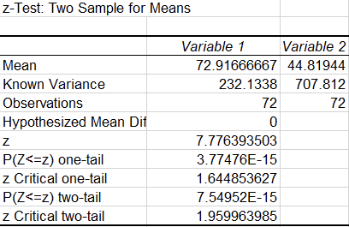
Interpretation
Hypothesis Testing (Z-test)
Group 1: The AVG purchase frequency of potential High-value customers
Group 2: The AVG purchase frequency of non High-value customers (sampling out 72 record from 1000)
Null hypothesis: There is no difference between Group 1 and Group 2
Conclusion: Reject null hypothesis, there is actually a significant difference among two groups
Place any supporting images, graphs, data or extra text here.

Slide 13
Defensibility
Could generate new features by incorporating external data like transportation, person workplace address as a stronger indicator in determining whether a particular customer would make a purchase
May need customers future transactional data to validate our model

