Slide 1

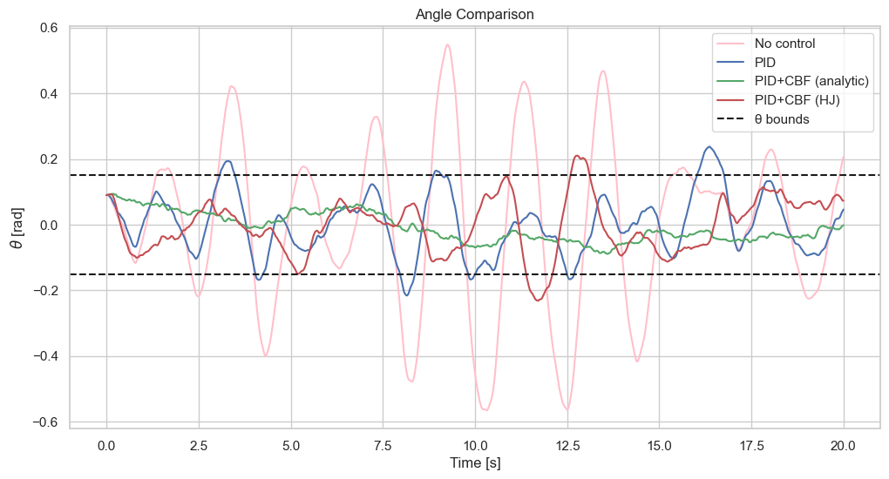
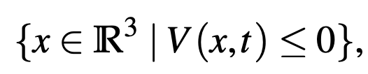
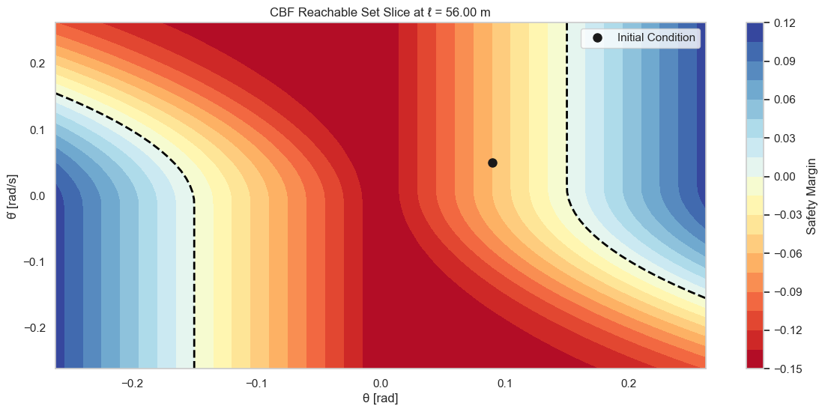


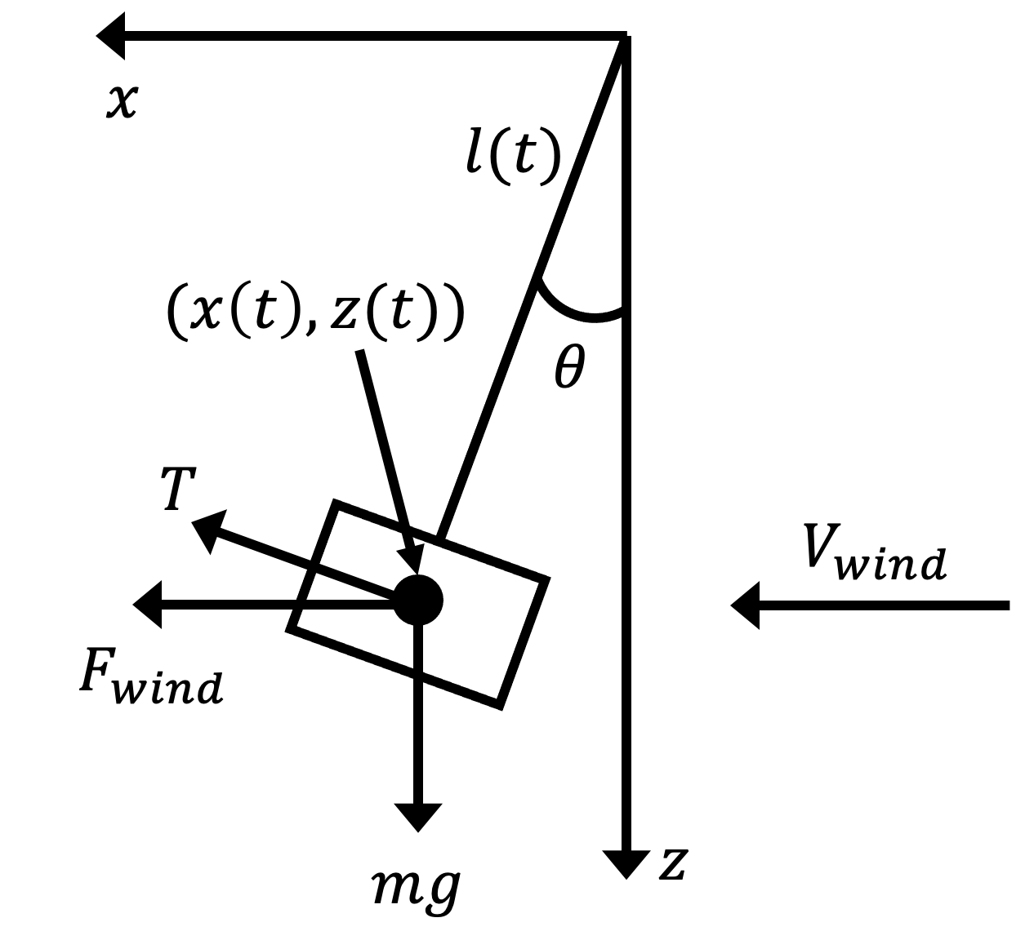
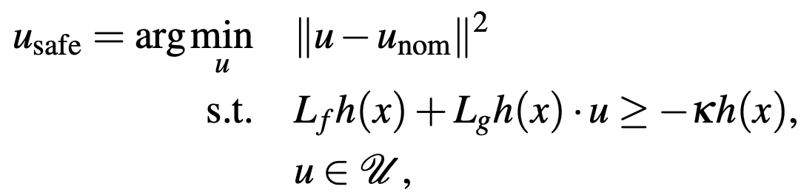

PID-CBF Framework for the Safe Landing of Delivery Drones
Jasper Matthé, Department of Aeronautics and Astronautics
Introduction
Proposed Approach
Experimental results
Food home deliveries are slow, unreliable, and food arrives cold. Companies like Zipline are slowly reducing last mile delivery times. However, the problem of trust is still an issue. How can one be certain that a robot remains safe and is able to complete its mission under the worst possible disturbances? This project aims to implement a safety robust CBF controller to guarantee the safe landing of a 2nd stage Zipline drone, a droid that is lowered from the mothership drone via a tether to customer's backyards.
To guarantee safety under bounded stochastic wind disturbances, a backward reachable tube (BRT) is computed using Hamilton–Jacobi (HJ) analysis. $V(x,t)$ is the value function solving the HJ PDE:
The sub-zero level set represents the set of states from which failure is inevitable:
A CBF is then formulated using the HJ BRT:
To ensure forward invariance:
A QP is used to solve for the optimal input that keeps the system in the safe set that is close to a nominal PID-derived input:
Using a droid of 4 kg, a drag coefficient of 1 (assuming drone is boxy), maximum wind gusts of up to 40 m/s (90 mph), and a maximum allowable deflection angle of 10 deg. A simulation of the droid’s dynamics produces the following swing angles over time:
The PID controller clearly violates safety constraints multiple times. The PID-CBF controller maintains well away from the boundaries. The PID-HJ-CBF controller is not safer than the PID controller, perhaps due to coarse interpolation of gradients from the value function.
Problem Description
The droid is modelled in a 2D plane as a bob attached to the fixed mothership via an inelastic, massless tether The state of the droid is its swing angle, swing rate, and tether length. The inputs to the system are the droid's thrust, which acts perpendicular to the tether, and the commanded reel-out rate of the tether. The disturbance to the system is a stochastic bounded horizontal wind speed.
Broader Impacts
There is a need to understand the boundary between desirable and undesirable operations as defined by human’s preferences and experiences. But encoding this is challenging. T
Conclusions
The PID-CBF controller exhibited very good behavior over the 20 second simulation time span, maintain a safe distance away from the safety constraints. Further analysis is needed to explain why the PID-HJ-CBF underperforms.
References
https://uw-ctrl.github.io/lmc-book/lectures/reachability.html
Notes:
We are living in very exciting times, we are witnessing how autonomous systems are revolutionizing the world we live in. As robots, or autonomous systems, become more pervasive in our everyday life, we find more and more sitations where, we as humans, must interact with them.

Slide 2

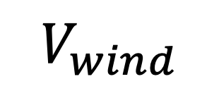

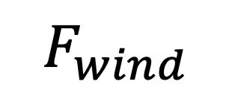
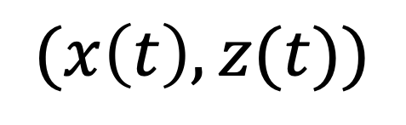
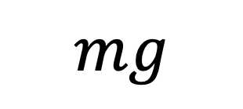
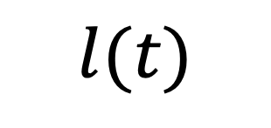


$$x$$
$$l(t)$$
$$(x\left(t\right), z(t))$$
$$θ$$
$$T$$
$$V_{wind}$$
$$F_{wind}$$
$$mg$$
$$z$$

