Slide 1
R for Graph, Network and Trees
Applications in Biomedical Research Xiaotao Shen 2025/4/7

Slide 2
About the class
Instructor: Xiaotao Shen (https://www.shen-lab.org/)
Email: xiaotao.shen@ntu.edu.stg
WhatsApp: +1 5712679283
Github Repo: https://github.com/jaspershen-lab/MD7115-NTU
Reference:
R for Data Science
R Graphics Cookbook
Network Analysis with R

Slide 3
Introduction
In this course, we will learn how to use R to analyze and visualize data in the form of graphs, networks and trees. We will cover the following topics.
What is a graph, network and tree?
Their applications in biomedical research
How to use R to analyze and visualize them

Slide 4
Preparation
We need to install some R packages before the class.
Some packages are in Bionconductor, so we need to install BiocManager first.
if (!requireNamespace("BiocManager", quietly = TRUE)){ install.packages("BiocManager") }

Slide 5
Preparation
tidyverse is a collection of R packages designed for data science, and it includes ggplot2, which is a basic graph package for network and tree in R.
if (!requireNamespace("tidyverse", quietly = TRUE)){ install.packages("tidyverse") }

Slide 6
Preparation
Some specific packages for graph, network and tree analysis.
if (!requireNamespace("igraph", quietly = TRUE)){ install.packages("igraph") } if(!requireNamespace("ggraph", quietly = TRUE)){ install.packages("ggraph") }

Slide 7
Preparation
Some specific packages for graph, network and tree analysis.
if(!requireNamespace("tidygraph", quietly = TRUE)){ install.packages("tidygraph") } if(!requireNamespace("ggnetwork", quietly = TRUE)){ install.packages("ggnetwork") }

Slide 8
Preparation
Some specific packages for graph, network and tree analysis.
if(!requireNamespace("ggtree", quietly = TRUE)){ BiocManager::install("ggtree") } if(!requireNamespace("treeio", quietly = TRUE)){ BiocManager::install("treeio") } if(!requireNamespace("ggtreeExtra", quietly = TRUE)){ BiocManager::install("ggtreeExtra") }

Slide 9
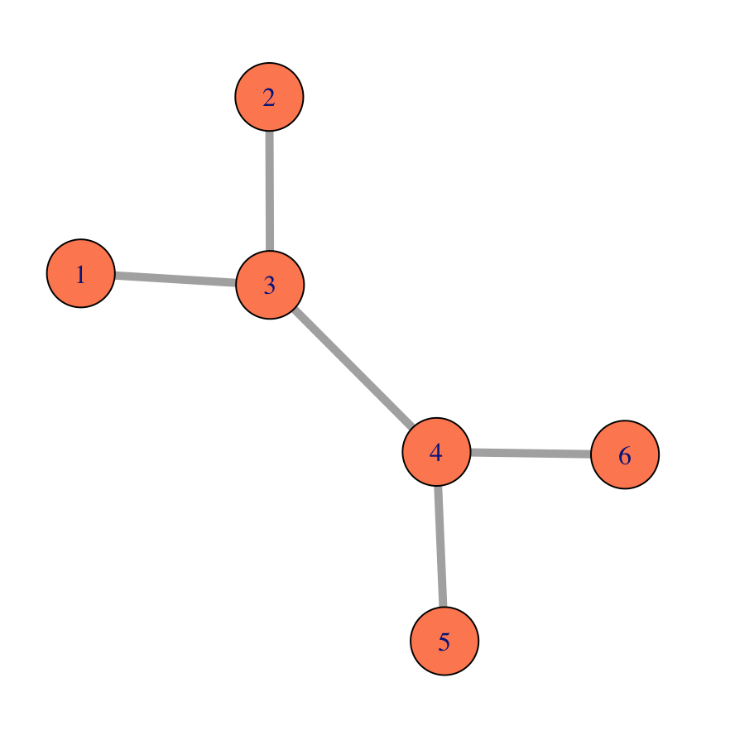
What is a graph?
A graph is a collection of nodes (vertices) and edges (links) that connect pairs of nodes.
A small undirected graph with numbered nodes.

Slide 10
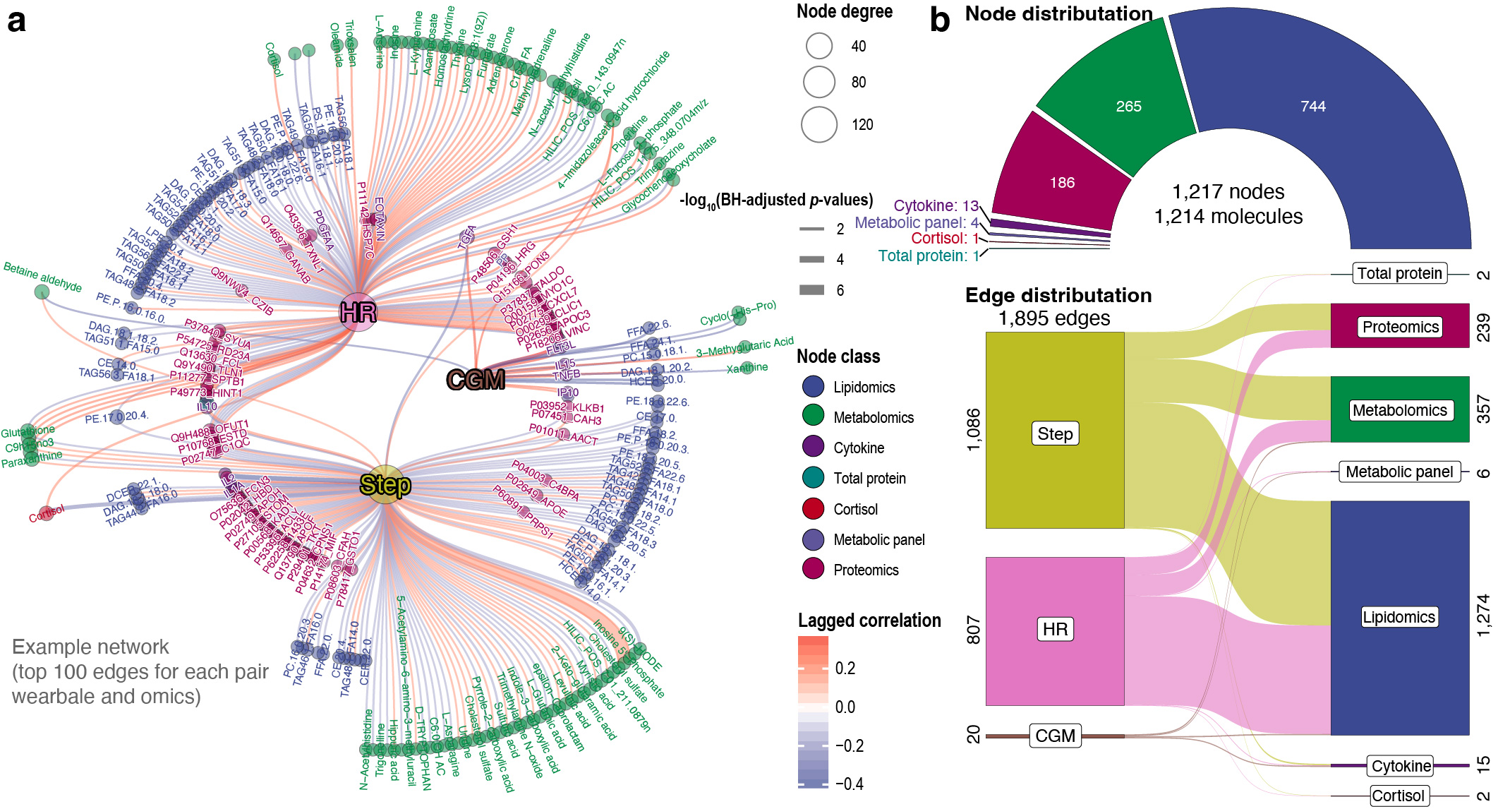
Example 1
Shen, et al. Nature Biomedical Engineering, 2024

Slide 11
Example 1
What’s the network?
Nodes:
Wearable data: Step, HR, and CGM (continuous glucose monitoring) data
Omics data: Proteins, metabolites, and lipids
Edges:
Lagged correlations
Blue: negative correlations
Red: positive correlations
Shen, et al. Nature Biomedical Engineering, 2024

Slide 12
Read the data
## node data if (!require(readr)) { install.packages("readr") } node_data <- readr::read_csv( "https://raw.githubusercontent.com/jaspershen-lab/MD7115-NTU/main/2_demo_data/example_node_data.csv" )

Slide 13
Read the data
##edge data edge_data <- readr::read_csv( "https://raw.githubusercontent.com/jaspershen-lab/MD7115-NTU/main/2_demo_data/example_edge_data.csv" )

Slide 14
Node data
head(node_data)
# A tibble: 6 × 4 node class mol_name class2 <chr> <chr> <chr> <chr> 1 CGM cgm CGM wearable 2 cortisol_1 cortisol Cortisol internal-omics 3 cytokine_34 cytokine IP10 internal-omics 4 cytokine_40 cytokine TNFB internal-omics 5 cytokine_20 cytokine IL15 internal-omics 6 cytokine_4 cytokine TGFA internal-omics

Slide 15
More references
Morden Statistics for Morden Biology
Network Analysis with R

