Slide 1
R for Graph, Network and Trees
Applications in Biomedical Research Xiaotao Shen 2025/4/7

Slide 2
Quarto
Quarto enables you to weave together content and executable code into a finished presentation. To learn more about Quarto presentations see https://quarto.org/docs/presentations/.

Slide 3
Bullets
When you click the Render button a document will be generated that includes:
Content authored with markdown
Output from executable code

Slide 4
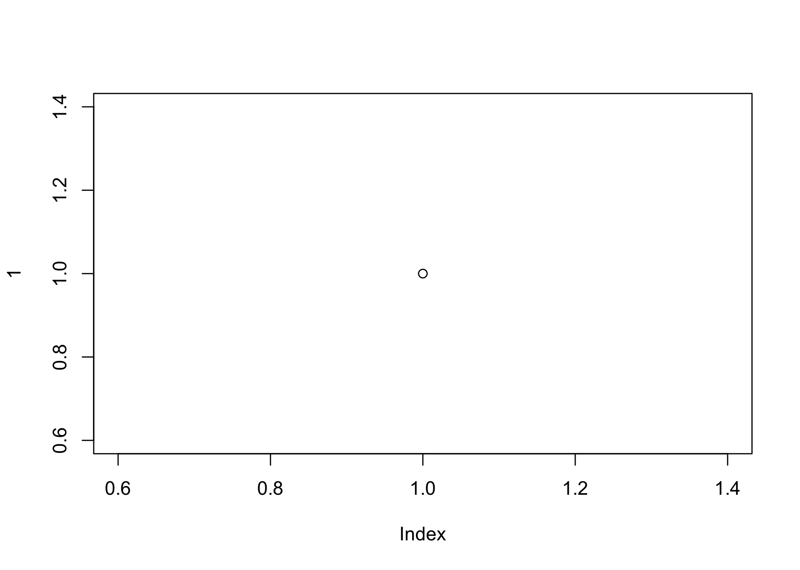
Code
When you click the Render button a presentation will be generated that includes both content and the output of embedded code. You can embed code like this:
[1] 2

