Slide 1

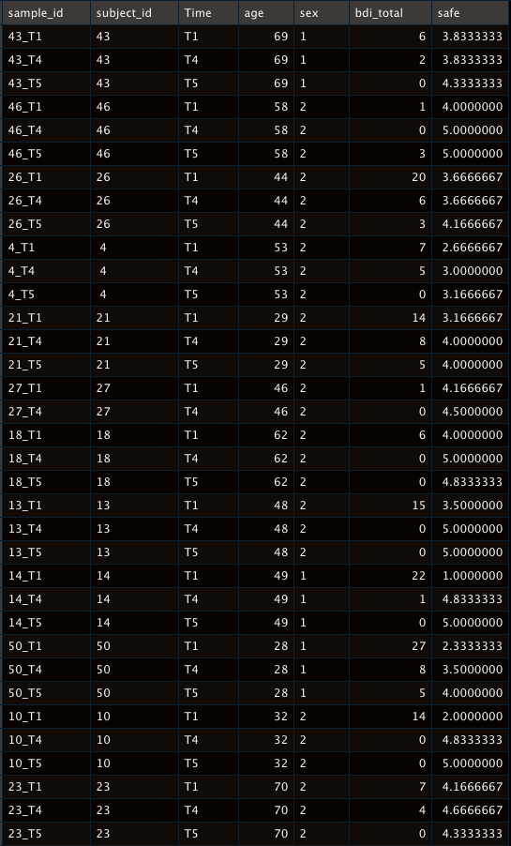
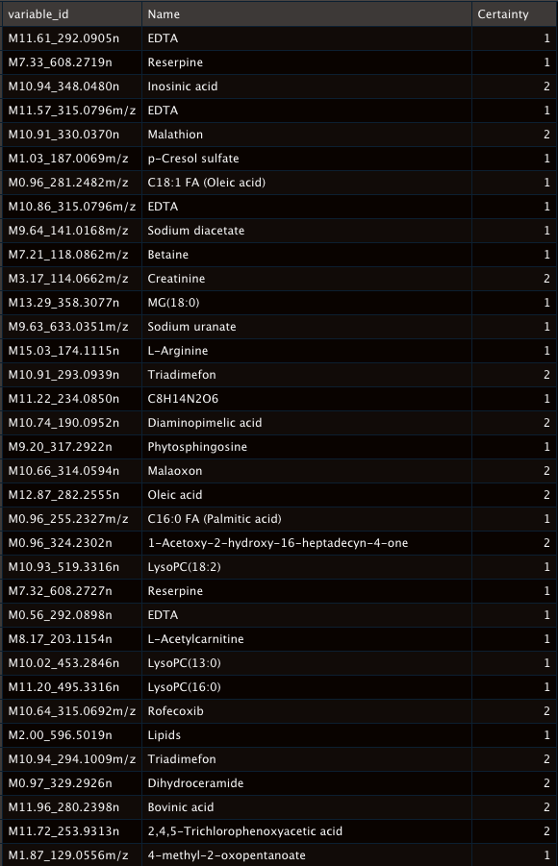

Metabolomics
185 samples and 6351 features
How to do metabolite annotation?

Slide 2
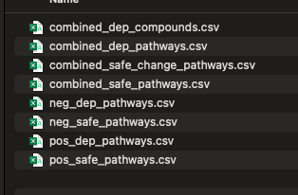
Metabolomics

Slide 3
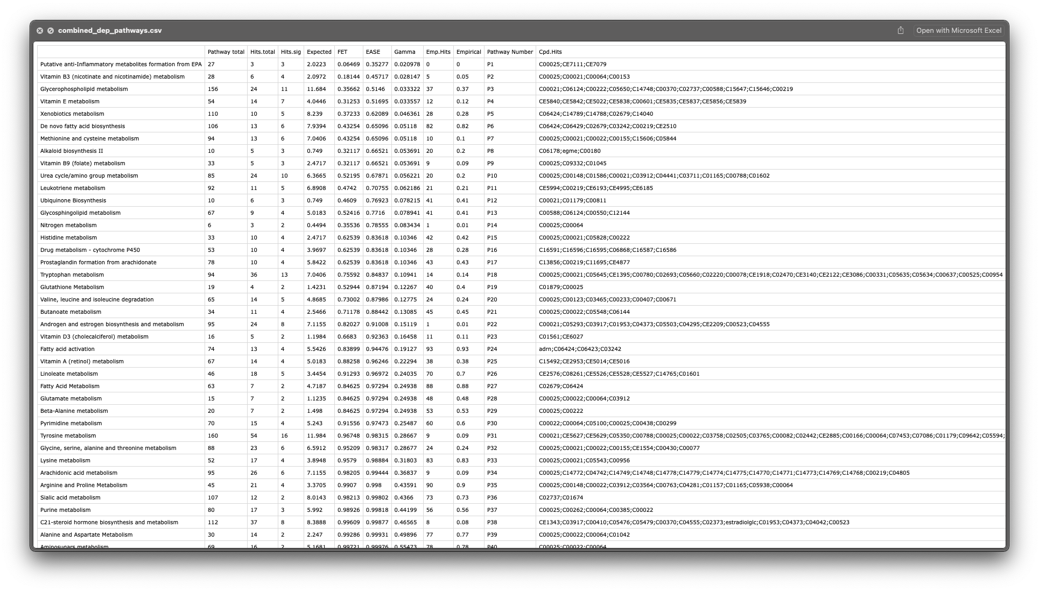
Metabolomics
What pathway database?

Slide 4
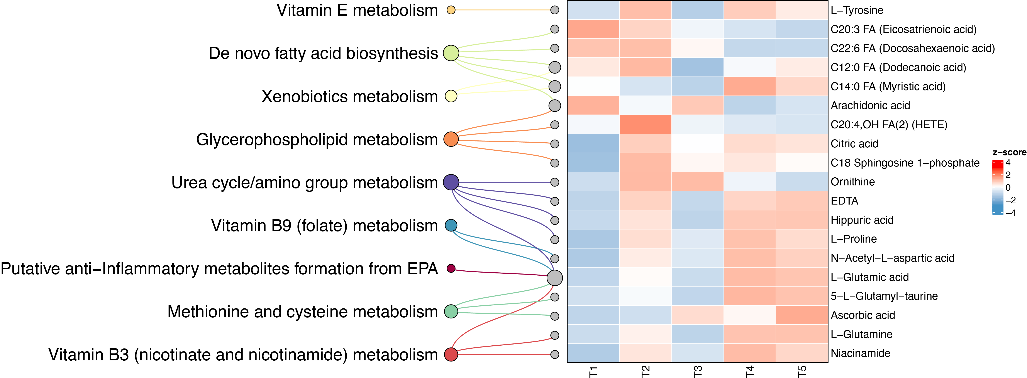
Pathway visualization
combined_dep_pathways.csv

Slide 5
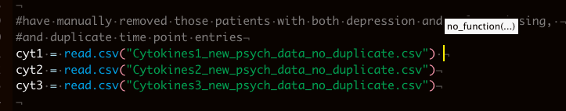

Cytokine

Slide 6

Depression (bdi_total) decrease according to time

Slide 7
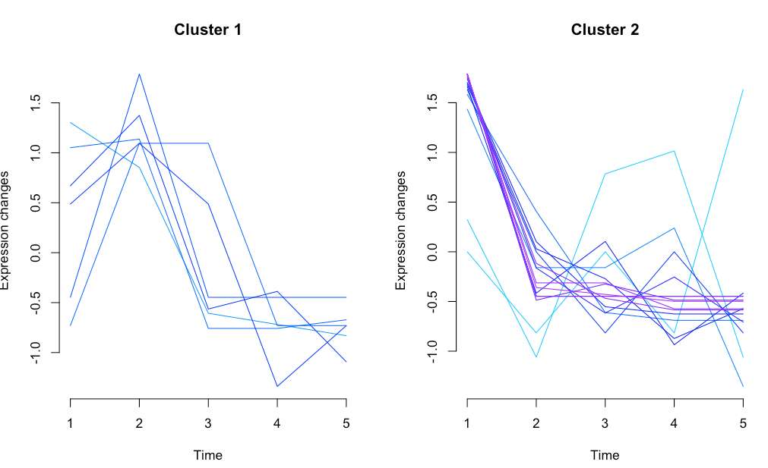
Depression (bdi_total) decrease according to time

Slide 8
Fuzzy k means clustering

Slide 9
Fuzzy k means clustering

Slide 10
Fuzzy k means clustering

