Slide 1
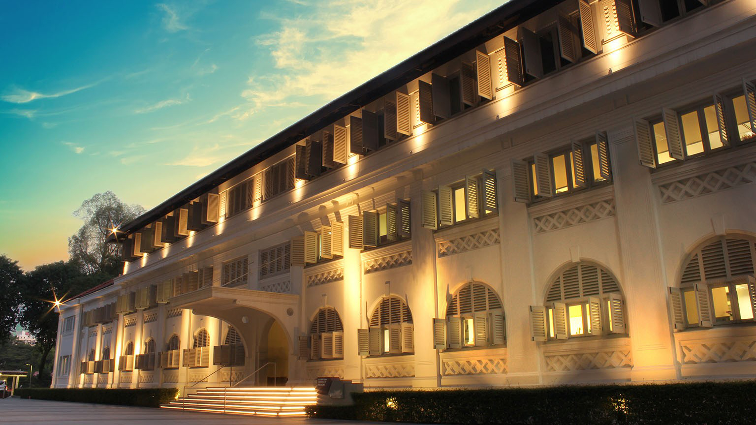


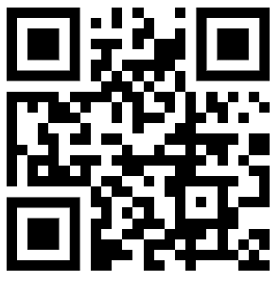
TidyMass: An Object-oriented Reproducible Analysis Framework for LC-MS Data
Xiaotao Shen, Ph.D.
Nanyang Assistant Professor
Lee Kong Chian School of Medicine &
School of Chemistry, Chemical Engineering and Biotechnology
Nanyang Technological University, Singapore
May 29th, 2024
xiaotao.shen@ntu.edu.sg
xiaotaoshen1990
shen-lab.org
github.com/jaspershen

Slide 2


Outline
TidyMass: An Object-Oriented Reproducible Analysis Framework for LC-MS Data
- Concept of Design
- massDataset: mass_dataset class object
- Reproducible Analysis Using TidyMass
Case Study: A Blood Metabolome Atlas of Rhesus Macaques
Notes:
There are two parts of my presentation todays. First part is the metID, and the second part I want to talk something something I am still working on. So let’s get it started with the part 1.

Slide 3

Study design and overview

Slide 4
Thank You For Your Attention!
Q&A
Xiaotao Shen, Ph.D.
Nanyang Assistant Professor
Lee Kong Chian School of Medicine &
School of Chemistry, Chemical Engineering and Biotechnology
Nanyang Technological University, Singapore
xiaotao.shen@ntu.edu.sg
xiaotaoshen1990
shen-lab.org
github.com/jaspershen

