Slide 1
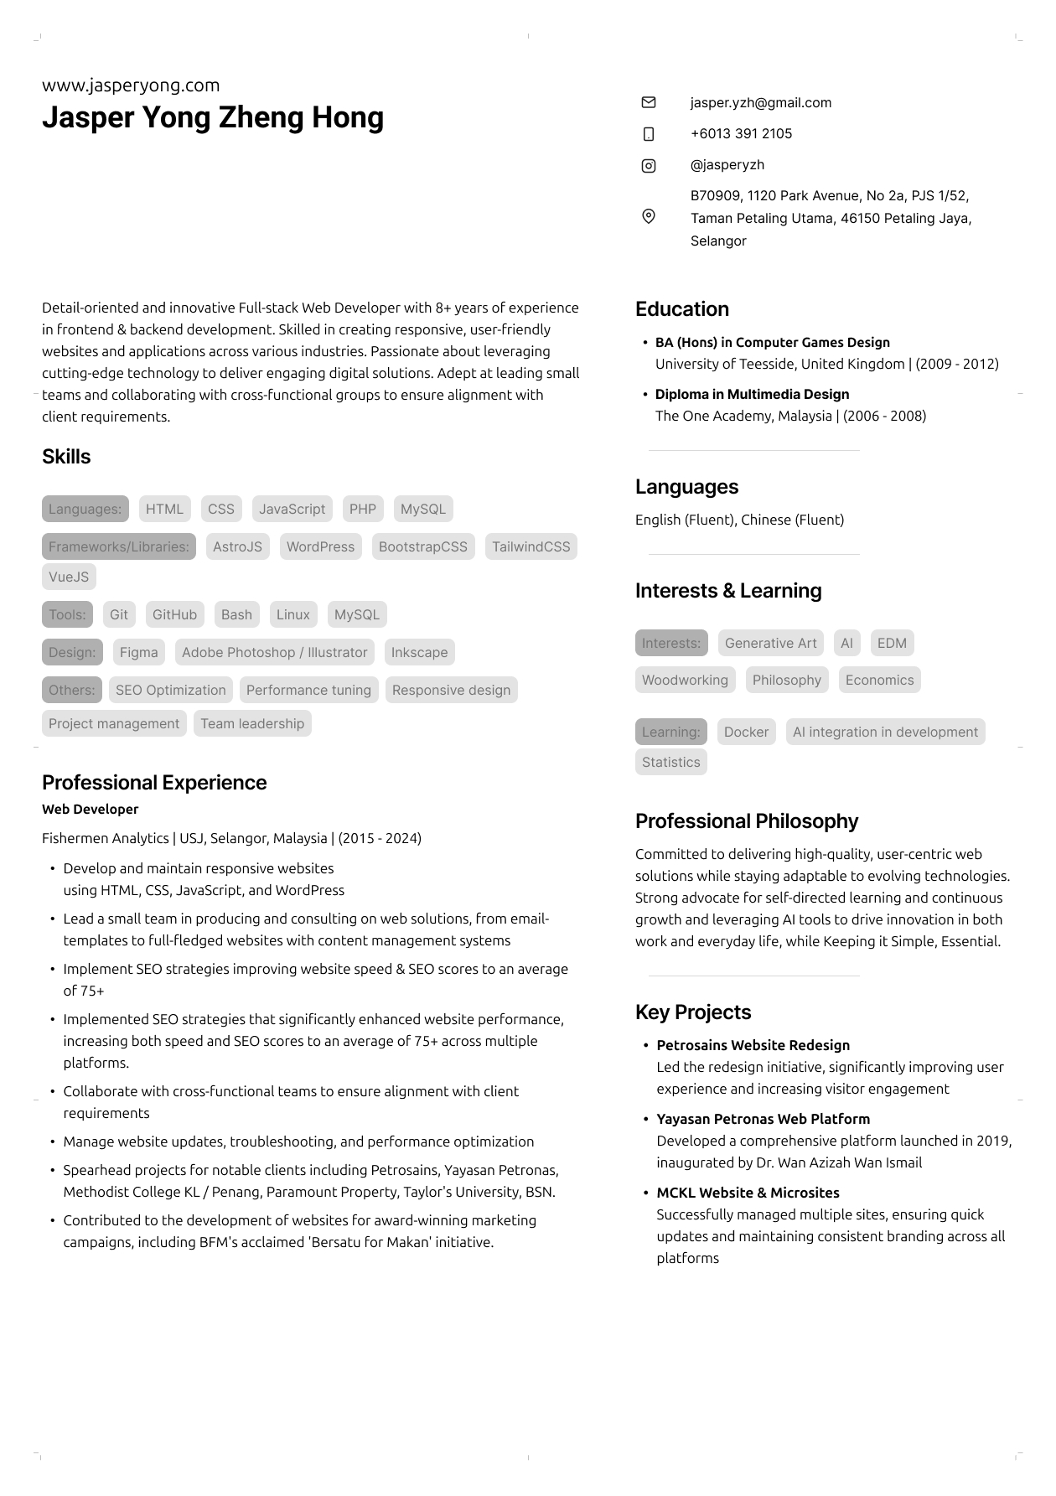
I think this section is really hard to read due to the colours. I am not interested enough to put in the kind of focus necessary to understand it
I would spend some time to explain what Fishermen Analytics is. Otherwise it really doesn’t provide the recruiter any context of the significance of this company. Also, if you can find a way to add in something towards why you were here for so long. It could be positioned as growth, loyalty etc etc… kelentong something that a recruiter would love to see. This would be a good place to do it.
There is a lot going on here. I would suggest you categories your points into broad areas i.e: Web Dev, SEO, Multimedia etc etc.
That way at a glance it is clear that you are multiskilled. Again, no one is interested enough to read through all your bullet points. Having them in categories gives the recruiter a quick feel. All he needs to know is that you have those categories, even if he ignores your bullet points
In this area, feel free to add in some additional “projects” that are SEO related or campaign related. Embellish a bit, make it sound grand. Currently they just sound all too bland.
SELL IT!
Even if it is not 100% true, it’s ok. Now you are pitching yourself there is plenty of time for complete honestly later.
Have a section called something like “Personal Achievements”
There you can talk about grooming team members, pitching, project management… whatever la.
REMEMBER. Recruiters are only drawn to keywords that scream you are the ideal candidate. So make those keywords stand out!!~
*You don’t have to force it to be a 1-pager. 2 pages is fine as long as it is interesting.

