Slide 1
DTF: Predicting Drug-Drug Synergy in Cancers Using Deep Tensor Factorization
Mitacs Globalink Student: Zexuan Sun
Wuhan University
Supervisor: Pingzhao Hu
August 19th, 2019

Slide 2
CONTENTS
What is a tensor ?
Tensor Rank and Decompositions
Predicting Drug-Drug Synergy in Cancers

Slide 3
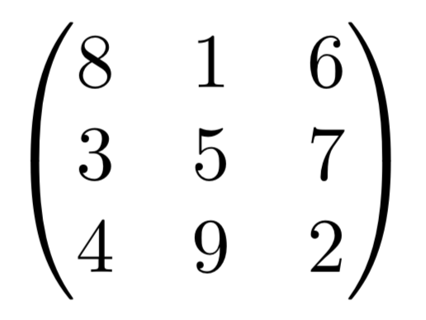
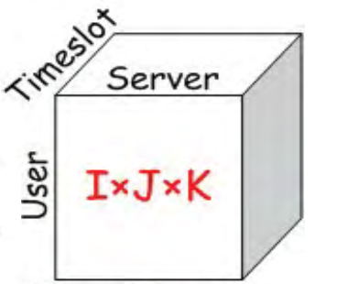
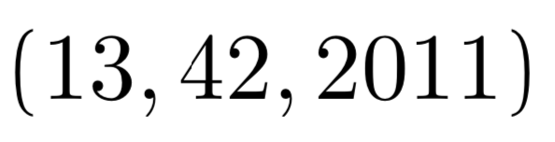
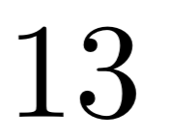
What is a tensor ?
A tensor is a multi-way extension of a matrix
A multi-dimensional array
A multi-linear map
In particular, all following examples
are tensors:
– Scalars
– Vectors
– A 3-D Tensor
– Matrices

Slide 4
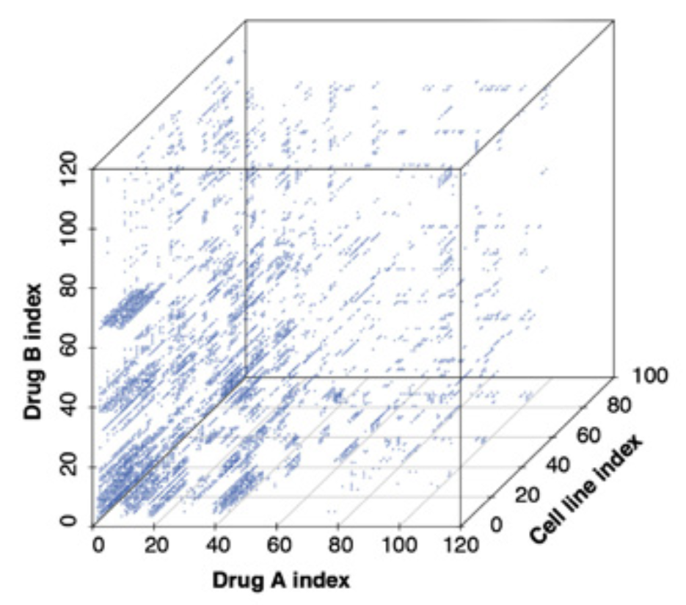
Why Tensors?
Tensors can be used when matrices are not enough
A matrix can represent a binary relation
A tensor can represent multi-way relations
The example we are investigating now

Slide 5
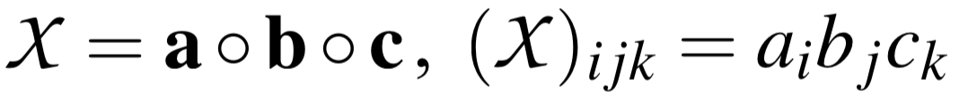
Tensor Terminology and Basic Operation
We say a tensor is N-way array
E.g. a 3-way tensor can be N-by-M-by-K dimensional
A multi-way vector outer product is a tensor where
each element is the product of corresponding
elements in vectors (a, b, c):

Slide 6
Matrix Rank
The rank of a matrix M is the
Number of linearly independent rows (row rank)
Number of linearly independent columns (column rank)
Number of rank-1 matrices needed to be summed to get M
(Schein rank)
Rank-1 matrix is an outer product of two vectors
They all are equivalent
This we generalize

Slide 7
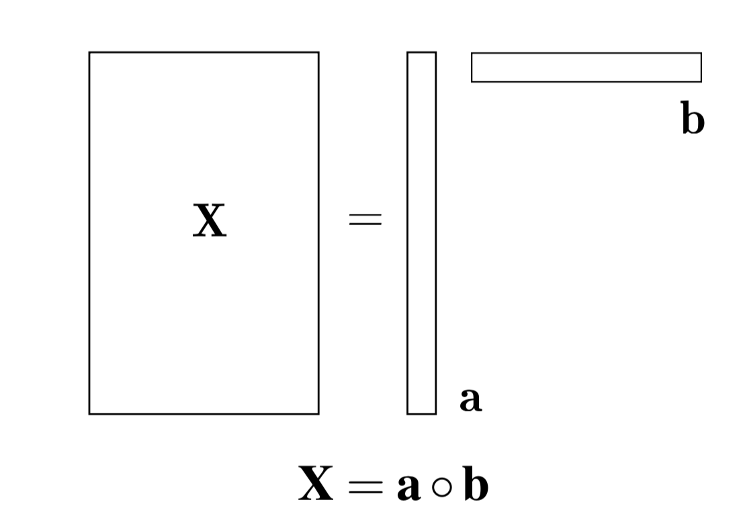
Rank-1 Matrix

Slide 8
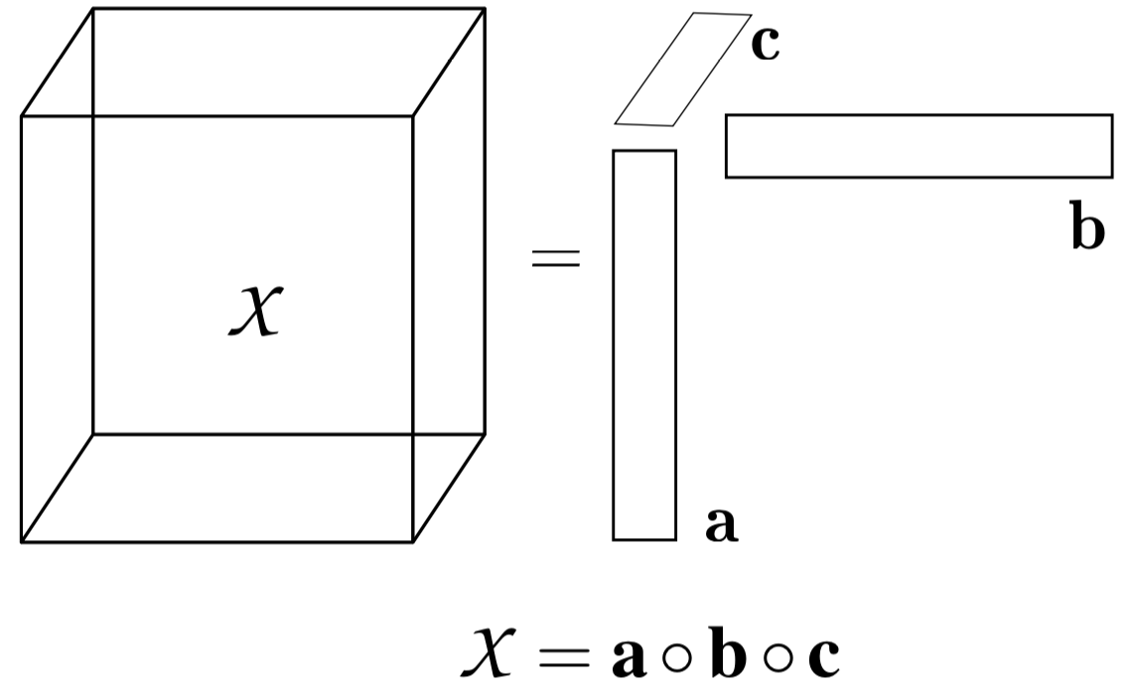
Rank-1 Tensor
A N -way tensor is of rank-1 if it can be strictly decomposed into the outer product of N vectors.

Slide 9
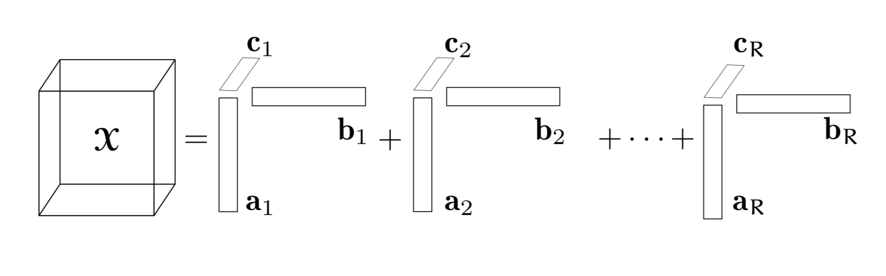
Tensor Rank
• The rank R of a tensor is the minimum number
of rank-1 tensors needed to represent the tensor exactly
– Generalizes the matrix Schein rank

Slide 10
Tensor Decomposition Overview
Tensor with all data available
Canonical Polyadic Decomposition(Hitchcock,1927)
(CP Decomposition)
Tensor with missing values
CP Weighted Optimization(Acar, E. et al. 2010)
(CP-WOPT)

Slide 11
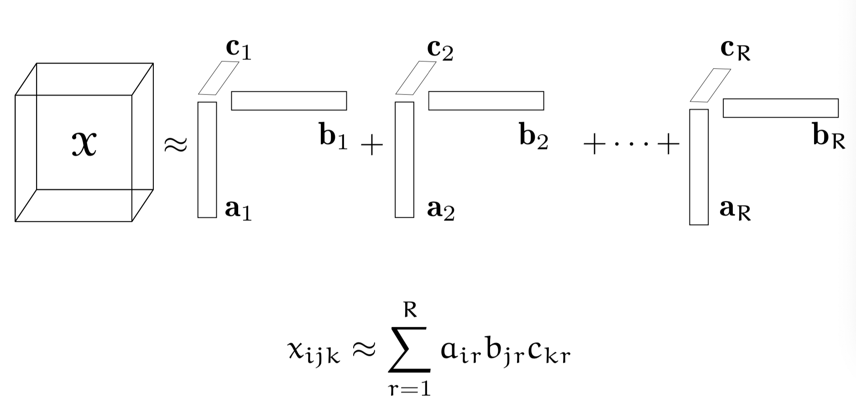
The CP Tensor Decomposition
Express a tensor as the sum of a finite number of rank-one tensors.

Slide 12
About the parameter R
It is known that the problem of computing the rank of a tensor is NP-hard.
Just set the parameter R as large as possible at first.
And then decrease R.

Slide 13
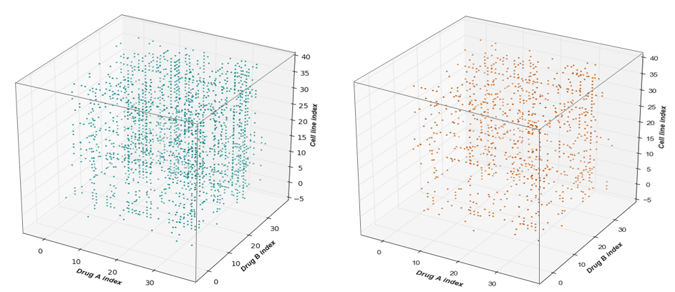
CP Weighted Optimization(CP-WOPT)
• Why CP-WOPT?
CP decomposition cannot handle missing values

Slide 14
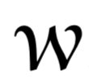
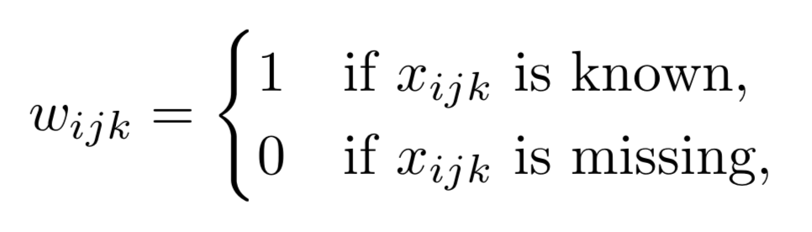
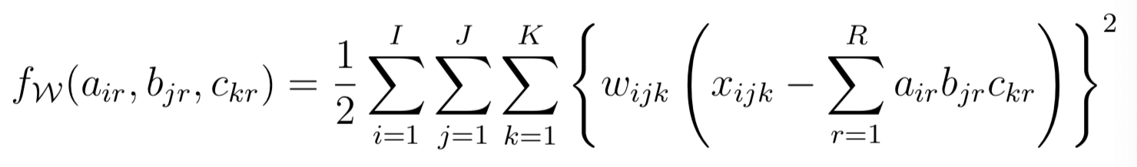
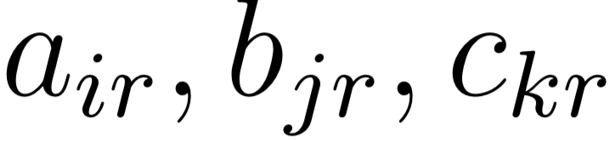
The Steps of CP-WOPT
Introduce a nonnegative weight tensor , where
Construct weighted least squares problem for the CP model, that is
Find the that minimize the above objective function

Slide 15
Application: Predicting Drug-Drug Synergy in Cancers Using CP-WOPT

Slide 16
Data Set and Research Objective
Drug-drug synergy (DDS): 38 drugs, 39 cell lines for 7 cancer types
45474 drug-drug pairs with synergy scores, 9360 drug-drug pairs with missing synergy scores
Objective: predict drug-drug synergy using deep tensor factorization technology

Slide 17
Step 1: Transfer the Data with missing observations to a Tensor

Slide 18
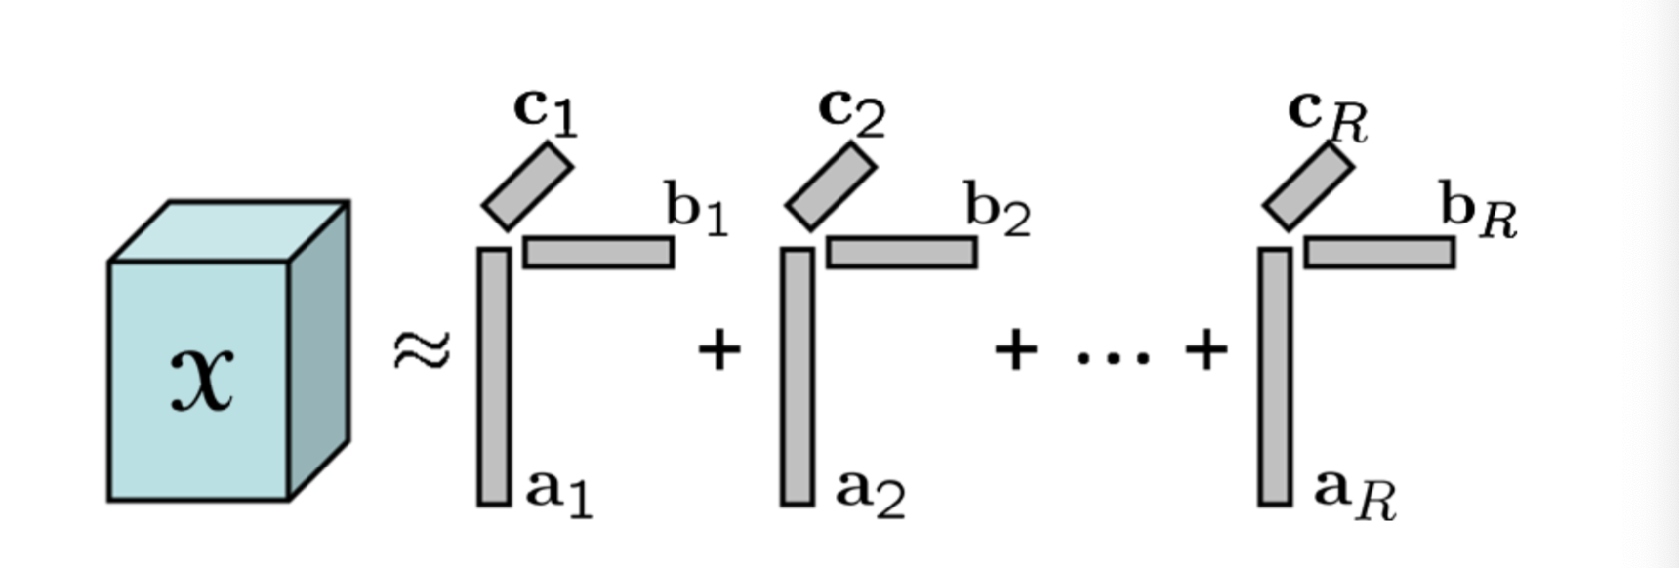
Step2: Use CP-WOPT to Decompose the Tensor

Slide 19
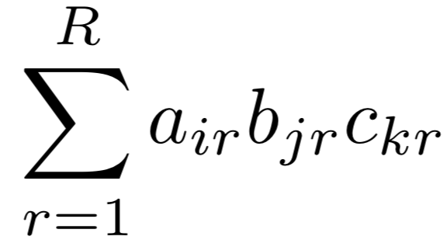
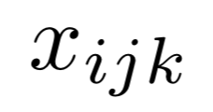
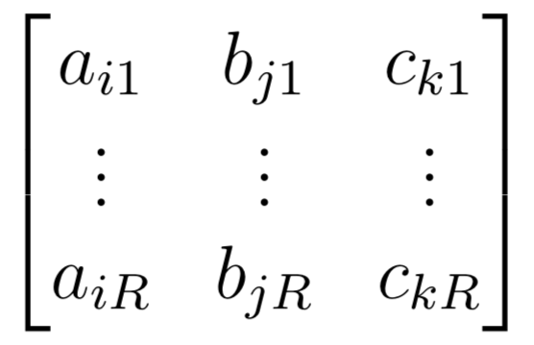
Step 3: Preprocess the data of the result of CP-WOPT
Drug B feature
For each synergy score
Cell line feature
Drug A feature
Pair

Slide 20
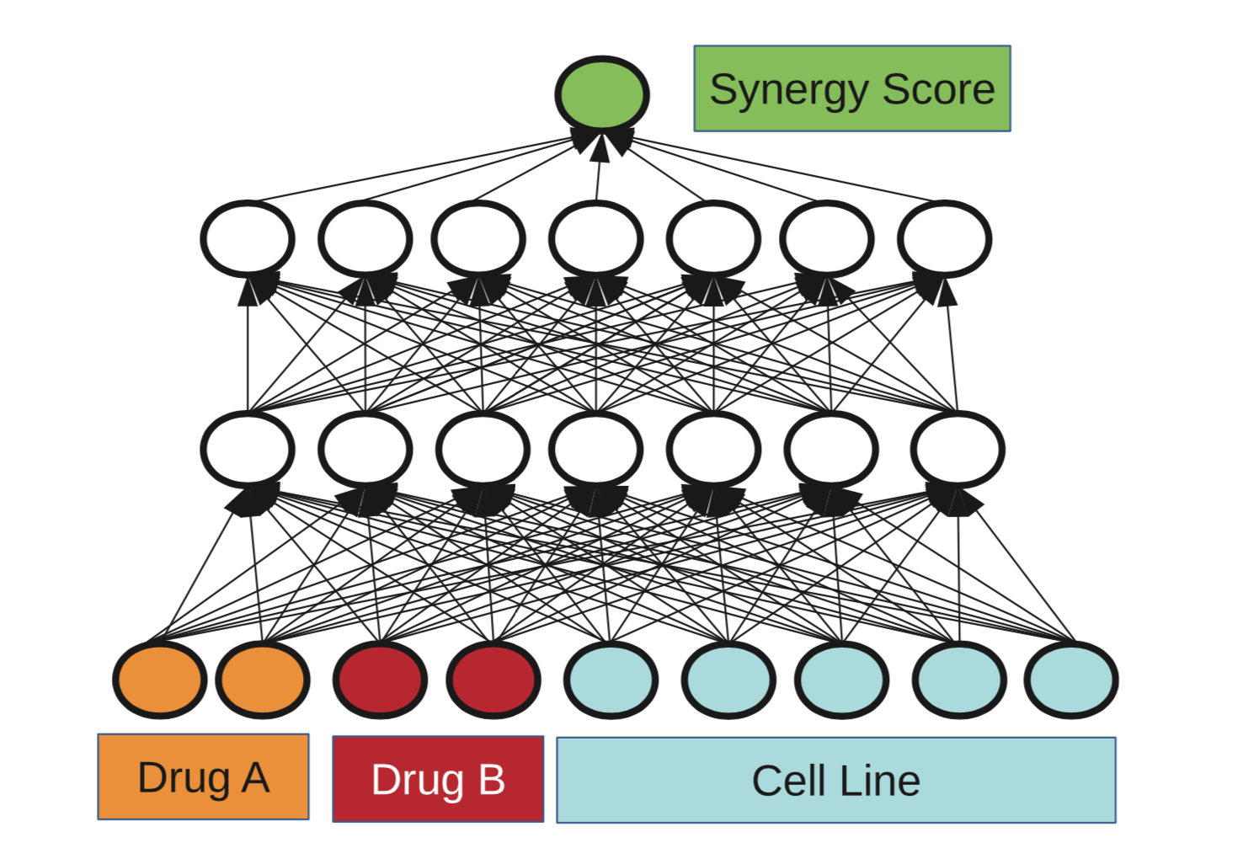
Step 4: Use the data from the known synergy to train the Deep Neural Network and use the trained Deep Neural Network to predict the unknown synergy score
Evaluation:
Cross validation
input feature sets from Step 3

Slide 21
Results
Numerical experiments and analysis are being continued

Slide 22



Acknowledgement
Dr. Pingzhao Hu’s Lab: Peiran Jiang, Shujun Huang and other students
CHI: Dr. Lisa Lix and Kristine Kroeker
Globalink Research Internship offered by MITACS
Funding offered by China Scholarship Council (CSC)

