Slide 1


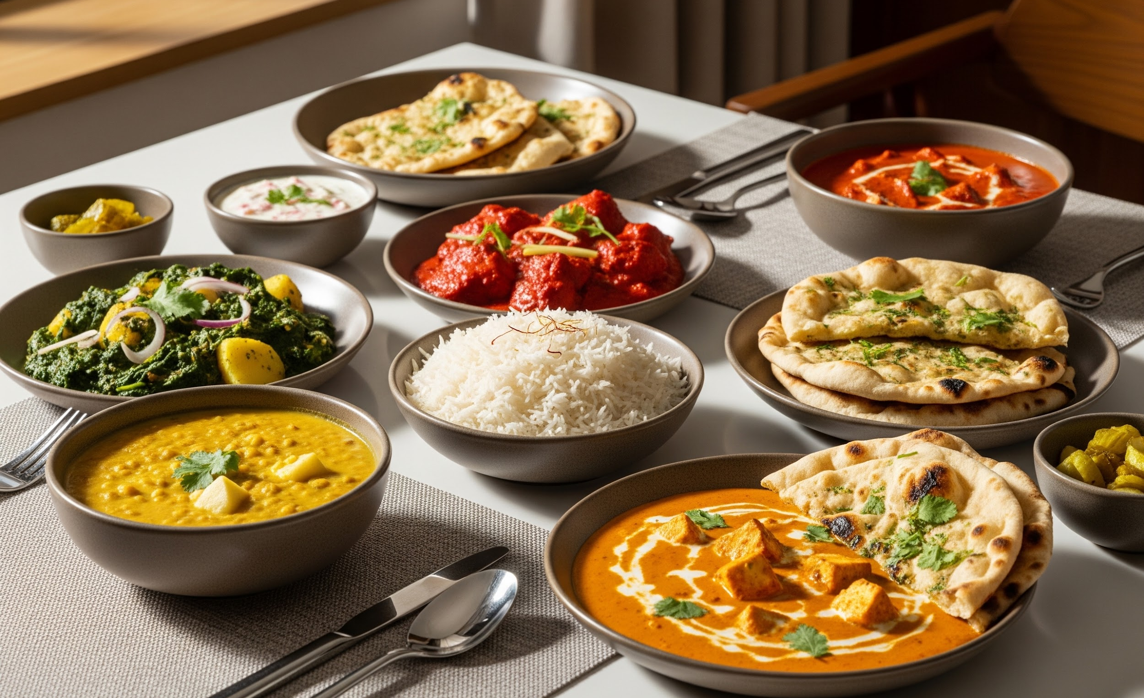

Mid-Term Project Presentation • Spring 2026 Session • B.Tech Computer Science • NIT Srinagar
AI-Based Food
Recognition
with Nutrition-Aware Recommendations
Presented and made by
Jaspreet Singh (2022BCSE019)
Inderpal Singh (2022BCSE037)
Guide: Dr. Lavanya Madhuri Bollipo
Co-Guide: Dr. Insha Majeed

Slide 2
Introduction
🥗
🤖
🎯
Growing Need
This Project
Core Goal
Food recognition and nutrition awareness are becoming essential for healthier dietary choices and active health monitoring.
An AI-powered system focused on Indian cuisine that identifies food items from images and provides instant nutritional analysis.
Combine food-image recognition with nutrition lookup into one practical, integrated system accessible through the web.
Problem: Users, especially in India, lack a simple tool to photograph a meal and instantly understand its nutritional composition.

Slide 3
Literature Review
Khana: A Comprehensive Indian Cuisine Dataset (2025)
Indian cuisine is underrepresented in food-image datasets, with high inter-class visual similarity and regional complexity making standard models insufficient.
What is there in an Indian Thali? & Lightweight DeepLabv3+ (2025)
Multi-item meal detection is difficult due to overlap, occlusion, and high computational cost.
Indian Food Composition Database & Enhancing FKG.in (2024)
Existing nutrition resources cover raw ingredients but are less accurate for cooked composite Indian dishes.
AI-Driven Personalized Meal Planning & NutriGen (2025)
Dietary systems are shifting from passive food logging toward active, culturally-aware personalized recommendation engines.

Slide 4
Research Gap
❌
Indian Food Underrepresented
❌
Poor Multi-Item Detection
Existing systems do not address the visual complexity and regional diversity of Indian cuisine.
Many solutions cannot detect multiple food items in one image, which is common in real Indian meals.
❌
Inaccurate Nutrition Mapping
❌
No Integrated Pipeline
Accurate nutrition data for cooked Indian dishes is difficult to obtain from raw-ingredient databases.
Food recognition and nutrition analysis are often treated as separate tasks, lacking a seamless end-to-end system.
❌
Future Scope Gap: There is a need to transition from passive food detection toward active, personalized dietary recommendation systems.

Slide 5
Objectives of the Study
01
Indian Food Recognition
Recognize Indian food items from user-provided images using an AI-based object detection model.
02
Nutrition Mapping
Map detected food items to a nutrition database and display macronutrient details (calories, protein, fat, carbs).
03
Multi-Item Support
Support simultaneous detection of multiple food items within a single image.
04
Web Interface
Provide a simple drag-and-drop web interface accessible to the users.

Slide 6
System Workflow
▶
▶
▶
📸
🧠
🗄️
📊
Step 1
Step 2
Step 3
Step 4
Image Upload
Food Detection
DB Matching
Result Display
User uploads a food photo via the drag-and-drop web interface
YOLO11s model detects and labels all food items in the image
Detected names matched with INDB nutrition database
UI shows food labels with bounding boxes and nutrition values
⚙️
Backend
🖥️
Frontend
FastAPI server handles inference and DB lookup
Next.js UI renders bounding boxes and nutrition panel

Slide 7
Technologies, Tools & Datasets
computer
Frontend
settings
Backend
Next.js
TypeScript
Tailwind CSS
FastAPI
Python
SQLite
psychology
AI / ML
storage
Datasets
YOLO11
PyTorch
OpenCV
IndianFoodNet-30
• Roboflow — Food Detection
Indian Food Nutritional
Values (2025)
• Kaggle — Nutrition Mapping

Slide 8
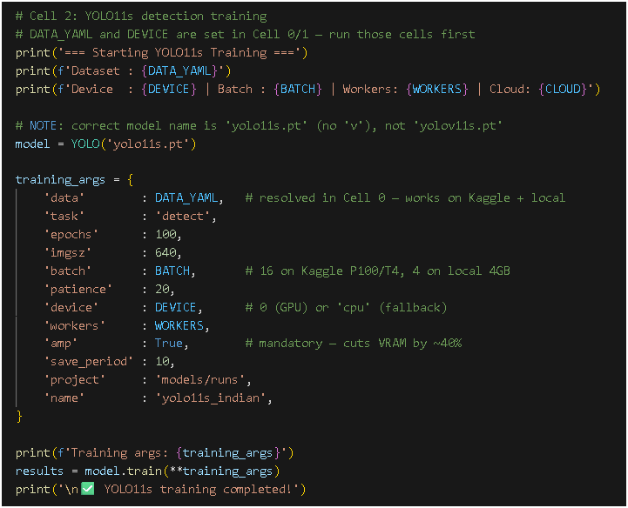
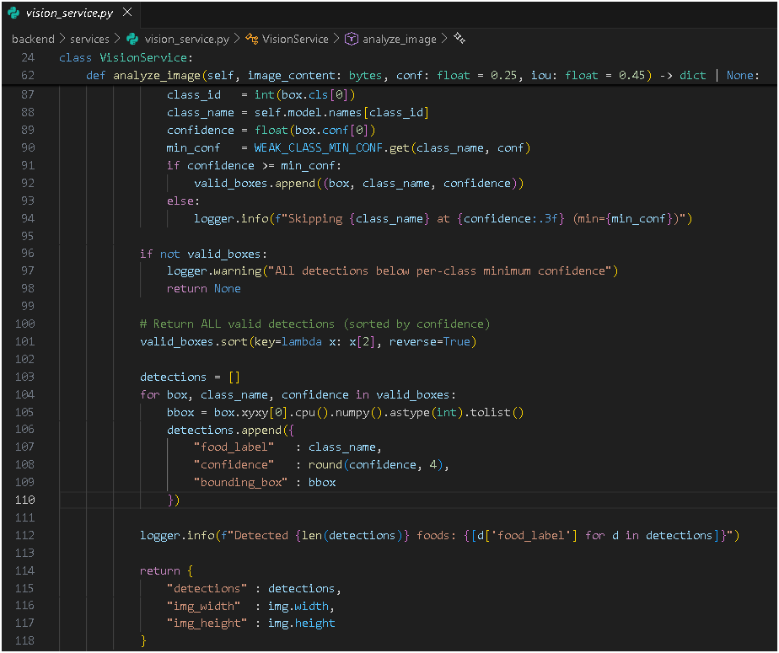
Code Snippets
Model Training
Yolo Inference (Food Detection)

Slide 9
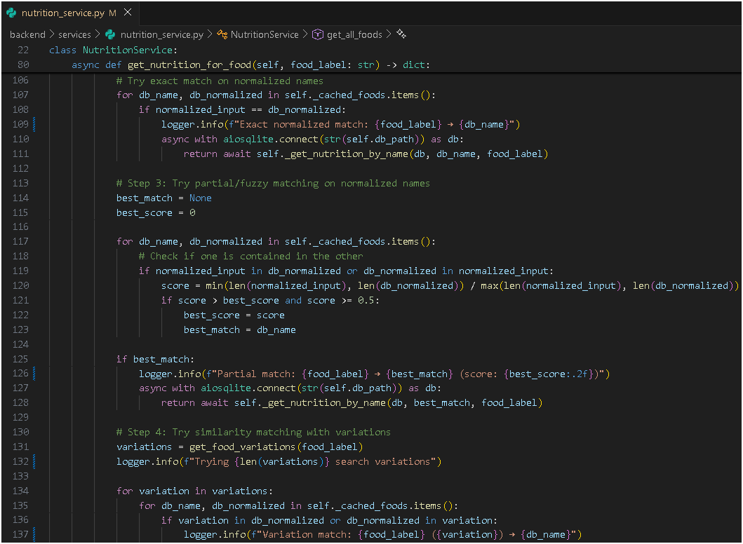
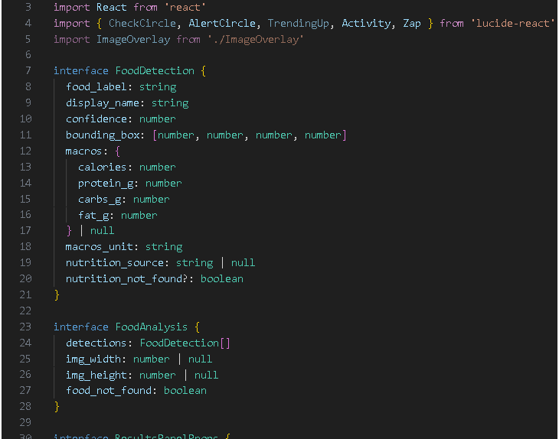
Code Snippets
Nutrition Mapping
Frontend

Slide 10
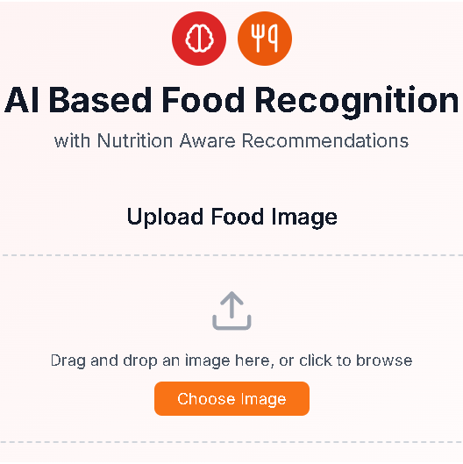
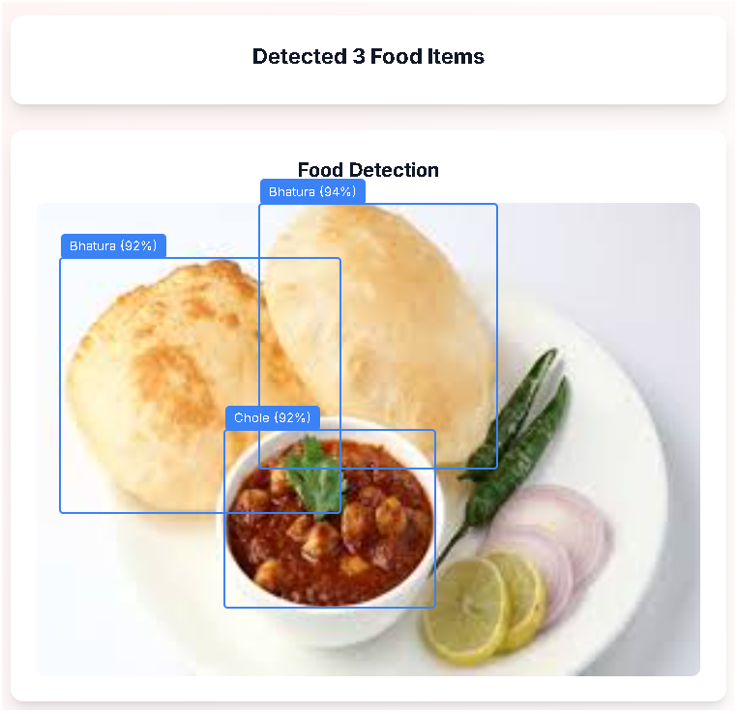
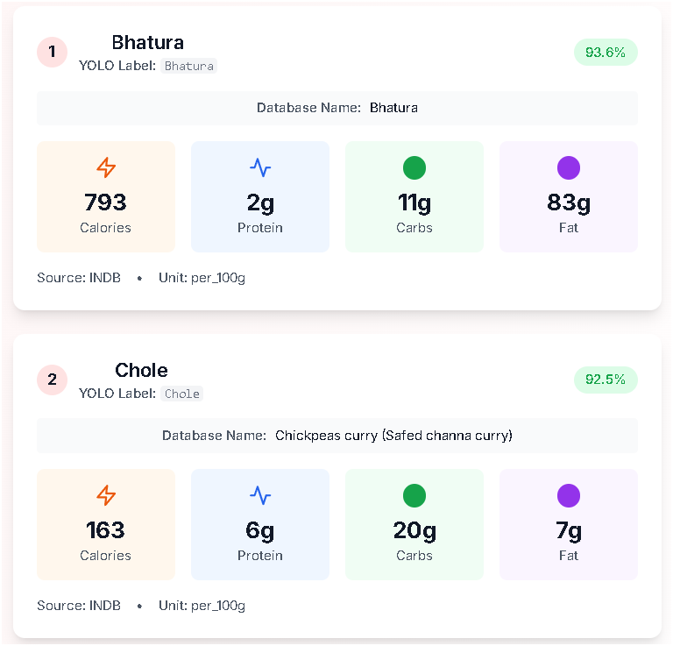

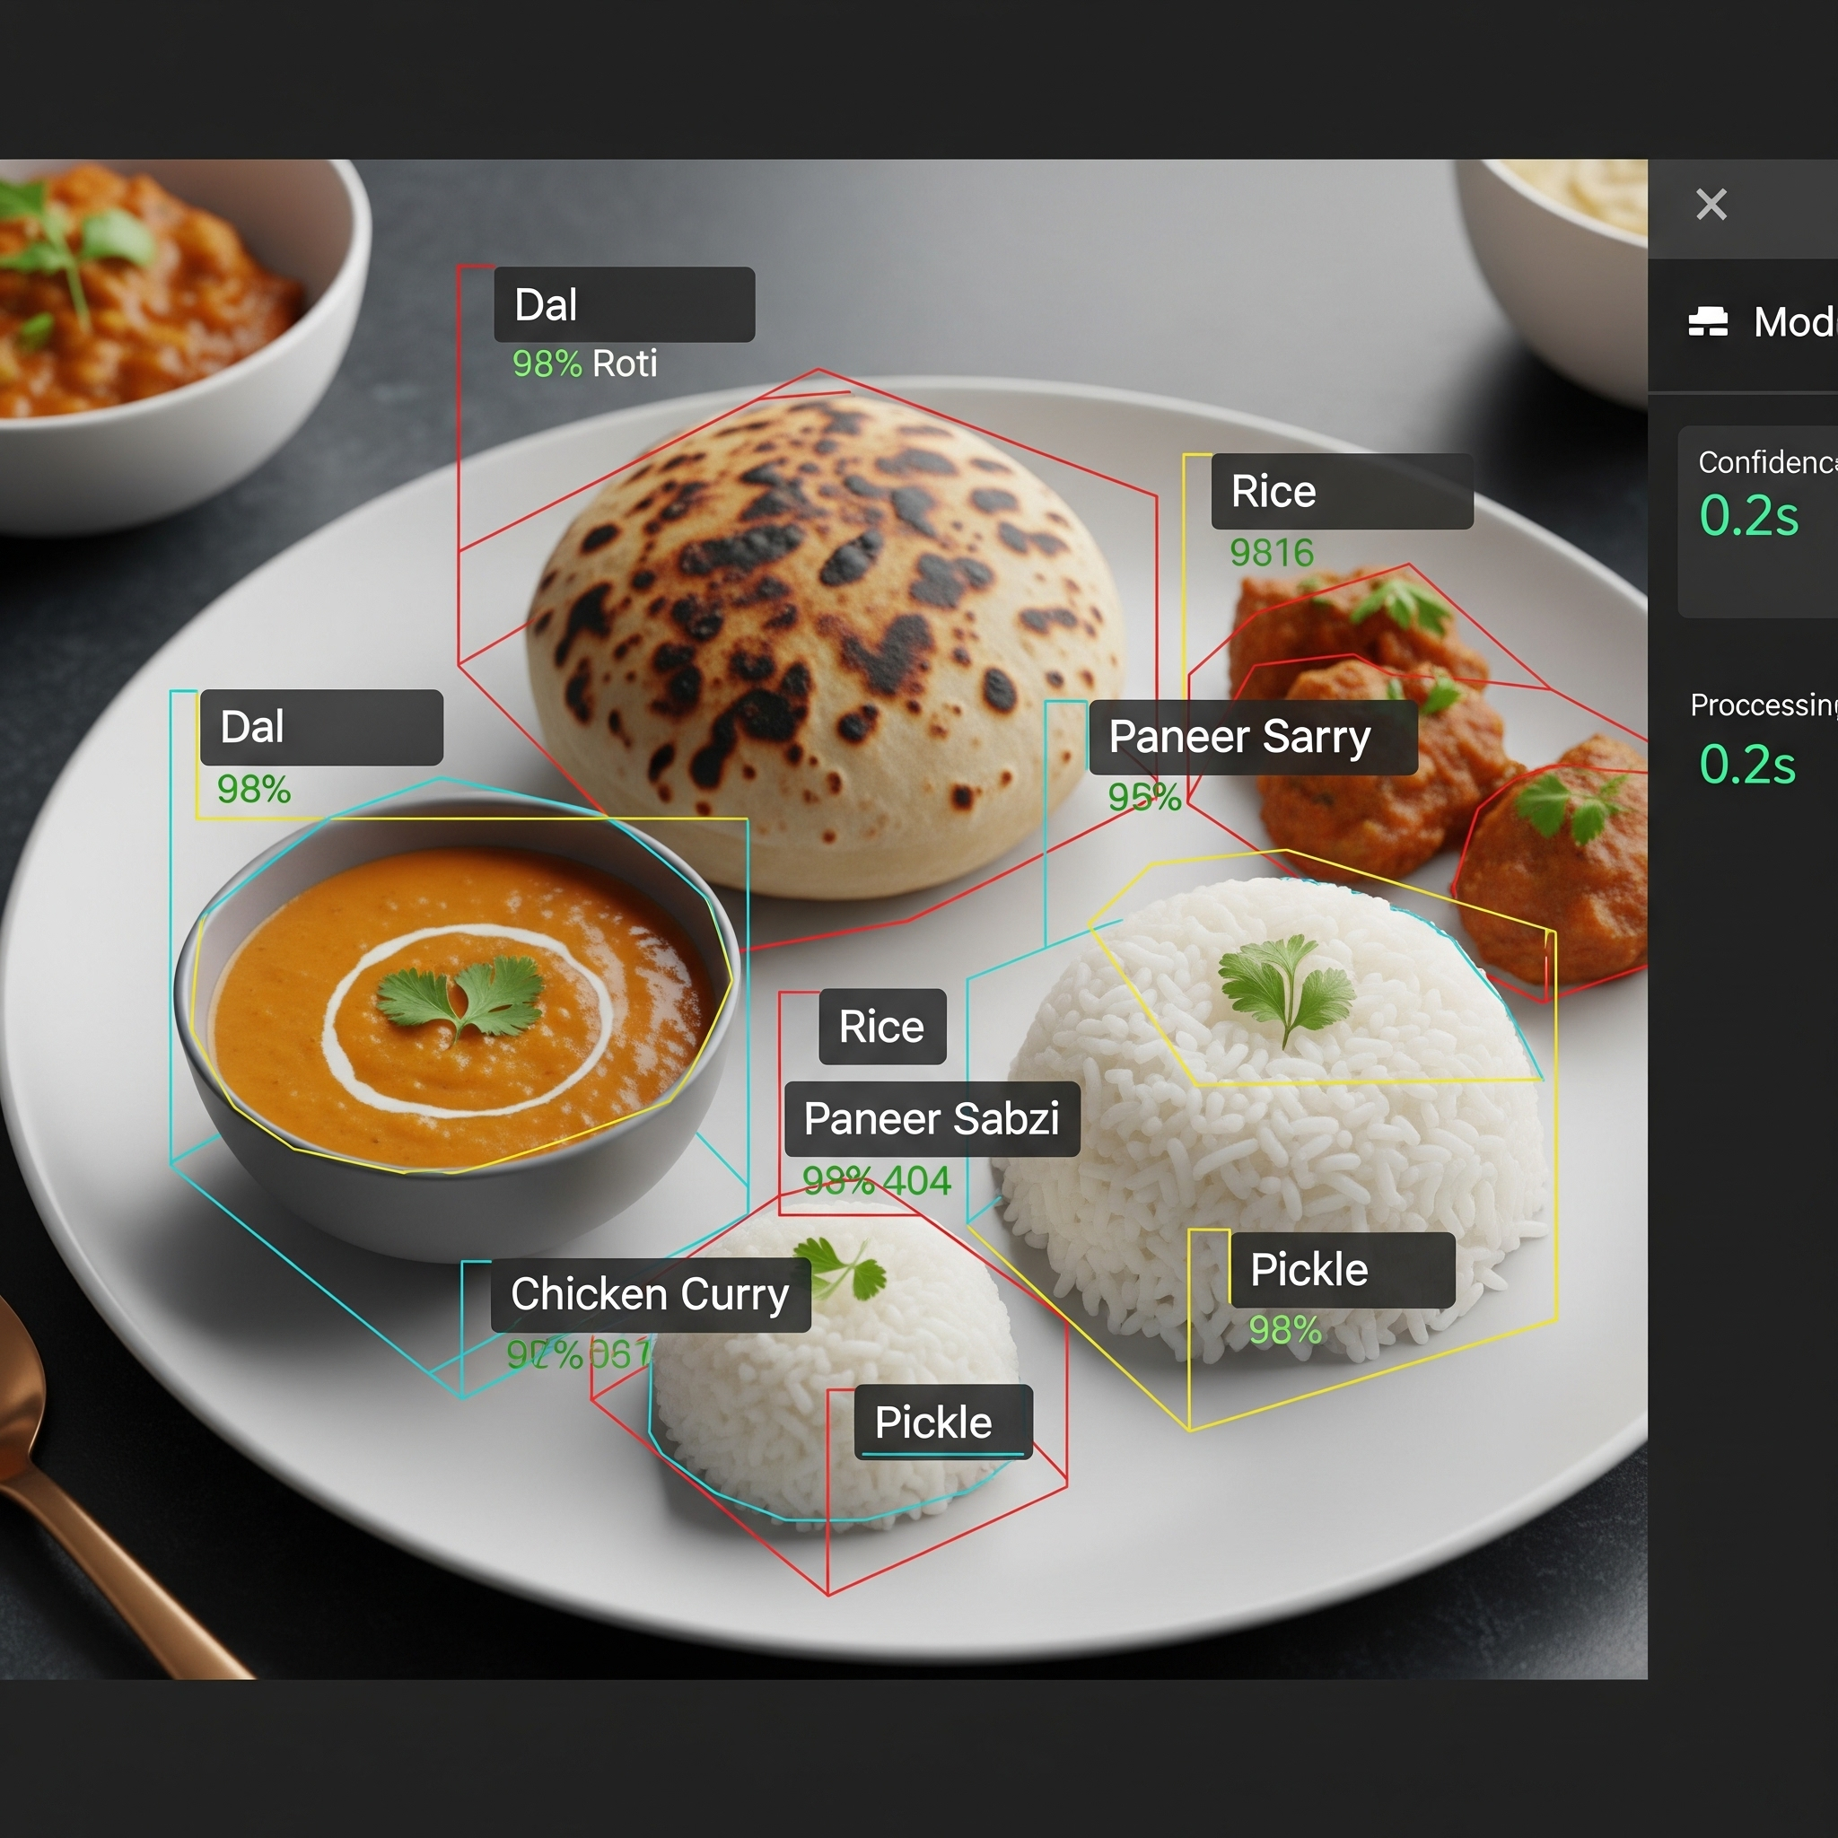
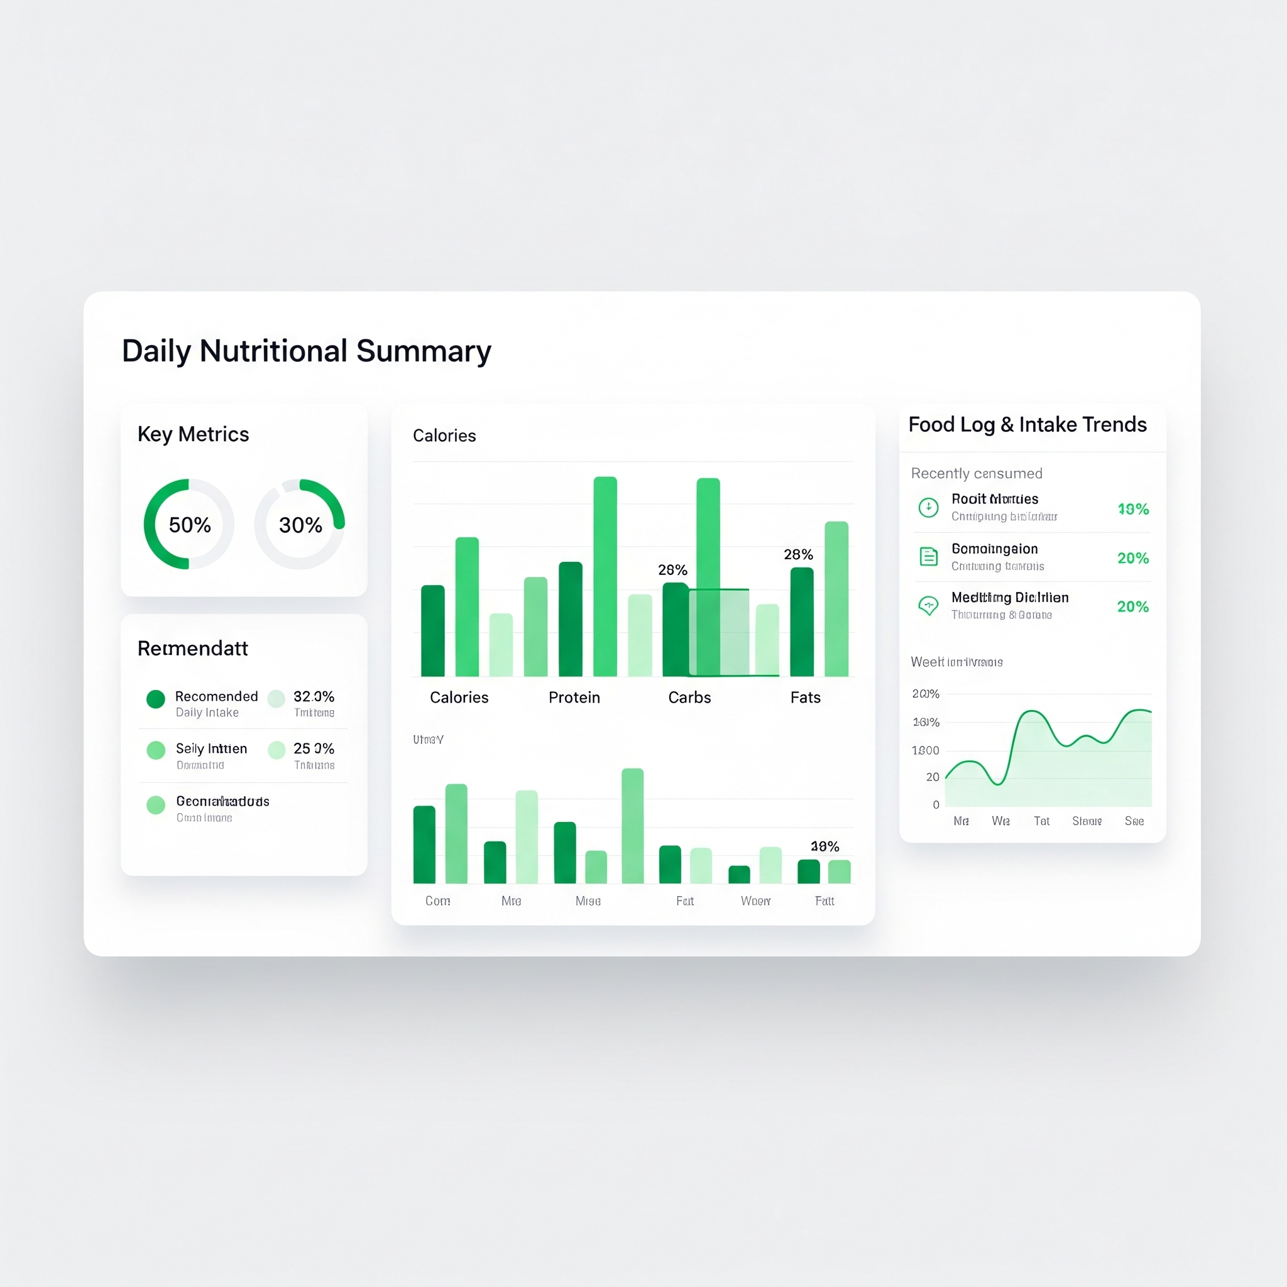
Project Screenshots
Upload Interface
Food Detection Output
Nutrition Display

Slide 11
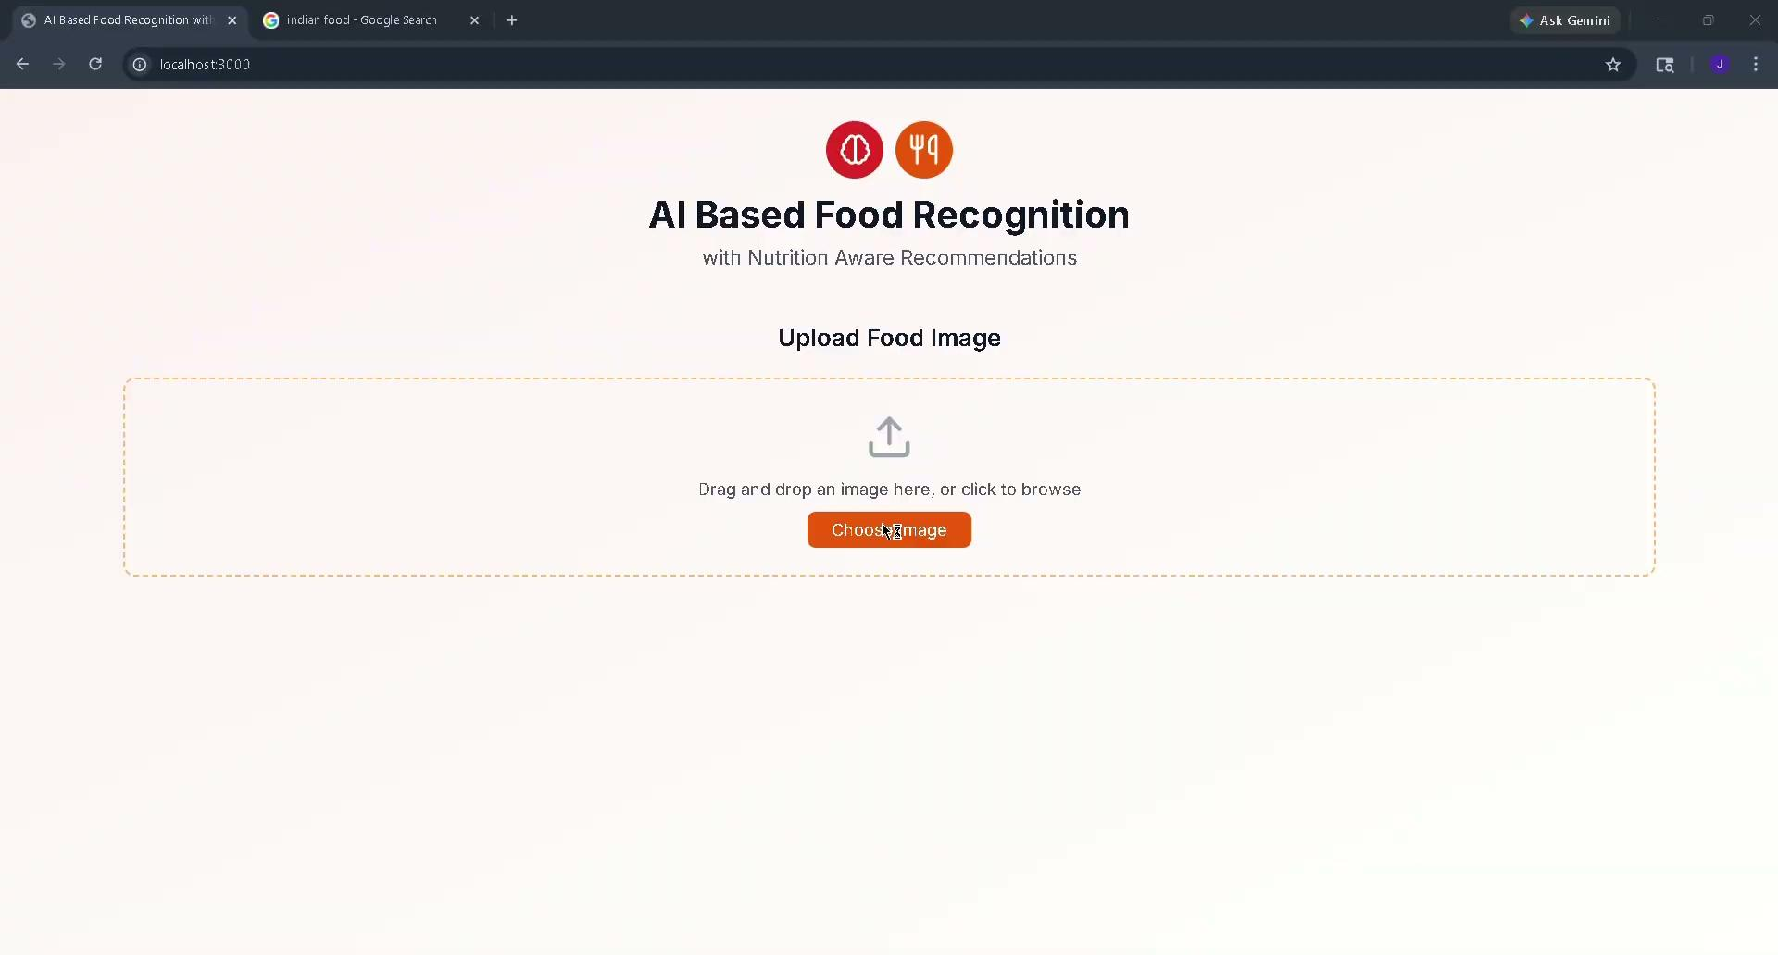
Project Demo

Slide 12

Conclusion
Future Work
What We Built
What Comes Next
✓
A working system for real-time Indian food identification from images.
Recommendation System
→
AI-powered personalized dietary guidance based on detected food and user health goals.
✓
Integrated nutrition mapping using an Indian food nutrition database.
✓
An accessible, web-based interface combining computer vision and nutritional intelligence in one pipeline.
Expanded Food Classes
→
Scale beyond 30 classes to cover a wider range of regional Indian dishes.
Addresses the research gaps identified from current literature.

