Slide 1


Marketing Analysis of MAGNET TELELINKS PVT LTD
Unveiling Insights to Drive Growth
By Jaspreet Singh Saini

Slide 2
About the Company
Company Name: MAGNET TELELINKS PVT LTD
Industry: Electronics Retail
Headquarters: Mumbai, India
Overview: Leading pure-play value e-commerce company in India. Top destination for electronics retail, catering to budget-conscious consumers.

Slide 3
Sales Dataset Overview
Dataset Description:
Source: Sales data provided by MAGNET TELELINKS PVT LTD.
Time Frame: January 2023 to September 2023.
Scope: Covers various aspects of sales and customer behavior.
Key Statistics:
Number of Records: 2,478 rows (individual sales entries).
Number of Attributes: 39 columns.

Slide 4
Data Cleaning and Feature Engineering
Data Cleaning
Initial Dataset:
39 columns with diverse sales and customer attributes.
Steps Taken:
Removed irrelevant or redundant columns, such as:
Non-informative attributes (e.g., IDs, empty fields).
Duplicates or columns with excessive missing values.
Final Feature Set: 27 relevant features retained for analysis.
Feature Engineering
Created new features to enhance analysis:
Days in Stock:
Calculated the number of days a product remained in inventory before being sold.
Provides insights into inventory turnover and product popularity.
Giveaway:
Flagged instances where products were offered as part of promotions or complimentary offers.
Helps analyze the effectiveness of promotional strategies.

Slide 5
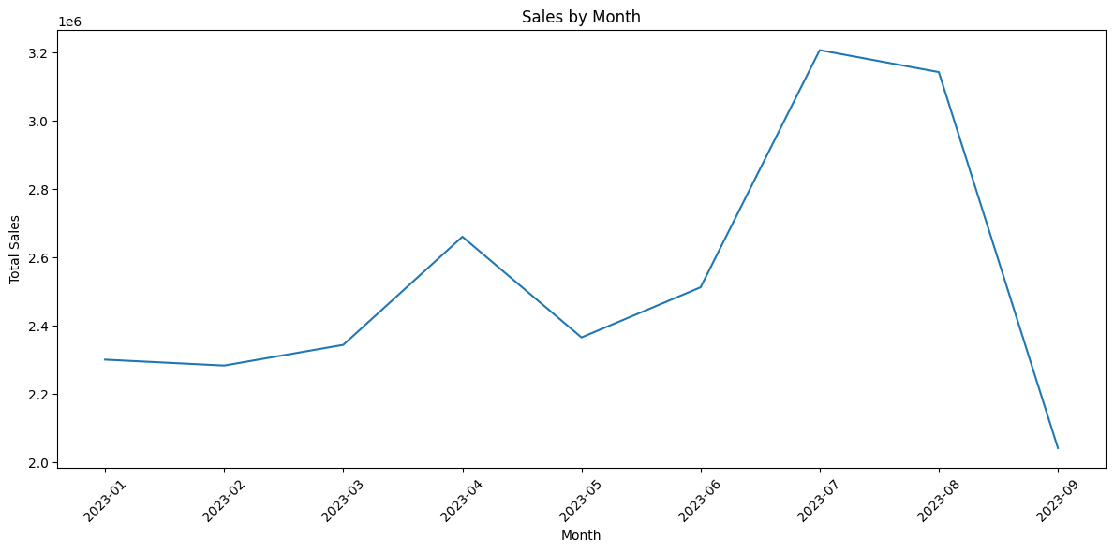
Sales Performance Analysis
Sales Trends
Peak Sales Period:
Highest sales recorded between July and August.
Indicates a seasonal trend, possibly driven by:
Back-to-school season other promotional campaigns.
Festivals.

Slide 6
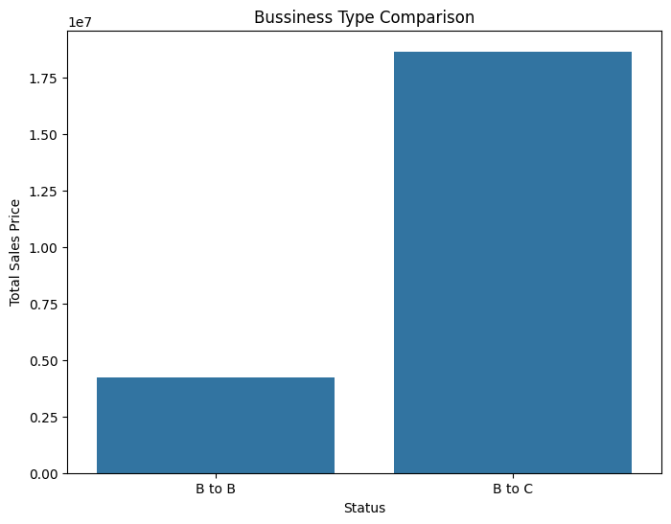
Sales Performance Analysis
Business-to-Consumer (B2C):
Over 75% of total sales are from B2C transactions.
Emphasizes the importance of retail customers in driving revenue.
Business-to-Business (B2B):
Contributes less than 25%, highlighting potential for growth in this segment

Slide 7
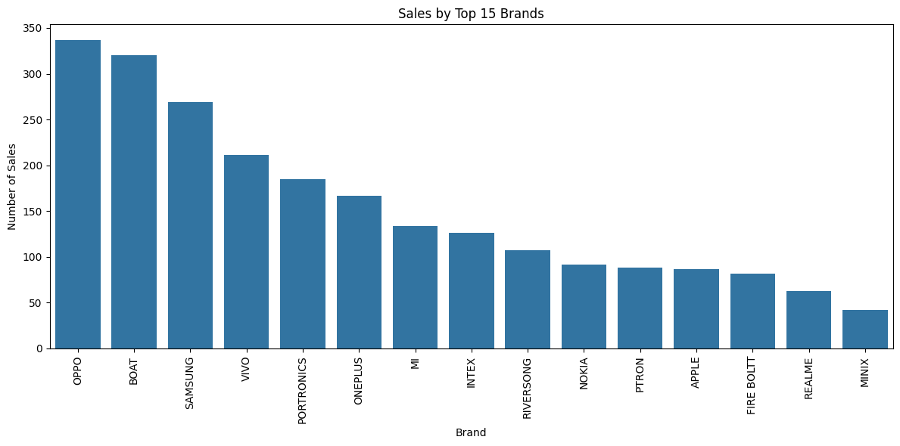
Customer Behaviour Analysis
Product Preferences
Android Dominance:
Customers show a strong preference for Android devices over iOS.
Android sales account for most smartphone purchases.
Possible Reasons for Preference
Affordability:
Android devices offer a wider range of price points, catering to budget-conscious consumers.
Variety:
Diverse options in brands, models, and features.
Customization:
Android's flexibility appeals to tech-savvy customers.

Slide 8
Customer Behaviour Analysis
Key Insights
High Monetary Value for Apple Models:
Despite lower sales volume compared to Android, Apple models generate the highest monetary value per purchase.
Indicates strong brand loyalty and willingness to pay premium prices.
Possible Drivers of High Monetary Value
Premium Pricing: Apple’s products are positioned as luxury items.
Customer Loyalty: Apple’s ecosystem encourages repeat purchases.
Higher Margins: Products contribute significantly to profitability.
BRAND | Recency | Frequency | Monetary Value
APPLE | 437 | 87 | 2967139
BOAT | 432 | 320 | 402728
CONEKT | 462 | 1 | 1500
DEFY | 451 | 9 | 9
FIRE BOLTT | 442 | 82 | 160339

Slide 9
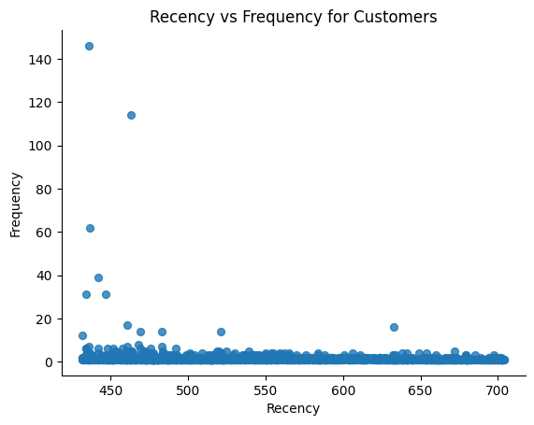
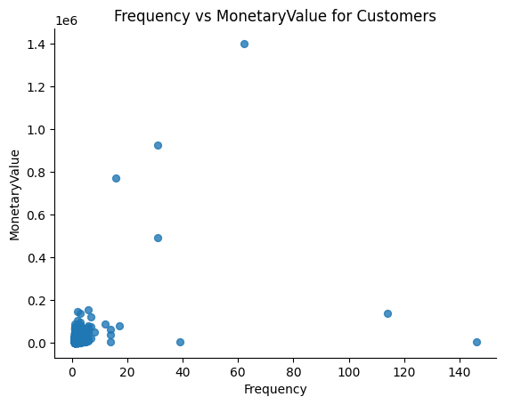
RFM ON customer

Slide 10
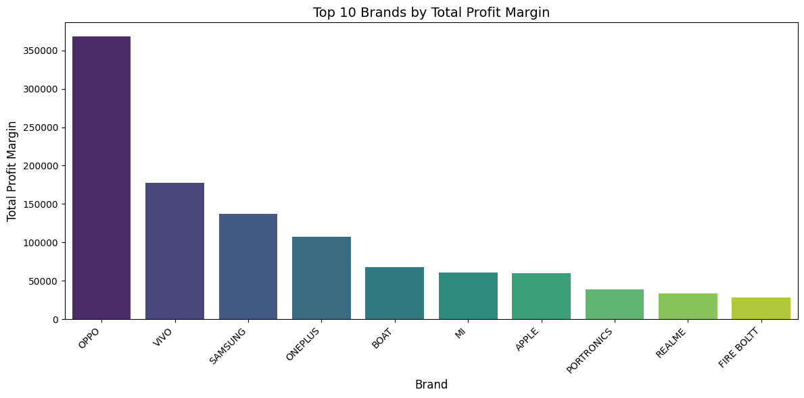
Identifying Valuable Models and Products

Slide 11
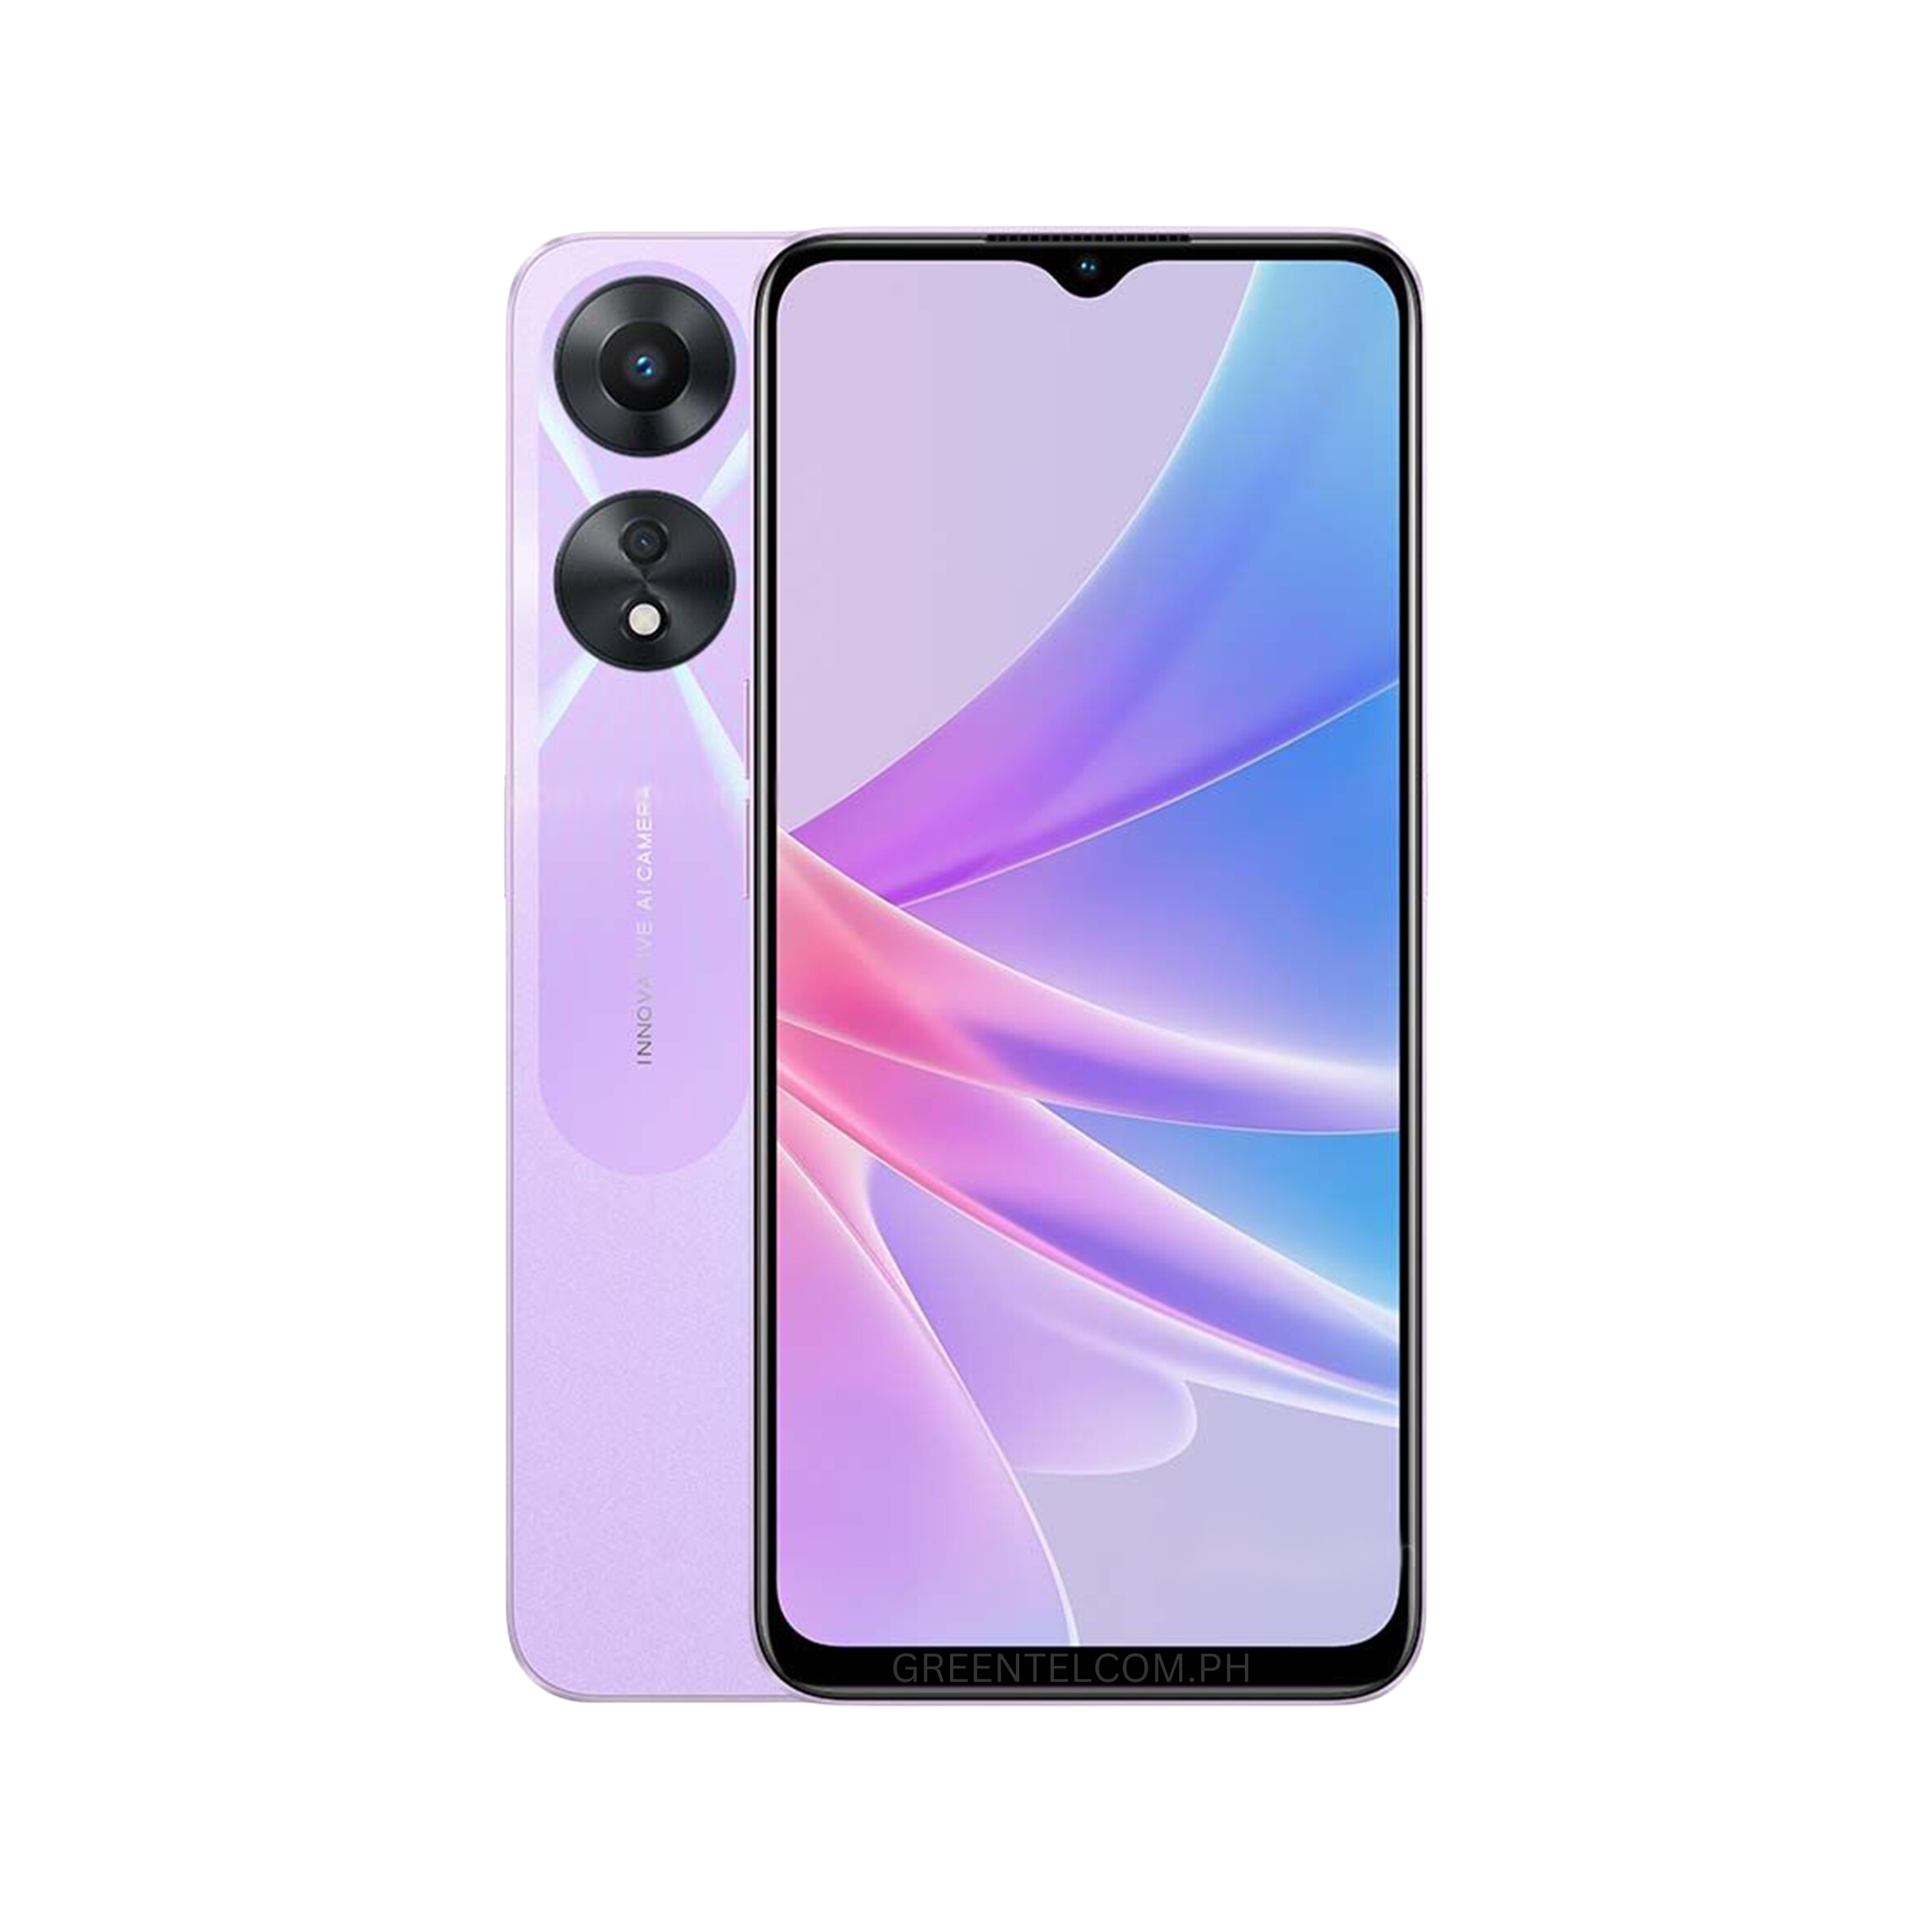
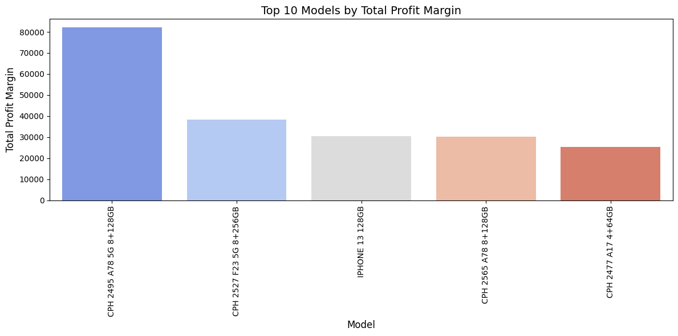
OPPO A78 5G Best Selling Product

Slide 12
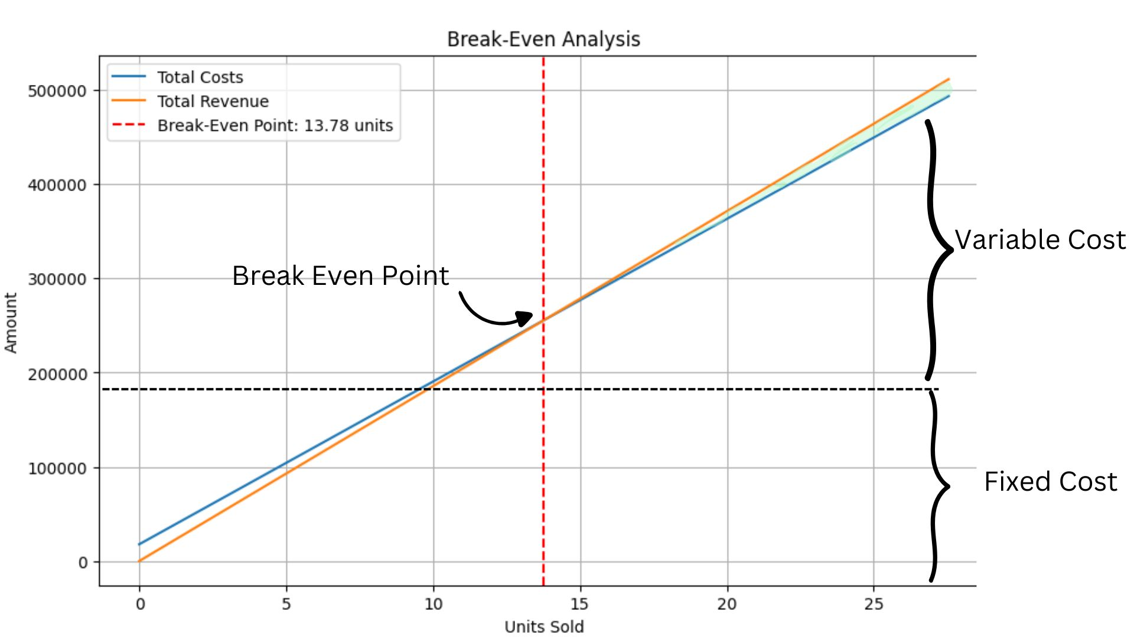
Break Even Point For OPPO A78 5G

Slide 13
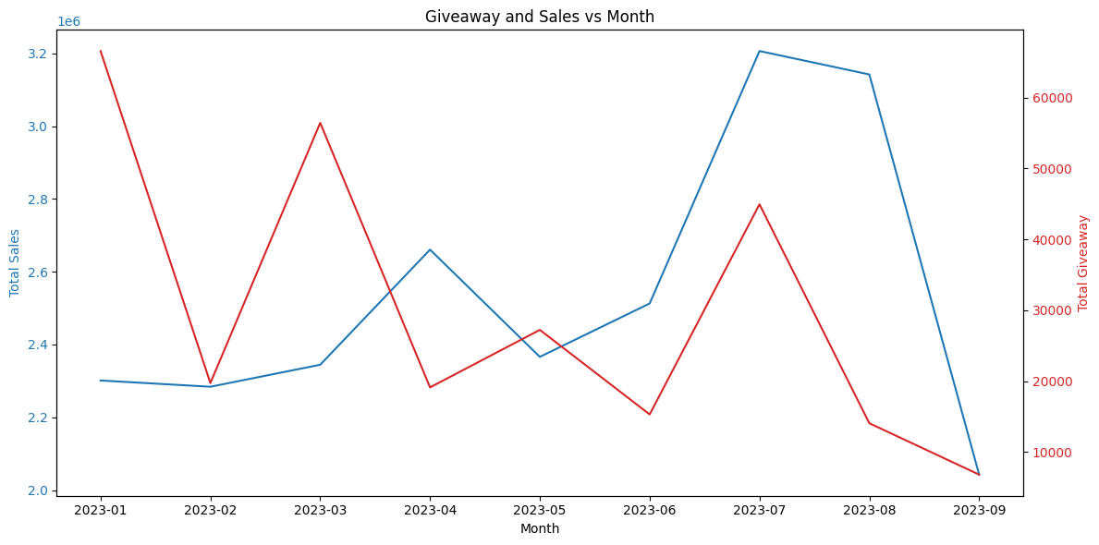
Promotion Planning(part1)
It appears that Magnet Telecoms gave away a total of Rs 270,151.21 over a 9-month period.
Higher Giveaways Do Not Always Correlate with Increased Sales:
In some months (e.g., March and July), giveaway campaigns peaked significantly, but this did not result in proportionally higher sales. This suggests that giveaways alone may not drive sales effectively without a complementary strategy, such as targeted advertising or bundling promotions.

Slide 14
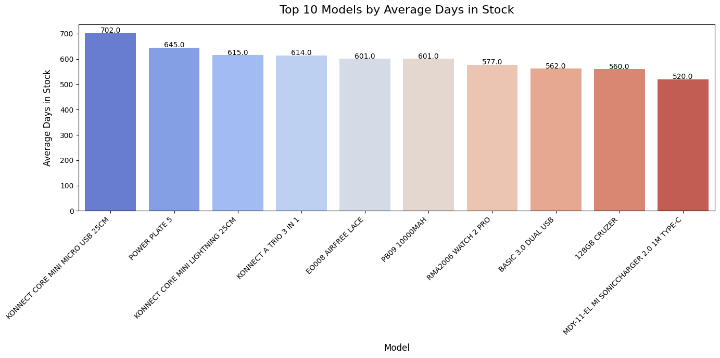
Promotion Planning(part2)
Bundling Slow-Moving Products with Popular Items
Strategy: Combine slow-moving inventory with high-demand products in bundled offers. For example, "Buy our best-seller and get [slow-moving product] for free!"
Benefit: This reduces shelf space usage while boosting sales of popular products, creating a win-win scenario. It also gives exposure to the lesser-known or slow-moving product.

Slide 15
SWOT
Strengths: Established Brand Presence: Recognizable in the market, providing a foundation for B2B expansion. Diverse Product Range: Ability to cater to different customer segments, including businesses. Existing Infrastructure: Distribution and operational networks can be leveraged for B2B strategies.
Weaknesses: Ineffective Marketing Strategies: Current efforts are not driving desired results, leading to inefficient budget allocation. Limited Online Presence: Lagging behind competitors on digital platforms, reducing reach and visibility. Dependency on Giveaways: Heavy reliance on discounts and giveaways might devalue the brand.
Opportunities: Expansion into B2B Markets: Targeting businesses with tailored solutions (e.g., bulk sales, corporate contracts) to diversify revenue streams. Digital Transformation: Invest in e-commerce, social media marketing, and online customer support to capture the growing online audience. Partnerships and Collaborations: Collaborate with service providers or corporate clients to secure bulk deals and contracts.
Threats: Rising Competition from Online Platforms: E-commerce giants and direct-to-consumer brands are capturing market share. Economic Fluctuations: Changes in market demand or financial constraints of potential clients can affect sales. Rapid Technology Changes: Falling behind in innovation could lead to obsolescence in a competitive industry.

Slide 16
Recommendations:
Focus on B2B Expansion: Develop business-centric packages or solutions for corporate clients, like customized plans, device bundles, or service agreements.
Strengthen Digital Strategy: Build a strong online presence through SEO, targeted ads, and engaging content to compete with online platforms.
Enhance Value Proposition: Move away from giveaways toward demonstrating product quality and service reliability for long-term brand equity.

