Slide 1

SIMUTECH PROJECT

Slide 2
Standard Template library
Vectors
Stacks
Queues

Slide 3
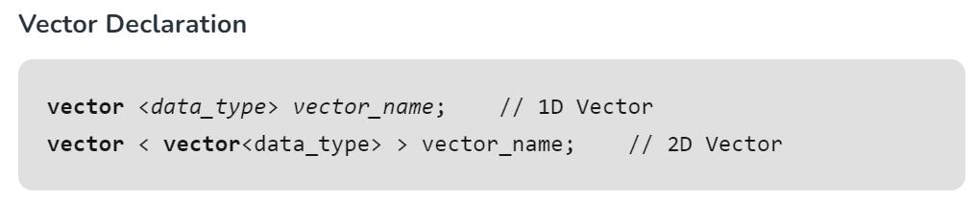

Vectors

Slide 4

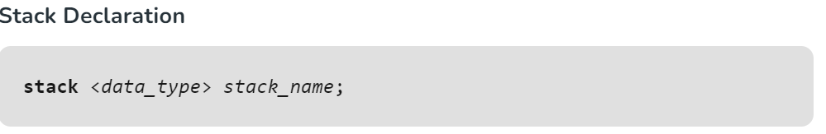
Stacks

Slide 5

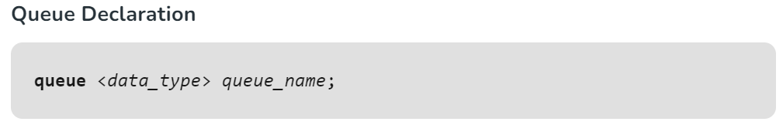
Queues

Slide 6
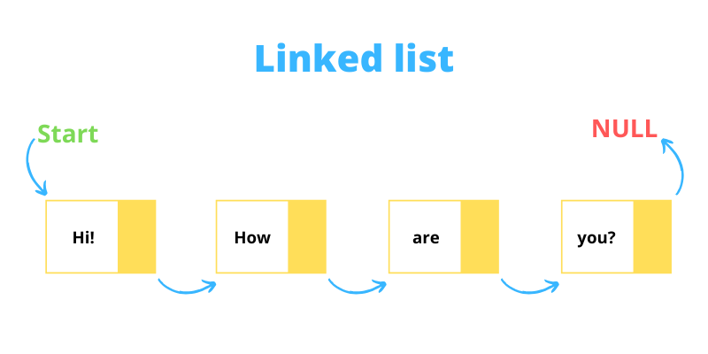
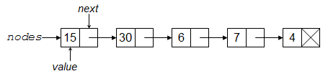
Linked Lists
This Photo by Unknown Author is licensed under CC BY-SA-NC
This Photo by Unknown Author is licensed under CC BY-NC-ND

Slide 7

Problems discussed
Largest rectangle in histogram
Reverse linked list
Palindrome linked list
Delete the middle node of a list
Merge two sorted lists

Slide 8
Binary Tree
3 Types of traversal
Inorder
Preorder
Postorder

Slide 9
Questions
Search in a BST
Max depth of a BST
Symmetric tree
Validate BST
Maximum level sum of a binary tree

Slide 10

Dangling Pointers
Dangling pointer occurs at the time of the object destruction when the object is deleted or de-allocated from memory without modifying the value of the pointer. In this case, the pointer is pointing to the memory, which is de-allocated. The dangling pointer can point to the memory, which contains either the program code or the code of the operating system. If we assign the value to this pointer, then it overwrites the value of the program code or operating system instructions; in such cases, the program will show the undesirable result or may even crash. If the memory is re-allocated to some other process, then we dereference the dangling pointer will cause the segmentation faults.

Slide 11
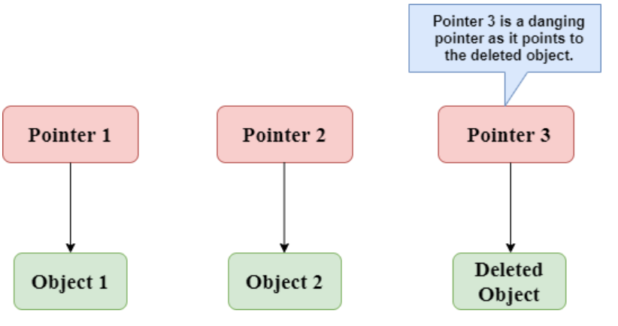

Slide 12

Heaps
Types of Heap Data Structure Generally, Heaps can be of two types: Max-Heap: In a Max-Heap the key present at the root node must be greatest among the keys present at all of it’s children. The same property must be recursively true for all sub-trees in that Binary Tree. Min-Heap: In a Min-Heap the key present at the root node must be minimum among the keys present at all of it’s children. The same property must be recursively true for all sub-trees in that Binary Tree.

Slide 13
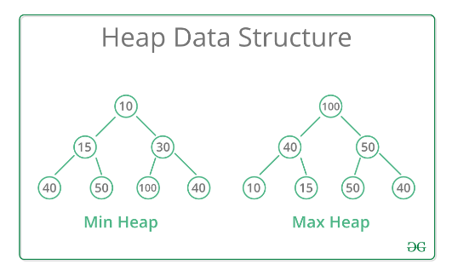
Representation

Slide 14
Some graphs questions
Depth first search
Breadth first search
Is graph bipartite?
Cycle detection in undirected graph
Priority queue

Slide 15
Use of Djikstra’s Algo in Chemical Engg
Read a research paper
It mentioned about how this algo can be used in chemical kinetics.
Also in the plasma chemical reaction engineering
It uses a dataset, that contains the data required for plasma chemical reaction engineering generally consists of a list of reactions with their corresponding reactants and products, along with the rate coefficients of such reactions which are generally constants

Slide 16

Monte Carlo Simulation

Slide 17
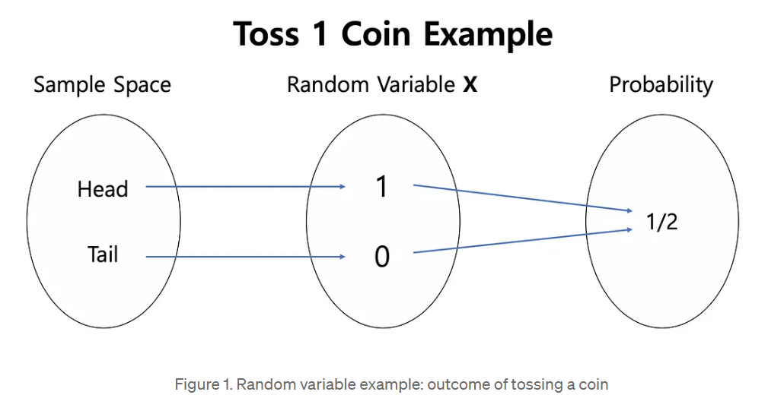
Random Variable
Random variables have 2 types
Discrete
Continuous

Slide 18

Discrete Random Variable
A discrete variable is a variable whose value is obtained by counting(finite). It can take only distinct, separate values.
The random variable in figure 1 and 3 is an example of a discrete random variable. It has two values which are 1 and 0, those are apparently distinctive and countable values. In other words, if a random variable 𝑿 has a finite and countable number of values that it can take on, then 𝑿 is a discrete random variable

Slide 19

Continuous Random Variable
In contrast to discrete random variables, a continuous random variable is a variable whose value is obtained by measuring. It can take on any value in some interval(low, high).
For instance, let the random variable 𝐘 denotes the exact mass of a random human selected on the earth. 𝐘 might take on any value somewhere between 0 and 200kg. However, we can not list all of the possible masses in this interval since there is an infinite number of values between consecutive two numbers. For example, between 70.01 and 70.02 there are 70.001, 70.0001, 70.00001, 70.00…0001 and so on. Namely, since it is impossible to make a list of all possible values that 𝐘 can take on, 𝐘 is a continuous random variable.

Slide 20

Some subtopics
Variance
Standard Deviation
Probability
Expectation Value
Statistical Distribution

Slide 21
Types of Statistical Distribution
Binomial
Poisson
Normal/Gaussian
Bernoulli
Uniform

Slide 22
Some examples
Monty hall problem
Toy collector problem
Complicated integral

Slide 23
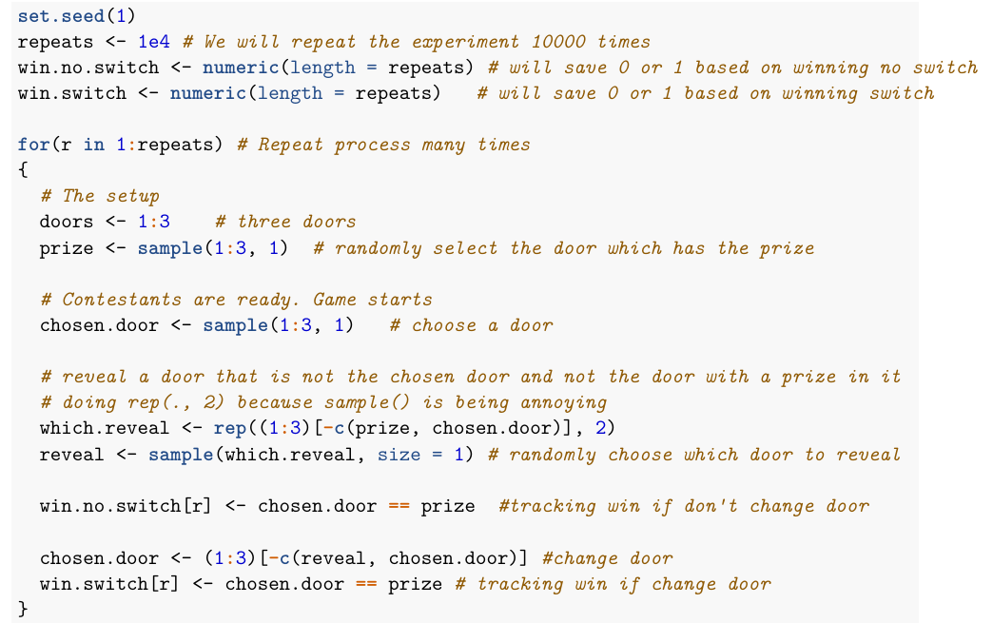
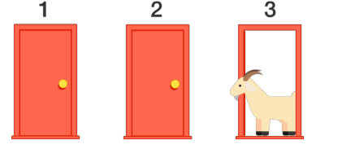
Monty Hall

Slide 24
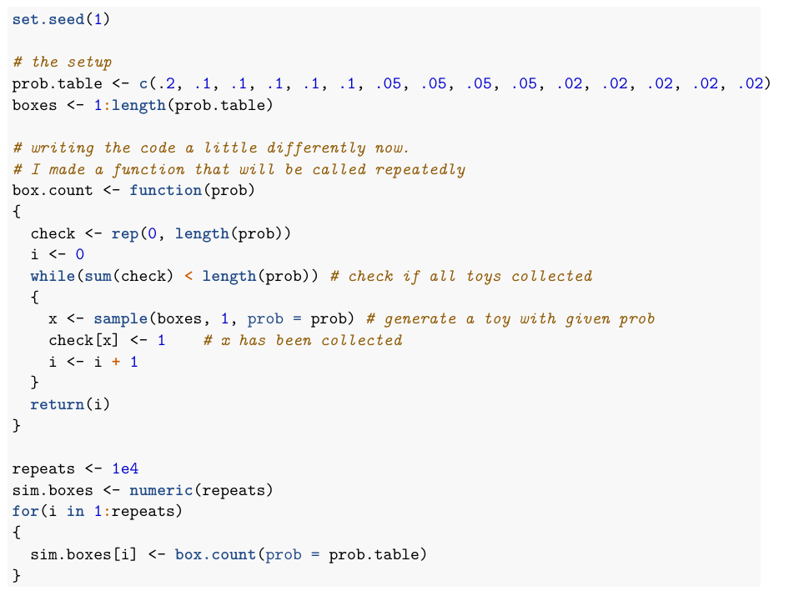
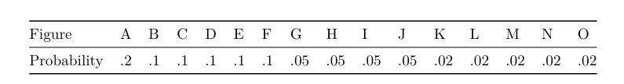
Toy Collector

Slide 25
Few methods and techniques
Inverse transform method
Acceptance-Rejection Technique

Slide 26
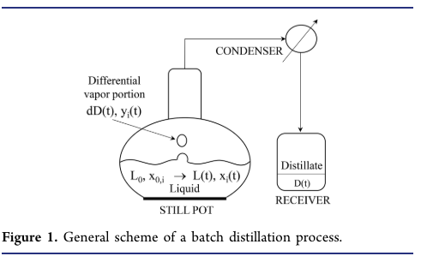
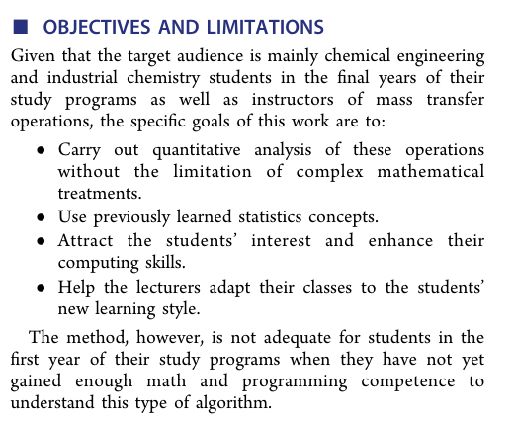
Stochastic Approach for Mass Transfer

Slide 27
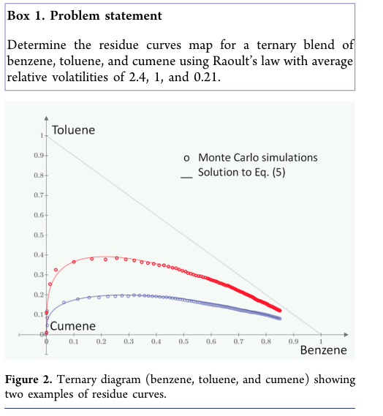
Case Study 1: Multicomponent Batch Distillation and Residue Curves (Transient Operation)

Slide 28
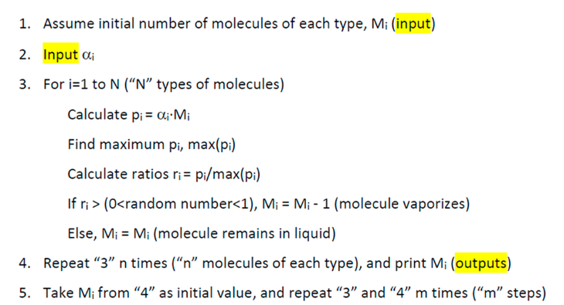
Pseudocode

Slide 29
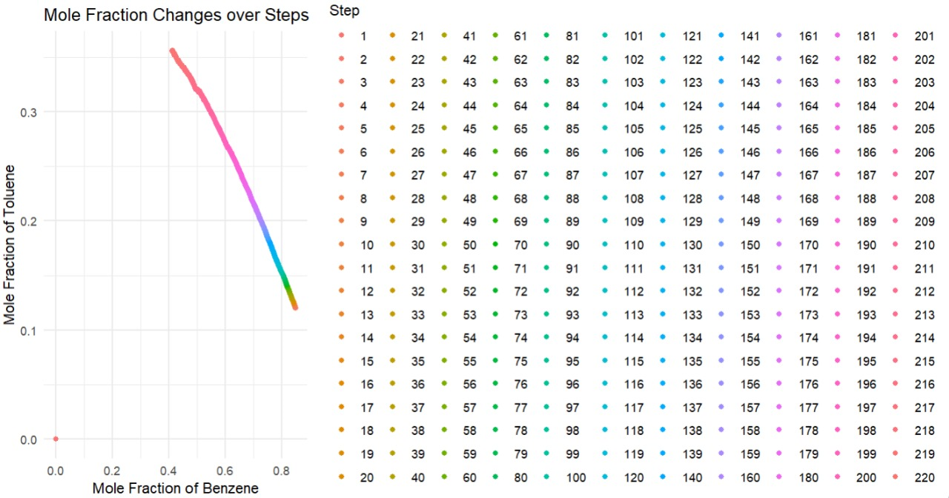
Results in R

Slide 30
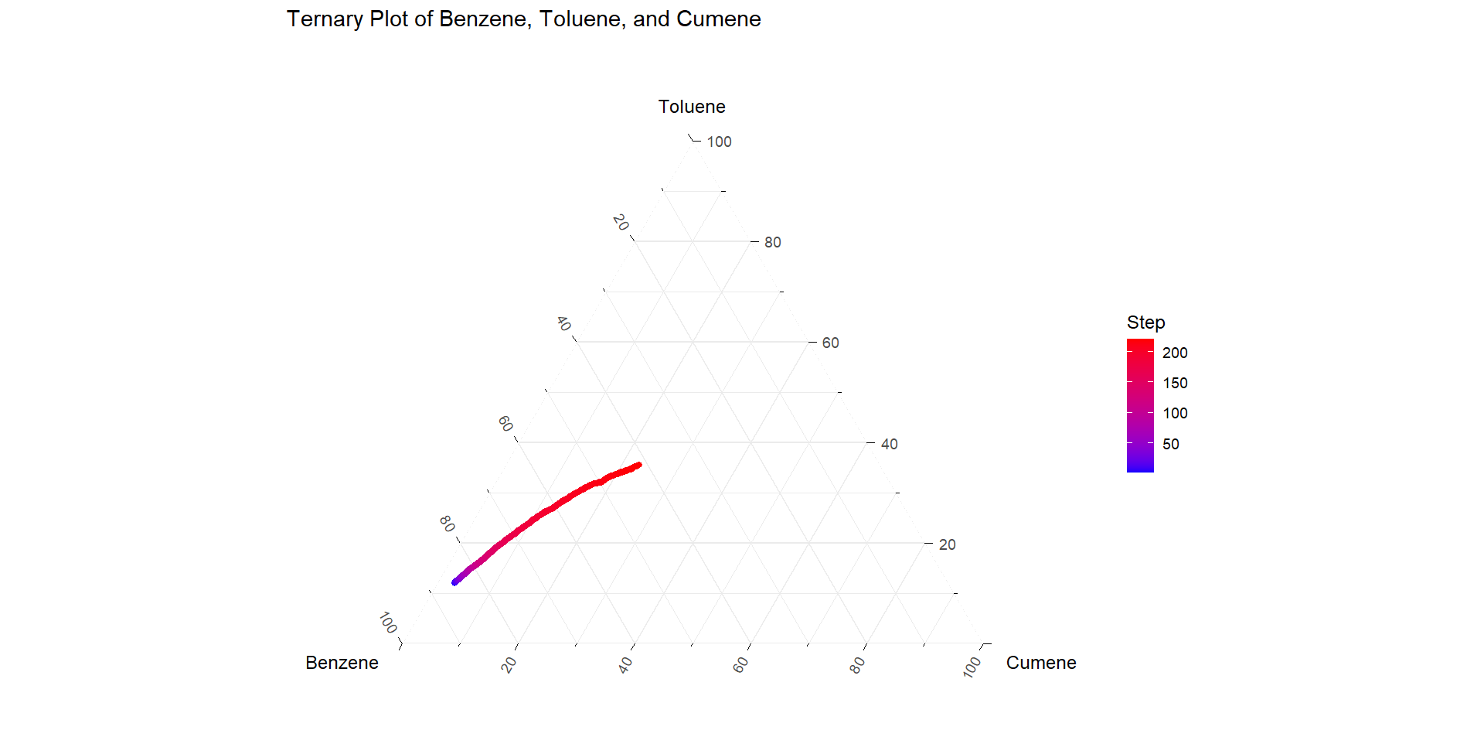
Results in R

Slide 31
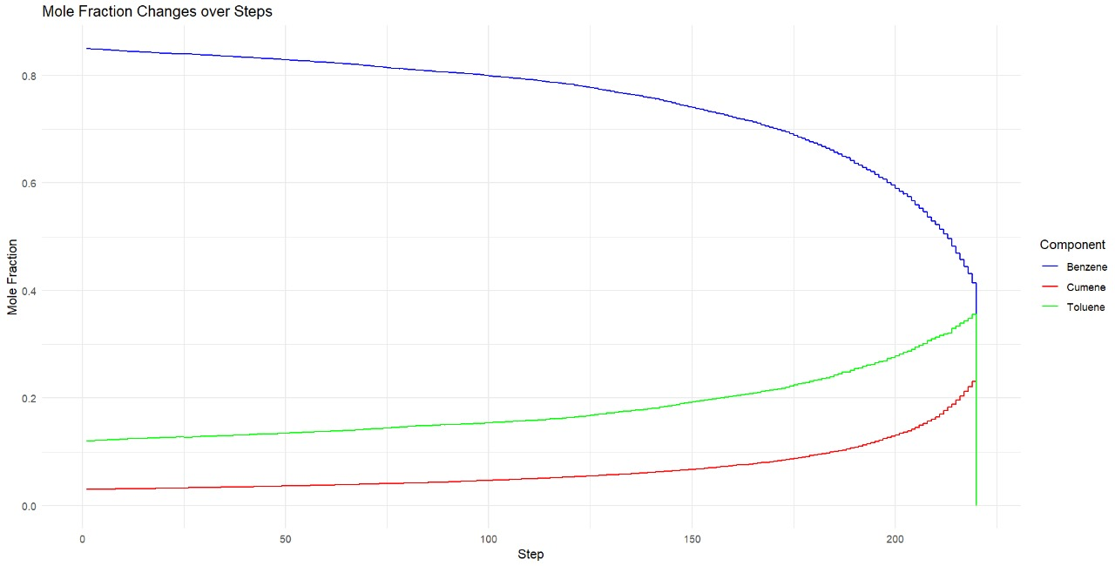
Results in R

