Slide 1
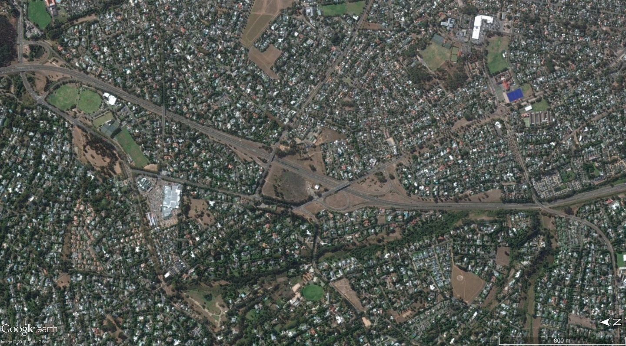
Site Location

Slide 2
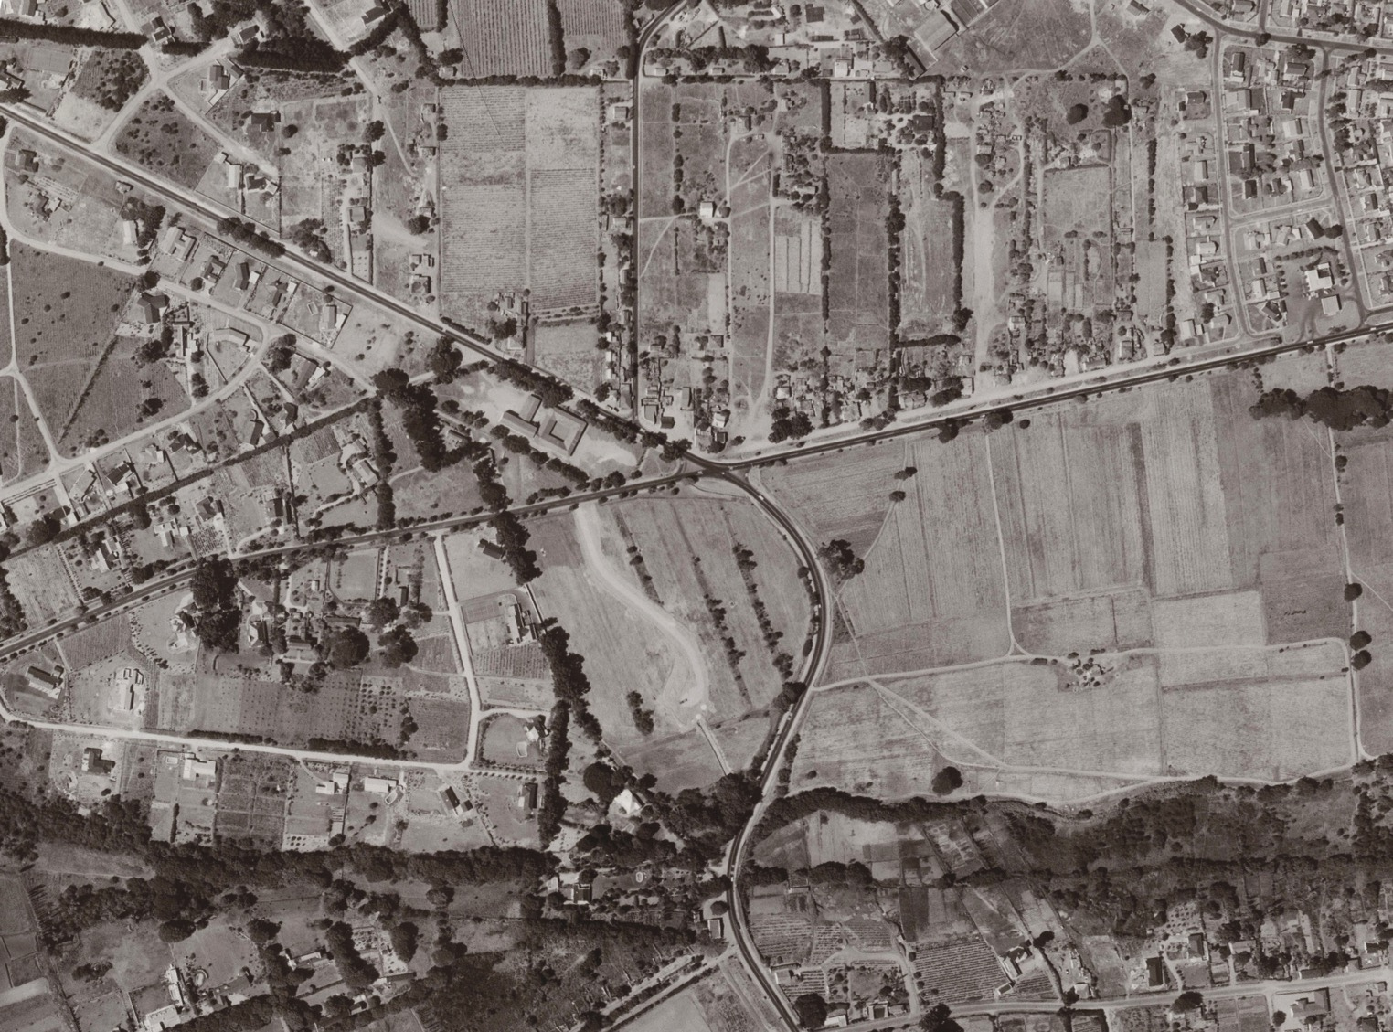
Site Location

Slide 3
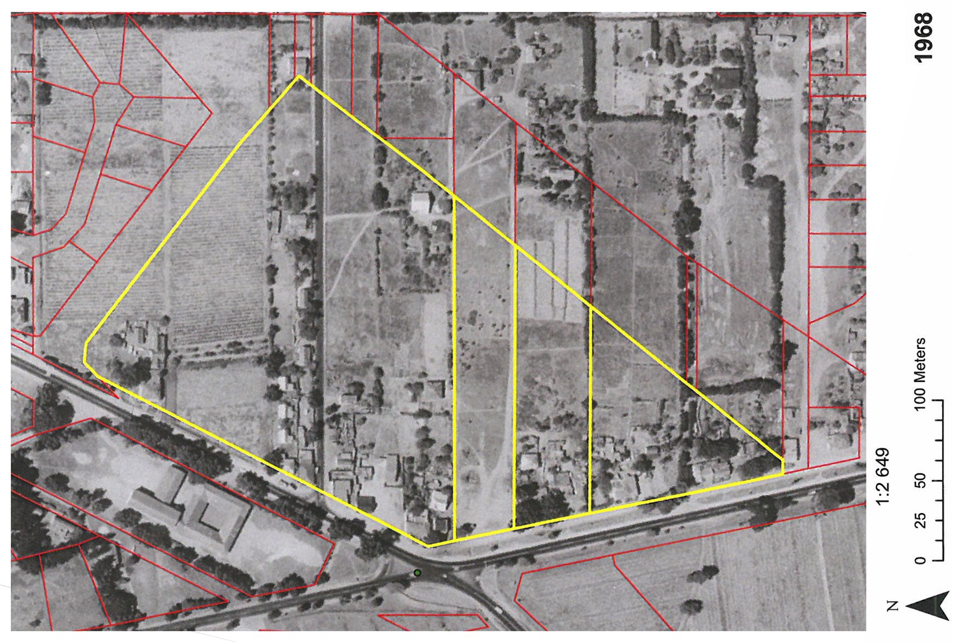
Historic Background

Slide 4
Tree Lane
Tree Lane
Tree Lane
Historic Road Alignment
Tree Lane
Tree Lane
Buildings activate the Street
Buildings activate the Street
Site Informants

Slide 5
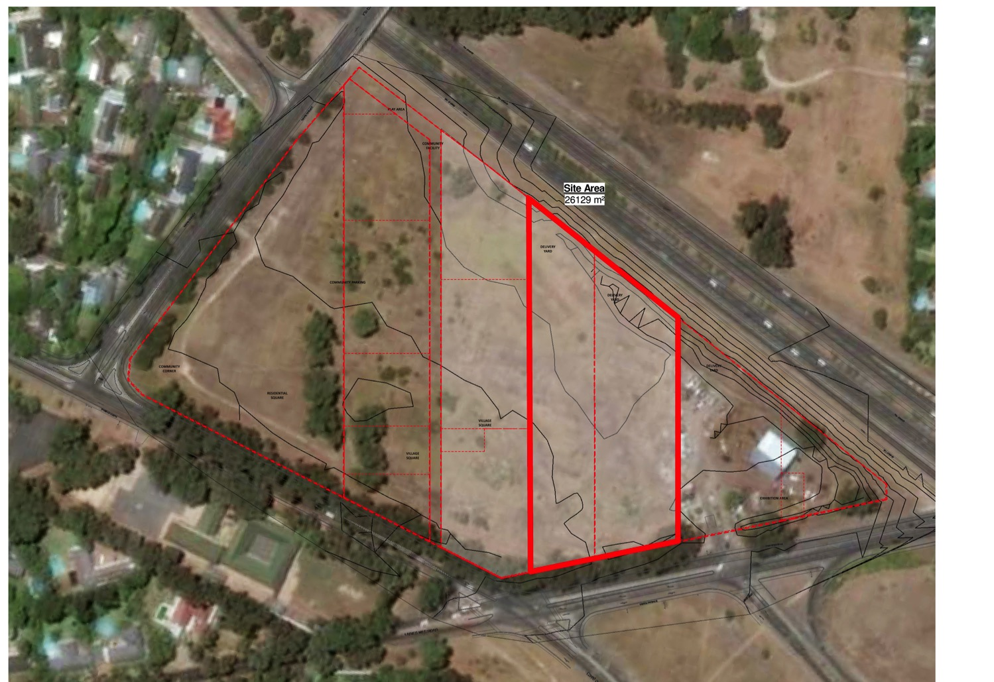
Active Street
Site Informants

