Slide 1
Proposal add program check IO vacuum drop PCBA ROT
Presenter: PE KIC
Date: 07 May 2026

Slide 2
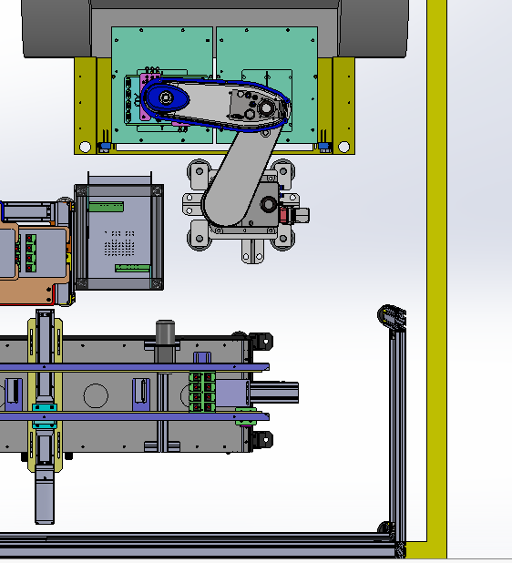
Proposal add program check IO vacuum drop PCBA ROT
● Add program and process flow
Plan setup
Old Process Flow
New Process Flow
Cutting PCBA
Cutting PCBA
Robot pick PCBA form router jig
1
Robot pick PCBA form router jig
1
Vacuum check
Vacuum check
1
2
Double check
Robot move to clean PCBA and leave frame
Robot move to clean PCBA and leave frame
2
Vacuum check
Robot move PCBA to place on conveyor
Robot move PCBA to place on conveyor
Robot to prepare pickup next PCBA
Robot to prepare pickup next PCBA

Slide 3
THANK YOU FOR YOUR ATTENTION

