Slide 1
Natural Language Processing
Lecture 9
Steve Kunath

Slide 2
Updates
Quiz next week
Project updates moved now due next week
Homework #3 released next week
Any questions?

Slide 3
Tonight
Discuss projects
How was homework #2?
Discuss NLP Data Annotation
Discuss Evaluation

Slide 4
Project Status?
How is the project going?
Any data requests?
Would meeting outside of class be helpful?

Slide 5
Other Questions?

Slide 6
Evaluating
So far in this class we have talked about a variety of different NLP techniques
Do all these things work well?
How would we know if things are working well or not?

Slide 7
Tokenization Accuracy
Current tokenization accuracy can generally be over 80%, depending on the data types
Challenges to tokenization related to what type of data you are looking at.
Twitter
Newswire
Biomedical
Tokenization is particularly sensitive to the types of data you are using and what your tokenizers have been tweaked for
One challenge is that most additional NLP processes rely on accurate tokenization

Slide 8
Segmentation Accuracy
Segmentation of documents into sentences and other smaller chunks is challenging.
Normally it is downstream of tokenization which means it relies on accurate tokenization.
Challenges abound due to complex sentence structures that are further afield than normal newswire text
Additional challenges exist when you are dealing with documents that contain non-textual areas. Consider tables, images, and other things outside of continuous text.

Slide 9
Part-of-Speech tagging accuracy
Currently it’s around 97% accurate
What does this accuracy mean?
Tag the following sentence:
John Deere shipped a tractor.
A 60% slash in the common stock dividend (noun or verb?)
Blaming the disaster on substandard construction (noun or verb?)
Why might some of the above sentences be inaccurately tagged?

Slide 10
Syntactic Parsing Accuracy
Syntactic parsing accuracy generally ends in the 80-95% range.
One challenge here is that these scores are typically reported on only a small number of datasets.
A frequently used dataset is the PennTreebank on Wall Street Journal data.
A challenge that remains for syntactic parsing is that data for this is particularly tedious.
Imagine having to manually construct and evaluate trees for a large number of sentences

Slide 11
Information Extraction Accuracy
Information Extraction accuracy is typically a function of the data types being used and the extracted concepts being identified in the document
For example, identifying names of people might be easier than identifying the names of pharmaceuticals. Any thoughts as to why?
Typical reports are done by category. Some categories can be up to 95%+ accuracy levels (typically names of people).

Slide 12
How do we investigate accuracy?
Up to now we’ve simply been quoting numbers of accuracy without getting into the details of how these numbers are determined.
What then do we mean by accuracy?
How then are these scores produced?
Does one simply want to use numbers like accuracy or are there more specialized values that can be used?

Slide 13
Types of evaluating
Generally we would like everything to be automated for the purposes of evaluation
Why?
It makes life simple and the evaluations are quick to run
Robots are better
Challenges?
Humans are the ones evaluating the results of your NLP system so you want to capture their perspective in your evaluation
Manual evaluation instead?
You can manually evaluate the output of your NLP system, but this can be tedious and time consuming

Slide 14
The general shape of evaluations
To perform an evaluation requires that you have things to evaluate
A first step in any evaluation then is to begin the process of constructing a dataset
After you identify your documents, you need to consider what you want to evaluate from the documents
Consider if it is an information extraction or part-of-speech tagging problem
Identify and codify your evaluation and data scheme for the first time
Have humans read over the raw data (possibly supported by early versions of output)
Human tag the data – generally have two people tag the same data
Compare the tags between the individuals
Possibly update your evaluation scheme
Repeat until you are satisfied … you then have an evaluation data set

Slide 15
Document Selection
One initial challenge with constructing an evaluation is randomly collecting documents
How should one select documents?
For example, if you are trying to perform NLP over tweets what type of documents should you select?
Ideally, the documents in your collection will be appropriately representative
To identify you might try to cluster documents together to see how similar or different they are
There is no single right answer for what documents to select

Slide 16
Document Identification
One challenge with evaluations relates to managing what documents are in the data set and what documents are in the data set at different times
Most scores will be reported based on data sets and these data sets can change over time
It is important then to always be able to identify which documents are in the data set especially over time
You can then have unique IDs for both the documents as well as the sets of documents you are evaluating
Tracking documents by unique ids will become more important when people start to evaluate and annotate documents

Slide 17
What are you evaluating?
Different evaluations require you to consider what it is that you are using your documents to evaluate
If you are attempting to evaluate part-of-speech performance you will want to have a rich set of documents that allow you to test different types of sentences
What types of representation challenges might occur in looking at part-of-speech tags?
Will your document provide examples of all possible part-of-speech phenomenon?
How might you figure out if your evaluation set is sufficiently representative?

Slide 18
More complex evaluation questions
If you are building information extraction tools, how do you describe what it is that your system should automatically extract?
Carefully…
Normally you will produce guidelines for extraction categories like person or organization
You will then, normally, want to come up with both a description of the category as well as a set of examples demonstrating what the category looks like in a document
We will look at the ACE (Automatic Content Extraction) guidelines look like for English
This is a NIST evaluation conduction for a number of years

Slide 19
ACE Person Guidelines
3.1 Persons (PER)
Each distinct person or set of people mentioned in a document refers to an entity of type Person. For example, people may be specified by name (“John Smith”), occupation (“the butcher”), family relation (“dad”), pronoun (“he”), etc., or by some combination of these. Dead people and human remains are to be recorded as entities of type Person. So are fictional human characters appearing in movies, TV, books, plays, etc.
There are a number of words that are ambiguous as to their referent. For example, nouns, which normally refer to animals or non-humans, can be used to describe people. If it is clear to the annotator that the noun refers to a person in a given context, it should be marked as a Person entity.
He is [a real turkey] 1 [The political cat of the year] She’s known as [the brain of the family]

Slide 20
ACE Person Subtypes
Subtypes for Person
PER.Individual
If the Person entity refers to a single person, tag it as PER.Individual. [Bill Clinton] [Edmund Pope] [The President of the U.S.] The police found [[his] body]
PER.Group
If the Person entity refers to more than one person, tag it as PER.Group unless the group meets the requirements of an Organization or a GPE as described below. This will include family names and ethnic and religious groups that do not have a formal organization unifying them.
[Analysts] [IBM s lawyers] [The family] [The house painters] [The linguists under the table] [The Kennedys] [The Arabs] [The Christians] [the Hmong individuals] [the ethnic Albanians]
PER.Indeterminate
If from the context you can’t judge whether the Person entity refers to one or more than one person, tag it as PER.Indeterminate
[You] want to go to the party. If [you] believe in god, [you] must..

Slide 21
Guidelines in Hand…
Now that you have your guidelines you will want to take your guidelines to real people
Ask each person involved in the task to read your guidelines and agree to them
Ensure that you listen to their questions and comments
Frequently there will be misunderstandings that can be difficult to initially identify
Write down what your annotators are saying
Let them tag some example documents and then check to see if they are understanding the nature of the task
Once you’ve confirmed that they seem to get it, let them tag some more documents
Ensure that documents are double annotated (this is always the hope, but frequently doesn’t happen)

Slide 22
Demonstration
Here we will demonstrate how hand annotation works.
The focus here will be on information extraction, but the same techniques will apply to most text processing problems.
There are a number of free annotation tools. Most are not great.
https://dataturks.com is a free online resource
The Brat Tagger is generally okay
Prodigy (by the Spacy folks) is nice but costs money

Slide 23
Can’t we just use Mechanical Turk?
No… not generally
But yes, frequently.
The point here is that you can use some things like Mechanical Turk for data collection, but you have to really think through the way you are evaluating user data.
You also need to examine user behavior to verify that they are not simply clicking labels randomly.

Slide 24
Evaluating Manual Annotations
How can you evaluate your hand annotated data when two or more people have produced markings?
In an ideal universe your taggers are great and your tagging guidelines are similarly great
In this case, the agreement between annotators would be 100%
Do you think this is likely to occur?
On any task?

Slide 25
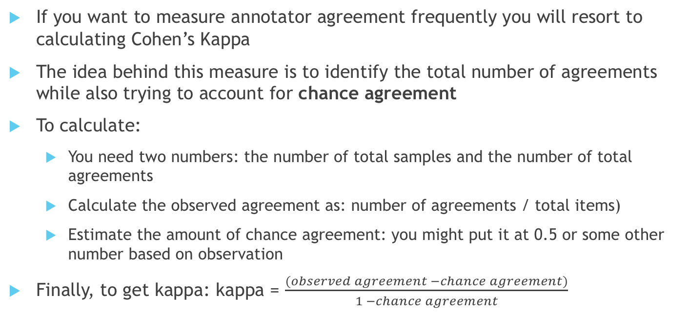
Cohen’s Kappa
If you want to measure annotator agreement frequently you will resort to calculating Cohen’s Kappa
The idea behind this measure is to identify the total number of agreements while also trying to account for chance agreement
To calculate:
You need two numbers: the number of total samples and the number of total agreements
Calculate the observed agreement as: number of agreements / total items)
Estimate the amount of chance agreement: you might put it at 0.5 or some other number based on observation
Finally, to get kappa: kappa = $\frac{(observed agreement −chance agreement)}{1 −chance agreement}$

Slide 26
Kappa in reality
Imagine you have two raters and they are simply identifying if words are or are not entities. (yes/no decision)
These users agree on 20 + 25 items out of 20 + 10 + 15 + 25 items
So amount of agreement is 45/70 = 0.64
Chance agreement is 0.5
Kappa is (0.64 – 0.5)/(1-0.5) = 0.14/.5 = 0.28
These numbers are generally only useful in comparison to other agreement measures… interpretation can be tricky
A\B | Yes | No
Yes | 20 | 10
No | 15 | 25

Slide 27
Fun problems with evaluation
An additional question relates to how does one score things like information extraction where an item can be one of a multitude of things
Additionally, extracted things could be a single category or multiple
You need to determine your counting strategy as that would affect which way to look at agreement.
For example, in ACE guidelines you can have agreement that a portion of text is an entity but disagree on what kind it is.

Slide 28
Precision/Recall
Generally we will want to report metrics that are widely used by “the community.”
Coming up with new metrics can be rather challenging as there can be unforeseen issues with your new metric
Precision and Recall has historically been a metric used in many NLP tasks due to its ability to be used in other evaluation programs
Recall indicates that a relevant item has been returned
In extraction it would be correctly identifying a portion of text as containing an entity
Precision generally refers to the idea that of the items returned there are some number that are actually relevant
So you can return documents that are no relevant and that would decrease the precision of your results

Slide 29

Precision and Recall Calculations
Precision and recall are calculated from a contingency table identifying relevant and retrieved portions of text
Precision then is: $r/(r+n)$
Recall then is: $r/(r+R)$
 | Relevant | Not Relevant
Retrieved | r | n
Not Retrieved | R | N

Slide 30
How can you improve your scores without trying?
Everyone wants to beat metrics.
There are thus very easy ways to cheat.
To improve your recall just return every document
To improve your precision only return 1 document that you already know to be correct
How to identify cheats or bad system performance? Somehow mix the two measures

Slide 31
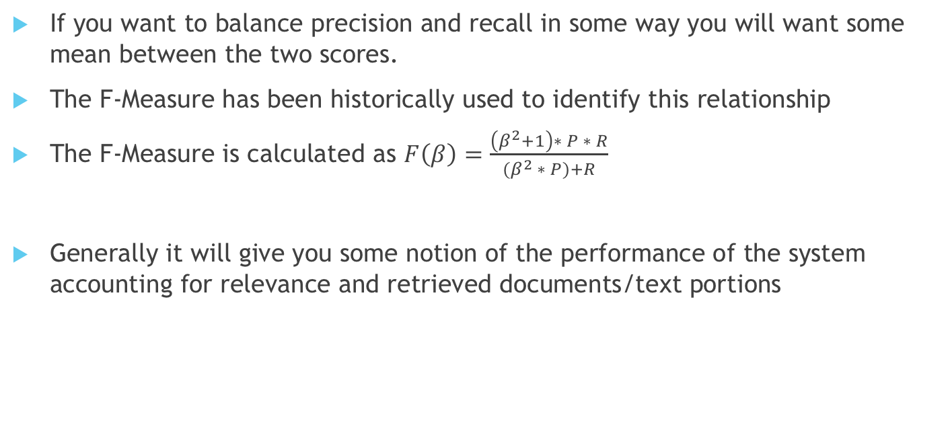
F-Measures
If you want to balance precision and recall in some way you will want some mean between the two scores.
The F-Measure has been historically used to identify this relationship
The F-Measure is calculated as $F\left(β\right)=\frac{\left(β^{2}+1\right)∗ P ∗ R}{(β^{2} ∗ P)+R}$
Generally it will give you some notion of the performance of the system accounting for relevance and retrieved documents/text portions

Slide 32
Evaluations outside of Information Extraction
How might you evaluate a question and answering system?
Imagine the question is: Who was the first president of the United States?
What is the right answer?
What about the question: Who is the present king of France?
How do you evaluate the possible answer space?

Slide 33
Challenges to Question and Answering Evaluation
A challenge then with evaluating question and answering systems relates to how specific an answer might need to be
One way you could try to evaluate these systems is look at relevant conferences
Also, you might look at ways that machine translation systems are evaluated
The BLEU score constructed by IBM gives a way of identifying the amount of overlap in potential translation outputs
You want sentences like this to be considered similar:
The quick brown fox jumped over the lazy dog.
The fast brown fox zoomed past the lethargic dog.
Also, how do you model questions an average user might provide?
Think of the stuff Siri says website

Slide 34
Find a number…
Generally though you will just want to start with some number or metric that captures what you are doing
You will most likely need to improve this metric over time
You need to ensure that you keep records of your score to track performance over time
In production systems you need to figure out how to occasionally see if things are getting better or worse in your system.

Slide 35
Questions?

