Slide 1
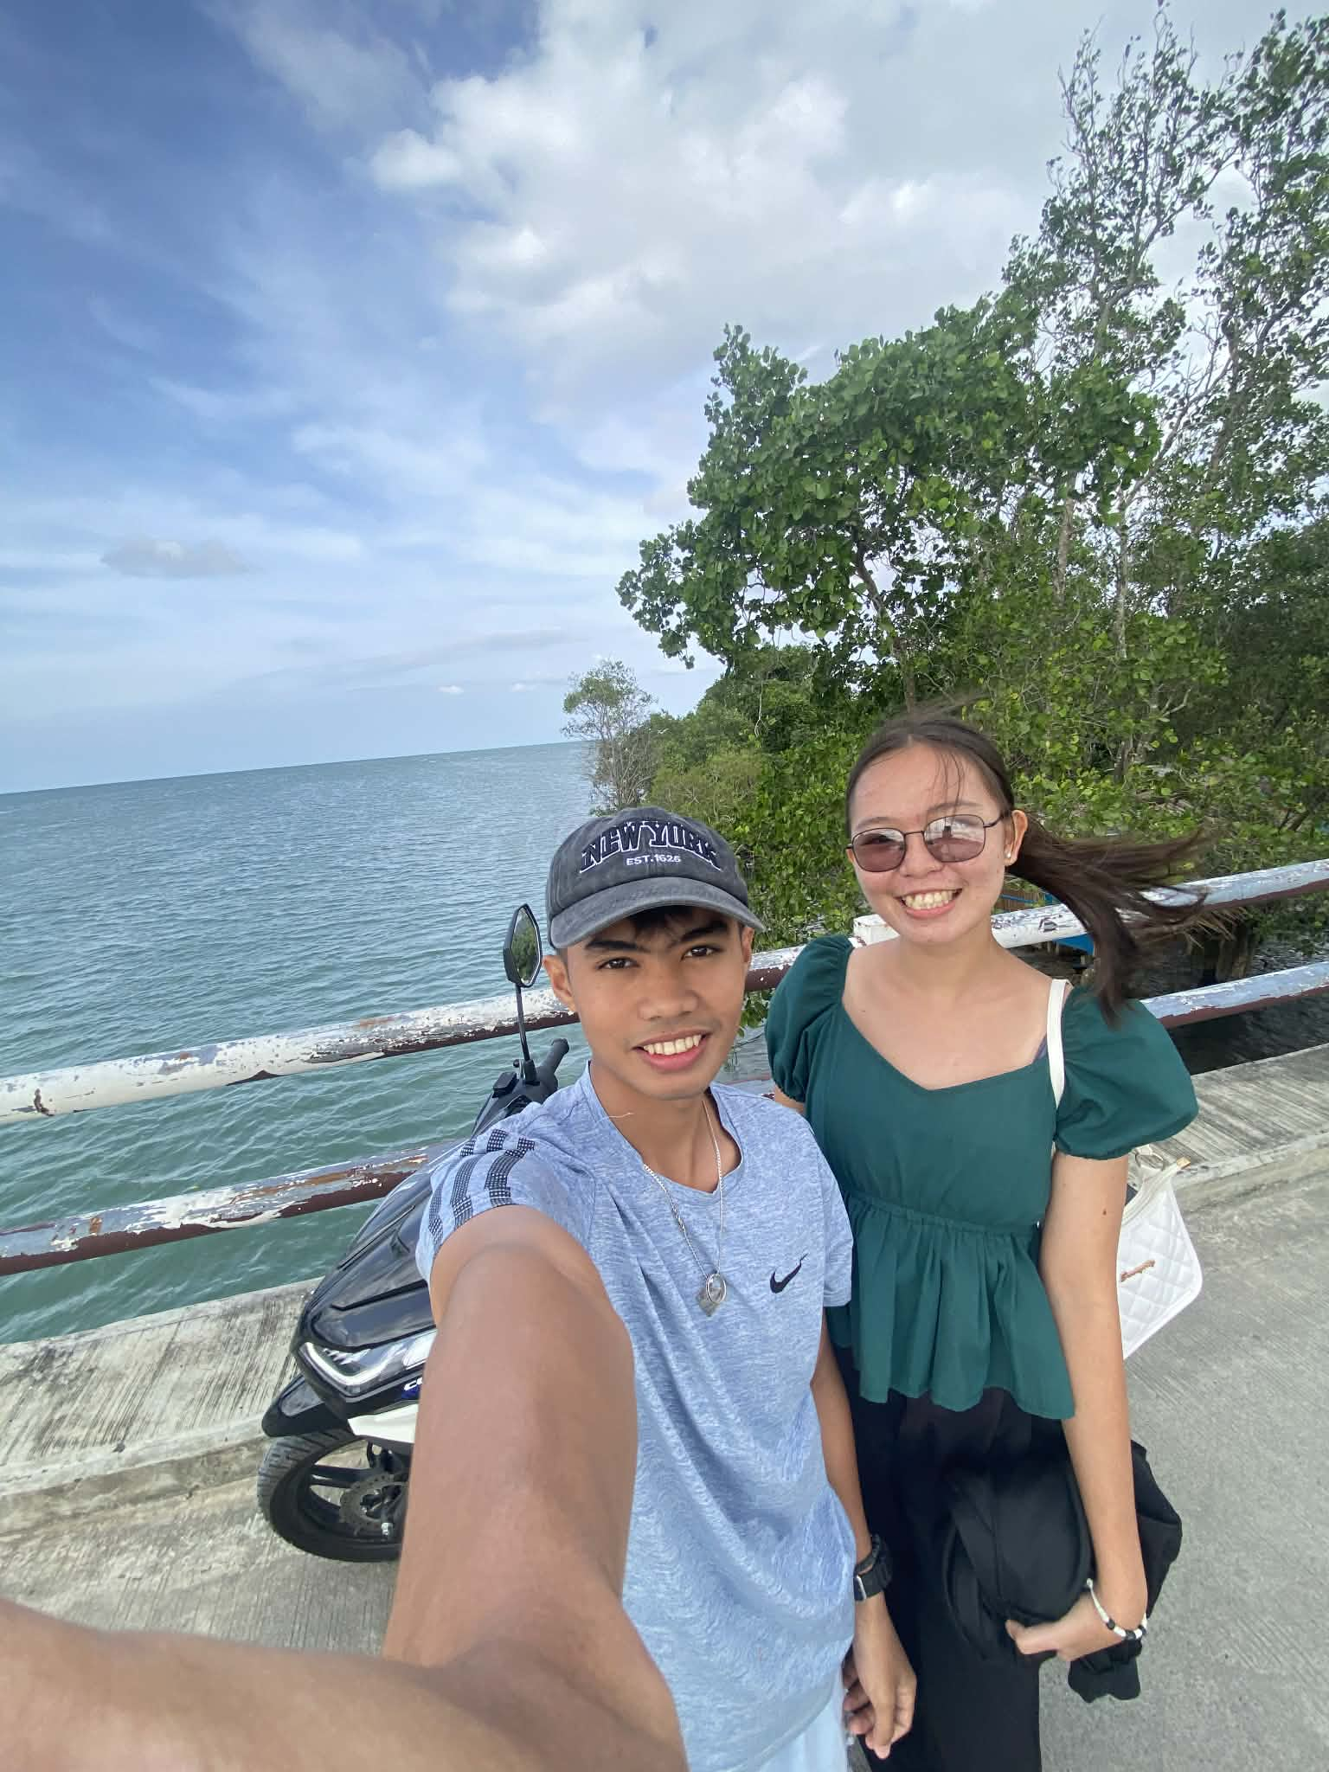
SPOTIFY
FEATURED PRESENTATION
JASPHER
Spotify-Themed Portfolio Showcase
Top Tracks
01 Hello, I'm Jaspher
02 Full-Stack Developer & UI/UX Designer
03 Crafting modern, scalable web experiences
04 React · Node.js · JavaScript · Design Systems
05 Ready for your next project collaboration
Jaspher Portfolio Mix
Full-Stack Developer · UI/UX Designer

Slide 2
SPOTIFY
ARTIST PROFILE
About the Artist
Who is Jaspher?
Bio
Passionate full-stack developer and UI/UX designer
Builds accessible, modern, and high-performance web apps
Enjoys open-source, emerging tech, and solving real problems
Focuses on clean code and thoughtful user experiences
About Me
Developer mindset with design empathy

Slide 3
SPOTIFY
LISTENER STATS
Career Highlights
Numbers that define impact
50+
Projects Completed
3+
Years Experience
25+
Happy Clients
10+
Technologies
Career Highlights
Consistent growth and delivery

Slide 4
SPOTIFY
TOP GENRES
Technical Skill Mix
Core competencies and strengths
JavaScript 95%
React 90%
Node.js 85%
UI/UX Design 80%
Python 75%
Databases 80%
Technical Skill Mix
Frontend + Backend + Design

Slide 5
SPOTIFY
PLAYLIST TIMELINE
Experience Journey
From intern to senior full-stack developer
Timeline
2024–Present Senior Full-Stack Developer
2022–2024 Frontend Developer
2021–2022 UI/UX Developer Intern
2019–2023 B.S. Computer Science
Experience Journey
Growth through real-world problem solving

Slide 6
SPOTIFY
FEATURED TRACKS VOL. 1
Project Highlights
Selected builds and shipped solutions
A-Side
B-Side
E-Commerce Platform · React/Node/MongoDB/Stripe
Modern UI, scalable backend, and smooth UX
Real-Time Chat App · React/Socket.io/Express/Redis
Performance, maintainability, and product thinking
Portfolio Website · HTML/CSS/JS/AOS
Built for impact and user delight
Project Highlights
End-to-end product engineering

Slide 7
SPOTIFY
FEATURED TRACKS VOL. 2
More Creations
Versatile apps across multiple domains
Track List
Task Management App · Vue.js/Firebase/Tailwind/PWA
Weather Dashboard · React/APIs/Geolocation/Charts
Blog Platform · Next.js/MDX/Prisma/PostgreSQL
Focus: intuitive UI, strong architecture, and clean APIs
More Creations
Building across stacks and use cases

Slide 8
SPOTIFY
BONUS TRACK
Fun Meets Engineering
Interactive experiments and play-driven learning
Ball Bounce Game
Canvas-based physics simulation with collisions and gravity feel
Interactive controls: add balls, reset state, track count live
Demonstrates creativity, real-time rendering, and event handling
Fun Meets Engineering
Creativity powers technical excellence

Slide 9
SPOTIFY
FOLLOW THE ARTIST
Let’s Collaborate
Open to opportunities, projects, and partnerships
Connect
Email: jaspher.dev@example.com
Phone: +1 (234) 567-8900
Location: San Francisco, CA
GitHub · LinkedIn · Twitter · Dribbble
Let's Collaborate
Available for impactful digital products

Slide 10
SPOTIFY
END OF PLAYLIST
Thank You
Turn this vibe into your next project success story
JASPHER
Full-Stack Developer · UI/UX Designer
Thanks for listening
Let's build something exceptional

