Slide 1
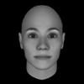
Notes:
F-1

Slide 2
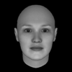
Notes:
F-2

Slide 3
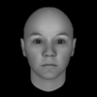
Notes:
F-3

Slide 4
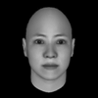
Notes:
F-4

Slide 5
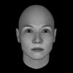
Notes:
F-5

Slide 6
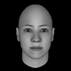
Notes:
F-6

Slide 7
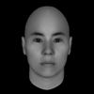
Notes:
F-7

Slide 8
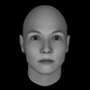
Notes:
F-8

Slide 9
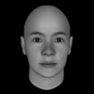
Notes:
F-9

Slide 10
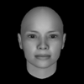
Notes:
F-10

Slide 11
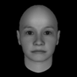
Notes:
F-11

Slide 12
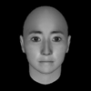
Notes:
F-12

Slide 13
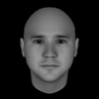
Notes:
M-1

Slide 14
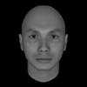
Notes:
M-2

Slide 15
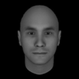
Notes:
M-3

Slide 16
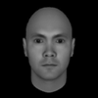
Notes:
M-4

Slide 17
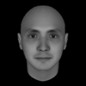
Notes:
M-5

Slide 18
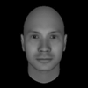
Notes:
M-6

Slide 19
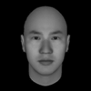
Notes:
M-7

Slide 20

Notes:
M-8

Slide 21
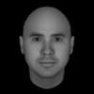
Notes:
M-9

Slide 22
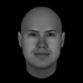
Notes:
M-10

Slide 23
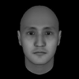
Notes:
M-11

Slide 24
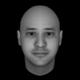
Notes:
M-12

Slide 25
Notes:
F-1-ROTATED

Slide 26
Notes:
F-2-ROTATED

Slide 27
Notes:
F-3-ROTATED

Slide 28
Notes:
F-4-ROTATED

Slide 29
Notes:
F-5-ROTATED

Slide 30
Notes:
F-6-ROTATED

Slide 31
Notes:
F-7-ROTATED

Slide 32
Notes:
F-8-ROTATED

Slide 33
Notes:
F-9-ROTATED

Slide 34
Notes:
F-10-ROTATED

Slide 35
Notes:
F-11-ROTATED

Slide 36
Notes:
F-12-ROTATED

Slide 37
Notes:
M-1-ROTATED

Slide 38
Notes:
M-2-ROTATED

Slide 39
Notes:
M-3-ROTATED

Slide 40
Notes:
M-4-ROTATED

Slide 41
Notes:
M-5-ROTATED

Slide 42
Notes:
M-6-ROTATED

Slide 43
Notes:
M-7-ROTATED

Slide 44
Notes:
M-8-ROTATED

Slide 45
Notes:
M-9-ROTATED

Slide 46
Notes:
M-10-ROTATED

Slide 47
Notes:
M-11-ROTATED

Slide 48
Notes:
M-12-ROTATED

Slide 49
Notes:
F-1-ROTATED

Slide 50
Notes:
F-2-ROTATED

Slide 51
Notes:
F-3-ROTATED

Slide 52
Notes:
F-4-ROTATED

Slide 53
Notes:
F-5-ROTATED

Slide 54
Notes:
F-6-ROTATED

Slide 55
Notes:
F-7-ROTATED

Slide 56
Notes:
F-8-ROTATED

Slide 57
Notes:
F-9-ROTATED

Slide 58
Notes:
F-10-ROTATED

Slide 59
Notes:
F-11-ROTATED

Slide 60
Notes:
F-12-ROTATED

Slide 61
Notes:
M-1-ROTATED

Slide 62
Notes:
M-2-ROTATED

Slide 63
Notes:
M-3-ROTATED

Slide 64
Notes:
M-4-ROTATED

Slide 65
Notes:
M-5-ROTATED

Slide 66
Notes:
M-6-ROTATED

Slide 67
Notes:
M-7-ROTATED

Slide 68
Notes:
M-8-ROTATED

Slide 69
Notes:
M-9-ROTATED

Slide 70
Notes:
M-10-ROTATED

Slide 71
Notes:
M-11-ROTATED

Slide 72
Notes:
M-12-ROTATED

