Slide 1
CSE 635 MILESTONE 3 Presentation
AUTHORSHIP ATTRIBUTION FOR NEURAL TEXT GENERATION
(SYNTHETICALLY GENERATED TEXT DETECTION)
BY:
Rachna Bhatia (rachnatr)
Charan Sai Sadla (charansa)
Jasleen Kaur (jasleen2)
Deepanshu (deepans2)

Slide 2
OUTLINE
Problem Definition
Model Architecture
Results
Error Analysis
Areas Of Improvement
Conclusion

Slide 3
PROBLEM DEFINITION
Recent proposals for neural network-based language models, in particular, have shown their astounding capabilities to generate texts that are difficult to differentiate from human-written texts with the human sight.
Despite the fact that such neural techniques (NLGs) have many advantages and utilities, it's critical to be able to identify the author of a text in some contexts, such as forensic linguistics, plagiarism detection, or tracing the origin of threats or anonymous messages.
Therefore, it becomes necessary to differentiate between texts produced by machines and those written by people.
So, a critical solution to the Authorship Attribution (AA) problem would be to identify which NLG method, out of several contenders, produced the given text in question.

Slide 4
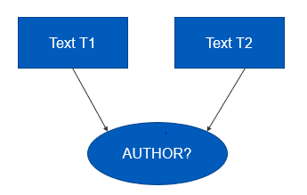
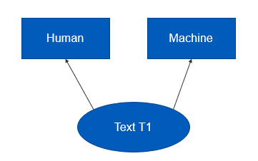
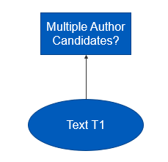
Problem 1 (Same Method or Not)
Given two texts T1 and T2, determine if both T1 and T2 are generated by the same NLG method (or human) or not.
Problem 2 (Human vs. Machine)
Given a text T1, determine if T1 is written by human or generated by any k NLG methods.
Problem 3 (Authorship Attribution)
Given a text T1, single out one NLG method (among k alternatives) that generated T1.

Slide 5
MODEL ARCHITECTURE

Slide 6
Problem 1 (Same Method or Not) - Siamese Neural Network
Input : Pairs of texts
Output : Binary classification.
Tokenization : Keras Tokenizer function. Converts words to numerical indices.
Padding : Padded prompt sequences to equal length.
1st Embedding Layer : Word2Vec (Trained on corpus) => Embedding Matrix (For tokenizer vocabulary) => Embedding Layer
2nd Embedding Layer : Bidirectional LSTM => dense layer with a ReLU activation function and dropout regularization
Output Layer : Single neuron with a sigmoid activation function => similarity score between the two input texts.
Model : Siamese with Adam optimizer, binary cross-entropy loss function

Slide 7
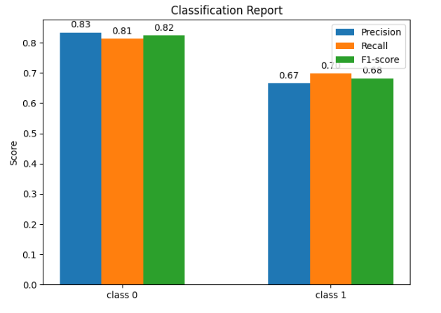

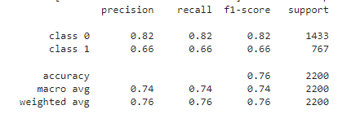
Evaluation Metrics
Classification Report

Slide 8
Problem 2 (Human vs. Machine)- BERT

Slide 9
Evaluation Metrics
Classification Report

Slide 10
Problem 3 (Authorship Attribution)-

Slide 11
Evaluation Metrics
Classification Report

Slide 12
THANK YOU

