Slide 1
CSE 635 MILESTONE 3 Presentation
AUTHORSHIP ATTRIBUTION FOR NEURAL TEXT GENERATION
(SYNTHETICALLY GENERATED TEXT DETECTION)
BY:
Rachna Bhatia (rachnatr)
Charan Sai Sadla (charansa)
Jasleen Kaur (jasleen2)
Deepanshu (deepans2)

Slide 2
OUTLINE
Problem Definition
Model Architecture
Evaluation Metrics
Linguistic Analysis
Evaluation using Reddit Data
Analysis & Areas Of Improvement

Slide 3
PROBLEM DEFINITION
Recent proposals for neural network-based language models, in particular, have shown their astounding capabilities to generate texts that are difficult to differentiate from human-written texts with the human sight.
Despite the fact that such neural techniques (NLGs) have many advantages and utilities, it's critical to be able to identify the author of a text in some contexts, such as forensic linguistics, plagiarism detection, or tracing the origin of threats or anonymous messages.
Therefore, it becomes necessary to differentiate between texts produced by machines and those written by people.
So, a critical solution to the Authorship Attribution (AA) problem would be to identify which NLG method, out of several contenders, produced the given text in question.

Slide 4
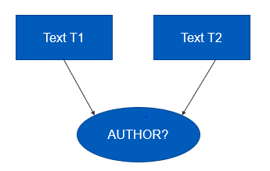
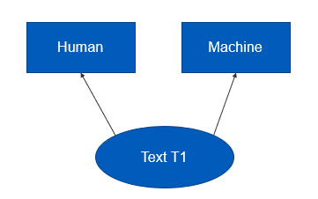
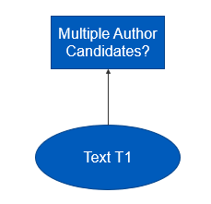
Problem 1 (Same Method or Not)
Given two texts T1 and T2, determine if both T1 and T2 are generated by the same NLG method (or human) or not.
Problem 2 (Human vs. Machine)
Given a text T1, determine if T1 is written by human or generated by any k NLG methods.
Problem 3 (Authorship Attribution)
Given a text T1, single out one NLG method (among k alternatives) that generated T1.

Slide 5
Linguistic Features
Extracted discourse structure features (no. of sentences, no. of words, and avg words per sentence)
Extracted part-of-speech (POS) features (tokenization, POS tagging, and counting the freq of each POS tag)
Calculated the average sentence length
Calculated the type-token ratio (TTR)
Calculated the avg no. of clauses per sentence
Concatenated all the features to create the final feature set.

Slide 6
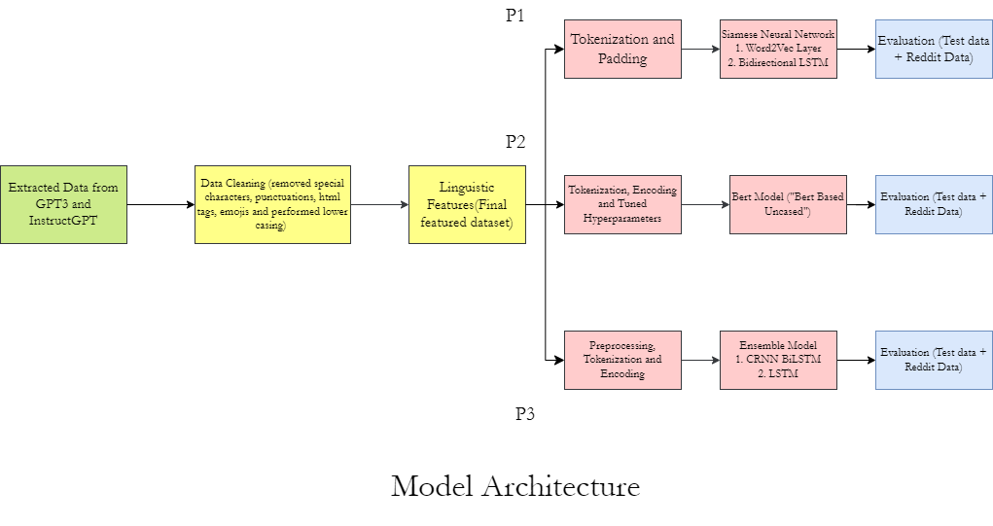
MODEL ARCHITECTURE

Slide 7
Problem 1 (Same Method or Not) - Siamese Neural Network
Input : Pairs of texts
Output : Binary classification.
Tokenization : Keras Tokenizer
Padding : Padded prompt sequences to equal length.
1st Embedding Layer : Word2Vec + tokenization
2nd Embedding Layer : BiLSTM + ReLU + dropout regularization
Output Layer : Sigmoid activation function
Model : Siamese with Adam optimizer, binary cross-entropy loss function

Slide 8
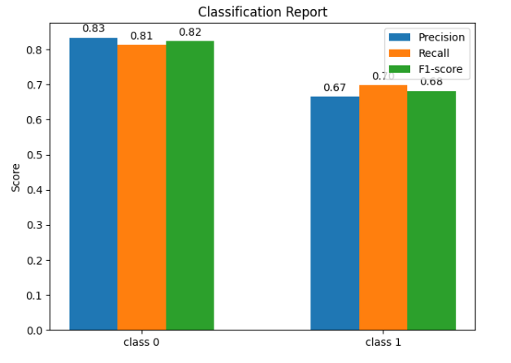

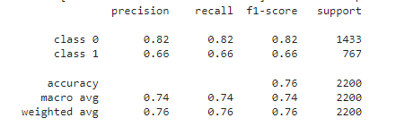
Evaluation Metrics
Classification Report

Slide 9
Problem 2 (Human vs. Machine)- BERT (“Bert-Base-Uncased”)
tokenize_and_encode : BertTokenizer
get_dataloader : returns a dataloader
train_model : Model training
evaluate_model : computes evaluation metrics
hyperparameters : MAX_LENGTH, BATCH_SIZE, NUM_EPOCHS, and LEARNING_RATE
Model : BertForSequenceClassification with AdamW optimizer.

Slide 10
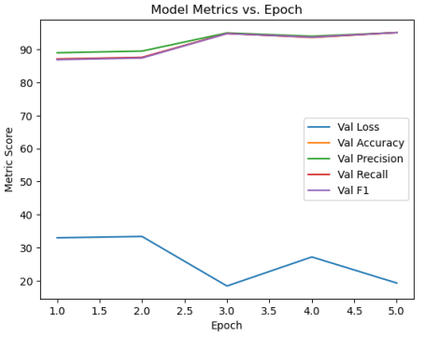
Evaluation Metrics
 | ctrl | fair | gpt | gpt2 | gpt3 | grover | instructgpt | pplm | xlm | xlnet
human | 0.93 | 0.89 | 0.94 | 0.95 | 0.82 | 0.98 | 0.87 | 0.88 | 0.95 | 0.97

Slide 11
Problem 3 (Authorship Attribution)- CRNN BiLSTM + LSTM
Tokenizer : Keras Tokenizer
Encoding : LabelEncoder
1st model : Sequential + Embedding layer(1st layer)+ 1D convolutional layer,+ max pooling layer + bidirectional LSTM, and dense layer with softmax activation function + Compiled model with Adam optimizer, categorical cross-entropy loss function
2nd model : Sequential model + Embedding layer(1st layer) + LSTM layer, dropout layer and dense layer with softmax activation function + Compiled model with Adam optimizer, categorical cross-entropy loss function
Combined Prediction : Argmax of the sum of their predicted probabilities.
Accuracy : Combined prediction + argmax(y_test)

Slide 12
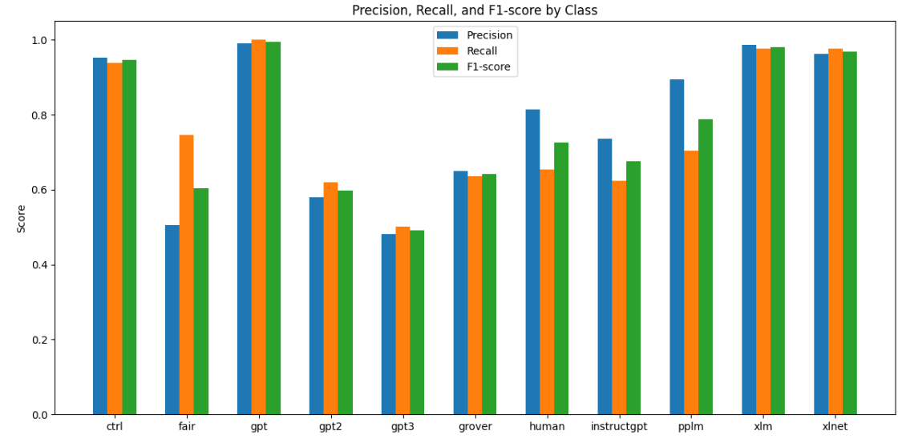
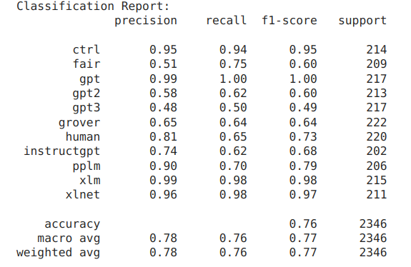
Evaluation Metrics
Classification Report

Slide 13
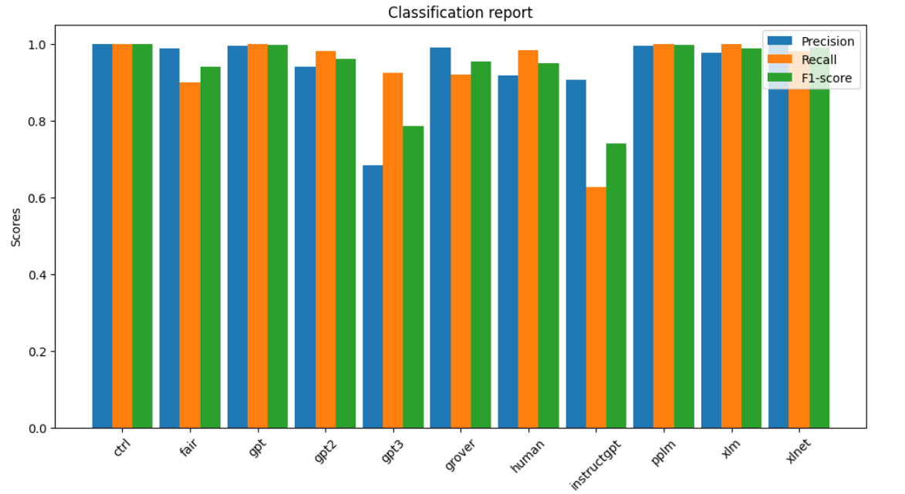
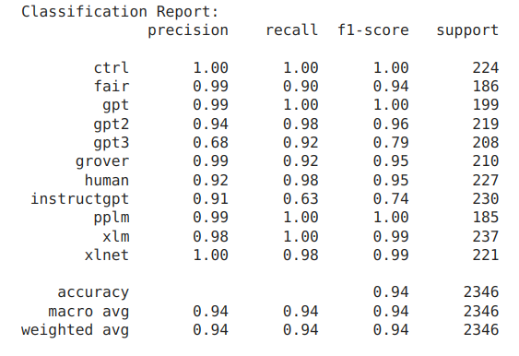
Evaluation Metrics for RoBERTa

Slide 14
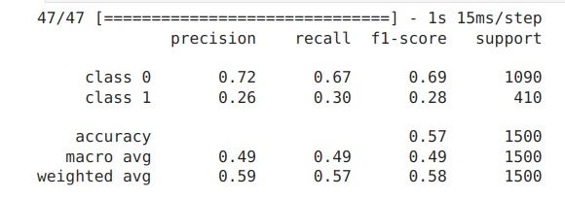
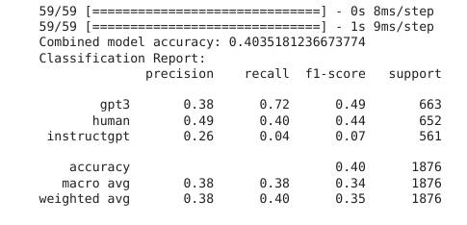
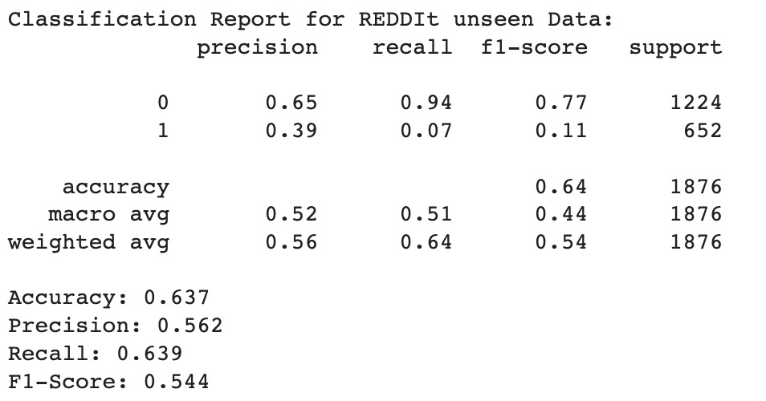
Evaluation using Reddit Data

Slide 15
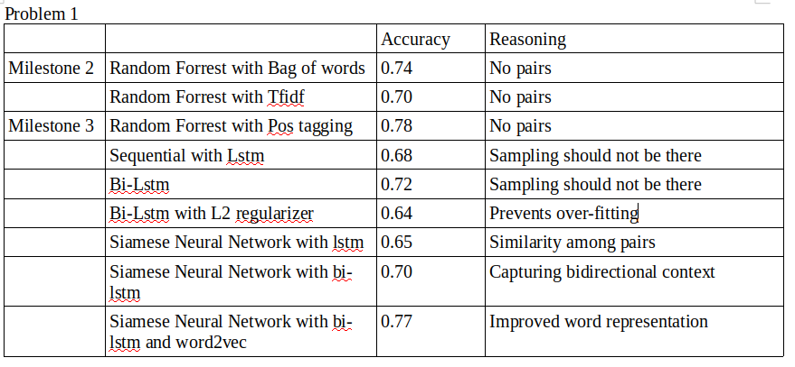
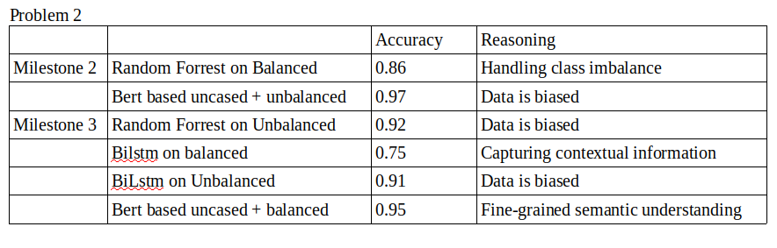
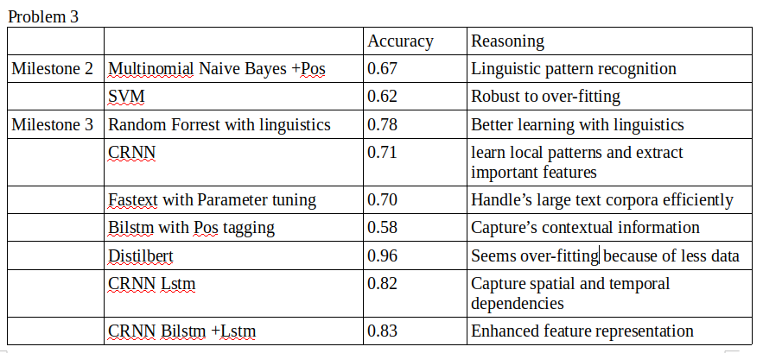
Analysis & Areas of Improvement

Slide 16
Jasleen Kaur
Data Extraction | Data scraping from OpenAI and Reddit
Data Cleaning and Preprocessing | Reddit data cleaning
Problem 1 | Siamese model and its variants and reddit data testing
Problem 2 | Tried different neural models
Problem 3 | Tried DistilBERT with parameter tuning for problem 3
Presentation and reports | Contributed in forming presentations and group report
Github | Maintaining github repo and created readme

Slide 17
References
https://github.com/AdaUchendu/Authorship-Attribution-for-Neural-Text-Generation
https://medium.com/@samia.khalid/bert-explained-a-complete-guide-with-theory-and-tutorial-3ac9ebc8fa7c
https://medium.com/voice-tech-podcast/text-classification-using-cnn-9ade8155dfb9
https://medium.com/voice-tech-podcast/text-classification-using-cnn-9ade8155dfb9
https://medium.com/@raghavaggarwal0089/bi-lstm-bc3d68da8bd0

Slide 18
THANK YOU

