Slide 1
CSE 635 MILESTONE 1 Presentation
AUTHORSHIP ATTRIBUTION FOR NEURAL TEXT GENERATION
(SYNTHETICALLY GENERATED TEXT DETECTION)
BY:
Rachna Bhatia (rachnatr)
Charan Sai Sadla (charansa)
Jasleen Kaur (jasleen2)
Deepanshu (deepans2)

Slide 2
OUTLINE
Project Objectives
Literature Review
Baseline and Evaluation Metrics
Project Planning And Strategy

Slide 3
PROJECT OBJECTIVES
Recent proposals for neural network-based language models, in particular, have shown their astounding capabilities to generate texts that are difficult to differentiate from human-written texts with the human sight.
Despite the fact that such neural techniques (NLGs) have many advantages and utilities, it's critical to be able to identify the author of a text in some contexts, such as forensic linguistics, plagiarism detection, or tracing the origin of threats or anonymous messages.
Therefore, it becomes necessary to differentiate between texts produced by machines and those written by people.
So, a critical solution to the Authorship Attribution (AA) problem would be to identify which NLG method, out of several contenders, produced the given text in question.

Slide 4
Problem 1 (Same Method or Not)
Given two texts T1 and T2, determine if both T1 and T2 are generated by the same NLG method (or human) or not.
Text T1
Text T2
AUTHOR?

Slide 5
Problem 2 (Human vs. Machine)
Given a text T1, determine if T1 is written by human or generated by any k NLG methods.
Human
Machine
Text T1

Slide 6
Problem 3 (Authorship Attribution)
Given a text T1, single out one NLG method (among k alternatives) that generated T1.
Multiple Author Candidates?
Text T1

Slide 7
LITERATURE REVIEW
Authorship attribution (AA) is the task of identifying the author of a text based on various linguistic features.
The rise of powerful natural language models, such as GPT-2 and BERT, has enabled the automatic generation of new texts that can imitate a given author's style.
This raises concerns about the potential for these generated texts to deceive AA methods, which are widely used in various applications such as forensics, spam and phishing detection, and identification of compromised accounts.
Existing research has focused on author-style transfer, which involves rewriting existing texts while preserving their semantic content but changing their authorial style.
However, little research has been done on the degree to which natural language generators can imitate a given author's style and deceive AA models.

Slide 8
Successful models for detecting AI-generated texts are often limited in their generalizability and can only detect texts generated from specific known models and types of text.
The inconsistent nature of current text generators weakens their capacity for author-styled text generation, but the rise of more powerful models with steerable outputs could increase these capabilities in the future.
Understanding potential vulnerabilities in AA approaches is crucial for developing effective mitigation strategies.
Further research is needed to identify potential weaknesses in AA systems and develop safeguards to protect against authorial generative deception.

Slide 9
Here are some related sources:
Defending Against Neural Fake News (NeurIPS 2019) by Rowan Zellers et al. https://neurips.cc/Conferences/2019
Convolutional Neural Networks for Authorship Attribution of Short Texts (ACL 2017) https://aclanthology.org/E17-2106.pdf
Are You Robert or RoBERTa? Deceiving Online Authorship Attribution Models Using Neural Text Generators https://arxiv.org/pdf/2203.09813.pdf
Additionally, a student from Princeton recently introduced new software called GPTZero, which can detect AI-written text from human-written text using two metrics: perplexity and burstiness. The tool was launched on January 3, 2023. https://app.gptzero.me/app/welcome

Slide 10
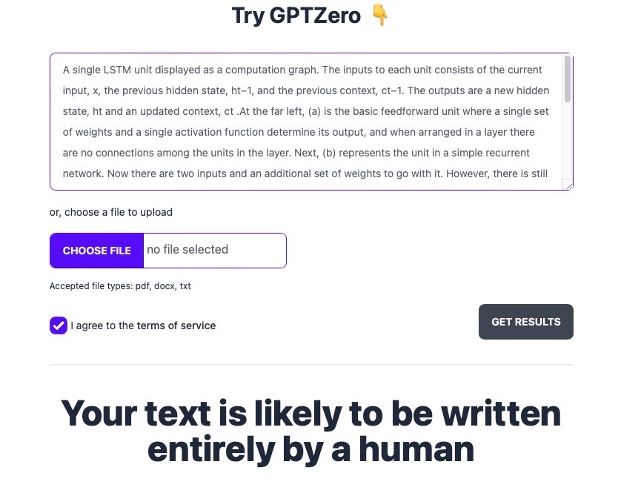
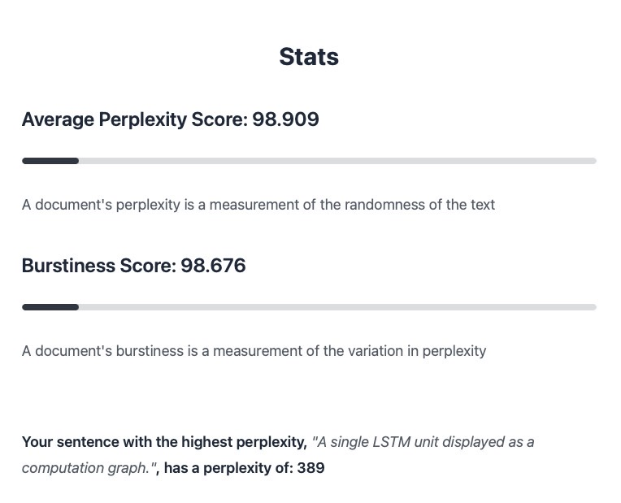
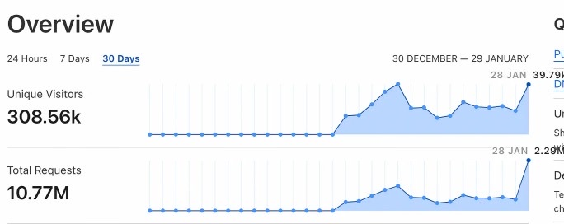
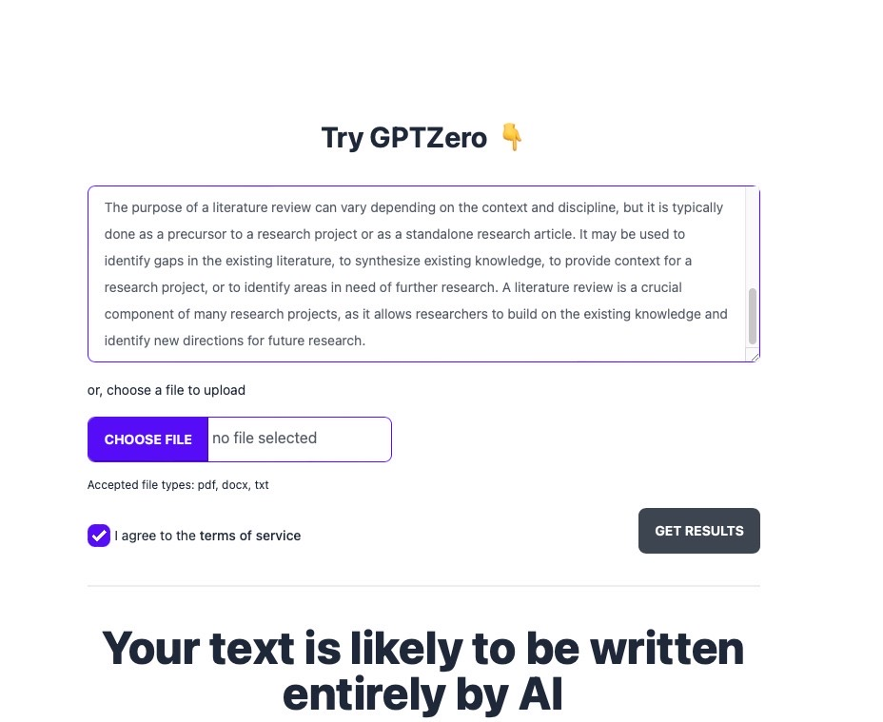
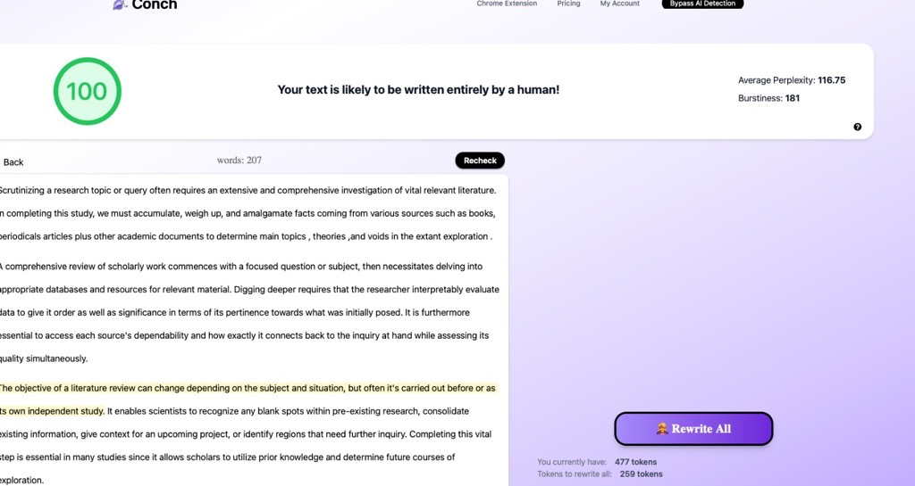

Slide 11
PROJECT BASELINE
Data Collection - Collect data from github repo and openAI for GPT3. Scrape data from Reddit and GPT3 for case study.
Data Preprocessing and cleaning - Remove unwanted characters and grammar check
Perform Linguistic Analysis on Data – LIWC features, Rhetorical Style etc.
Train and test models on the balanced and unbalanced dataset
Evaluate the models based on metrics – Precision, Recall, F1 score, Macro F1.
Tweak model parameters and evaluate again to improve performance

Slide 12
EVALUATION METRICS
Precision – How many of the positive predictions are truly positive. Precison (P)= TP / TP +FP
Recall - What is the number of positive examples that were accurately identified as positive. Recall (R)= TP/ TP + FN
F1 - Harmonic mean of recall and precision for a more balanced model performance summary F1 = 2 (P * R / P + R)
Macro-averaged F1 score - Average F1 score per class calculated by taking the arithmetic mean, which gives equal importance to all classes regardless of their support values. Support refers to the number of actual occurrences of the class in the dataset.
Weighted-averaged F1 score - Average F1 score per-class while considering each class’s support

Slide 13
PROJECT PLANNING & STRATEGY
Step 1 : To scrap the data from different sources such as Reddit, OpenAI, GPT3 and InstructGPT
Who will do this & why:
Since credit is limited so, every single member will run through each source and get portion of data
Step 2 : Data Cleaning & Preprocessing
Who will do this:
Rachna & Jasleen will do the data cleaning, prepare balanced and unbalanced dataset for training the models and perform tokenization.
Charan & Deepanshu will make word embeddings using Bag of words and word2vec.

Slide 14
PROJECT PLANNING
Step 3 : Linguistic features & analysis
Who will do this:
Every single member will pickup one of the Linguistic features and perform analysis
Step 4 : Problem 1 : Same Method or Not
Who will do this:
Charan & Deepanshu will do the cosine similarity over the word embeddings

Slide 15
PROJECT PLANNING
Step 5 : Problem 2: Human vs. Machine
Who will do this:
Rachna & Jasleen will run the data over RoBERTa. We’ll compare the embeddings and RoBERTa results and will evaluate which produced the better results.
Step 6 : Problem 3: Authorship Attribution
Who will do this:
Charan & Deepanshu will apply Random Forest classifier to perform multi-class classification over NLGs.
Based on time and effort, we’ll tweak and tune our parameters and apply multiple models to improve our evaluation results.

Slide 16
THANK YOU

