Slide 1
Battle of the Neighborhoods
Segmentation of New York City Based on Cuisines

Slide 2
Business Problem
The idea of this project is to categorically segment the neighborhoods of New York City into major clusters and examine their cuisines. A desirable intention is to examine the neighborhood cluster's food habits and taste.
Stakeholders would be the one who are interested to use this quantifiable analysis to understand the distribution of different cultures and cuisines over "the most diverse city on the planet - NYC". Also, this project can be utilized by a new food vendor who is willing to open his or her restaurant. Or by a government authority to examine and study their city's culture diversity better.

Slide 3
Data Source
New York City Dataset Link: https://geo.nyu.edu/catalog/nyu_2451_34572
Description: This New York City Neighborhood Names point file was created as a guide to New York City’s neighborhoods that appear on the web resource, “New York: A City of Neighborhoods.” Best estimates of label centroids were established at a 1:1,000 scale, but are ideally viewed at a 1:50,000 scale. This dataset will provide the addresses of neighborhood of NYC in json format.
Foursquare API Link: https://developer.foursquare.com/docs
Description: Foursquare API, a location data provider, will be used to make RESTful API calls to retrieve data about venues in different neighborhoods. This is the link to Foursquare Venue Category Hierarchy. Venues retrieved from all the neighborhoods are categorized broadly into "Arts & Entertainment", "College & University", "Event", "Food", "Nightlife Spot", "Outdoors & Recreation", etc.

Slide 4
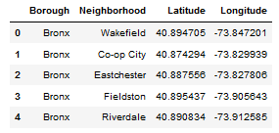
Data Processing
Create a data frame with Borough, Neighborhood, Latitude and Longitude details of the New York City’s neighborhood.

Slide 5
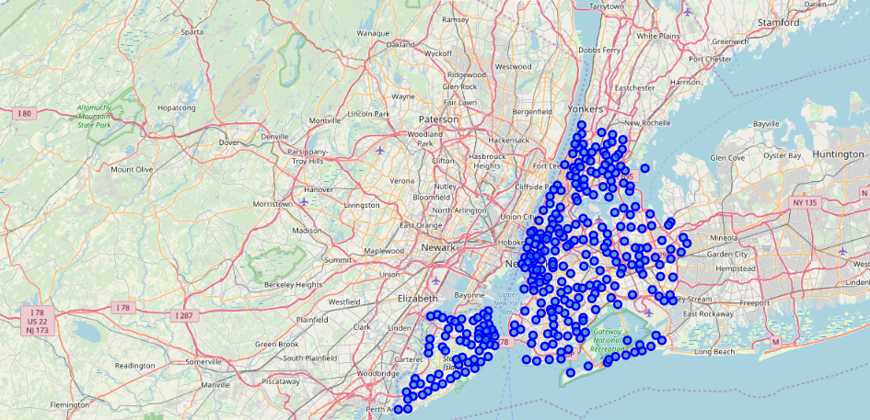
Data visualization of New York City with neighborhoods superimposed on top

Slide 6
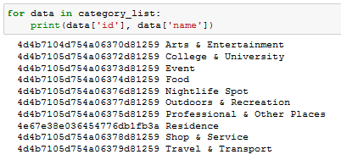
Major categories of venues

Slide 7
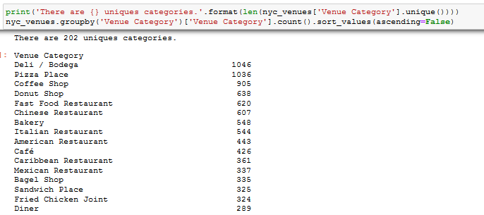
202 unique sub-categories under Food category

Slide 8
Machine Learning
‘k-means’ is an unsupervised machine learning algorithm which creates clusters of data points aggregated together because of certain similarities. This algorithm will be used to count neighborhoods for each cluster label for variable cluster size.
To implement this algorithm, it is very important to determine the optimal number of clusters (i.e. k). There are 2 most popular methods for the same, namely ‘The Elbow Method’ and ‘The Silhouette Method’.

Slide 9
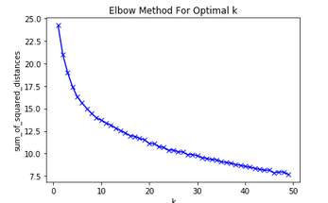
Elbow Method

Slide 10
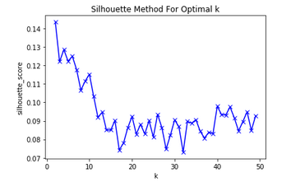
The Silhouette Method

Slide 11
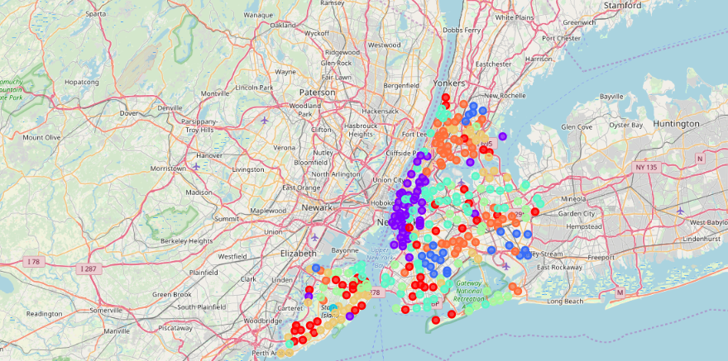
Visualization after clustering

Slide 12
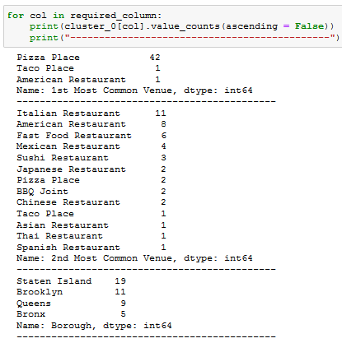
Cluster 0

Slide 13
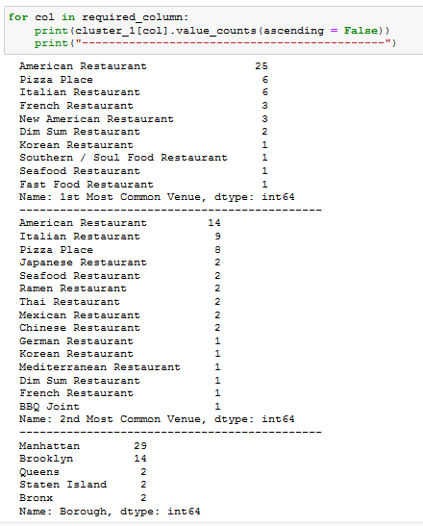
Cluster 1

Slide 14
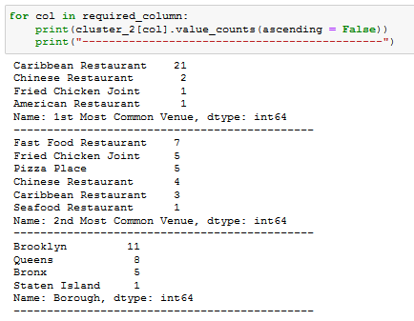
Cluster 2

Slide 15
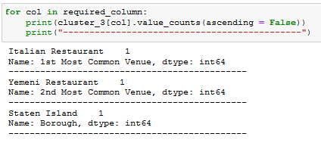
Cluster 3

Slide 16
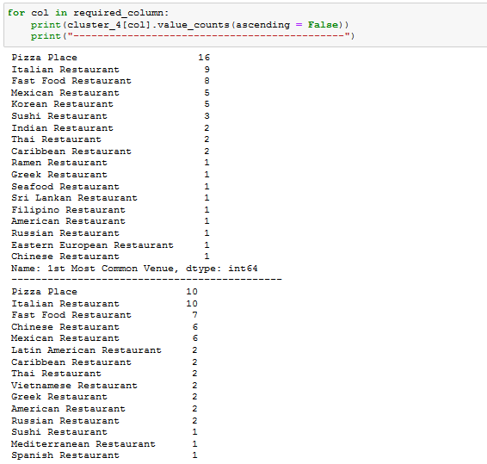
Cluster 4

Slide 17
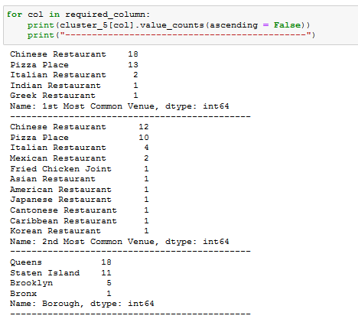
Cluster 5

Slide 18
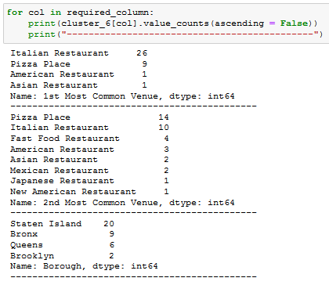
Cluster 6

Slide 19
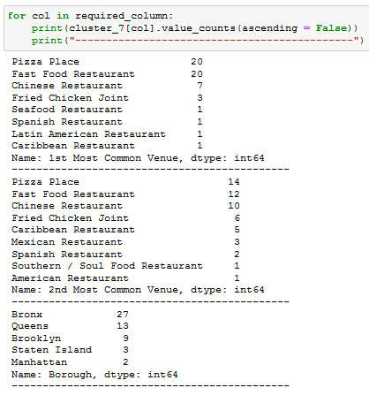
Cluster 7

Slide 20
Discussions
We analysed the different clusters by using the following metrics
Cont of Borough
Count of 1st Most Common Venue
Count of 2nd Most Common Venue
From the analysis, it is obvious that Pizza Place is the most common venue across all the clusters. Following could be the name of the clusters segmented by K-Means unsupervised machine learning algorithm.
Cluster 0 : Pizza
Cluster 1 : American
Cluster 2 : Caribbean
Cluster 3 : Italian
Cluster 4 : Mix of Cuisines
Cluster 5 : Chinese
Cluster 6 : Italian
Cluster 7 : Fast Food

Slide 21
Conclusion
The Neighborhoods of New York City were very briefly segmented into eight clusters and upon analysis it was possible to rename the clusters based on the venues in and arond the neighborhood. Along with American cuisine, Italian & Chinese are very dominant in NYC.
The results of this project can be improved by using a current dataset along with API which is more interested in Food venues. The scope of the project can be expanded further to understand the dynamics of each neighborhood and suggest a new vendor a profitable venue to start his food place.

Slide 22
References
Notebook created by Alex Aklson and Polong Lin for the Applied Data Science Capstone project.

