Slide 1
Introduction
This presentation defines a modern and responsive website for a coffee shop. The homepage section ("Home") features a captivating message about starting the day with coffee, accompanied by an inviting call-to-action button. The "About" section you get to know about coffee shop’s rich history. The "Products" section showcases a variety of popular coffee products with images, names, prices, and options to add them to the cart. Additionally, the website features a "Contact" section with a feedback form, welcoming users to share their thoughts and experiences.

Slide 2
Overview
1. Home page
2. About us
3. product page
4. Contact us

Slide 3

Persona

Slide 4
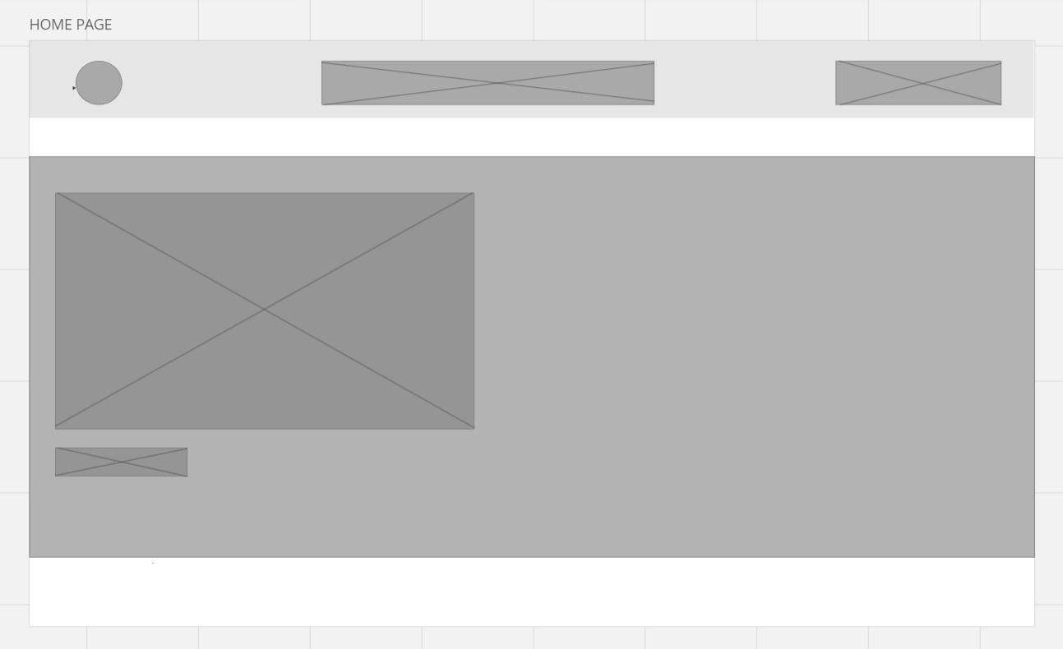
Wireframe

Slide 5
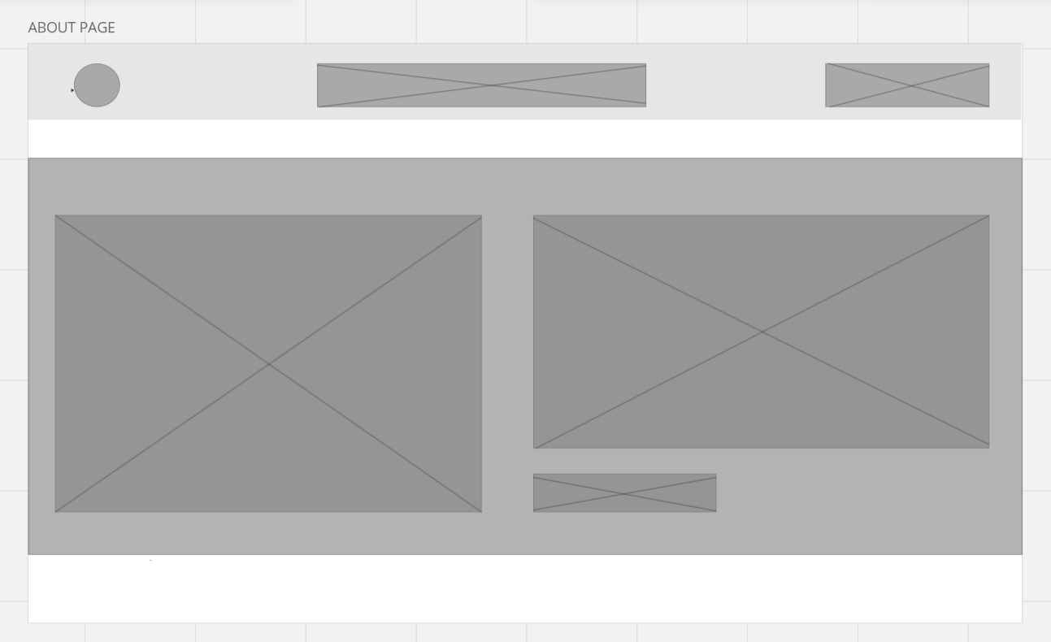
Wireframe

Slide 6
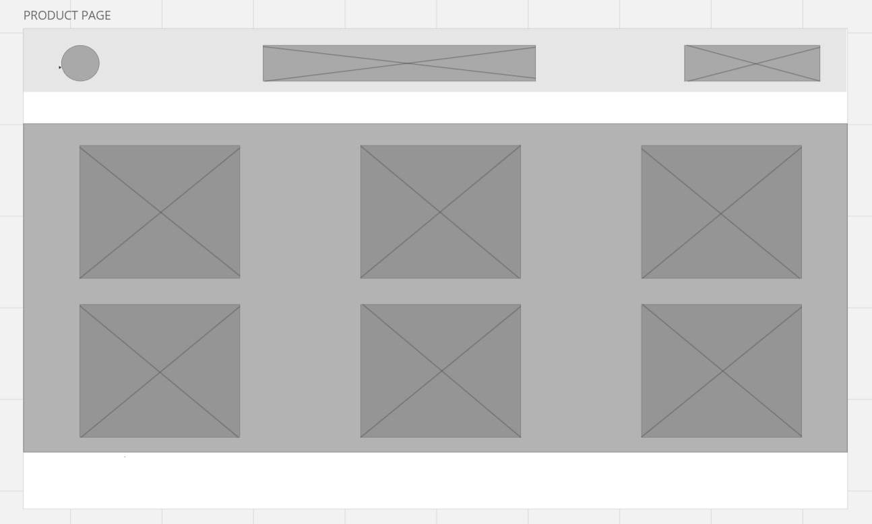
Wireframe

Slide 7
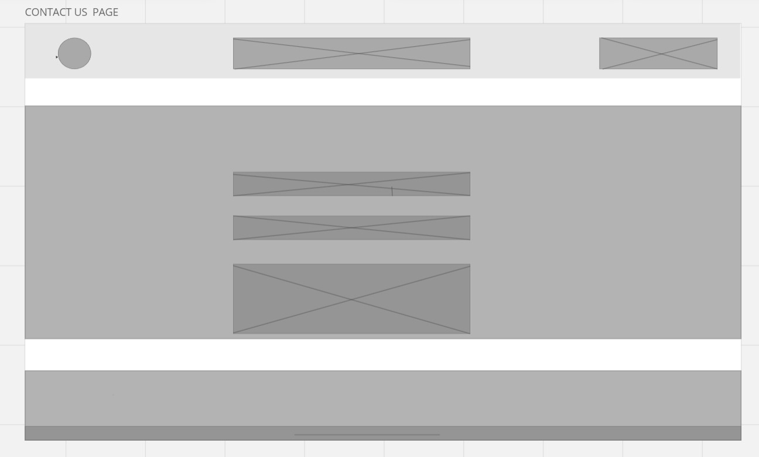
Wireframe

