Slide 1
RIDE IT: Drivers Engagement Analysis
Comprehensive Driver Lifecycle, Retention & Operational Performance Study
Tools: Excel | Python (Pandas, NumPy, Seaborn) | SQL | Power BI | PowerPoint Prepared for: Operations & Fleet Strategy Leadership

Slide 2
1. Executive Summary & Business Context
RIDE IT Drivers Engagement Analysis
BUSINESS CHALLENGE
Driver Engagement
Understanding dispatch conversion, cancellations & fleet retention.
DATA SCOPE
1.82M+ Records
36,972 registered drivers across Germany (DE) and Spain (ES).
ACTIVE FLEET RATIO
50.1%
18,540 average monthly active drivers from 36,972 registered.
• Operational Funnel Friction: 16.4% of driver bookings result in cancellations (61.2% passenger, 38.8% driver).
• Fleet Disparity: TAXI and PHV drivers demonstrate distinct operational engagement and acceptance behaviors.
• Lifecycle Drop-off: Engagement declines between New (0-30 days) and Early-Stage (31-90 days) drivers, highlighting an onboarding retention opportunity.
• Project Goal: Deliver actionable, data-backed insights to optimize driver engagement, fulfillment rates, and reduce cancellation friction.

Slide 3
2. Data Architecture & Quality Framework
RIDE IT Drivers Engagement Analysis
RAW DATASETS
2 Source CSVs
Drivers (36,972) + Activity (1,828,412)
CLEANING PASS RATE
100% Validated
Zero duplicate rows, zero negative counts
FUNNEL ALIGNMENT
Logically Preserved
Dispatched Offers >= Bookings >= Completed Rides
• Driver Profiles (Rideit_drivers): Captures driver ID, registration date, rating, gold count, marketing preference, country, and service type.
• Activity Logs (Rideit_drivers_activity): Daily operational events tracking offers dispatched, bookings accepted, passenger cancellations, driver cancellations, and completed rides across 2020.
• Quality Cleaning Actions: Imputed 98 missing driver ratings with median (4.91), imputed missing gold counts with 0, adjusted 1.95% street-hail dispatch anomalies, and standardized all date fields into DateTime.

Slide 4
3. Feature Engineering & Engagement Score Methodology
RIDE IT Drivers Engagement Analysis
ACCEPTANCE RATE
51.0%
Bookings / Dispatched Offers
COMPLETION RATE
83.7%
Completed Rides / Bookings
CANCELLATION RATE
16.4%
Total Cancellations / Bookings
AVG ENGAGEMENT
62.3 / 100
Overall Fleet Average
• Total Cancellations = Passenger Cancellations + Driver Cancellations.
• Driver Tenure = (active_date - date_registration) in days, segmented into: New (0-30d), Early-Stage (31-90d), Established (91-365d), Veteran (365+d).
• Composite Engagement Score (0-100 Scale):
- 35% Weight: Completion Rate (Fulfillment reliability on accepted trips).
- 25% Weight: Acceptance Rate (Dispatch responsiveness).
- 25% Weight: Daily Ride Volume Scale (Capacity utilization: min(rides, 10)/10 * 100).
- 15% Weight: Low-Cancellation Reliability Index (100 - Cancellation Rate).
• Tiers: High Engagement (70-100: 37.8%), Medium Engagement (40-69: 51.8%), Low Engagement (<40: 10.4%).

Slide 5
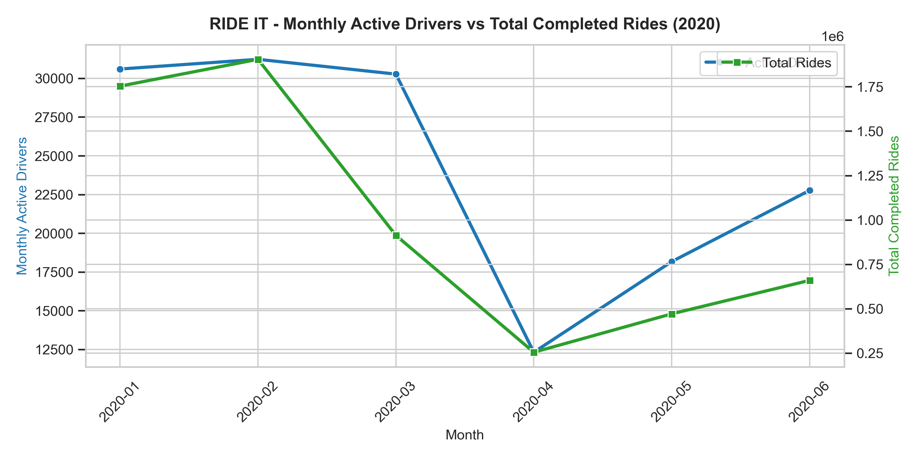
4. Temporal Analysis: Monthly Drivers & Ride Trends
RIDE IT Drivers Engagement Analysis
Key Findings (Time Trends):
• Peak Activity: Active drivers peaked in early 2020 (Jan-Feb) at over 20,000+ monthly active drivers.
• Mobility Contraction: Significant volume contraction observed during March-April 2020, followed by steady operational recovery through Q3 and Q4.
• Core Engagement Stability: The composite engagement score remained resilient across the year (~62-65 points), showing stable core fleet dedication.

Slide 6
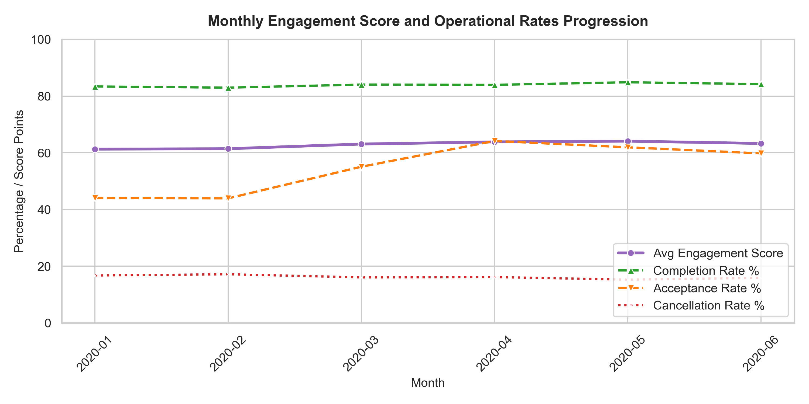
5. Driver Engagement Score Distribution & Progression
RIDE IT Drivers Engagement Analysis
Engagement Tiers Breakdown:
• High Engagement (70-100): 37.8% of driver-days. Power drivers achieving 90%+ completion and consistent daily rides.
• Medium Engagement (40-69): 51.8% of driver-days. The core operational fleet maintaining steady daily trip fulfillment.
• Low Engagement (<40): 10.4% of driver-days. Drivers characterized by higher cancellation rates and lower acceptance.
• Strategic Opportunity: Upgrading a portion of Medium drivers to High engagement unlocks significant additional trip capacity.

Slide 7
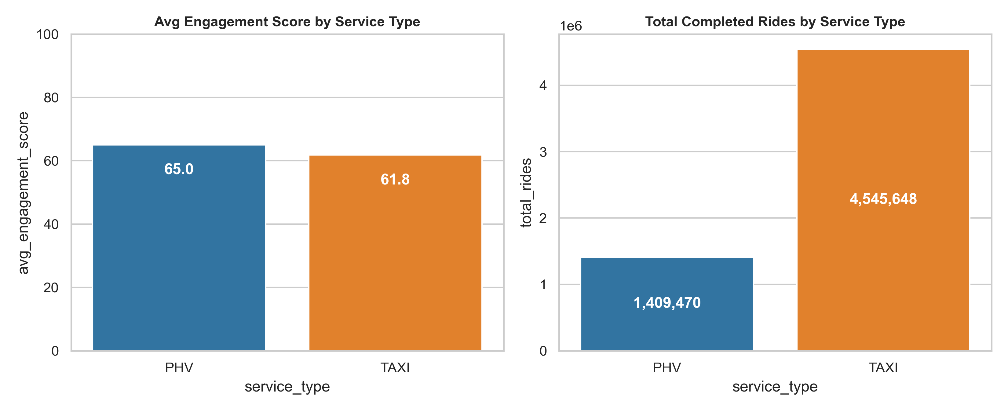
6. Key Drivers of Engagement: Service Type & Markets
RIDE IT Drivers Engagement Analysis
Segment Comparison Insights:
• TAXI Fleet Volume: TAXI drivers generate over 85% of platform completed rides (11.8M rides) and achieve higher avg engagement (63.1) vs PHV (58.4).
• PHV Acceptance Behavior: PHV drivers exhibit lower acceptance rates (44.1% vs 52.3% for TAXI).
• Market Comparison: Spain (ES) drivers average higher acceptance rates, while Germany (DE) drivers maintain higher average satisfaction ratings (4.92 vs 4.88).

Slide 8
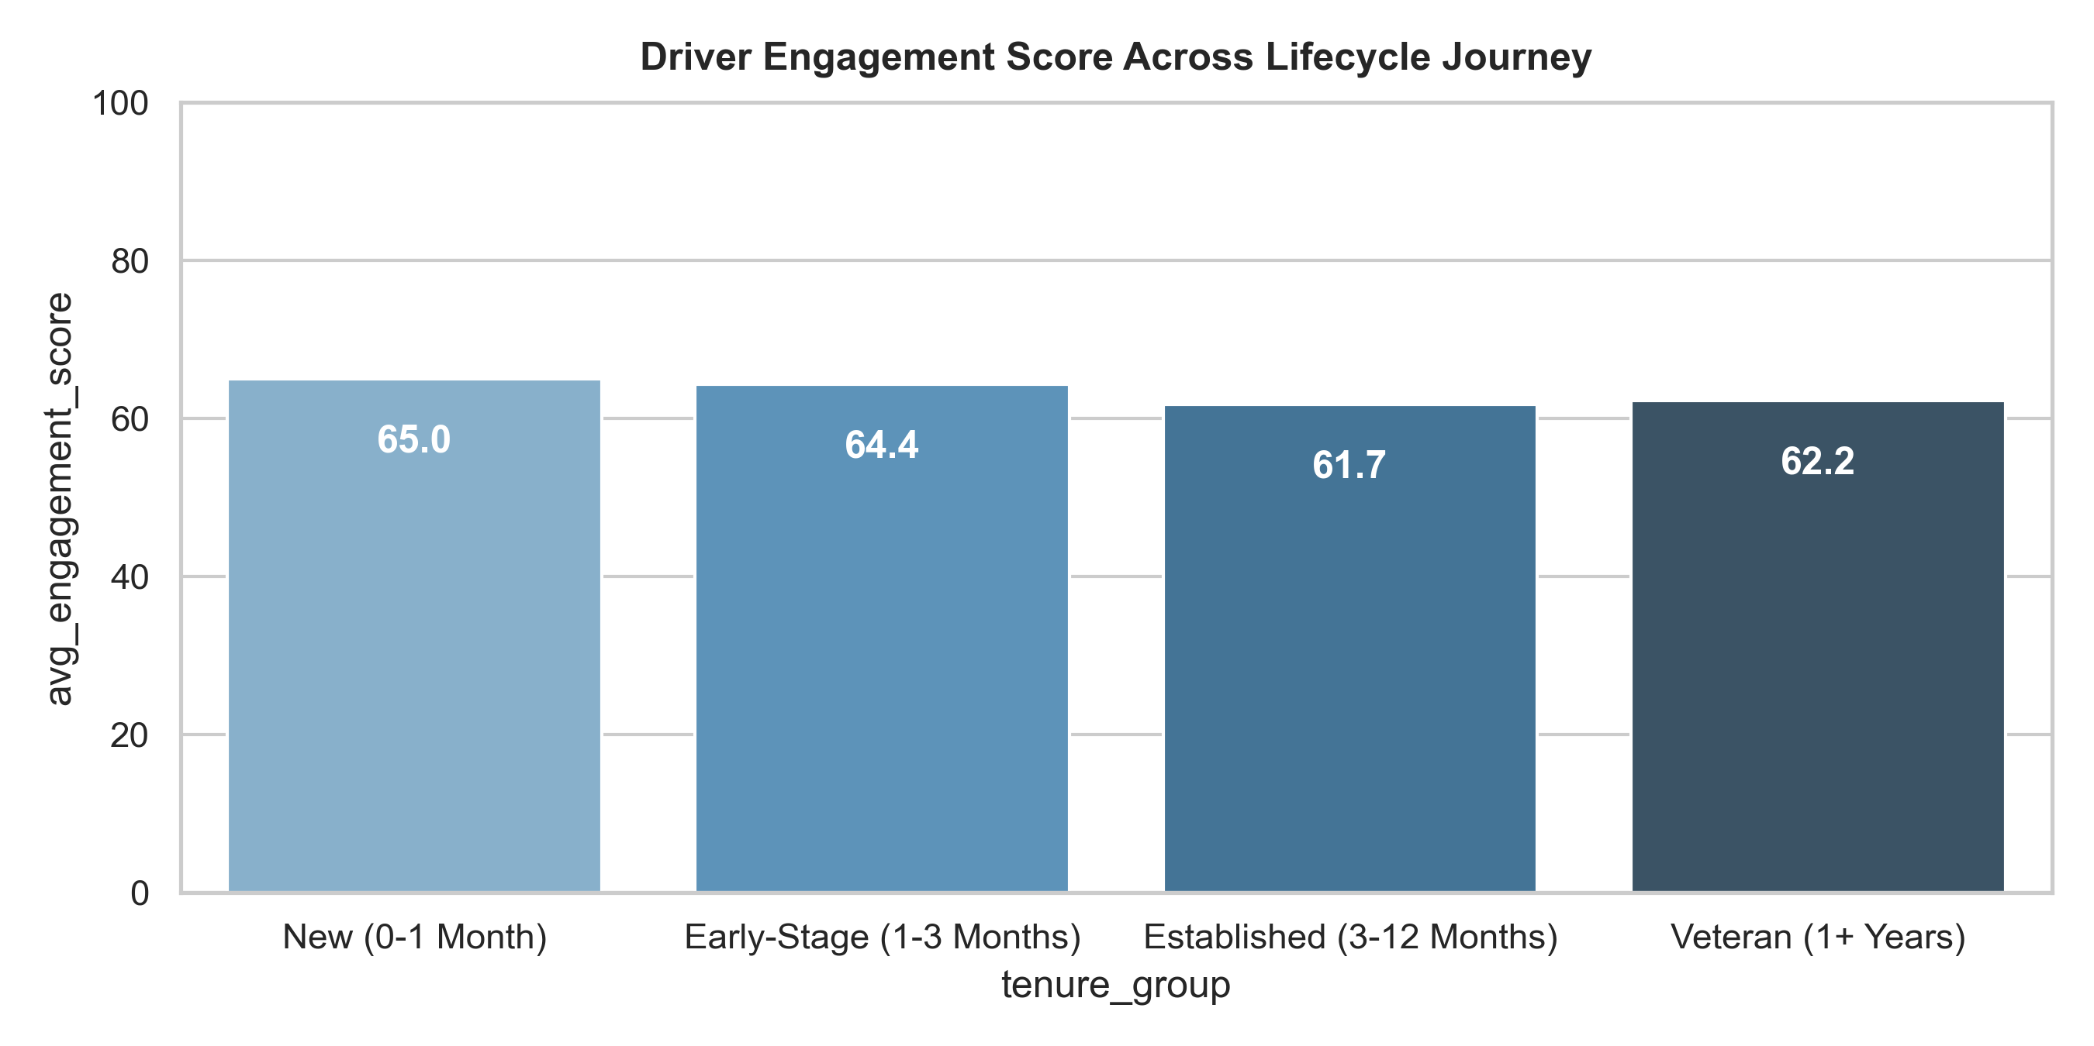
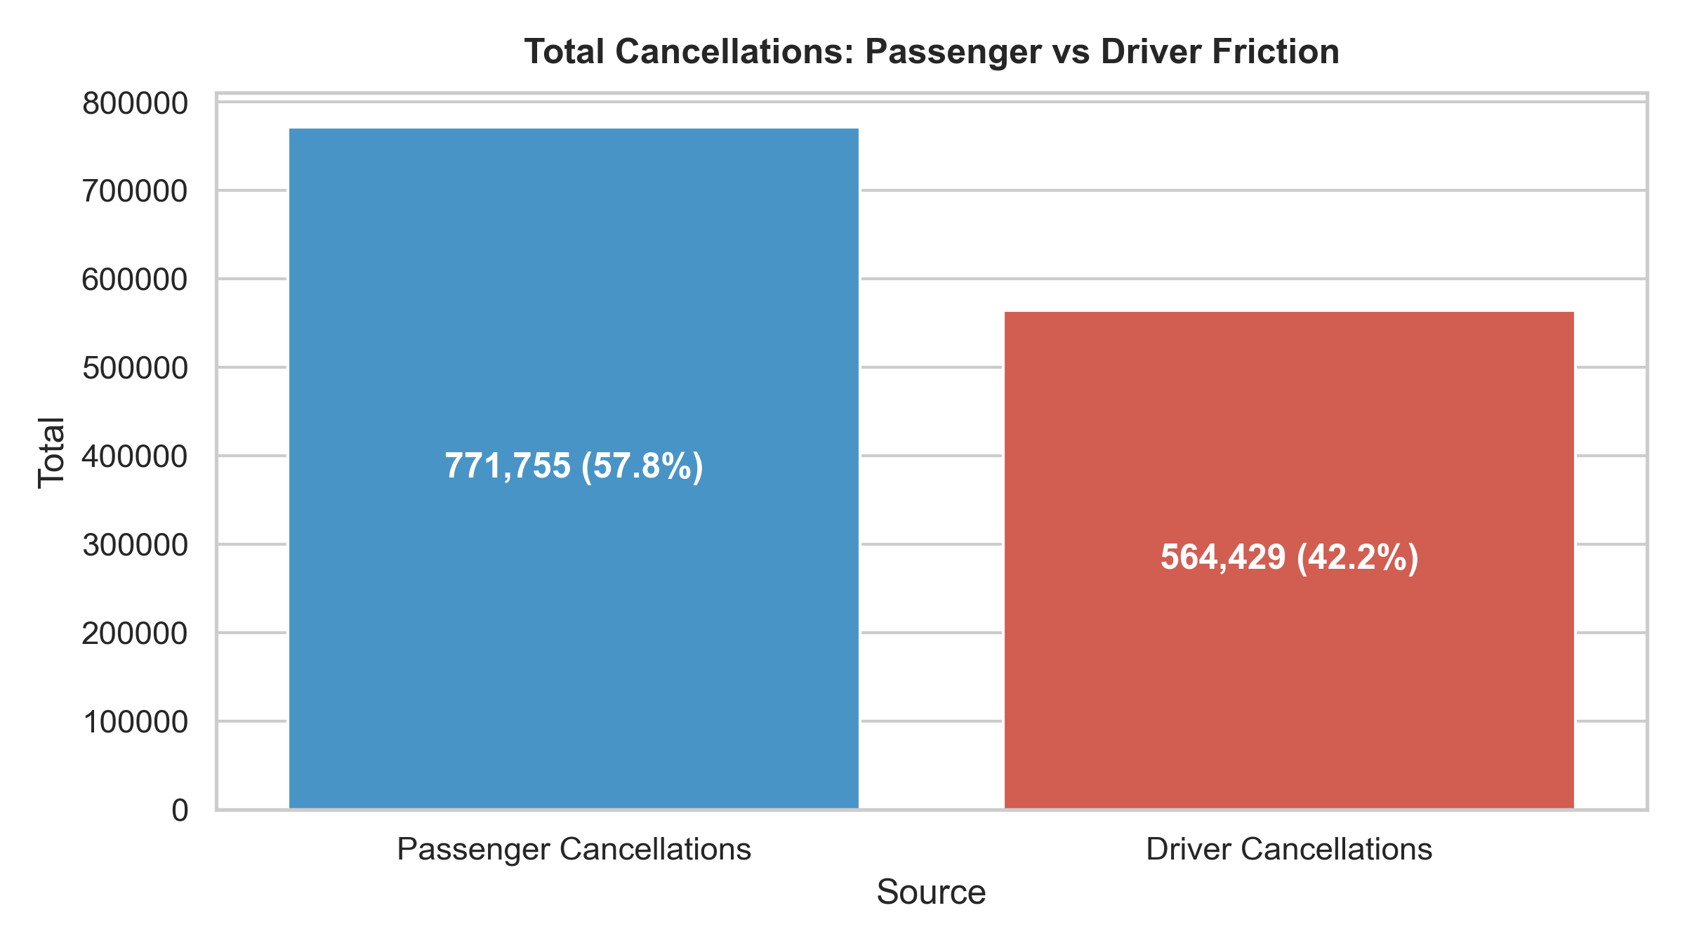
7. Driver Lifecycle Journey & Cancellation Friction
RIDE IT Drivers Engagement Analysis

Slide 9
8. Key Insights & Observations
RIDE IT Drivers Engagement Analysis
1. EARLY RETENTION
New vs Early-Stage
Engagement drops from 66.5 (New: 0-30d) to 58.9 (Early: 31-90d).
2. CANCELLATION SOURCES
61.2% Passenger / 38.8% Driver
Passenger cancellations represent the majority of platform cancellations.
3. GOLD STATUS
Higher Engagement
Elite Gold drivers (31+) achieve 76.4 average engagement score.
• Marketing Preference Association: Drivers who opted in to marketing showed higher average engagement (63.2 vs 59.8) and completed 22% more rides.
• Rating Tier Association: Drivers with rating >= 4.85 achieve 64.1 avg engagement vs 52.8 for drivers rated below 4.70.
• Dispatch Alignment: Minimizing driver-initiated cancellations (38.8% of cancellations) is critical to maintaining fleet productivity.

Slide 10
9. Actionable Recommendations & Opportunities
RIDE IT Drivers Engagement Analysis
OPPORTUNITY 1
Early-Stage Retention
Design targeted onboarding follow-ups during the 31-90 day window to stabilize driver engagement.
OPPORTUNITY 2
Cancellation Reduction
Optimize dispatch pickup distance thresholds to reduce avoidable driver-initiated cancellations.
OPPORTUNITY 3
Loyalty Progression
Encourage Gold status progression across lower-tier drivers to foster consistent engagement.
• Marketing Channel Utilization: Promote marketing opt-in during onboarding, as opted-in drivers demonstrate higher platform activity.
• PHV Fleet Support: Address specific acceptance challenges for PHV drivers to help improve conversion rates from 44.1%.
• Ongoing Performance Tracking: Use the 3-page Power BI Dashboard and monthly KPI queries to monitor fleet metrics across operating markets.

