Slide 1

Department Of Computer Science And Applications
DAV UNIVERSITY, JALANDHAR
Presentation on
Soil Pollution: Causes, Effects, and Control
Submit By:
Prabhneet kaur (12500574)
Sukhdeep kaur (12500165)
Submit To:
Dr. Harpreet walia
(Assistant Professor)

Slide 2
What Is Soil Pollution?
Soil pollution is any harmful change to the soil’s physical, chemical, or biological properties that reduces its ability to support life. Polluted soil affects plants, animals, groundwater, and human health.
Key Causes
Why It Matters
Human activities, industrial waste, agricultural chemicals, and improper disposal of garbage.
Soil supports food production, stores carbon, filters water, and hosts biodiversity.

Slide 3
Major Sources of Soil Pollution
Agriculture
Industrial Waste
Waste Dumping
Mining & Development
Overuse of fertilizers and pesticides adds toxic chemicals and salts to soil.
Chemical spills, heavy metals, and improper disposal contaminate large areas.
Domestic, hospital, and commercial waste introduce plastics, pathogens, and hazardous compounds.
Mine dust and construction spoil bury healthy topsoil and spread pollutants.

Slide 4

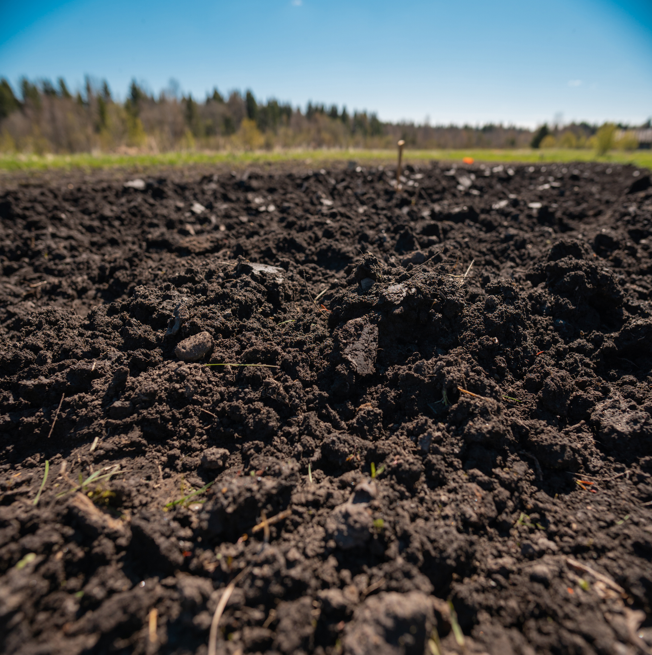
Effects on Soil Health
Kills beneficial organisms like earthworms and microbes
Reduces soil fertility and nutrient availability
Lowers soil’s self-regeneration and structure
Pesticides and toxins make soil unsafe for plants and humans
These biological and chemical changes make it harder to grow healthy crops and sustain ecosystems.

Slide 5
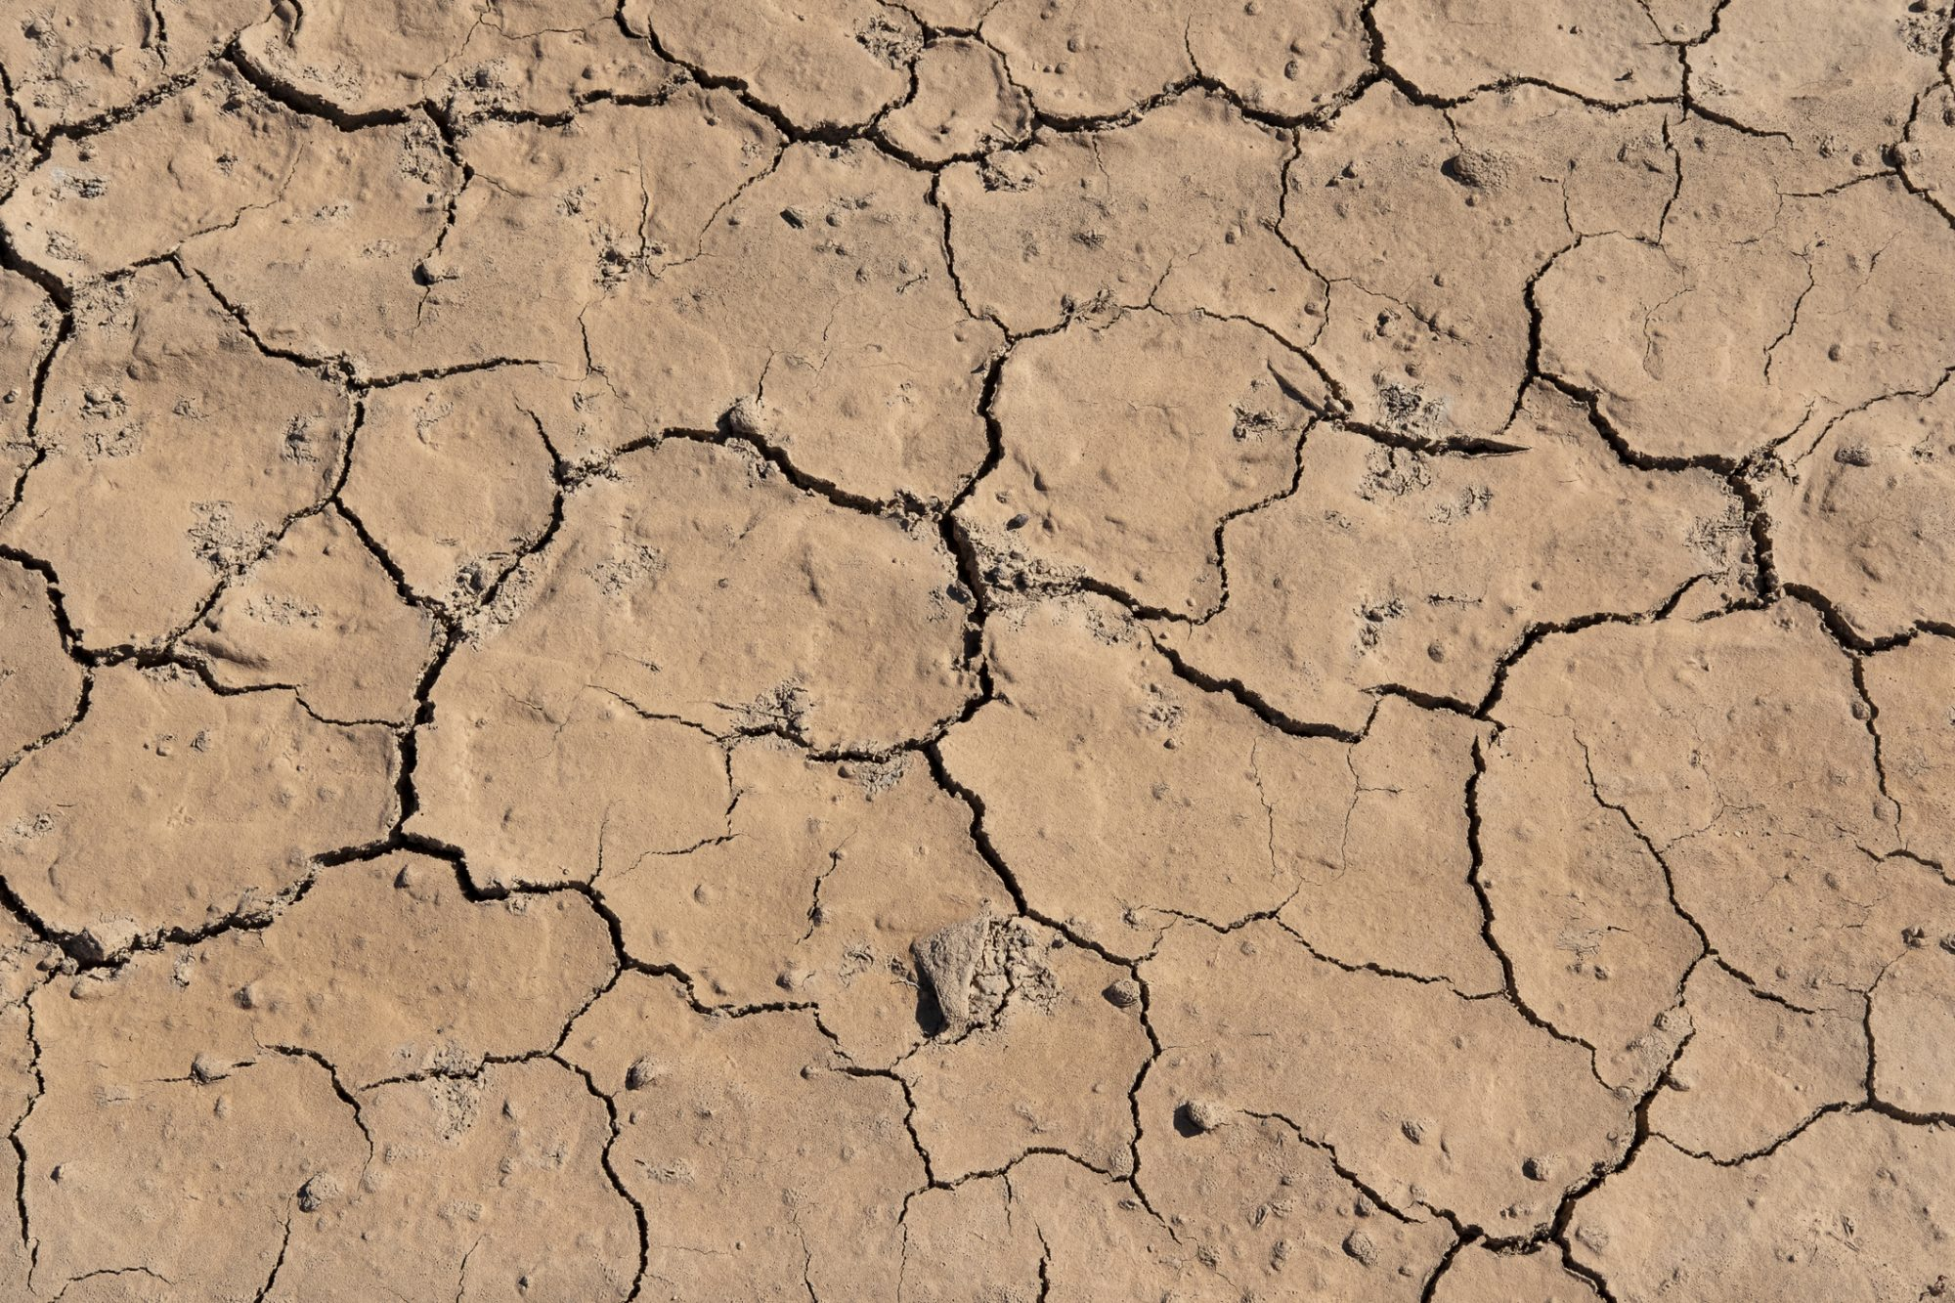
Effects on Environment & Water
Biomagnification: toxins move up the food chain
Eutrophication: nutrient runoff causes algal blooms in water
Salinization and waterlogging weaken crop growth
Desertification: fertile land turns to arid land
Polluted soil often contaminates groundwater and rivers, harming aquatic life and reducing clean water availability for communities.

Slide 6
Control Measures — Waste & Land Management
Reduce & Reuse
Proper Disposal
Afforestation
Planting trees stabilizes soil, reduces erosion, and improves water retention.
Adopt the 3Rs: Reduce consumption, Reuse materials, Recycle where possible.
Use controlled landfills, incineration (when safe), and pyrolysis to limit leaks to soil.

Slide 7
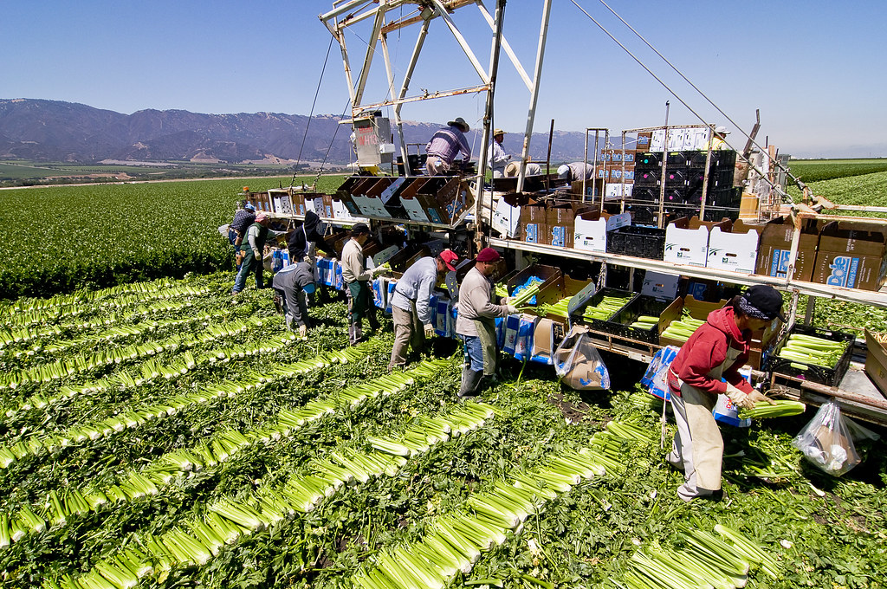
Control Measures — Farming & Industry
Switch to organic farming, crop rotation, and mixed cropping to restore soil fertility.
Convert animal waste to biogas and use agricultural residues for paper and bricks.
Adopt modern mining methods and use fly ash responsibly in industries.
Replace single-use plastics with biodegradable alternatives to cut long-term contamination.

Slide 8

Conclusion — Why Soil Protection Matters
Soil is a vital, nonrenewable resource. Preventing soil pollution protects food security, water quality, and ecosystems. Simple actions—better waste handling, sustainable farming, and community planting—make a big difference.
“Save Soil, Save Future.” — Small steps today keep our soil healthy for tomorrow.

