Slide 1

Enhancing Secure Data Transmission through Deep Learning-based Image Steganography and Super-Resolution Generative Adversarial Networks
Team Members
B N Sukanth BL.EN.U4AIE21014
Sathyavarapu Sri Jaswanth BL.EN.U4AIE21116
Sreyas Ramesh BL.EN.U4AIE21120
Date:16-05-2024
Course : Deep Learning for Signal & Image Processing
- 21AIE312
AIE 6th sem –E Sec

Slide 2
Outline
Introduction
Literature Survey
Dataset Description
Methodology
Results and Discussion
Conclusion

Slide 3
Introduction
Digital images are essential in multimedia technology.
With the increase in digital communication, concerns about data security and privacy breaches increase too.
Keeping secret data hidden and safe from unauthorized access is crucial.
Sensitive data leaking and falling into the wrong hands can lead to grave danger.

Slide 4
Introduction Cont.
To Address these issues:
Deep Learning models
Steganography
SRGAN
LSB
Generator
CAE
Sprite
Discriminator
VGG 16
ResNet50

Slide 5
Literature Review
Sl. No. | Paper Title | Year, publisher Author’s Name | Inferences
1 | An improved steganography without embedding based on attention GAN | 2021 - Yu Cong & Hu, Donghui & Zheng, Shuli & Jiang, Wenjie & Li, Meng & Zhao, Zhong-qiu. | Presents a methodology to enhance information recovery accuracy and steganography capacity using GANs By optimizing training modes and loss functions and incorporating attention mechanisms and soft margin discriminators
2 | Image Steganography-A New Approach using Block Truncation Coding and LSB Embedding | 2022 - P. Mohan, P. B. Menon, P. K. Rahul and K. S. Sidharth | Proposed a spatial domain steganography method utilizing Least Significant Bit (LSB) embedding and Block Truncation Coding (BTC). By embedding messages into the least significant bit of carrier images and compressing the negative of the input using BTC
3 | Encipher GAN: An End-to-End Color Image Encryption System Using a Deep Generative Model | 2023 - Panwar, K. Singh, A. Kukreja, S. Singh, K.K. Shakhovska, N. Boichuk | Discuss the application of generative adversarial networks (GANs), particularly Cycle-GAN, in image encryption schemes. Their proposed encryption scheme, Encipher GAN, employs deep convolutional neural networks to transform plaintext images into cipher images and vice versa.
4 | High invisibility image steganography with wavelet transform and generative adversarial network | 2024 - Ye Yao, Junyu Wang, Qi Chang, Yizhi Ren, Weizhi Meng | Discuss the emergence of deep learning-based steganography methods, combining Discrete Wavelet Transform (DWT) and GANs to enhance embedding capacity and security.
5 | Exploring Advanced Encryption and Steganography Techniques for Image Security | 2023 - M. Kataria, K. Jain and N. Subramanian | Stego images generated using Spread Spectrum method had higher PSNR and MSE values than those generated using the LSB method in terms of the PSNR metric. AES and ChaCha20 encryption algorithms outperformed DES and RSA in terms of runtime analysis
6 | Leveraging coverless image steganography to hide secret information by generating anime characters using GAN | 2024 - Hafiz Abdul Rehman, Usama Ijaz Bajwa, Rana Hammad Raza, Sultan Alfarhood, Mejdl Safran, Fan Zhang | Introduce a novel approach to coverless image steganography by utilizing GANs to hide secret information within anime characters. Their methodology involves character generation, utilizing LSTM and SRGAN models for text to face attribute labelling and high-resolution image generation.

Slide 6
Dataset Description
CIFAR-100
60,000 images having 100 classes
Each image is of the size 32 x 32
Each Image has class as a label
6

Slide 7
Dataset Description
Image Super Resolution
Divided into 2 main folders: train and val.
Subdirectories called high_res & low_res in both train and val
1370 images, 685 images each for high resolution and low resolution in train folder.
340 images, 170 images each for high resolution and low resolution in val folder
Image size 256x256 for high and low resolution
7

Slide 8
Methodology
4 major steps:
Extracting Semantic Features
Steganography
Reconstructing the image
Computing the evaluation metrics

Slide 9
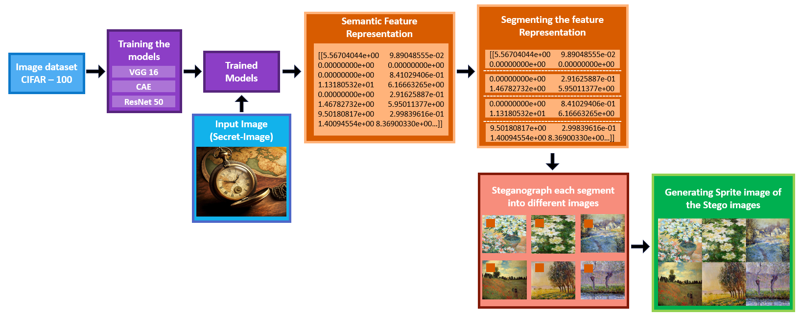
Sender side

Slide 10
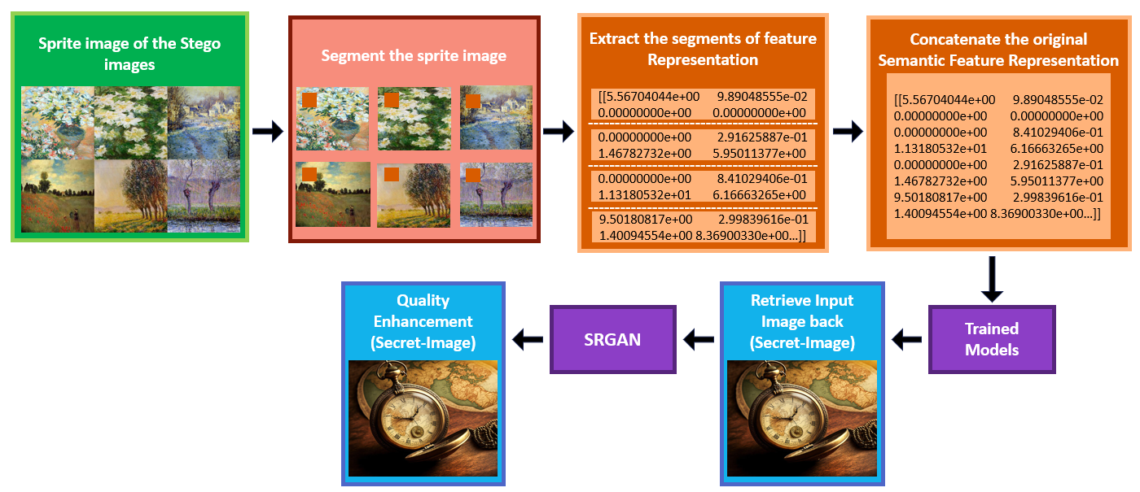
Receiver side

Slide 11
Extracting Semantic Features
Encoder architecture has been implemented.
3 Deep learning models have been used
Convolutional Autoencoder (CAE)
VGG-16
ResNet-50

Slide 12
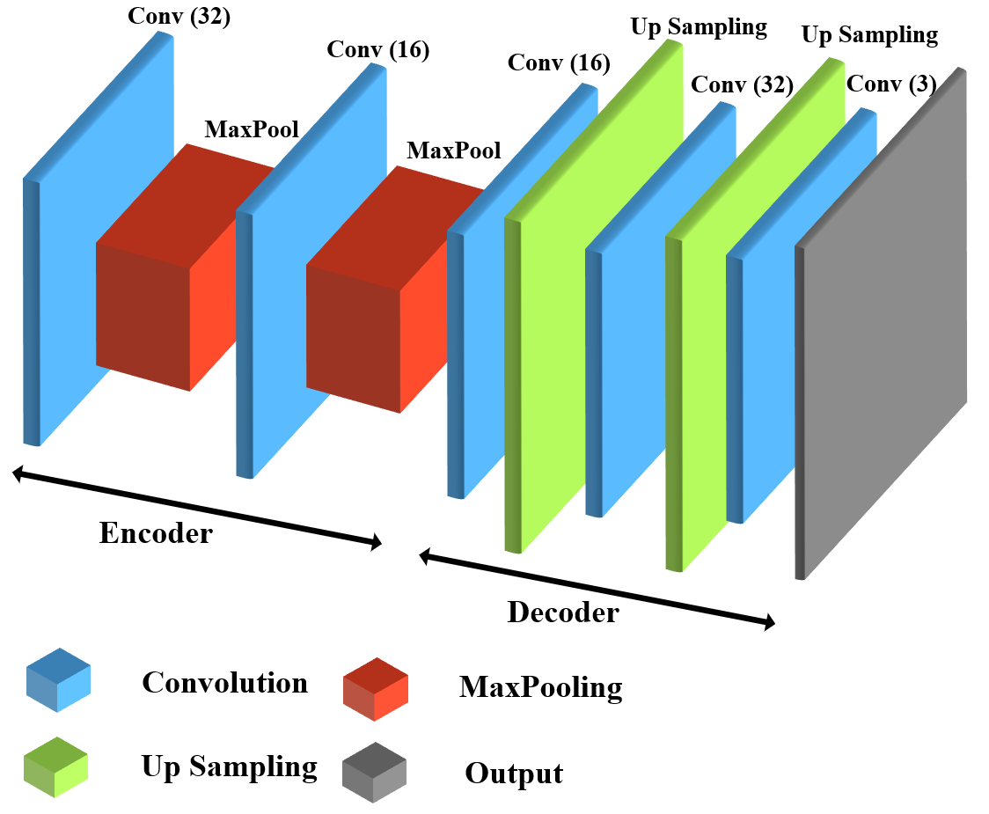
Model Building
CAE MODEL

Slide 13
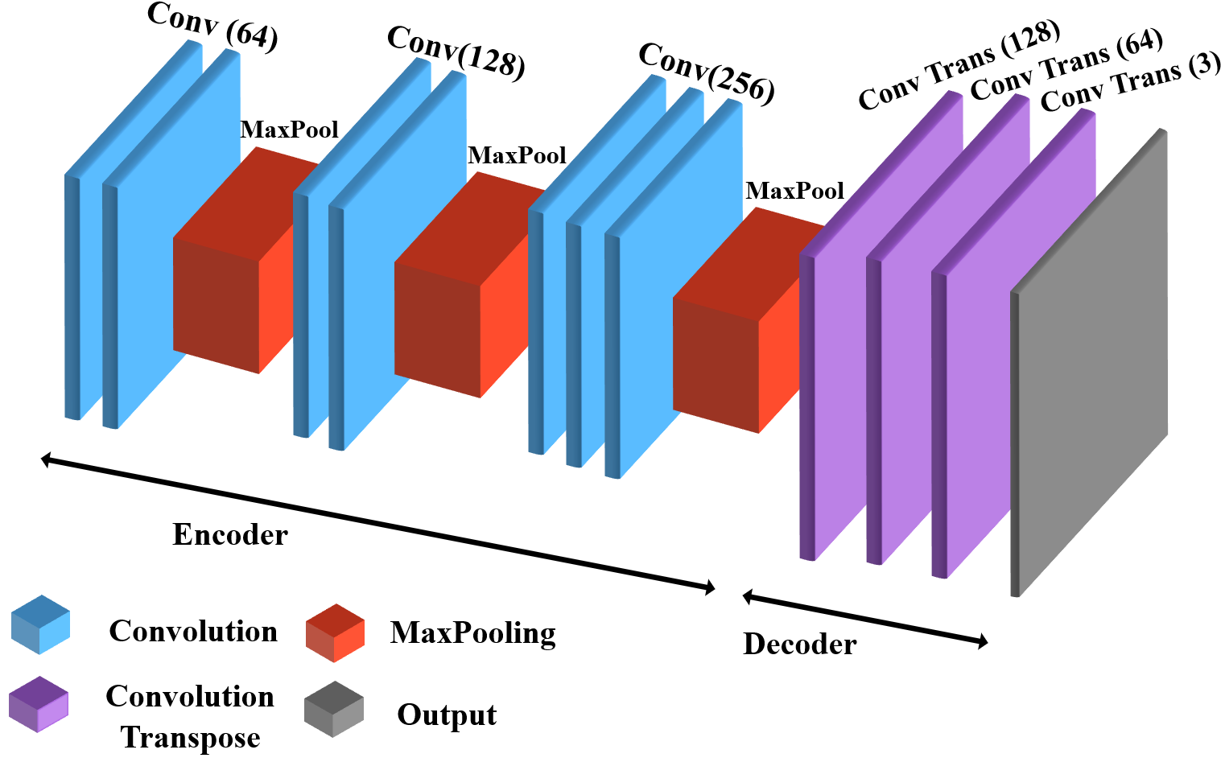
Model Building
VGG16 MODEL

Slide 14
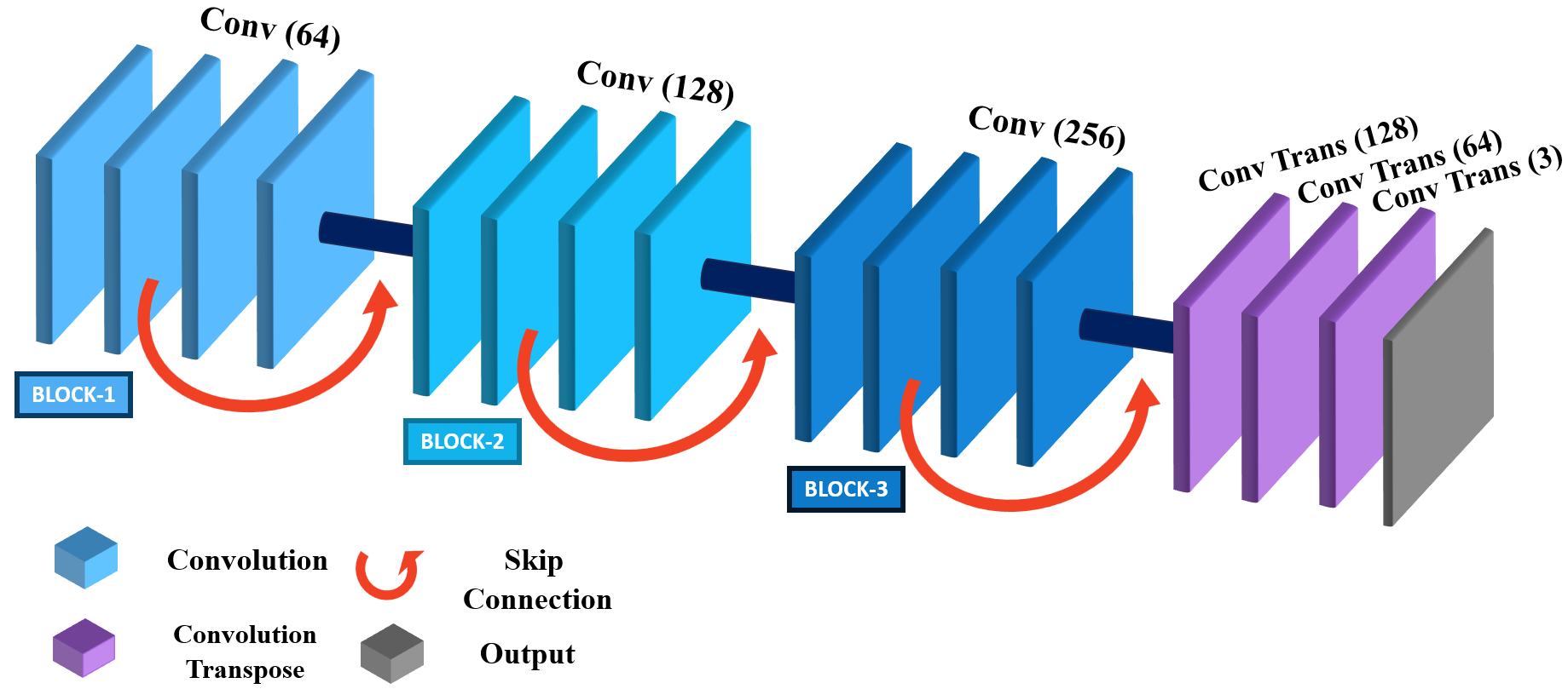
Model Building
ResNet50 MODEL

Slide 15
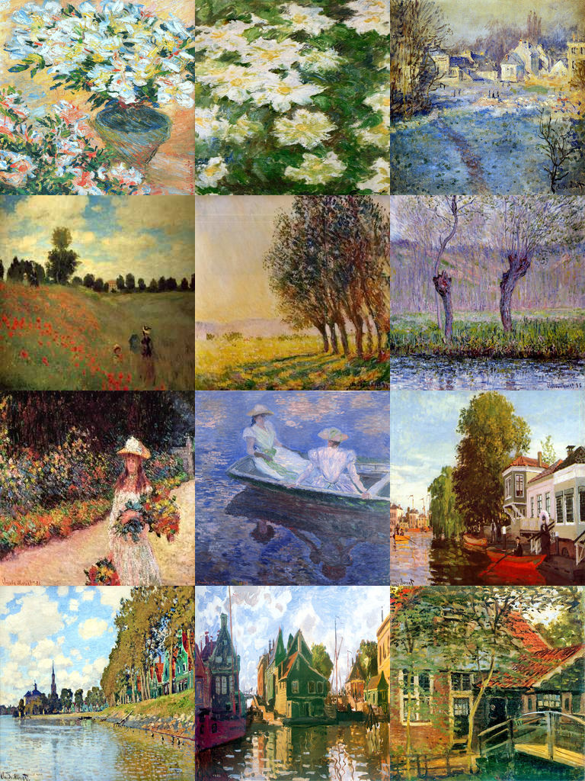
Steganography
Semantic Features Serialization
The 4-dimentional array form of the semantic features is converted to the form string with JSON
Embedding Message into image:
JSON string representing semantic features undergoes fragmentation.
Each fragment is concealed within separate images utilizing the Least Significant Bit.
Creation of Sprite image:
The amalgamation of images, each containing fragments of the JSON string.
Forms a collaged image called a Sprite image.

Slide 16
Steganography
Extraction of Embedded Messages:
The sprite image is segmented into individual images.
Each segment of the embedded message is extracted.
These messages are then concatenated to reconstruct the original JSON string.
Recovery of Semantic Features:
The reconstructed JSON string is deserialized back into a list of semantic features.

Slide 17
Image reconstruction
Decoder architecture has been implemented.
3 Deep learning models have been used
Convolutional Autoencoder (CAE)
VGG-16
ResNet-50

Slide 18
Evaluation Metrics
SSIM - Structural Similarity Index Measure
PSNR - Peak Signal-to-Noise Ratio
MAE - Mean Absolute Error
MSE - Mean Square Error

Slide 19
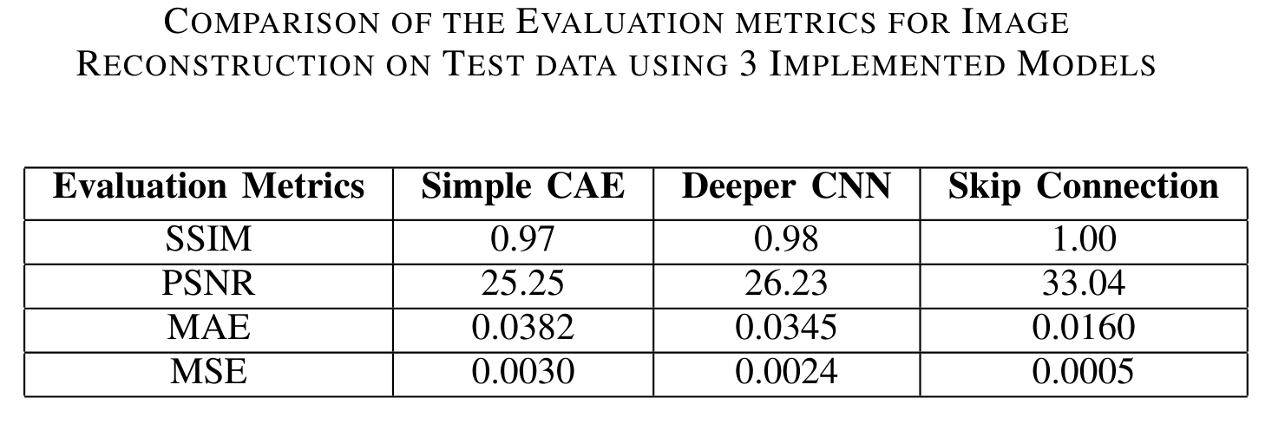
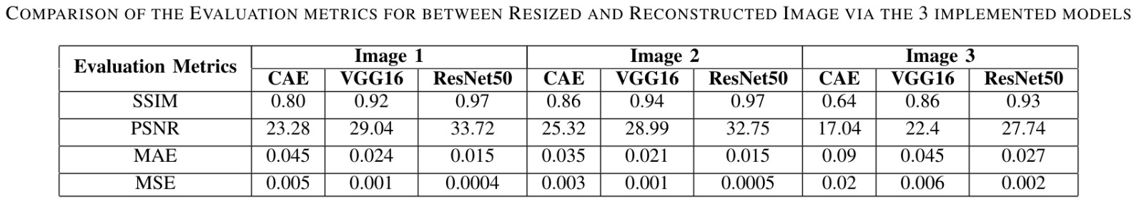
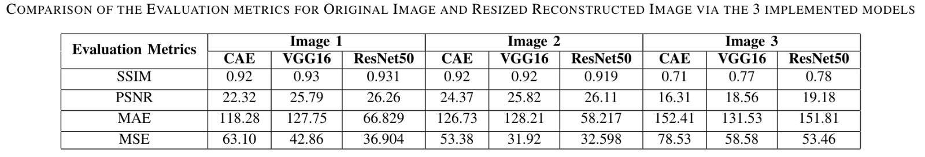
Results and discussions

Slide 20
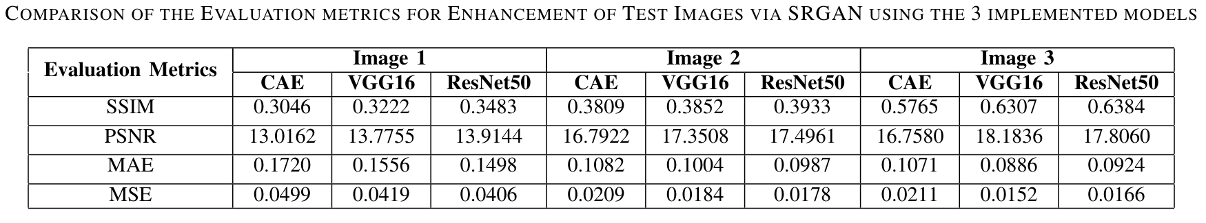
Results and discussions

Slide 21
Results and discussions
On test data all 3 models have worked well
On comparison with custom input
Resized original image vs reconstructed image
Original image vs Resized Reconstructed image
On comparing the performance of the models with 3 comparisons we found out that ResNet-50 has performed well.

Slide 22
Conclusion
Methodology that helps in embedding features of an image in an image file and then.
Reconstructing the image back using encoder decoder architecture
Three deep learning models CAE, VGG16 and Resnet-50.
Steganography is done by Creating a sprite where the segments of image feature are embedded
The steganography of the image is done by splitting the semantic feature
in the carrier file is done using LSB steganography technique.

Slide 23
Conclusion
The decoder helps in reconstructing the original image back using the features extracted from the audio.
The best model for reconstruction was Resnet 50.
SRGAN was used further to enhance the quality of the reconstructed.

Slide 24
References
[1] Zhenjie Bao and Ru Xue, ”Research on the avalanche effect of image encryption based on the Cycle-GAN,” Appl. Opt. 60, 5320-5334 (2021)
[2] Y. Ding, F. Tan, Z. Qin, M. Cao, K. -K. R. Choo and Z. Qin, ”DeepKeyGen: A Deep Learning-Based Stream Cipher Generator for Medical Image Encryption and Decryption,” in IEEE Transactions on Neural Networks and Learning Systems, vol. 33, no. 9, pp. 4915-4929, Sept. 2022
[3] Liu, Z., Xue, R. Visual image encryption based on compressed sensing and Cycle-GAN. Vis Comput (2023)
[4] Panwar, K.; Singh, A.; Kukreja, S.; Singh, K.K.; Shakhovska, N.; Boichuk, A. Encipher GAN: An End-to-End Color Image Encryption System Using a Deep Generative Model. Systems 2023
[5] Singh, O.D., Dhall, S., Malik, A. et al. A robust and secure immensely random GAN based image encryption mechanism. Multimed Tools Appl 82, 19693–19743 (2023).
[6] Yendluri Lohith JayaSurya , Yendluri Priya Yasaswini , Somepalli Saranya,”Image Steganography”, International Journal of Recent Technology and Engineering (IJRTE), Volume-9 Issue-3, September 2020
[7] P. Mohan, P. B. Menon, P. K. Rahul and K. S. Sidharth, ”Image Steganography-A New Approach using Block Truncation Coding and LSB Embedding,” 2022 6th International Conference on Trends in Electronics and Informatics (ICOEI), Tirunelveli, India, 2022
[8] M. Kataria, K. Jain and N. Subramanian, ”Exploring Advanced Encryption and Steganography Techniques for Image Security,” 2023 11th International Symposium on Digital Forensics and Security (ISDFS), Chattanooga, TN, USA, 2023
[9] Chahar, Vijay & Sharma, Sahil & Kumar, Chandan & Sahu, Aditya Kumar. “Latest Trends in Deep Learning Techniques for Image Steganography”, International Journal of Digital Crime and Forensics, 2023
[10] Monu Singh, Naman Baranwal, K.N. Singh, A.K. Singh, Huiyu Zhou, Deep learning-based biometric image feature extraction for securing medical images through data hiding and joint encryption–compression, Journal of Information Security and Applications, Volume 79, 2023

Slide 25
References
[11] Q. Li et al., ”A Novel Grayscale Image Steganography Scheme Based on Chaos Encryption and Generative Adversarial Networks,” in IEEE Access, vol. 8, pp. 168166-168176, 2020
[12] Qin, J.; Wang, J.; Tan, Y.; Huang, H.; Xiang, X.; He, Z. Coverless Image Steganography Based on Generative Adversarial Network. Mathematics 2020
[13] V. Sharma, M. Shukla, S. Srivastava and R. Mandal, ”Generative Network Based Image Encryption,” 2020 4th International Conference on Intelligent Computing and Control Systems (ICICCS), Madurai, India, 2020
[14] Ramaneti, K., Kakani, P., Krishna, C., Rajkumar, S. (2021). Image Steganography Using GANs. In: Lee, R. (eds) Computer and Information Science 2021
[15] Yu, C., Hu, D., Zheng, S. et al. An improved steganography without embedding based on attention GAN. Peer-to-Peer Netw. Appl. 14, 1446–1457 (2021).
[16] Yuan, C., Wang, H., He, P. et al. GAN-based image steganography for enhancing security via adversarial attack and pixel-wise deep fusion. Multimed Tools Appl 81, 6681–6701 (2022).
[17] Kuyoro, A., Nzenwata, U.J., Awodele, O., Idowu, S. (2022). GANbased encoding model for reversible image steganography. Revue d’Intelligence Artificielle, Vol. 36, No. 4, pp. 561-567.
[18] Alejandro Mart´ın, Alfonso Hernandez, Moutaz Alazab, Jason Jung, ´ David Camacho, “Evolving Generative Adversarial Networks to improve image steganography”, Expert Systems with Applications, Volume 222, 2023
[19] Hafiz Abdul Rehman, Usama Ijaz Bajwa, Rana Hammad Raza, Sultan Alfarhood, Mejdl Safran, Fan Zhang, “Leveraging coverless image steganography to hide secret information by generating anime characters using GAN”,Expert Systems with Applications,Volume 248, 2024
[20] Ye Yao, Junyu Wang, Qi Chang, Yizhi Ren, Weizhi Meng, ”High invisibility image steganography with wavelet transform and generative adversarial network”, Expert Systems with Applications, 2024
[21] Dewang Wang, Gaobo Yang, Jiyou Chen, Xiangling Ding, ”GANbased adaptive cost learning for enhanced image steganography security”,Expert Systems with Applications, Volume 249, Part A, 2024

Slide 26
Thank You
26

