Slide 1
SQL

Slide 2
SQL
Structured Query Language
SQL lets you access and manipulate databases
SQL is the standard language for Relational Database System.
All the Relational Database Management Systems (RDMS) like MySQL, MS Access, Oracle, Sybase, Informix, Postgres and SQL Server use SQL as their standard database language.

Slide 3
What Can SQL do?
SQL can execute queries against a database
SQL can retrieve data from a database
SQL can insert ,delete,update records in a database
SQL can create new databases
SQL can create new tables in a database
SQL can create stored procedures in a database
SQL can create views in a database
SQL can set permissions on tables, procedures, and views

Slide 4
A Brief History of SQL
1970 − Dr. Edgar F. "Ted" Codd of IBM is known as the father of relational databases. He described a relational model for databases.
1974 − Structured Query Language appeared.
1978 − IBM worked to develop Codd's ideas and released a product named System/R.
1986 − IBM developed the first prototype of relational database and standardized by ANSI. The first relational database was released by Relational Software which later came to be known as Oracle

Slide 5
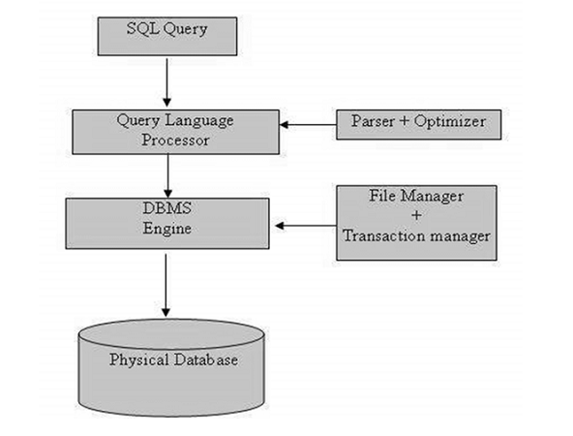
SQL Architecture

Slide 6
What is a table?
The data in an RDBMS is stored in database objects which are called as tables.
This table is basically a collection of related data entries and it consists of numerous columns and rows.
A table is the most common and simplest form of data storage in a relational database.

Slide 7
SQL Datatype
SQL Data Type is an attribute that specifies the type of data of any object.

Slide 8
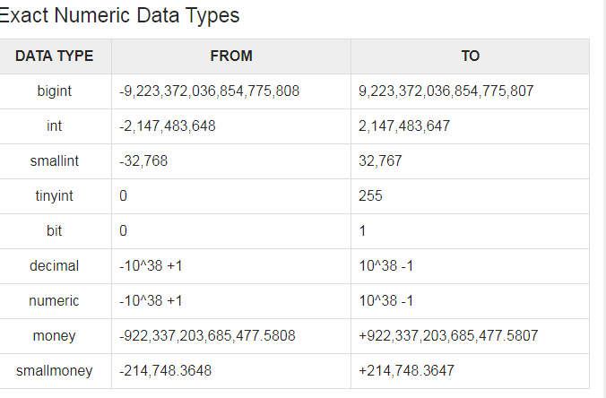

Slide 9
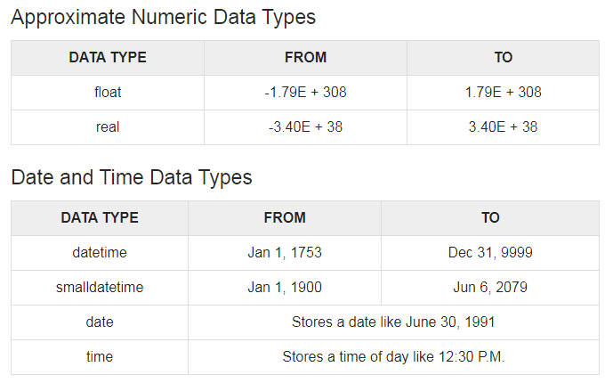

Slide 10
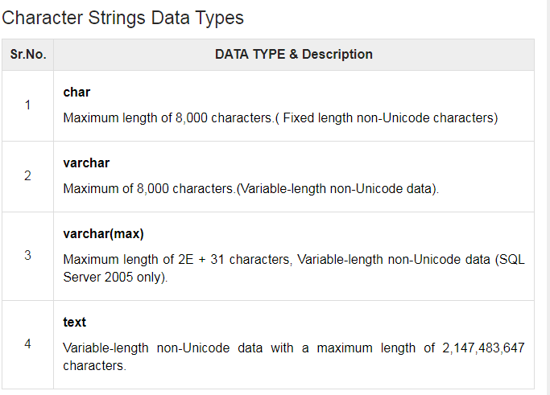

Slide 11
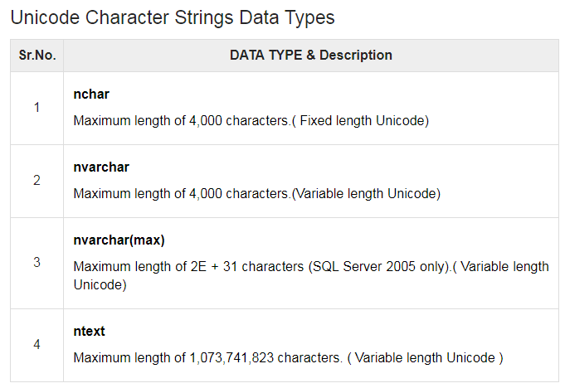

Slide 12
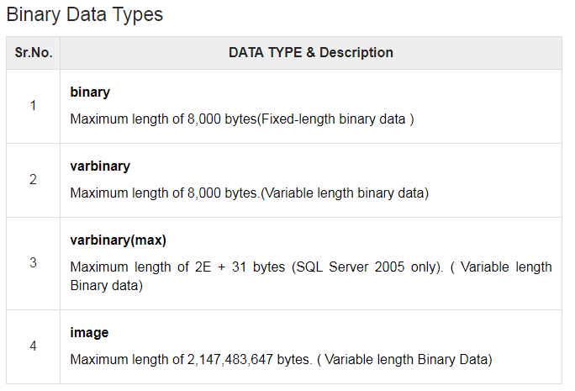

Slide 13
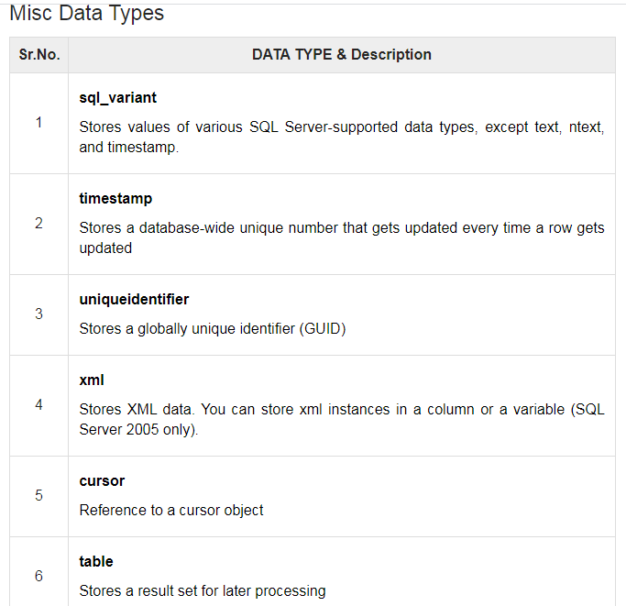

Slide 14
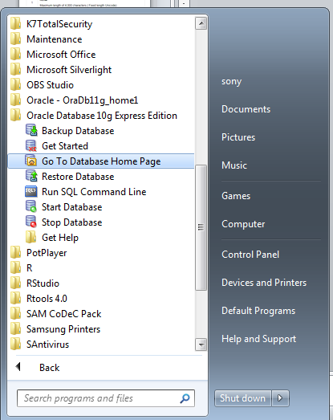
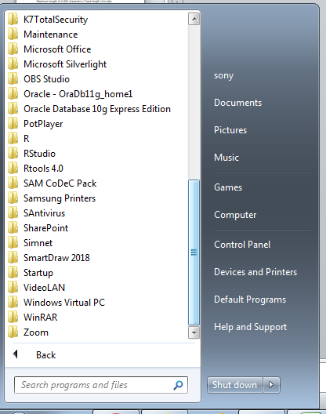
Steps

Slide 15
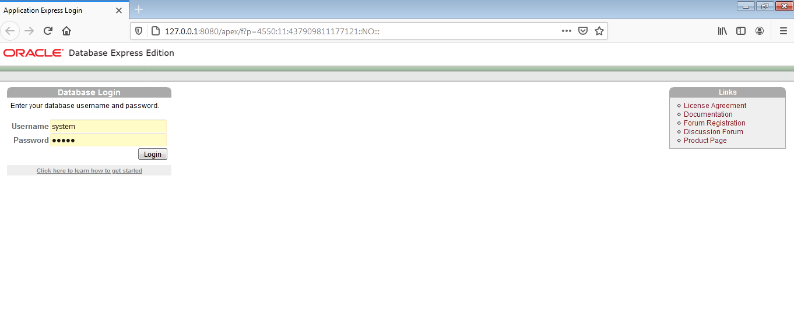

Slide 16
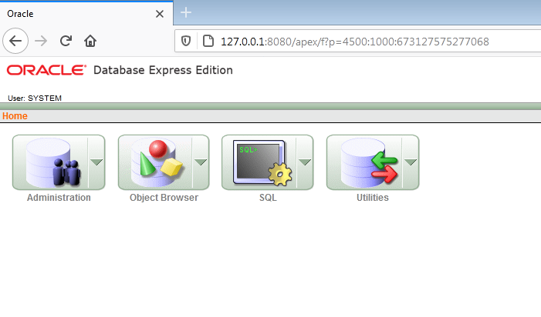

Slide 17
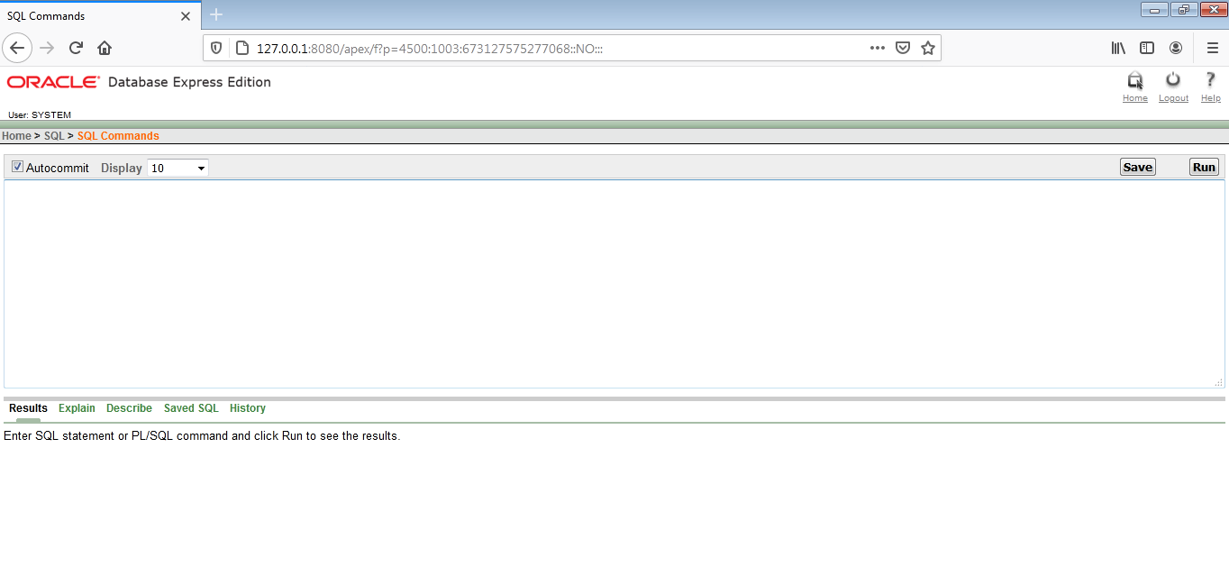
SQL-SQL Commands

Slide 18
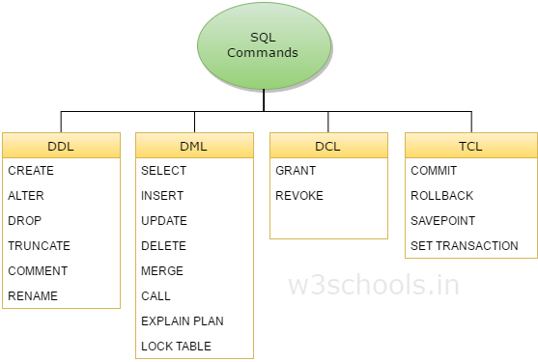

Slide 19
DDL - Data Definition Language
DDL deals with database schemas and descriptions, of how the data should reside in the database.
CREATE – to create database and its objects like (table, index, views, store procedure, function and triggers)
ALTER – alters the structure of the existing database
DROP – delete objects from the database
TRUNCATE – remove all records from a table, including all spaces allocated for the records are removed
COMMENT – add comments to the data dictionary
RENAME – rename an object

Slide 20
DML - Data Manipulation Language
DML deals with data manipulation, and includes most common SQL statements such SELECT, INSERT, UPDATE, DELETE etc, and it is used to store, modify, retrieve, delete and update data in database.
SELECT – retrieve data from the a database
INSERT – insert data into a table
UPDATE – updates existing data within a table
DELETE – Delete all records from a database table
MERGE – UPSERT operation (insert or update)
CALL – call a PL/SQL or Java subprogram
EXPLAIN PLAN – interpretation of the data access path
LOCK TABLE – concurrency Control

Slide 21
DCL - Data Control Language
DCL includes commands such as GRANT, and mostly concerned with rights, permissions and other controls of the database system.
GRANT – allow users access privileges to database
REVOKE – withdraw users access privileges given by using the GRANT command

Slide 22
TCL - Transaction Control Language
TCL deals with transaction within a database.
COMMIT – commits a Transaction
ROLLBACK – rollback a transaction in case of any error occurs
SAVEPOINT – to roll back the transaction making points within groups
SET TRANSACTION – specify characteristics for the transaction

