Slide 1
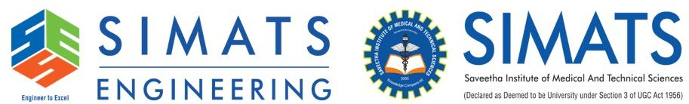
CAPSTONE PROJECT PRESENTATION
PROJECT TITLE
Smart Study Planner with Deadline Recovery and Workload Balancing Using C++
PRESENTED BY
G. Jaswanth (192472235)
D. Dileep Kumar (192424281)
Akshit Binu (192425284)
GUIDED BY
Dr.K. Jegadeesh

Slide 2


Introduction
A C++-based study planner for managing academic tasks, deadlines, and study workloads.
Analyzes task urgency, estimated effort, and available study hours to prioritize assignments.
Unique Feature: Constraint-Aware Study Recovery recommends revised schedules when students miss deadlines or face overlapping assignments.
Reschedules flexible tasks while respecting fixed deadlines and daily study-hour limits.
Identifies impossible schedules and explains why certain tasks receive higher priority.
Tracks academic progress and generates reports using local file storage.

Slide 3
Problem Statement
Students struggle to manage multiple assignments with overlapping deadlines and limited study hours.
Traditional task planners mainly track deadlines but may not address unrealistic study schedules.
Missed deadlines can create workload backlogs and increase academic pressure.
Students need a way to prioritize tasks based on urgency, workload, and deadline flexibility.
The proposed system addresses this through constraint-aware study recovery and workload balancing.

Slide 4
Objectives
Develop a C++ application to manage academic tasks and deadlines.
Prioritize tasks based on urgency, workload, and available study time.
Implement constraint-aware recovery to recommend revised schedules when plans fail.
Balance daily workloads while respecting fixed deadlines and study-hour limits.
Track task completion and generate academic progress reports.

Slide 5
Proposed Solution
Provides a centralized platform to manage academic tasks, deadlines, and study schedules.
Calculates task priority using urgency, estimated workload, and available study hours.
Introduces **Constraint-Aware Study Recovery** to recommend realistic schedules when students fall behind.
Balances workloads by rescheduling flexible tasks while respecting fixed deadlines and study-hour limits.
Identifies scheduling conflicts and explains task prioritization decisions.
Generates progress reports to help students monitor academic performance.

Slide 6
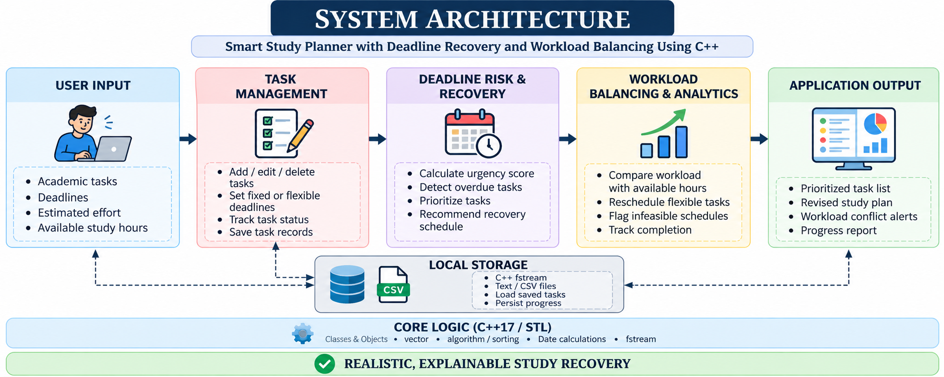
System Design / Architecture

Slide 7
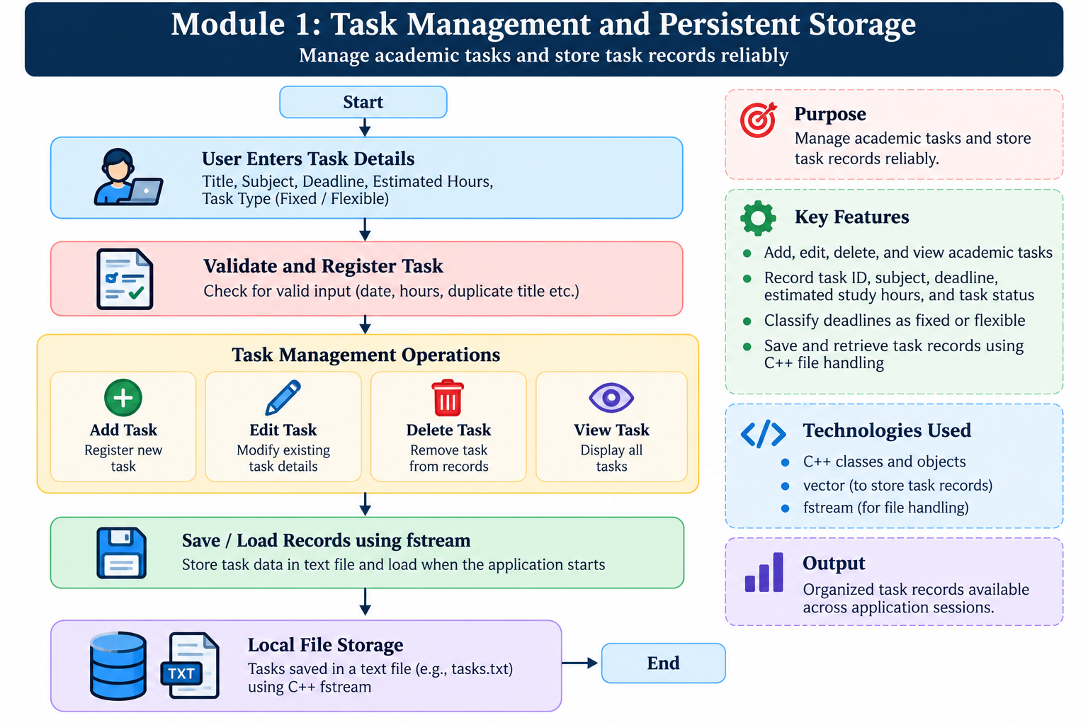
Module 1: Task Management and Persistent Storage

Slide 8
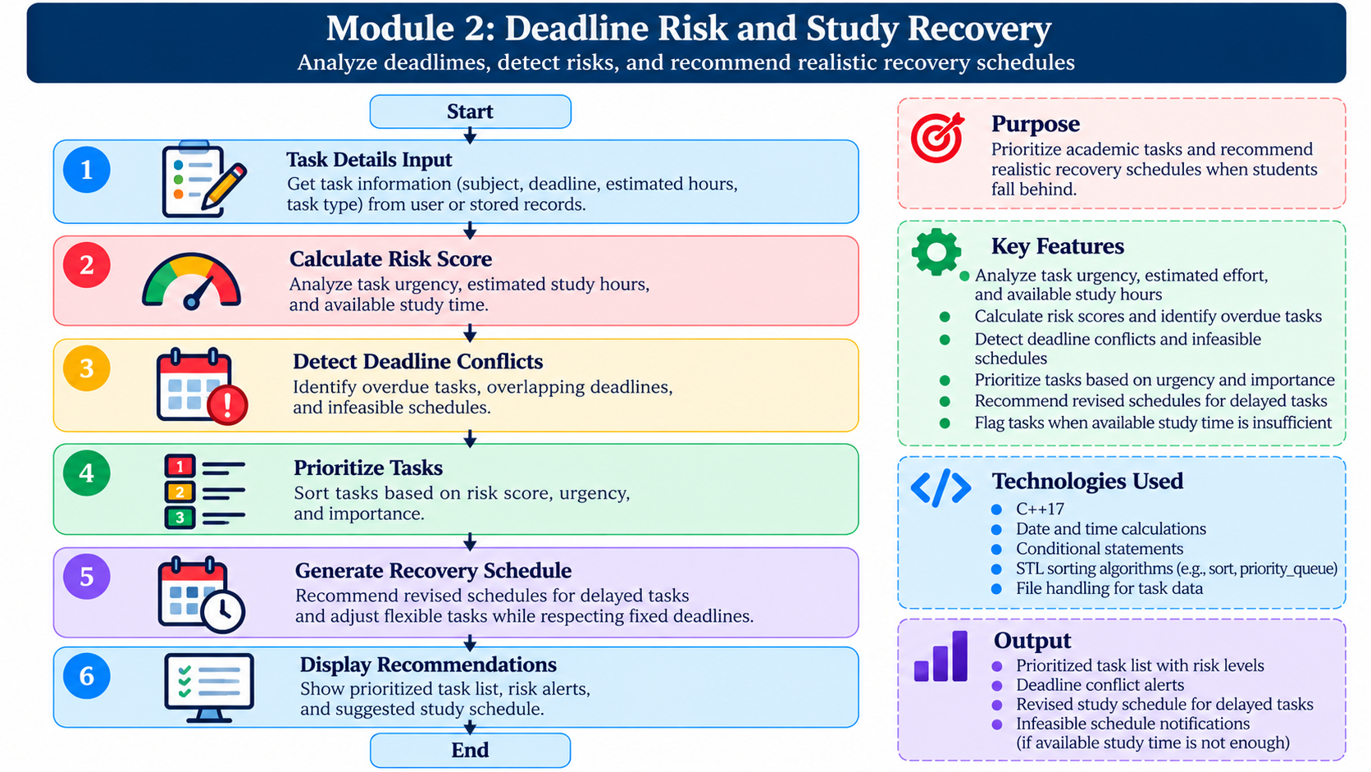
Module 2: Deadline Risk and Study Recovery

Slide 9
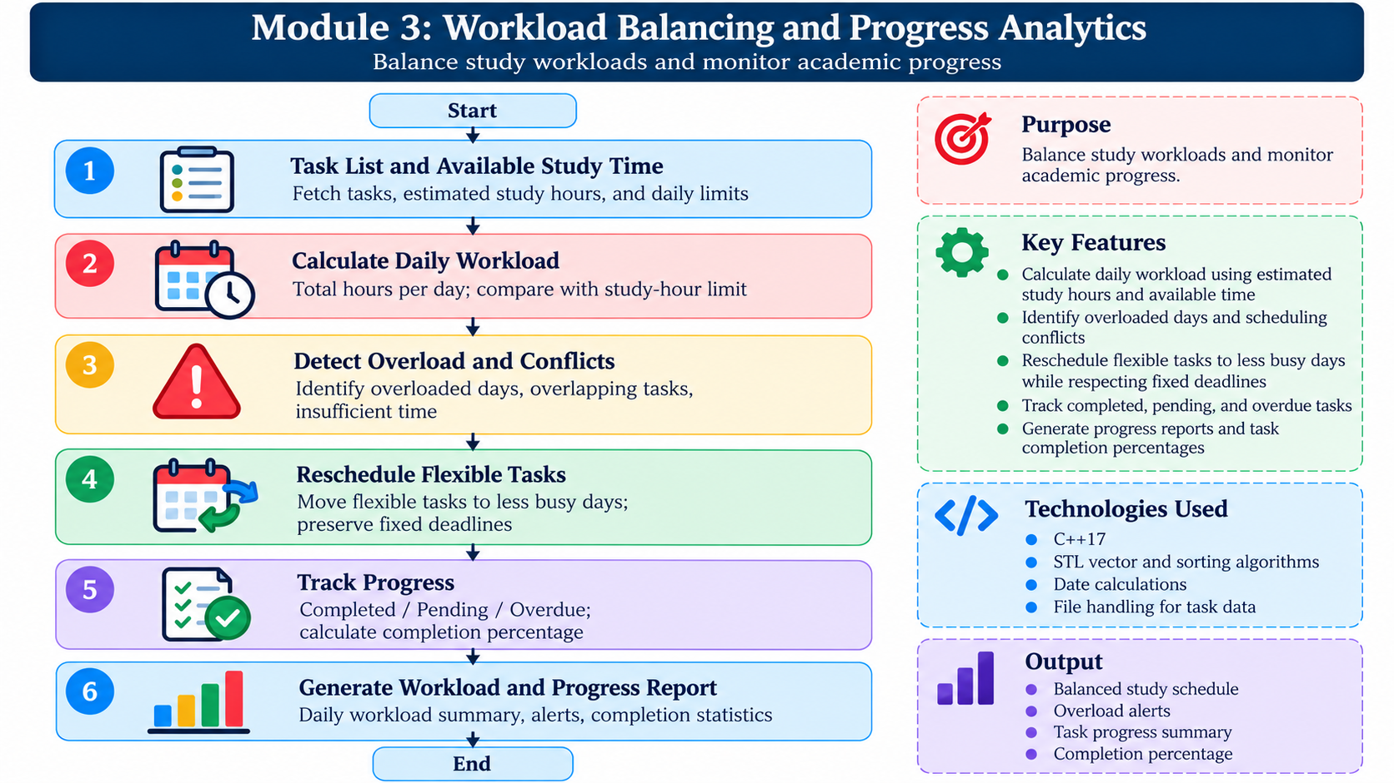
Module 3: Workload Balancing and Progress Analytics

Slide 10
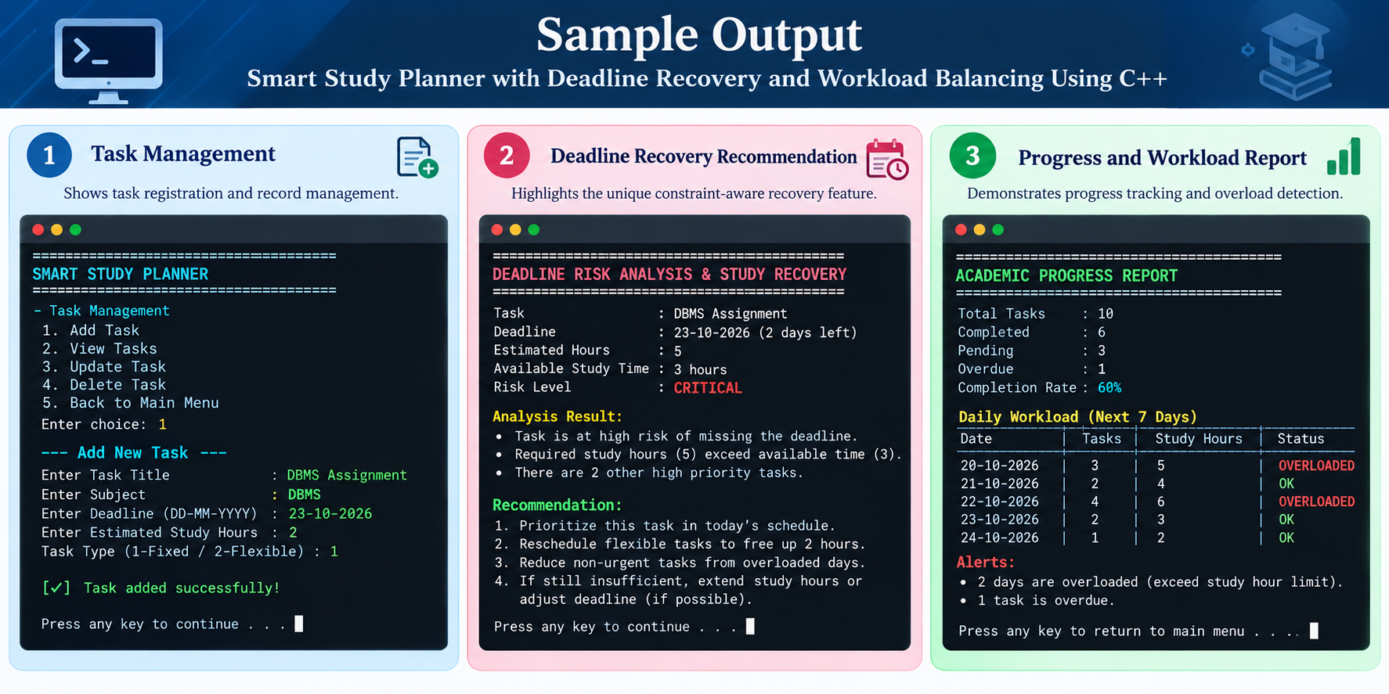

Slide 11
Advantages
Smart Prioritization: Identifies tasks that need immediate attention.
Deadline Recovery: Recommends revised schedules when students fall behind.
Workload Balancing: Distributes flexible tasks according to available study hours.
Conflict Detection: Flags overloaded days and unrealistic schedules.
Progress Tracking: Monitors completed, pending, and overdue tasks.
Low-Cost Solution: Uses C++ and local file storage without paid APIs.

Slide 12
Conclusion
The project provides a simple C++ solution for academic task and deadline management.
Its unique Constraint-Aware Study Recovery feature recommends realistic schedules when students fall behind.
Workload balancing helps identify overloaded days and reschedule flexible tasks.
Progress tracking supports better planning and monitoring of academic tasks.
Future enhancements include graphical interfaces, automated reminders, and calendar integration.

Slide 13
THANK YOU

