Slide 1

CAPSTONE PROJECT PRESENTATION
PROJECT TITLE
“”
PRESENTED BY
Pradeepkumar (192425016)
Yuvaraj R (192524058)
G. Jaswanth (192472235)
GUIDED BY
Dr. Kumaragurubaran T

Slide 2


Introduction
Overview
Automatic text summarization converts lengthy documents into concise, meaningful summaries. The proposed system uses the transformer-based T5 (Text-to-Text Transfer Transformer) model to generate abstractive summaries by understanding context and producing coherent, natural-language text.
Problem Statement
Traditional summarization methods mainly extract existing sentences and may fail to preserve the meaning, coherence, and context of complex documents. This makes them less effective for large and information-rich text.
Purpose
To develop an automatic text summarization system using the T5 model that generates accurate, concise, fluent, and context-aware summaries for large documents.

Slide 3
Objectives
Define Clear Goals
To design and implement an automatic text summarization system using a transformer-based T5 model.
Address the Problem Statement
To overcome the limitations of traditional summarization methods by generating coherent, context-aware, and meaningful abstractive summaries.
Expected Outcomes
To develop an efficient summarization model that produces accurate, concise, and grammatically correct summaries for
large text documents.

Slide 4
Background
Existing Research
Early text summarization approaches primarily focused on extractive techniques, while recent research increasingly uses transformer-based models for abstractive summarization. Models such as BERT, GPT, and T5 have demonstrated improved performance by capturing contextual and semantic relationships through attention mechanisms.
Research Gap
Despite these advancements, challenges remain in generating concise and coherent summaries for long documents while minimizing information loss. This highlights the need for optimized T5-based approaches that can improve summary quality and handle long-document summarization effectively.

Slide 5
Methodology
Tools & Frameworks
The system is developed using Python with deep learning and NLP libraries such as PyTorch, Hugging Face Transformers, and tokenizer utilities. Pandas and NumPy are used for data handling and analysis, while ROUGE metrics are used for model evaluation.
Development Approach
A transformer-based abstractive summarization approach is adopted. A pretrained T5/mT5 model is fine-tuned on multilingual data using a supervised learning pipeline consisting of preprocessing, training, validation, and testing.
Data Collection
The dataset consists of multilingual news articles and their human-written summaries collected from online news sources. The data is organized into training, validation, and test sets to support effective model training and evaluation.

Slide 6
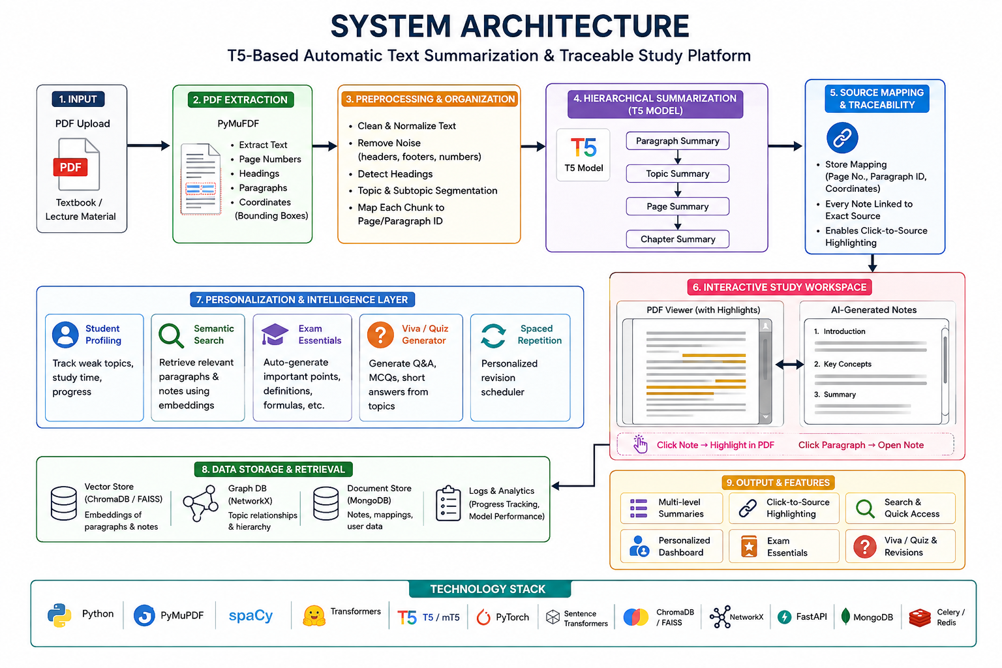

System Design / Architecture

Slide 7
Module 1: Data Collection, Preparation and Text Preprocessing
Raw Text Data
Description
Collection of text datasets from reliable sources.
Cleaning text by removing noise, special characters, and unnecessary symbols.
Tokenization, normalization, and dataset formatting for T5 model training and evaluation.
Splitting the dataset into training, validation, and testing sets.
Advantages
Improves data quality and consistency.
Reduces noise in raw text.
Enhances model training efficiency and accuracy.
Produces a well-structured dataset for summarization.
Limitations
Over-cleaning may remove useful contextual information.
Preprocessing large datasets can be time-consuming.
Preprocessing rules may vary across different languages and domains.
Text Cleaning
Tokenization
Normalization
Preprocessed Dataset

Slide 8
Module 2: Transformer-Based T5 Model Development & Summarization
Preprocessed Text
Description
Load the pre-trained T5 Transformer model.
Fine-tune the model using the prepared dataset.
Configure hyperparameters such as learning rate, batch size, and epochs.
Generate abstractive summaries using the fine-tuned T5 model.
Save the trained model for summary generation.
Advantages
Produces high-quality abstractive summaries.
Utilizes transfer learning, reducing training requirements.
Provides strong contextual understanding for summarization.
Generates concise and human-like summaries.
Limitations
Requires high computational resources such as GPU/TPU.
Fine-tuning can be time-consuming.
Performance depends heavily on dataset quality.
T5 Encoder
Attention Mechanism
T5 Decoder
Generated Summary

Slide 9
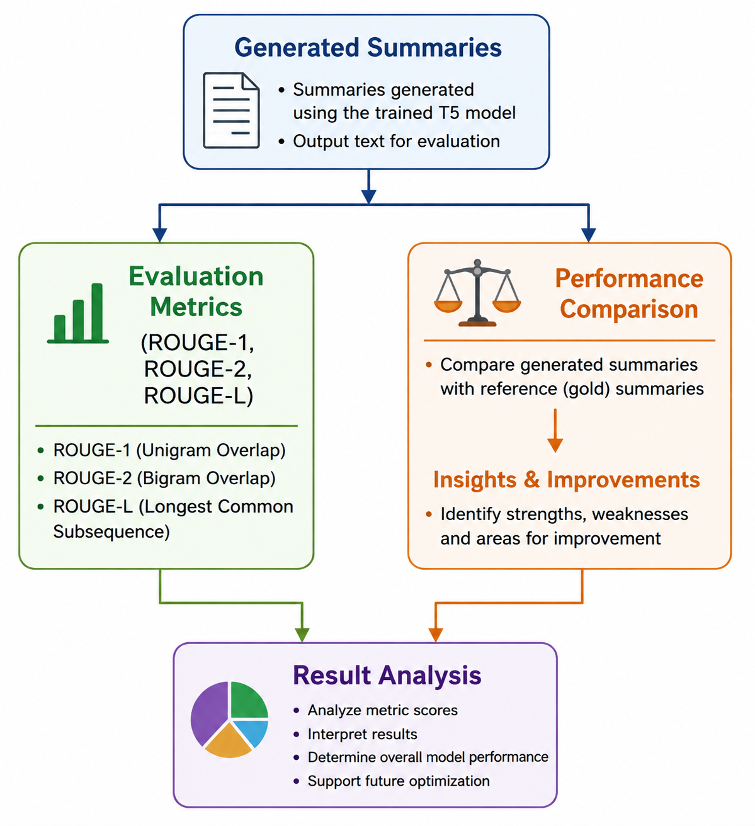
Module 3: Performance Evaluation, Web Integration & Visualization
Description
Generate summaries using the trained T5 model.
Compare generated summaries with reference summaries.
Evaluate model performance using ROUGE-1, ROUGE-2, and ROUGE-L metrics.
Analyze summary quality and identify areas for performance improvement.
Advantages
Provides objective evaluation of summarization quality.
Measures performance using standard NLP evaluation metrics.
Helps identify the strengths and weaknesses of the model.
Supports further performance optimization.
Limitations
ROUGE focuses mainly on word overlap rather than complete semantic meaning.
Different evaluation metrics may produce varying results.
Human evaluation is still required for a complete assessment of summary quality.

Slide 10
Description About The Datasets Used
Link to Dataset
➡️ MLSUM Multilingual Summarization Dataset – Kaggle
The MLSUM (Multilingual Summarization Dataset) is a large multilingual news summarization dataset created from online newspapers. It contains more than 1.5 million article–summary pairs across multiple languages, making it suitable for training and evaluating automated text summarization models.
Key Points
Includes news articles with human-written summaries.
Covers five major languages: French, German, Spanish, Russian, and Turkish.
Designed for multilingual NLP research, particularly abstractive summarization.
Organized into training, validation, and testing splits for model development and evaluation.

Slide 11
Applications of the Research
Automatic News Summarization: Quickly generate concise summaries of multilingual news articles for faster information consumption.
Information Retrieval Systems: Improve search engines and digital libraries by providing brief, relevant content summaries.
Media Monitoring & Analysis: Assist journalists and analysts in tracking trends and key events across multiple languages.
Educational Platforms: Help students and researchers understand lengthy documents efficiently.
Business Intelligence: Enable organizations to analyze large volumes of multilingual textual data for decision-making.
Cross-Lingual Communication: Support summarization in different languages, enhancing global accessibility of information.

Slide 12
Comparison & Analysis
Aspect | Traditional Methods | Proposed T5 Model
Approach | Extractive | Abstractive
Language Support | Single language | Multilingual
Context Understanding | Limited | Strong (Transformer-based)
Summary Quality | Less fluent | More coherent & natural
Scalability | Low | High

Slide 13
Conclusion
Implemented a Transformer-based T5 model for multilingual text summarization
Utilized the MLSAM multilingual news dataset
Generated concise and coherent abstractive summaries
Achieved better performance than traditional summarization methods
Demonstrated effectiveness of pretrained multilingual models
Suitable for real-world multilingual NLP applications

Slide 14
Future Enhancements
Extend the system to support additional low-resource and regional languages, improving inclusivity and global accessibility.
Adapt the summarization model to work across multiple domains such as medical, legal, academic, and social media texts.
Enhance performance on long documents by integrating long-context Transformer architectures or hierarchical summarization techniques.
Incorporate human-in-the-loop evaluation to refine summary quality based on user feedback and expert judgment.
Improve computational efficiency through model optimization, pruning, or distillation for faster and cost-effective deployment.
Deploy the system as a scalable web or mobile application with real-time summarization capabilities for practical use.

Slide 15
References
J. Wang, F. Meng, D. Zheng, Y. Liang, Z. Li, J. Qu, and J. Zhou, “Towards Unifying Multi‑Lingual and Cross‑Lingual Summarization with Many‑to‑Many Models,” arXiv Preprint, May 2023.
E. Daraghmi, L. Atwe, and A. Jaber, “A Comparative Study of PEGASUS, BART, and T5 for Text Summarization Across Diverse Datasets,” Future Internet, vol. 17, no. 9, 2025.
R. Krishna, K. M. Somasundaram, P. Arulmozhivarman, et al., “Deep learning for text summarization using NLP for automated news digest,” Sci. Rep., vol. 15, 36343, 2025.
P. Dhakal and D. S. Baral, “Abstractive Summarization of Low‑Resourced Nepali Language Using Multilingual Transformers,” Proc. CHiPSAL 2025, pp. 124–133, 2025.
M. Azhar, A. Amjad, G. Farid, D. A. Dewi, and M. Batumalay, “Efficient Transformer‑Based Abstractive Urdu Text Summarization Through Selective Attention Pruning,” Information, vol. 16, no. 11, 991, 2025.

Slide 16
THANK YOU

