Slide 1
Mutual Fund Analytics Dashboard & Performance Evaluation Capstone Project – Mutual Fund Analytics
Presented by
Nallabothu Jaswanth
Blue Stock Fintech Internship Program
Capstone Project I
June 2026

Slide 2
Project Overview
Objective:
Analyze mutual fund performance using historical NAV data.
Evaluate risk-adjusted returns using advanced financial metrics.
Compare fund performance against benchmark indices.
Tools & Technologies:
Python
Pandas
NumPy
Matplotlib
Github
Project Coverage:
40 Mutual Fund Schemes
Historical Data (2022–2025)
NIFTY 50 & NIFTY 100 Benchmarks
Performance & Risk Analytics

Slide 3
Data Sources & Project Architecture
Data Sources:
Mutual Fund Data:
Fund Master Data
NAV History Data
AUM Data
SIP Inflows Data
Investor Transaction Data
Benchmark Data:
40 Mutual Fund Schemes
Historical Data (2022–2025)
NIFTY 50 & NIFTY 100 Benchmarks
Performance & Risk Analytics

Slide 4
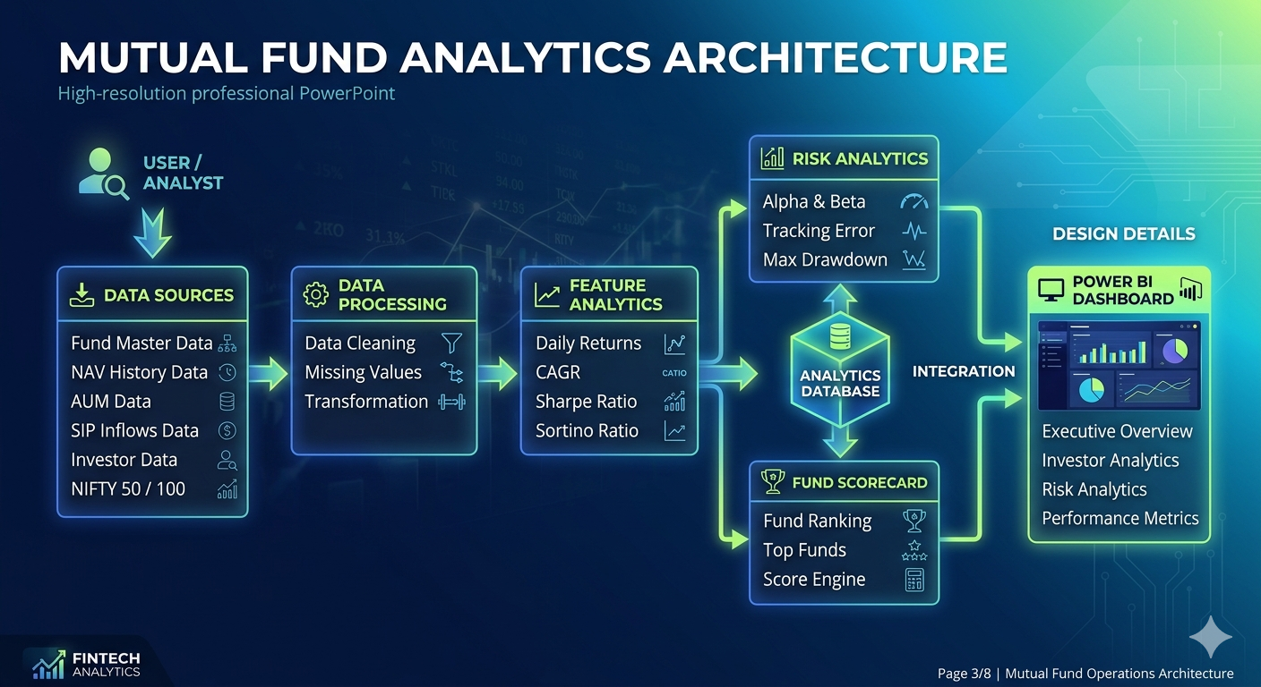
Project Architecture

Slide 5
Data Cleaning & Exploratory Data Analysis (EDA)
Data Cleaning Activities:
Removed duplicate records.
Handled missing and inconsistent values.
Standardized date formats and column names.
Validated data quality across datasets.
Exploratory Data Analysis:
Fund category distribution analysis.
SIP inflow trend analysis.
AUM growth analysis.
Investor demographic analysis.

Slide 6
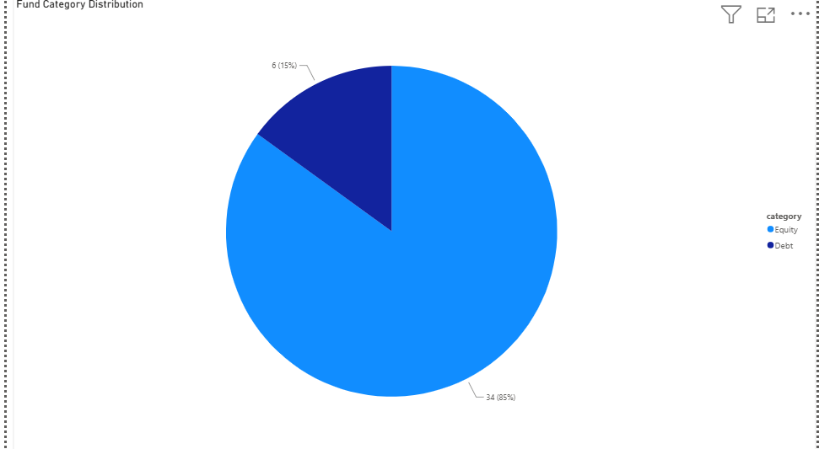
Fund Score Distribution Pie Chart

Slide 8
Performance Analytics Metrics
Metrics Calculated:
Measured the excess return generated by a mutual fund compared to its benchmark index.
Helped identify funds that consistently outperformed market expectations.
Methodology:
Calculated daily returns from NAV history.
Measured long-term growth using CAGR.
Evaluated risk-adjusted returns using Sharpe Ratio.
Assessed downside risk using Sortino Ratio.
Key Outcomes:
Identified top-performing mutual funds.
Compared fund performance across different categories.
Generated performance rankings based on calculated metrics.

Slide 9
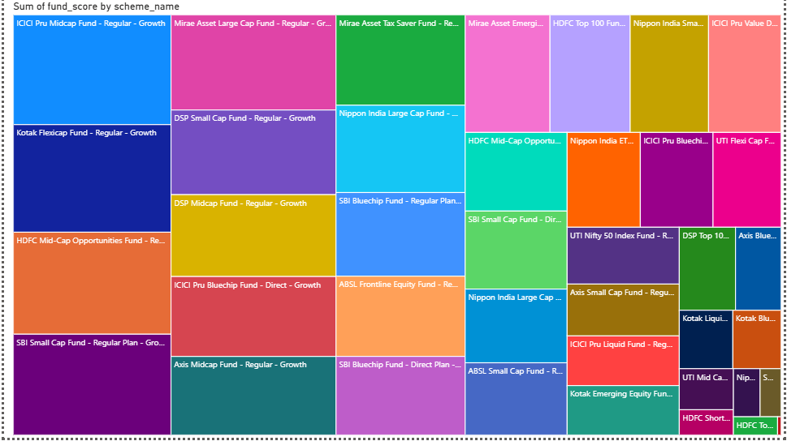
Fund Performance Ranking

Slide 10
Risk Analytics & Benchmark Evaluation
Risk Metrics Calculated:
Alpha:
Measured the excess return generated by a mutual fund compared to its benchmark index.
Helped identify funds that consistently outperformed market expectations.
Beta:
Evaluated the sensitivity of a fund's returns relative to market movements.
Used to assess the systematic risk associated with each fund.
Tracking Error:
Measured the deviation between fund returns and benchmark returns.
Helped analyze the consistency of benchmark tracking performance.
Maximum Drawdown:
Calculated the maximum observed loss from a peak to a trough during the investment period.
Provided insights into downside risk and capital preservation capability.

Slide 11
Key Findings:
Benchmark Comparison:
Alpha and Beta metrics enabled effective comparison of fund performance against benchmark indices.
Tracking Efficiency:
Tracking Error analysis identified funds with better benchmark replication and consistency.
Downside Risk Assessment:
Maximum Drawdown highlighted the potential losses investors could experience during adverse market conditions.
Risk-Adjusted Performance:
Combined risk metrics provided a comprehensive understanding of fund performance beyond returns alone.
Investment Insights:
Risk analytics helped identify funds with balanced return potential and manageable risk exposure.

Slide 12
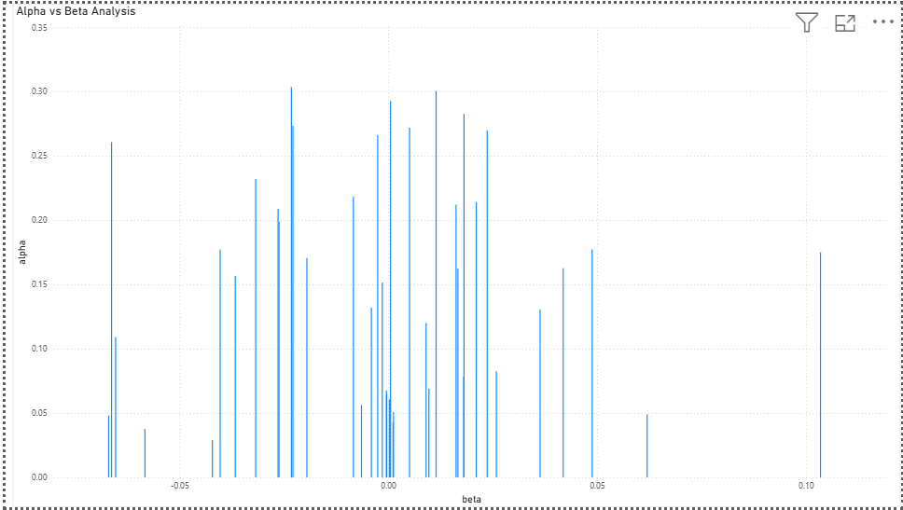
Tracking Error Analysis

Slide 13
Fund Scorecard & Top Performing Funds
Fund Scoring Methodology:
A composite fund score was generated using:
CAGR
Sharpe Ratio
Sortino Ratio
Alpha
Tracking Error
Maximum Drawdown
These metrics were combined to rank mutual funds based on both return potential and risk management.
Top Performing Funds:
ICICI Pru Midcap Fund
Kotak Flexicap Fund
HDFC Mid-Cap Opportunities Fund
SBI Small Cap Fund

Slide 14
Key Findings:
ICICI Pru Midcap Fund achieved the highest overall fund score.
Mid-cap and small-cap funds demonstrated strong performance potential.
Risk-adjusted metrics helped identify consistently performing schemes.
Fund scorecard simplified comparison across multiple mutual fund schemes.
Rank | Fund
1 | ICICI Pru Midcap Fund
2 | Kotak Flexicap Fund
3 | HDFC Mid-Cap Opportunities Fund
4 | SBI Small Cap Fund
5 | Mirae Asset Large Cap Fund

Slide 15
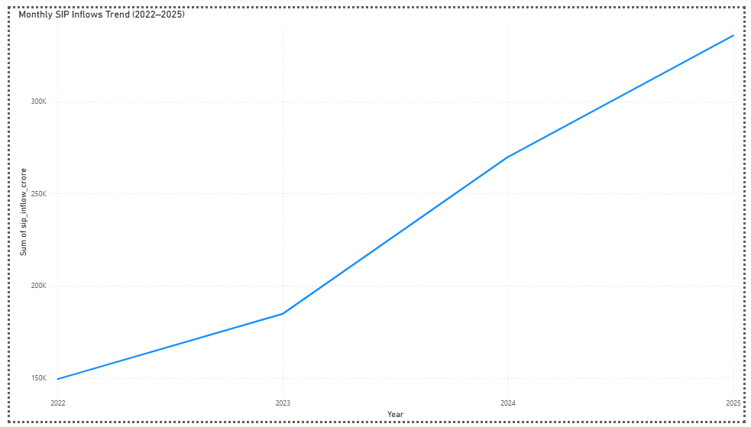
Executive Overview Dashboard
Key Insights:
SIP inflows increased steadily from 2022 to 2025.
Investor participation showed consistent growth.
Mutual fund investments gained momentum over the analysis period.
The trend reflects growing investor confidence in mutual funds.

Slide 16
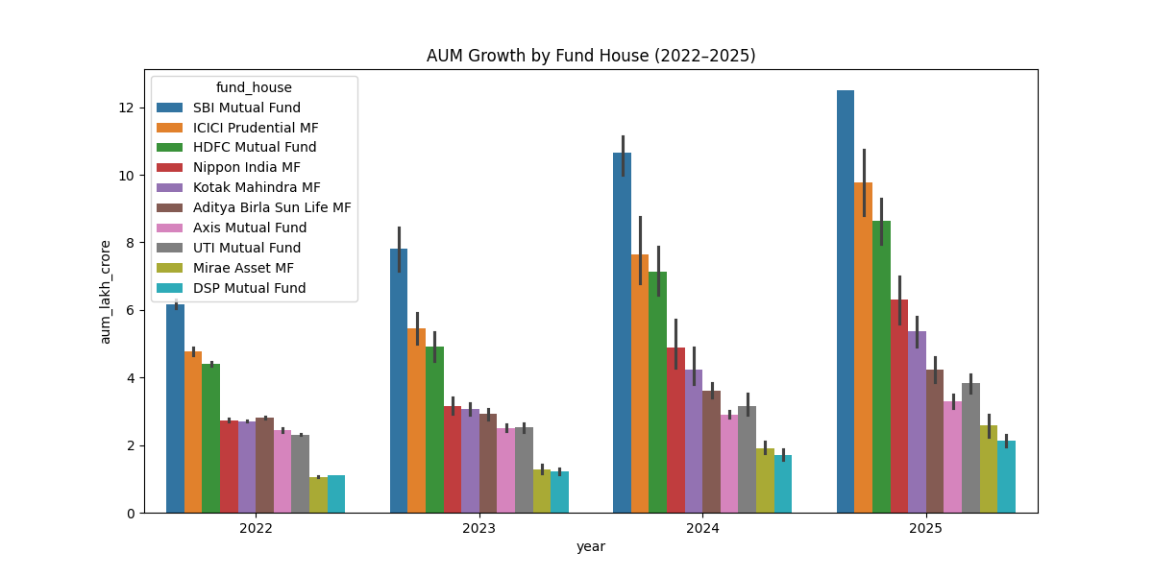

Slide 17
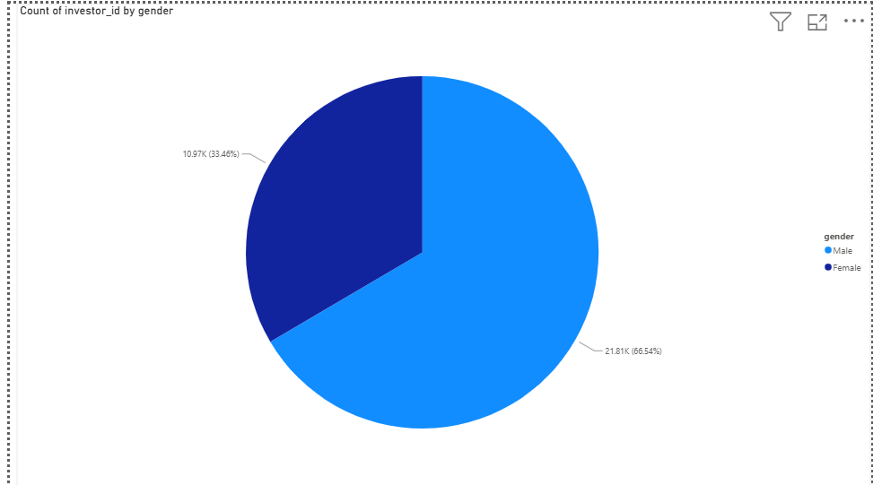
Investor Analytics Dashboard

Slide 18
Fig.Fund Category Distribution

Slide 19
Key Insights:
Fund Category Distribution:
Equity funds accounted for the majority of mutual fund schemes.
Debt funds represented a smaller portion of the portfolio.
Investor Demographics:
Male investors constituted approximately 66% of the investor base.
Female investors accounted for around 34% of investors.
The investor base showed healthy participation across demographics.
Business Value:
Helps understand investor preferences.
Supports fund segmentation and targeted investment strategies.
Provides insights into market participation trends.

Slide 20
Risk & Performance Dashboard
Fig.Alpha vs Beta Analysis

Slide 21
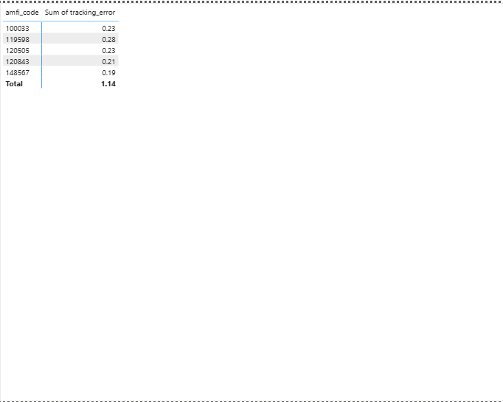
Fig.Tracking Error Analysis

Slide 22
Fig.Fund Score Distribution (Treemap)

Slide 23
Key Insights:
Alpha and Beta metrics were used to evaluate benchmark-relative performance.
Tracking Error measured benchmark tracking consistency.
Fund Score Distribution highlighted top-performing mutual funds.
Risk-adjusted analysis enabled comprehensive fund evaluation.
The analytics framework enabled identification of funds with balanced risk-return characteristics.
Comparative analysis supported more informed and data-driven investment decision-making.
Performance metrics helped distinguish consistently performing funds from highly volatile schemes.
Integrated risk analytics improved overall mutual fund evaluation accuracy.
The dashboard simplified interpretation of complex financial performance indicators through interactive visualizations.

Slide 24
Key Project Insights
1. Growing SIP Investments:
Monthly SIP inflows showed a consistent upward trend from 2022 to 2025.
Indicates increasing investor confidence in mutual fund investments.
2. Equity Funds Dominate:
Equity funds accounted for the majority of schemes in the dataset.
Investors showed a stronger preference for long-term wealth creation through equity investments.
3. Strong Fund Performance:
Several mutual funds demonstrated superior performance based on CAGR, Sharpe Ratio, and Sortino Ratio.
Fund scorecard helped identify top-performing schemes.
4. Effective Risk Assessment:
Alpha, Beta, Tracking Error, and Maximum Drawdown provided a comprehensive view of fund risk.
Risk-adjusted metrics enabled better investment evaluation.
5. Dashboard-Driven Decision Making:
Power BI dashboards transformed complex financial data into actionable insights.
Improved fund comparison and performance monitoring.

Slide 25
Conclusion & Future Scope
Conclusion:
Successfully analyzed mutual fund datasets using Python and Power BI.
Performed data cleaning, exploratory analysis, performance evaluation, and risk assessment.
Developed a fund scoring framework to rank mutual fund schemes.
Built interactive dashboards for investor analytics and fund performance monitoring.
Generated meaningful insights to support informed investment decisions.
Future Scope:
Integrate real-time mutual fund and benchmark data APIs.
Develop a personalized fund recommendation system.
Implement predictive analytics using Machine Learning models.
Add portfolio optimization and asset allocation features.

Slide 26
Thank You
Questions & Discussion
Presented By
Nallabothu Jaswanth
BlueStock Fintech Internship Program
June 2026

