Slide 1

Return & Refund
Analysis
E-commerce Power BI dashboard project for finding return drivers, refund leakage and product-level risk.
Executive Summary
Product Diagnostics
No Net Sales KPI
Dataset
3,100 orders
2025 full year
Returned Orders
745
derived measure
Return Rate
24.03%
DAX calculation
Refund Amount
₹3.82M
not source-fed
01 Project cover

Slide 2

Client Problem
Power BI Project
The business sees returns, but cannot explain them fast enough.
1. Refund leakage
Money is leaving through refunds, but the client cannot isolate the exact category, reason or channel behind it.
2. Messy return reasons
Return reasons arrive from multiple channels and need clean grouping before analysis.
3. Hidden root causes
Category-level charts hide the real issue: subcategory and return reason combinations.
4. Discount risk
Heavy discounts may create low-intent purchases and increase return probability.
Dashboard objective: move from “returns happened” to “why returns happened and what to fix first.”
02 Client context

Slide 3
Key Terminologies
Power BI Project
Simple business language for a beginner-friendly tutorial.
Total Orders
Distinct order IDs, not order lines.
Returned Orders
Orders with at least one returned item.
Return Rate %
Returned Orders divided by Total Orders.
Returned Units
Quantity of units returned.
Refund Amount
Returned quantity multiplied by paid price after discount and deductions.
Return Days
Days from delivery to return.
Return Reason
Customer or operational reason behind the return.
Refund Impact %
Optional later KPI: refund amount as share of sales after discount.
Deliberate scope rule: this deck avoids Net Sales and ignores Top 10 Returned Products because they are not part of the final report design.
03 Terminology

Slide 4
KPI Problem Statements
Power BI Project
Every KPI must answer a decision question.
KPI Business question Decision lens
Total Orders
How large is the order base? • Business volume
Returned Orders
How many orders came back? • Return exposure
Return Rate %
What share of orders were returned? • Operational risk
Refund Amount
How much money was refunded? • Financial leakage
Average Return Days
How quickly are items returned after delivery? • Customer behavior
Products Returned
How many products were affected? • Product spread
Top Return Category
Which category is creating the most returned units? • Priority area
Top Return Reason
Which root cause is biggest? • Action trigger
Weak dashboards show numbers. Useful dashboards show what decision the number should trigger.
04 KPI framing

Slide 5
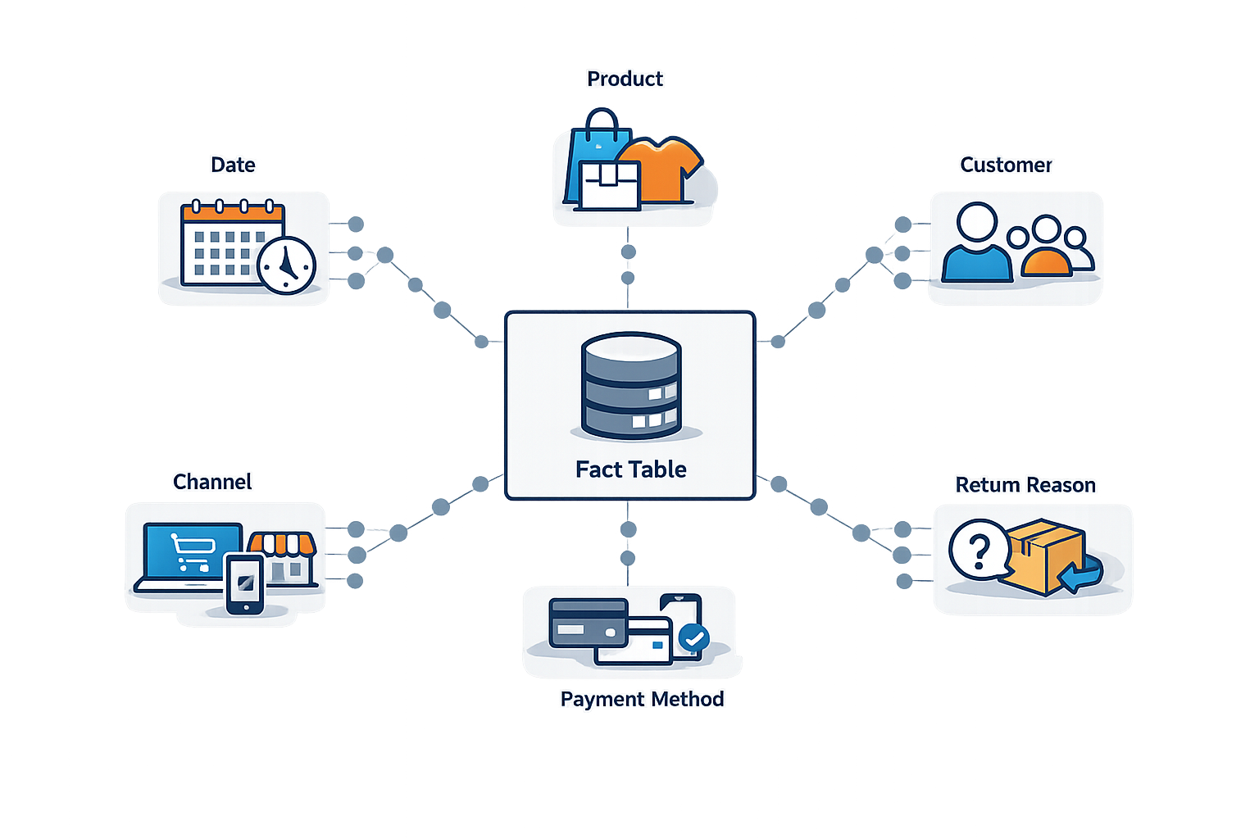
Dataset & Data Model
Power BI Project
Beginner-friendly star schema from a raw order-line table.
Raw grain
One row represents one product line inside an order.
Fact_Orders
Stores order IDs, dates, quantity, unit price, discount, return flag and return quantity.
Dimensions
Date, Product, Customer, Channel, Payment Method and Return Reason.
Derived fields
Refund Amount, Return Days, Return Rate, MoM and Pareto values are created in Power BI.
Teaching value: viewers learn cleaning, modeling, relationships, DAX and visual storytelling in one controlled project.
05 Data model

Slide 6
Page 1 — Executive Summary
Power BI Project
High-level return performance and refund pressure.
Total Orders
3,100
MoM arrow
Returned Orders
745
MoM arrow
Return Rate %
24.03%
MoM arrow
Refund Amount
₹3.82M
MoM arrow
Monthly Return Trend
Returned Orders + Return Rate over time to detect spikes and seasonality.
Return Reason Pareto
Ranks return reasons and shows cumulative returned units to find the vital few causes.
Returns by Category
Shows which categories contribute the most returned units.
Returns by Sales Channel
Donut share explains where returned units are concentrated across Website, App, Marketplace and Offline Store.
Slicers: Date Range • Category • Sales Channel • Reset Filters
06 Executive Summary

Slide 7
Page 2 — Product Diagnostics
Power BI Project
Root-cause page without a Top 10 Returned Products visual.
Avg Return Days
14.9 days
delivery to return
Products Returned
104
unique products
Top Category
Fashion
by returned units
Top Reason
Product Not As Expected
by returned units
Subcategory × Return Reason Heatmap
Pinterest-style dusty red colour scale shows exact root-cause clusters.
Discount vs Return Risk
Scatter plot tests whether higher discounts are linked to higher return rates. Bubble colour uses risk level.
Product Return Details Table
Product, subcategory, orders, returned units, return rate, refund amount, avg return days and avg discount.
Slicers: Date Range • Category • Sales Channel • Return Reason • Reset Filters
07 Product Diagnostics

Slide 8
Analytical Techniques
Power BI Project
What makes the report more useful than basic visuals.
MoM indicators
Previous month calculation + UNICHAR arrows below KPI cards.
Pareto analysis
Ranking and cumulative percentage to find the few reasons causing most returns.
Heatmap logic
Subcategory by return reason matrix with colour intensity.
Risk colouring
Scatter bubbles colored by product return rate versus benchmark.
Dynamic text KPIs
TOPN measures for Top Return Category and Top Return Reason.
Volume filters
Low-volume products excluded from risk visuals to avoid fake insights.
This is the real value of the project: modeling + DAX + visual storytelling, not just a pretty Power BI page.
08 Techniques

Slide 9

Business Recommendations
Power BI Project
How the client should turn dashboard findings into operational decisions.
Product Not As Expected
Improve product images, descriptions and expectation-setting.
Wrong Size
Add size guidance and return-feedback loop for fashion and footwear.
Damaged Product
Audit packaging and marketplace handling quality.
Quality Issue
Create vendor scorecards using returned units and refund amount.
Discount Risk
Avoid deep discounts on products already showing high return risk.
Priority rule: fix causes that combine high returned units and high refund amount first.
09 Action plan

