Slide 1
CS60010: Deep Learning
Sudeshna Sarkar
Spring 2019

Slide 2
The No Free Lunch Theorem
The no free lunch theorem (Wolpert, 1996) states that, averaged over all possible data generating distributions, every classiﬁcation algorithm has the same error rate when classifying previously unobserved points.
Inference from finite samples can effectively performed if and only if the problem satisfies some a priori condition.

Slide 3
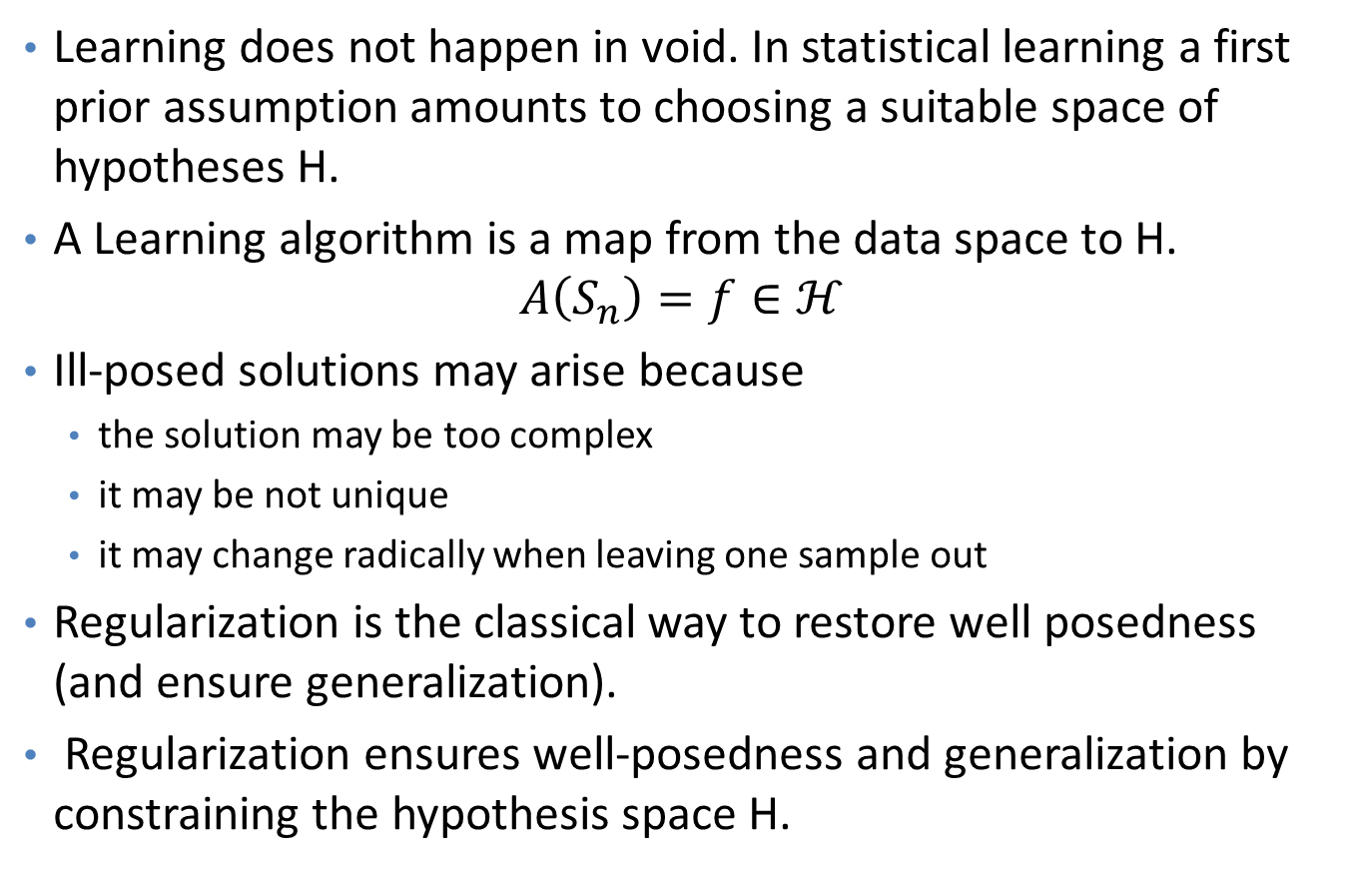
Hypotheses Space
Learning does not happen in void. In statistical learning a first prior assumption amounts to choosing a suitable space of hypotheses H.
A Learning algorithm is a map from the data space to H.
$$A\left(S_{n}\right)=f∈ℋ$$
Ill-posed solutions may arise because
the solution may be too complex
it may be not unique
it may change radically when leaving one sample out
Regularization is the classical way to restore well posedness (and ensure generalization).
Regularization ensures well-posedness and generalization by constraining the hypothesis space H.

Slide 4

Regularization
We can give a learning algorithm a preference for one solution in its hypothesis space to another
For example, we can modify the training criterion for linear regression to include weight decay
$$J\left(w\right)={MSE}_{train}+λw^{T}w$$
λ controls the strength of preference for smaller weights

Slide 5
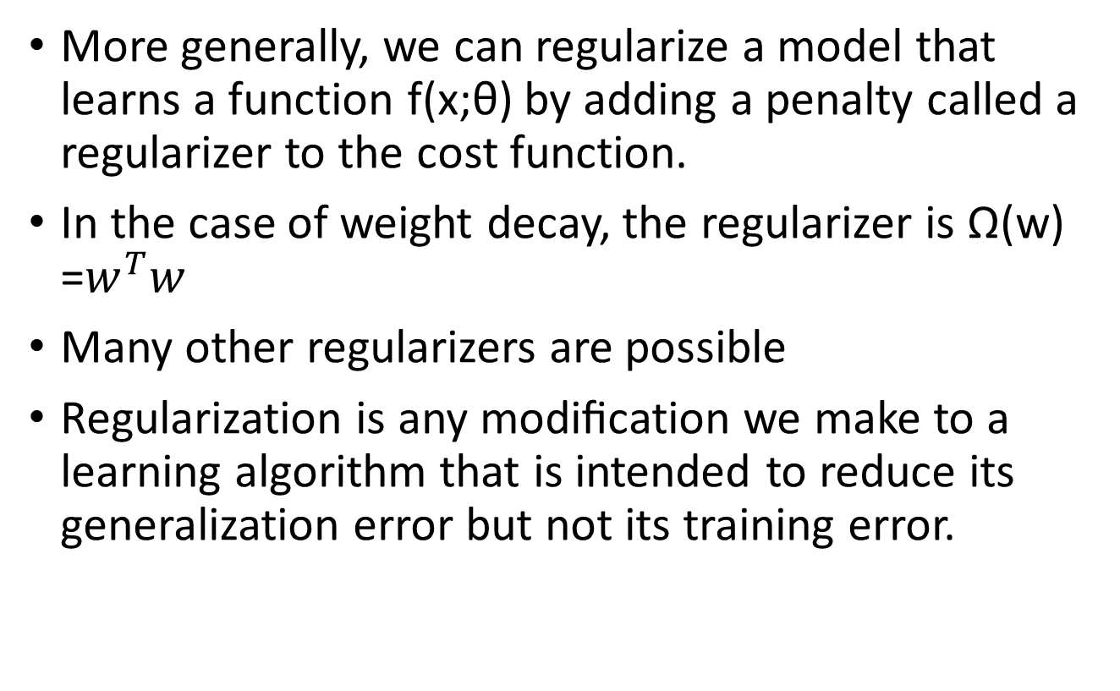
More generally, we can regularize a model that learns a function f(x;θ) by adding a penalty called a regularizer to the cost function.
In the case of weight decay, the regularizer is Ω(w) =$w^{T}w$
Many other regularizers are possible
Regularization is any modiﬁcation we make to a learning algorithm that is intended to reduce its generalization error but not its training error.

Slide 6
Hyperparameters and Validation Sets
Most ML algs have several settings that we can use to control the behaviour - hyperparameters.
Poly regression problem –
degree of the poly , Value of lambda
Sometimes a setting is chosen to be a hyper-parameter that the learning algorithm does not learn because it is diﬃcult to optimize.
Hyper-parameters that control model capacity cannot be learned on training set
To solve this problem, we need a validation set

Slide 7
Cross-Validation

Slide 8
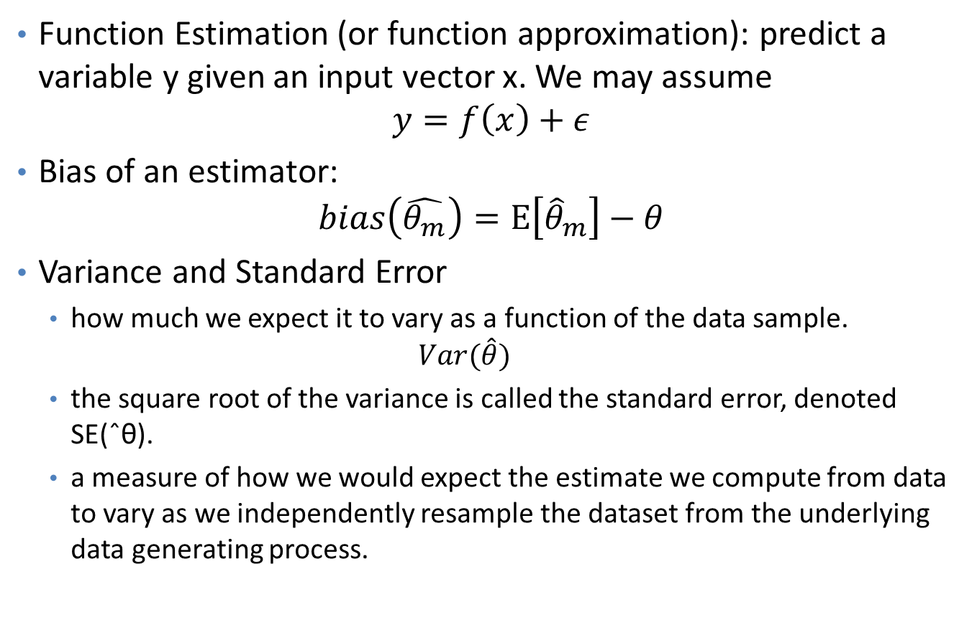
Estimators, Bias and Variance
Function Estimation (or function approximation): predict a variable y given an input vector x. We may assume
$$y=f\left(x\right)+ε$$
Bias of an estimator:
$$bias\left(\hat{θ_{m}}\right)=E\left[{\hat{θ}}_{m}\right]−θ$$
Variance and Standard Error
how much we expect it to vary as a function of the data sample.
$$Var(\hat{θ})$$
the square root of the variance is called the standard error, denoted SE(ˆθ).
a measure of how we would expect the estimate we compute from data to vary as we independently resample the dataset from the underlying data generating process.

Slide 9
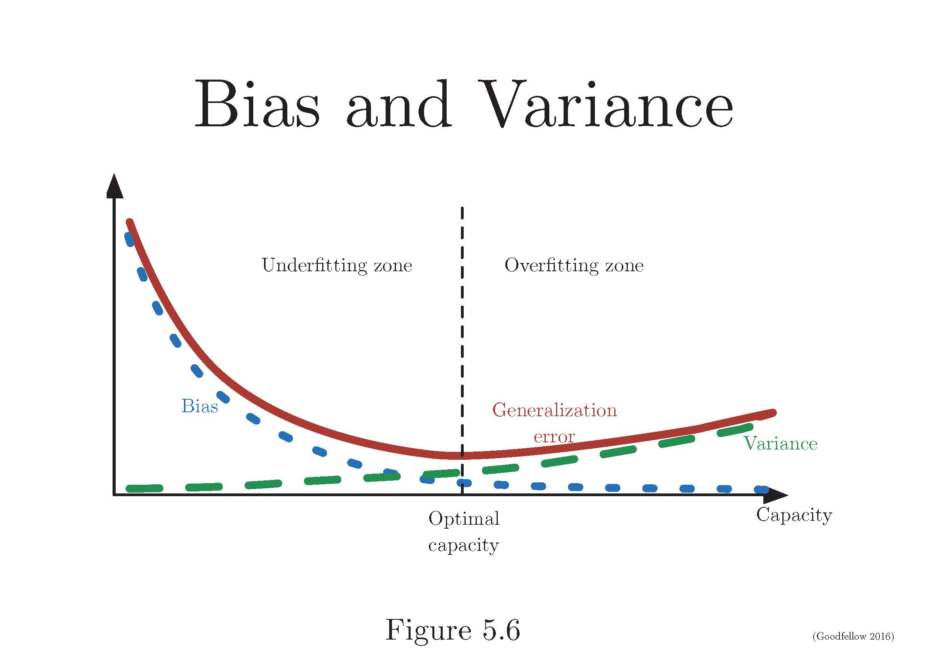
Trading oﬀ Bias and Variance to Minimize Mean Squared Error

Slide 10
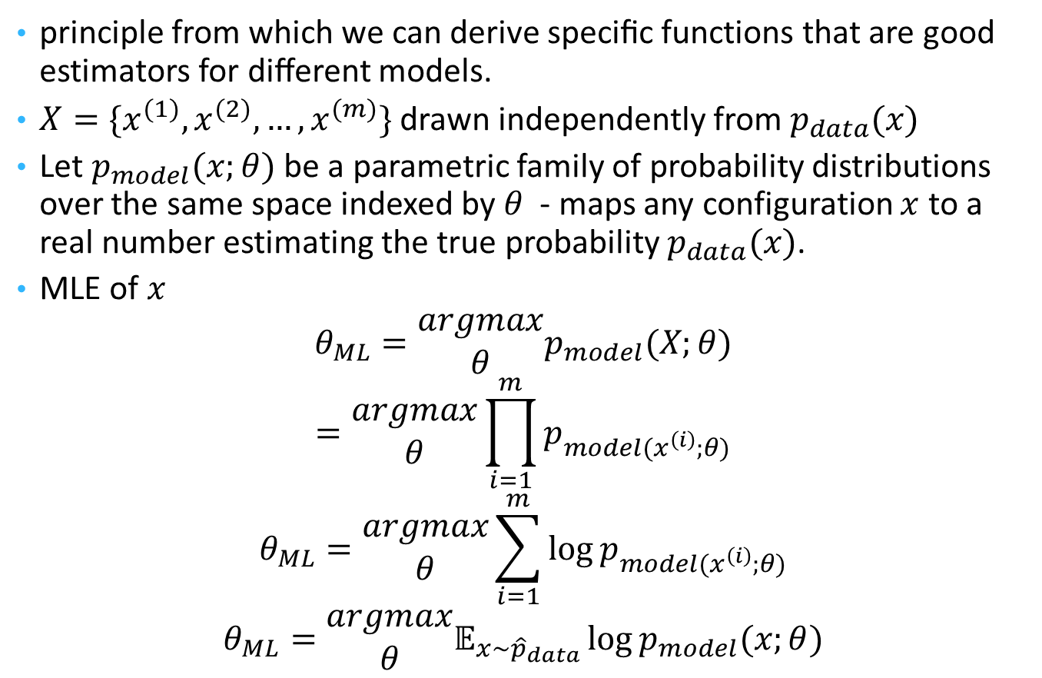
Maximum Likelihood Estimation
principle from which we can derive speciﬁc functions that are good estimators for diﬀerent models.
$X=\{x^{(1)},x^{(2)},…,x^{(m)}\}$ drawn independently from $p_{data}(x)$
Let $p_{model}(x;θ)$ be a parametric family of probability distributions over the same space indexed by $θ$ - maps any configuration $x$ to a real number estimating the true probability $p_{data}(x)$.
MLE of $x$
$$θ_{ML}=\begin{matrix}argmax \\ θ\end{matrix}p_{model}(X;θ)$$
$$=\begin{matrix}argmax \\ θ\end{matrix}\prod_{i=1}^{m}{p_{model(x^{\left(i\right)};θ)}}$$
$$θ_{ML}=\begin{matrix}argmax \\ θ\end{matrix}\sum_{i=1}^{m}{\log{p_{model(x^{\left(i\right)};θ)}}}$$
$$θ_{ML}=\begin{matrix}argmax \\ θ\end{matrix}𝔼_{x\sim {\hat{p}}_{data}}\log{p_{model}(x;θ)}$$

Slide 11
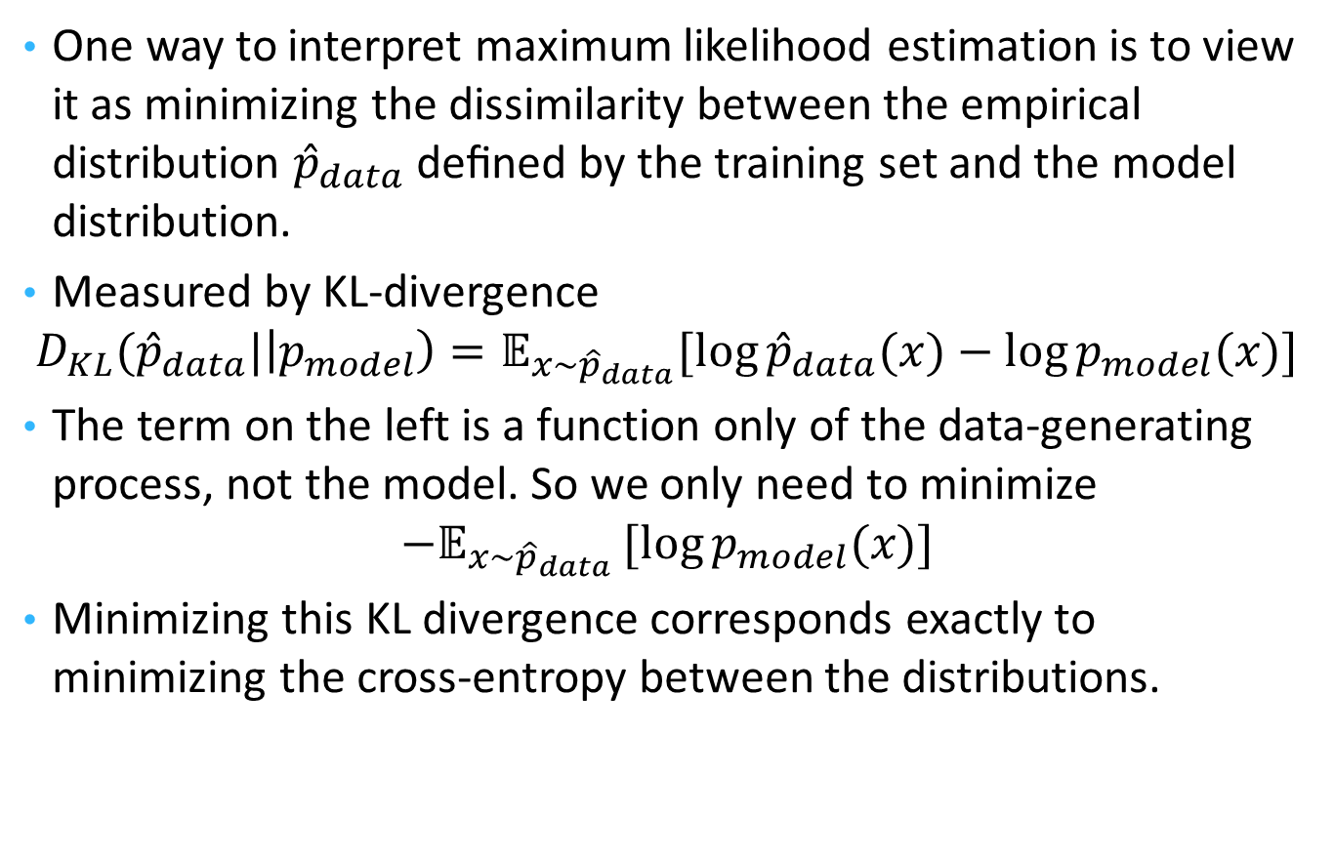
MLE
One way to interpret maximum likelihood estimation is to view it as minimizing the dissimilarity between the empirical distribution ${\hat{p}}_{data}$ deﬁned by the training set and the model distribution.
Measured by KL-divergence
$$D_{KL}({\hat{p}}_{data}|\left|p_{model}\right)=𝔼_{x\sim {\hat{p}}_{data}}[\log{{\hat{p}}_{data}(x)}−\log{p_{model}(x)}]$$
The term on the left is a function only of the data-generating process, not the model. So we only need to minimize
$${−𝔼}_{x\sim {\hat{p}}_{data}}[log{p_{model}(x)}]$$
Minimizing this KL divergence corresponds exactly to minimizing the cross-entropy between the distributions.

Slide 12
MLE
One way to interpret maximum likelihood estimation is to view it as minimizing the dissimilarity between the empirical distribution ${\hat{p}}_{data}$ deﬁned by the training set and the model distribution.
Measured by KL-divergence
$$D_{KL}({\hat{p}}_{data}|\left|p_{model}\right)=𝔼_{x\sim {\hat{p}}_{data}}[\log{{\hat{p}}_{data}(x)}−\log{p_{model}(x)}]$$
The term on the left is a function only of the data-generating process, not the model. So we only need to minimize
$${−𝔼}_{x\sim {\hat{p}}_{data}}[log{p_{model}(x)}]$$
Minimizing this KL divergence corresponds exactly to minimizing the cross-entropy between the distributions.

Slide 13
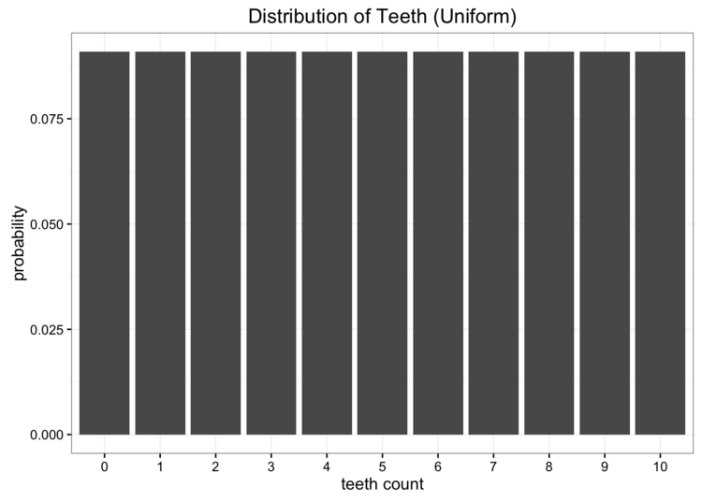
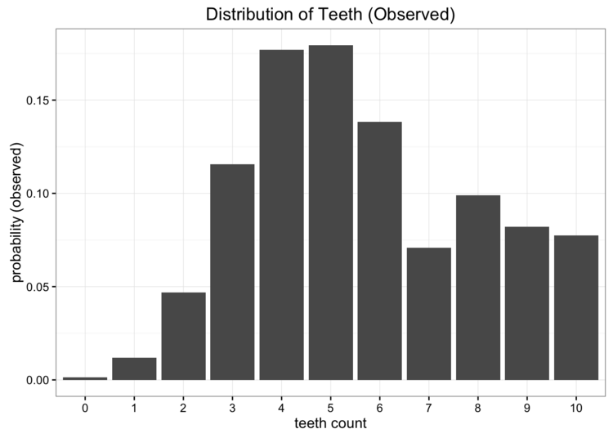
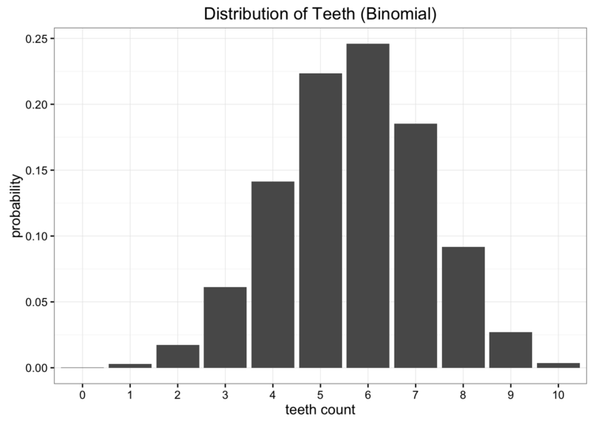
Kullback-Leibler Divergence Explained
KL Divergence measures how much information we lose when we choose an approximation.
The empirical probability distribution of the data collected
https://www.countbayesie.com/blog/2017/5/9/kullback-leibler-divergence-explained
Binomial distr: best estimate of p is 0.57

Slide 14
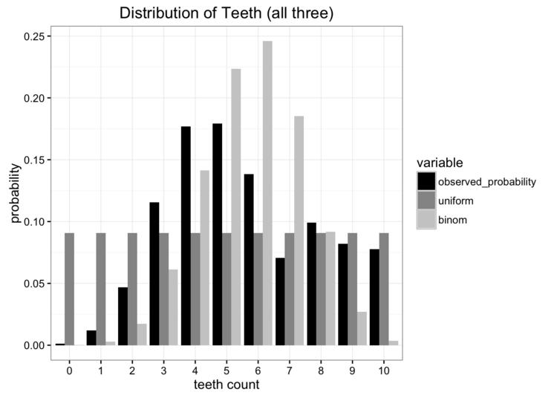
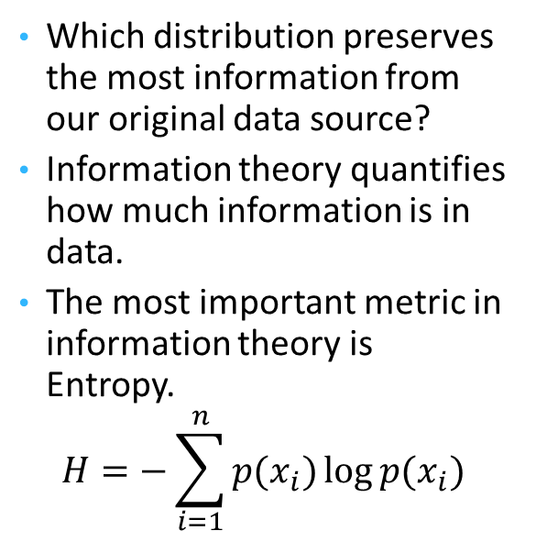
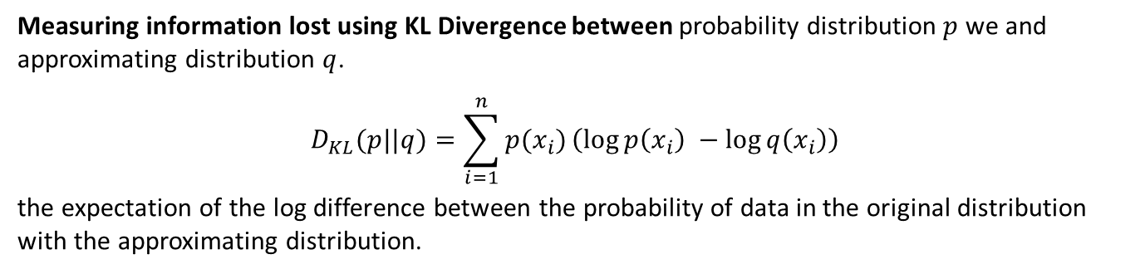
Comparing with the observed data, which model is better?
Which distribution preserves the most information from our original data source?
Information theory quantifies how much information is in data.
The most important metric in information theory is Entropy.
$$H=−\sum_{i=1}^{n}{p(x_{i})\log{p(x_{i})}}$$
Measuring information lost using KL Divergence between probability distribution $p$ we and approximating distribution $q$.
$$D_{KL}(p||q)=\sum_{i=1}^{n}{p(x_{i})}\left(\log{p\left(x_{i}​​\right)} −\log{q\left(x_{i}\right)}\right)$$
the expectation of the log difference between the probability of data in the original distribution with the approximating distribution.

Slide 15
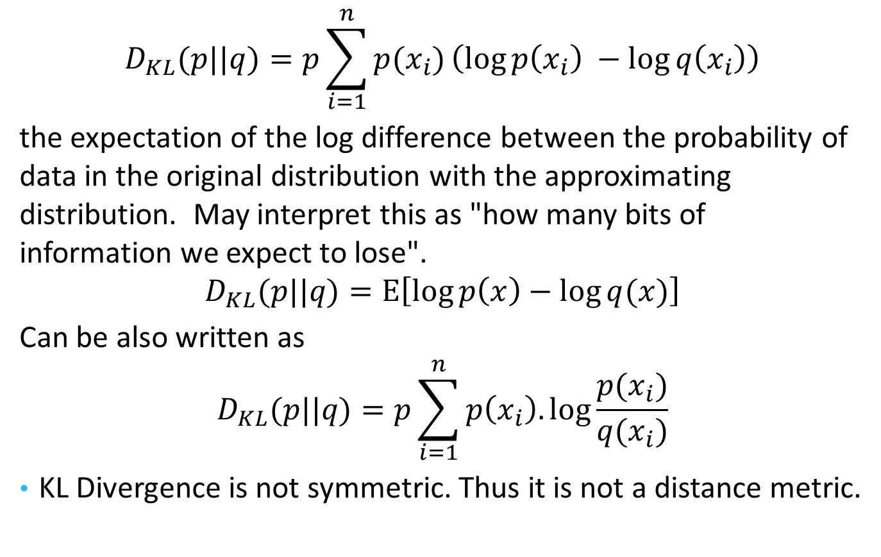
KL Divergence
$$D_{KL}(p||q)=​p\sum_{i=1}^{n}{p(x_{i})}\left(\log{p\left(x_{i}​​\right)} −\log{q\left(x_{i}\right)}\right)$$
the expectation of the log difference between the probability of data in the original distribution with the approximating distribution. May interpret this as "how many bits of information we expect to lose".
$$D_{KL}(p||q)=E\left[\log{p\left(x\right)−\log{q(x)}}\right]$$
Can be also written as
$$D_{KL}(p||q)=​p\sum_{i=1}^{n}{p\left(x_{i}\right).\log{\frac{p(x_{i})}{q(x_{i})}}}$$
KL Divergence is not symmetric. Thus it is not a distance metric.

Slide 16
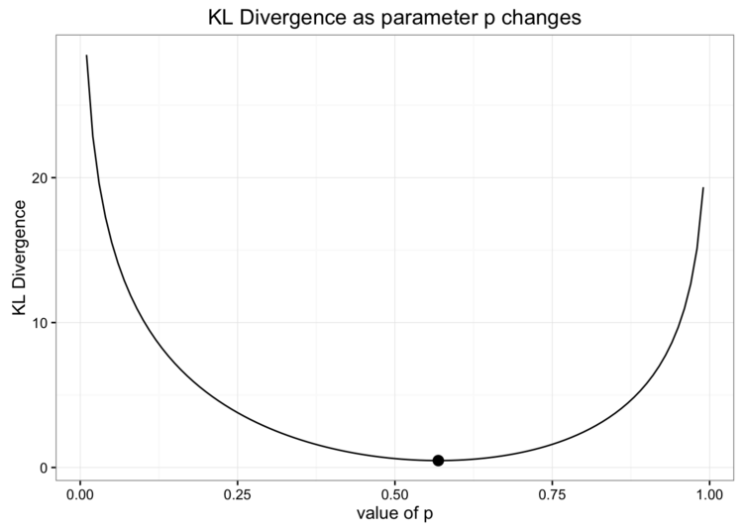
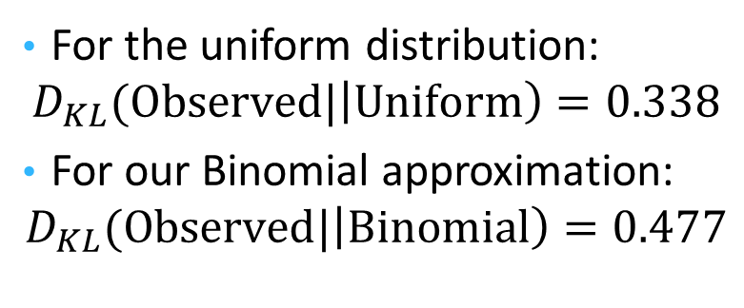
Comparing our approximating distributions
For the uniform distribution:
$$D_{KL}(Observed|\left|Uniform\right)=0.338$$
For our Binomial approximation:
$$D_{KL}(Observed|\left|Binomial\right)=0.477$$

