Slide 1

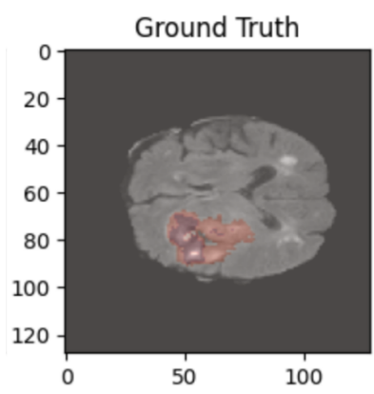
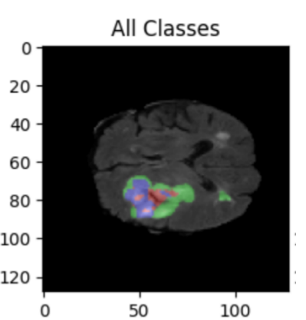
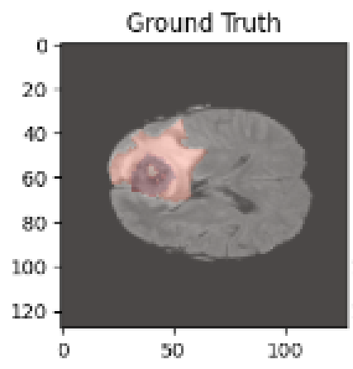
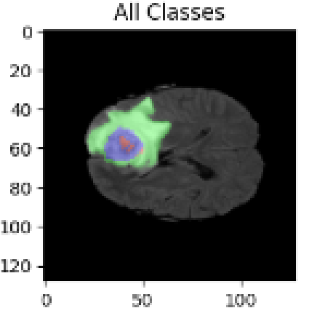
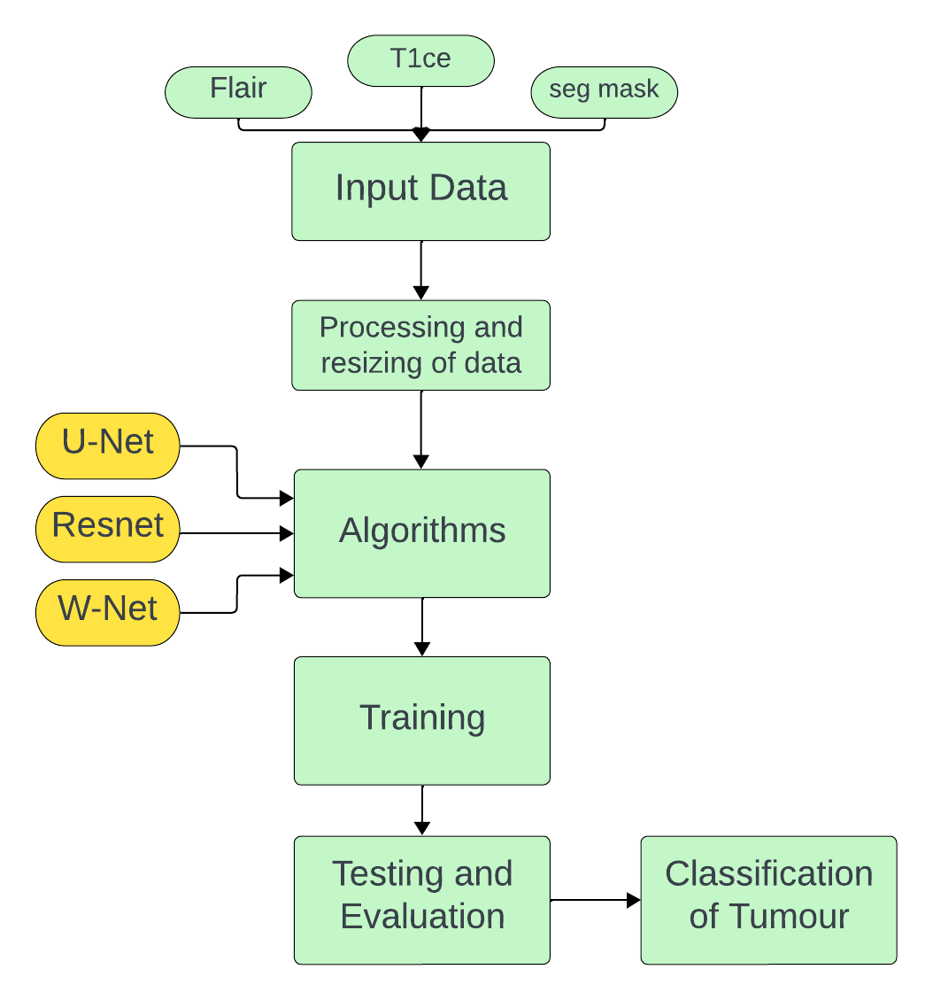
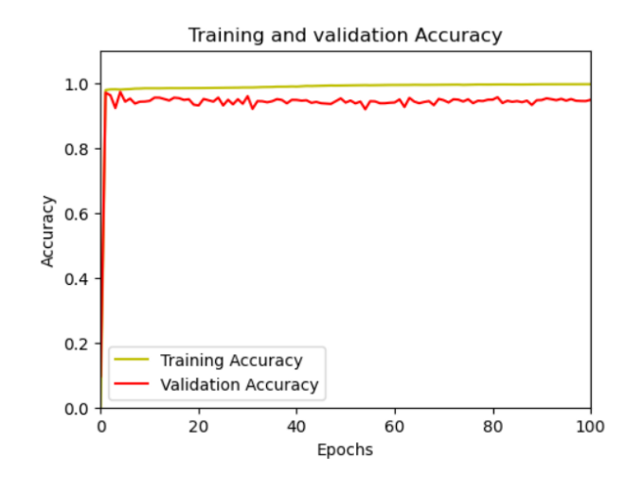
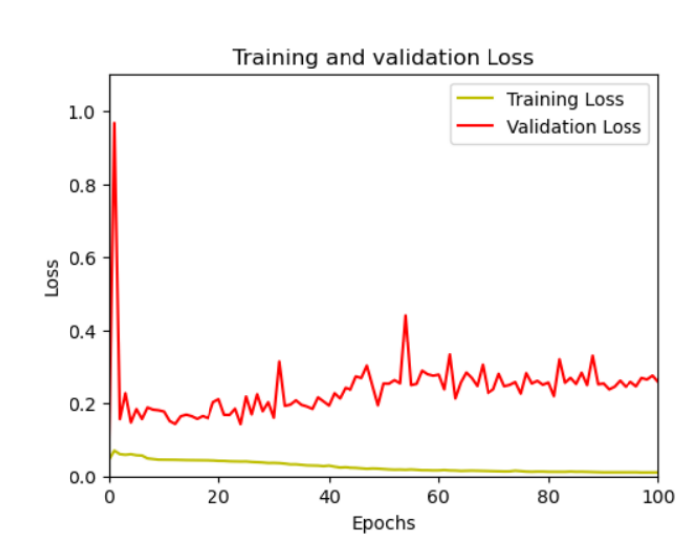
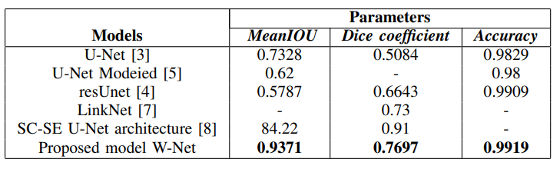
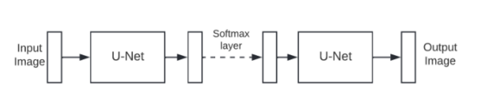


Brain Tumor Segmentation with W-net and Deep Neural Network Strategies
Borra Chetan sai, Gurujala Jaswanth and Gopireddy Harshavardhan Reddy | Prof. Jasmine Pemeena Priyadarsini M| SENSE
Motivation/ Introduction
Results
Brain tumors pose a major health risk due to their complexity, diverse manifestations, and potentially fatal consequences. Detecting them early and planning accurate treatments are vital for better patient outcomes. A critical approach to diagnosing and evaluating brain tumors is through medical imaging, especially Magnetic Resonance Imaging (MRI). However, extracting brain tumor segments from MRI data is complex because of differences in tumor shape, size, location, and type. This is where sophisticated deep learning models, like U-Net and W-Net, play a pivotal role in effective tumor segmentation.
SCOPE of the Project
Early detection of brain tumors is crucial for patient health and survival, given the life-threatening risks posed by higher grades. Magnetic Resonance Imaging (MRI) plays a vital role in this process, yet segmenting healthy brain cells from tumors proves challenging due to the vast MRI data and variations in tumor characteristics. Therefore, an accurate and automated segmentation method is essential for effective treatment planning and diagnosis. This study evaluates various convolutional neural networks and deep neural network architectures such as Enhanced U-Net, VGG, and W-Net on the BRATS 2020 Dataset, aiming to enhance the accuracy of tumor segmentation from MRI scans.
Methodology
The datasets used, the preprocessing and data augmentation methods and the various algorithms used are discussed in detail in the next subsections. The workflow for the work is presented in a flowchart form in Fig 1.
Dataset - All the datasets used in this work are from publicly available datasets published on the website “Kaggle". The dataset includes distinct directories for Training and Validation. In the Training folder, there are 369 individual brain scans, each containing four modalities (T1, T1ce, T2, Flair) along with a segmentation mask in the .nii file format. Each scan comprises images of the brain with dimensions of 240*240*155, and it offers three distinct views: Axial (240*240), Coronal (240*155), and Sagittal View (240*155).
Accuracy of the resnet model
Loss of the resnet model
Comparison of Metrics on Different Models
Fig. 1
Conclusion/ Summary
This study introduces a new architecture inspired by W-Net, utilizing a feature extraction channel. The design of the proposed network is depicted in Figure below. The network comprises 18 modules, including encoder and decoder blocks. Each module contains two 2D convolutional layers. The encoder modules are followed by max pooling to reduce the image size, while the decoder modules are followed by an up-sampling operation. The encoder layers start with 32 filters, doubling at each step until reaching 1024 filters in the bottommost layer.
In this paper, we introduced a new brain tumor segmentation model based on the W-net architecture. Our experiments with the BRATS 2020 dataset demonstrated this model’s effectiveness, achieving a mean IOU of 93, and an accuracy of 99, and a dice coefficient of 76. These results underscore the model’s ability to segment brain tumors with precision, a critical aspect for supporting clinical diagnosis and treatment planning. However, there’s still room for improvement. To further enhance segmentation accuracy, several modifications could be considered for the proposed model. Incorporating residual blocks can boost feature extraction by allowing deeper layers to reference earlier ones, reducing information loss during training. Attention mechanisms, which help the model focus on the most significant parts of the image, might also improve segmentation precision, potentially increasing the dice coefficient and mean IOU.
Basic W-net Block diagram
Contact Details
borrachetan.sai2020@vitstudent.ac.in gurjala.jaswanth2020@vitstudent.ac.in gopi.harshavardhan2020@vitstudent.ac.in
Evaluation Measures and parameters. Dice coefficient The Dice coefficient measures the similarity between two sets, A and B, with values ranging from 0 to 1. A score of 0 means there’s no overlap between the sets, while a score of 1 indicates that the sets are identical. The count of elements common to both sets is denoted by |A∩B|.
Acknowledgments/ References
B. H. Menze, A. Jakab, S. Bauer, J. Kalpathy-Cramer, K. Farahani, J. Kirby, et al. ”The Multimodal Brain Tumor Image Segmentation Benchmark (BRATS)”, IEEE Transactions on Medical Imaging 34(10), 1993-2024 (2015)
S. Bakas, H. Akbari, A. Sotiras, M. Bilello, M. Rozycki, J.S. Kirby, et al., ”Advancing The Cancer Genome Atlas glioma MRI collections with expert segmentation labels and radiomic features”, Nature Scientific Data, 4:170117 (2017)
Ronneberger O, Fischer P, Brox T (2015). ”U-Net: Convolutional Networks for Biomedical Image Segmentation”. arXiv:1505.04597
Mean IOU: When comparing data samples in machine learning, one of the most basic techniques is the intersection over union (IOU) method. In statistics, the Jaccard Index is often referred to as IoU. IoU is a technique used for evaluating computer vision tasks such as object tracking, object recognition, and semantic segmentation.

