Slide 1


AUTOMATING FACEBOOK USING APPIUM
R.JASWANTH
192011308

Slide 2
Objective
Testing helps in evaluating and accessing the features of website application so that it works accurately.

Slide 3
Abstract
The purpose of the project is to test the facebook
Facebook is one of the famous social sites.
To automate the facebook application which is mobile using to photos sharing ,videos sharing and social networking service that enables its users to take pictures and videos

Slide 4
Proposed Work
Installation of the software to automate the facebook application are -
- Android studio : Visualization
- Visual Studio Code : To write code
- Appium : To automate the application
Performing tests for facebook application such as –
- Verifying login credentials such as email and password.
- Verifying the number of viewers who view the story.
- Uploading a post
- Number of likes, comments and share
- Friend Request
- Followers and following
- Blocked accounts
- Massages/chats

Slide 5
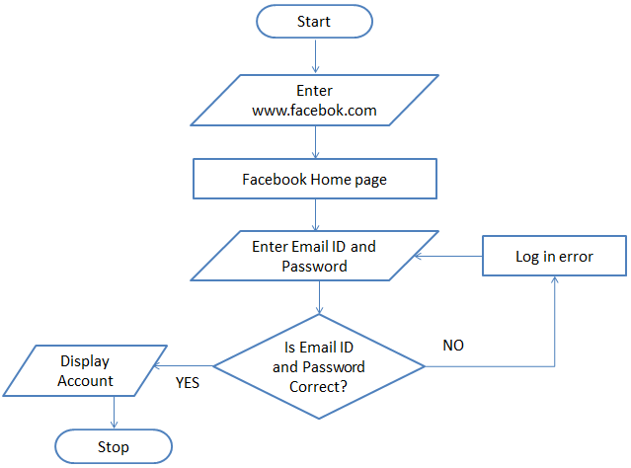
Flow chart

Slide 6
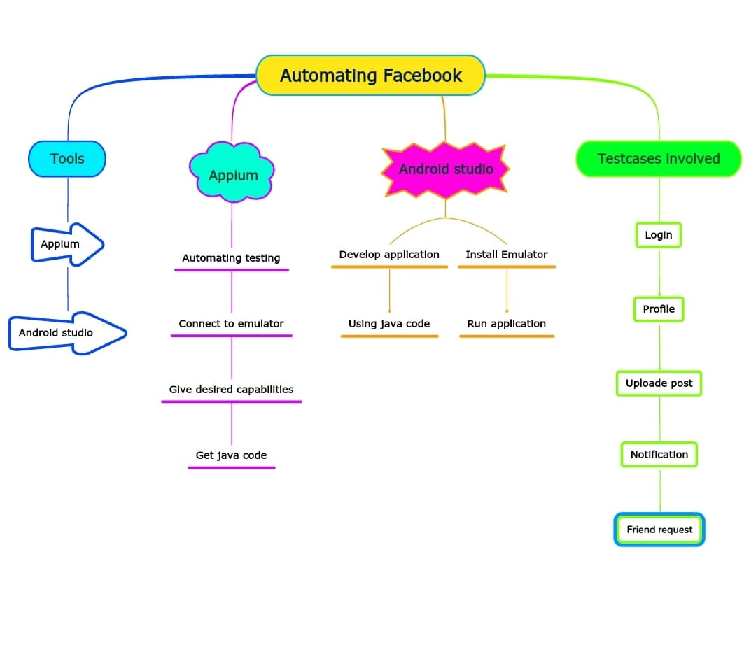
Concept Map

Slide 7
Test cases
Login id
Verify password
Verifying login credentials such as email and password
Verifying the number of viewers who view the story.
Uploading a post
Number of likes, comments and share
Friend Request
Followers and following
Blocked accounts
Massages/chats

Slide 8



App And Tools
Appium Inspector
Android Studio
Appium Server

Slide 9
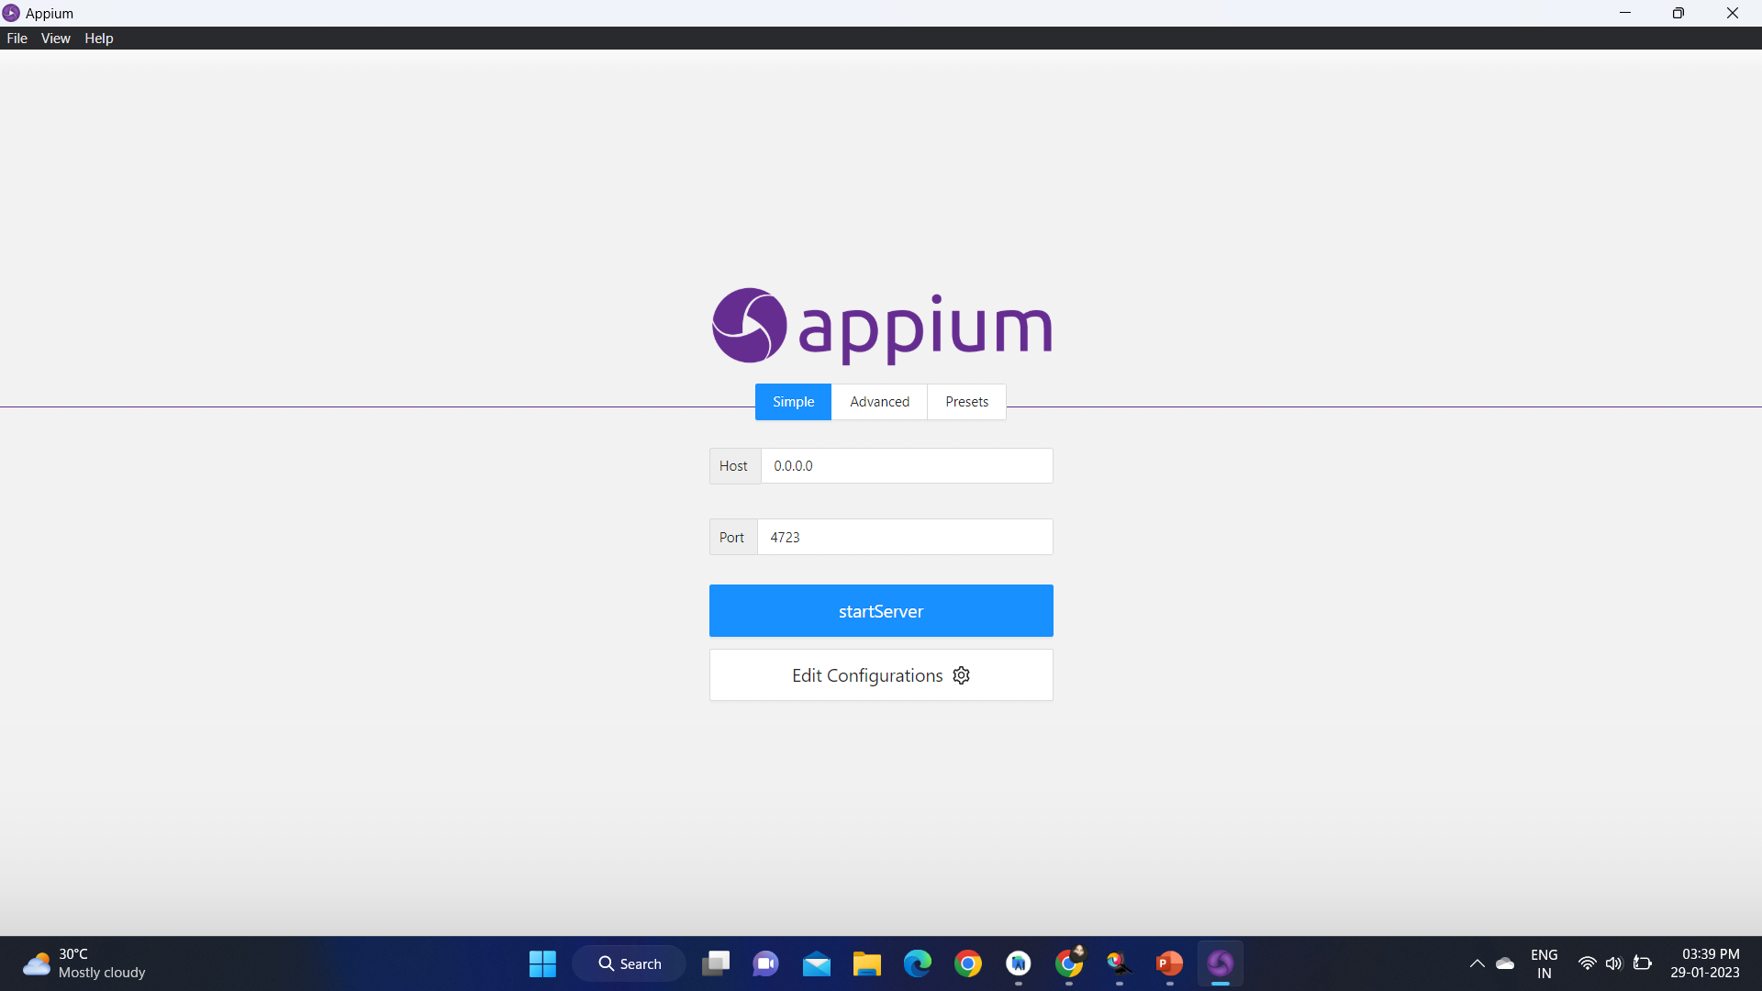
Installation

Slide 10
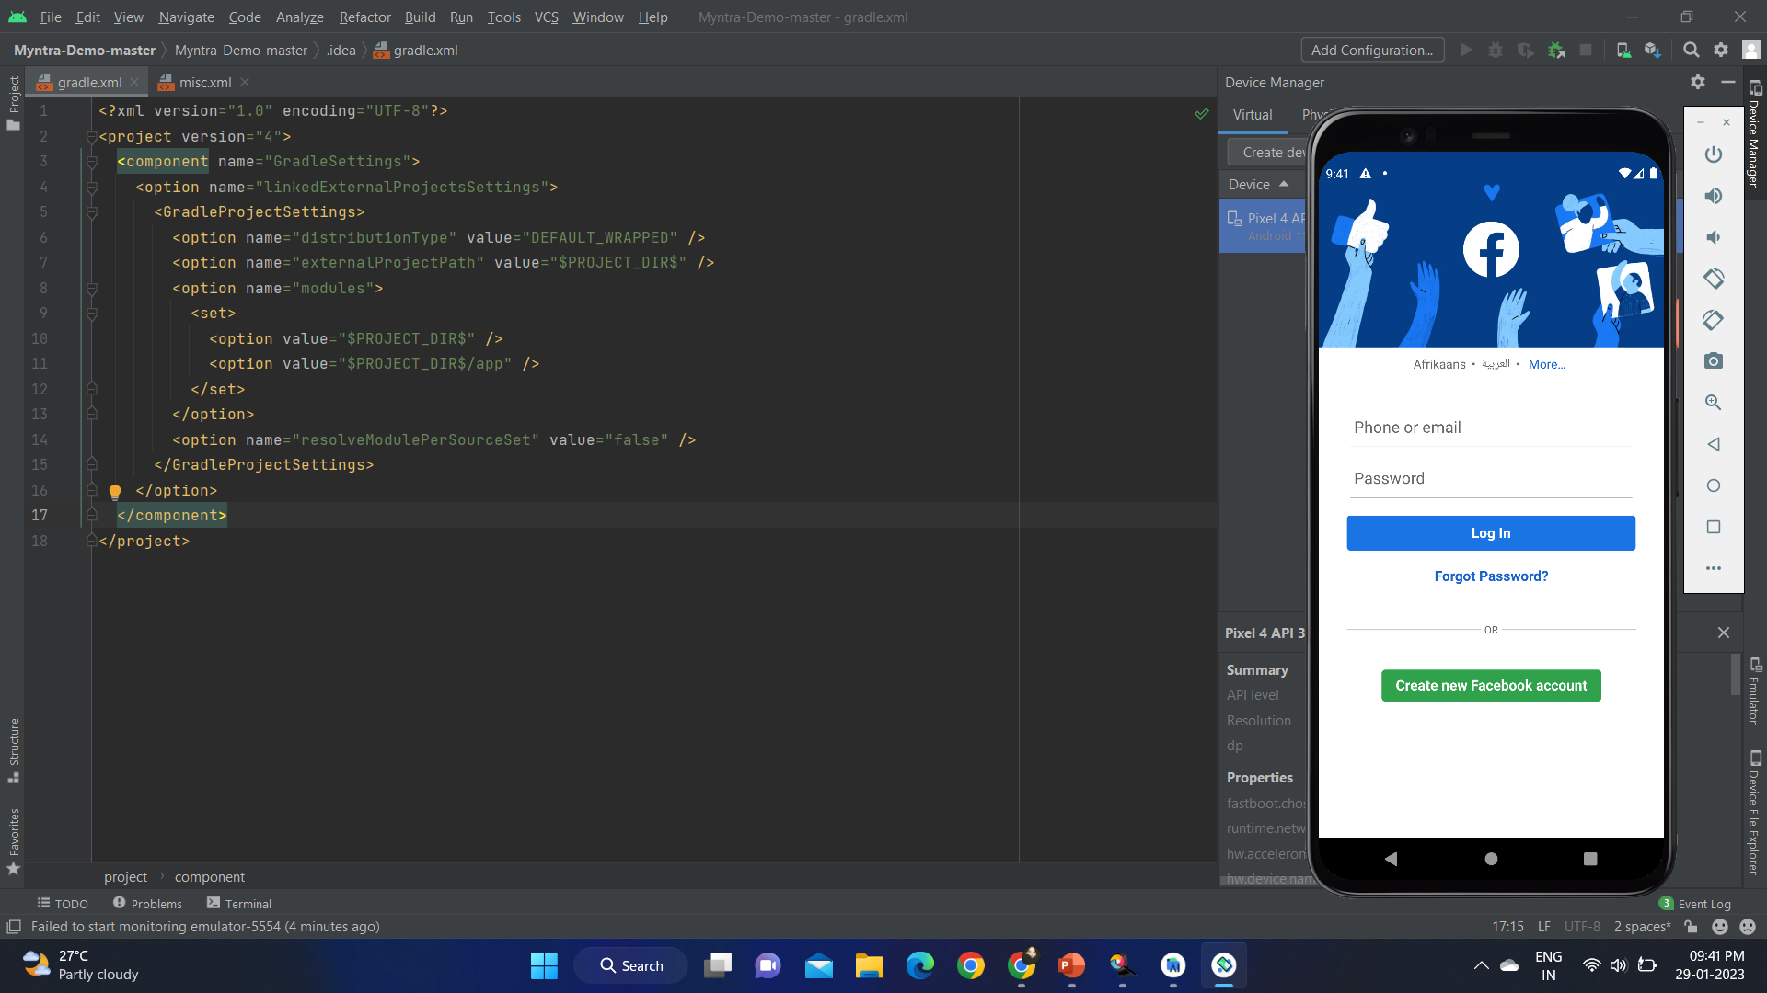
Implementation Of Testing

Slide 11
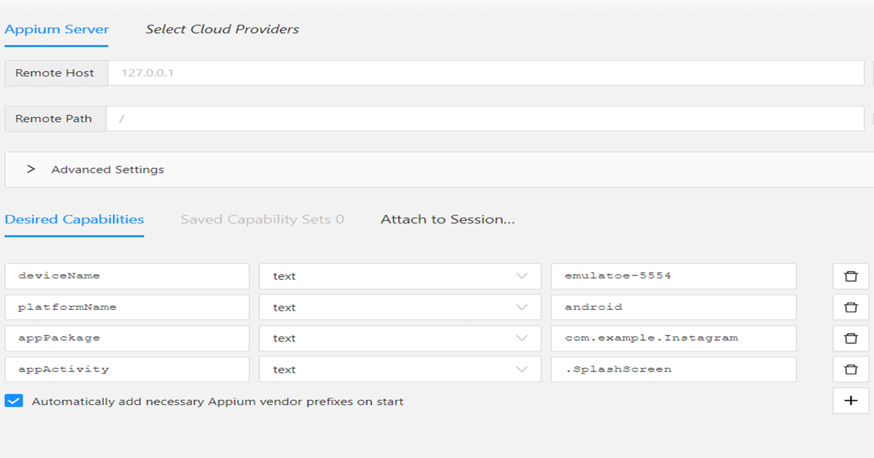
Appium Inspector

Slide 12
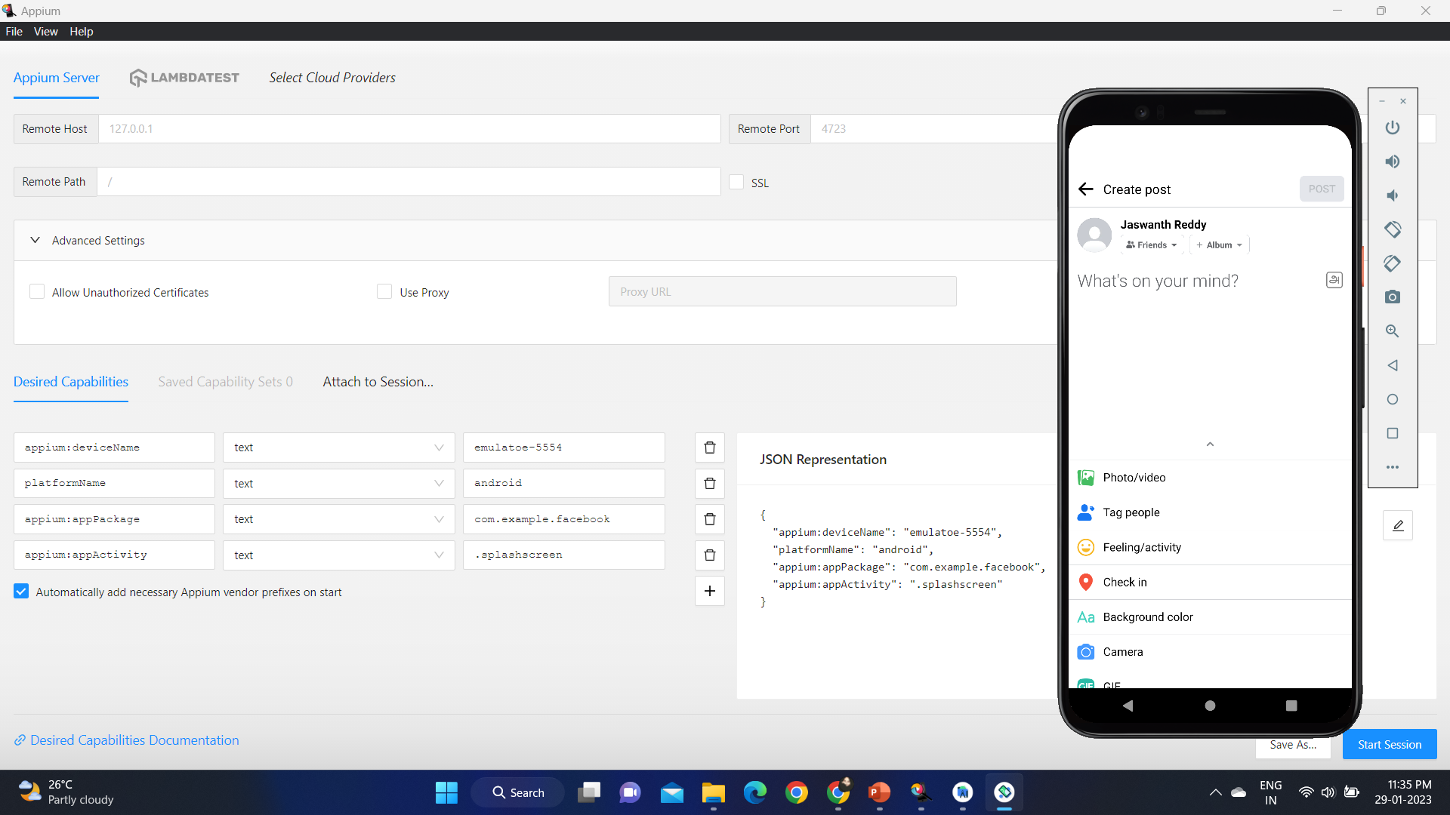
Testing Outputs

Slide 13
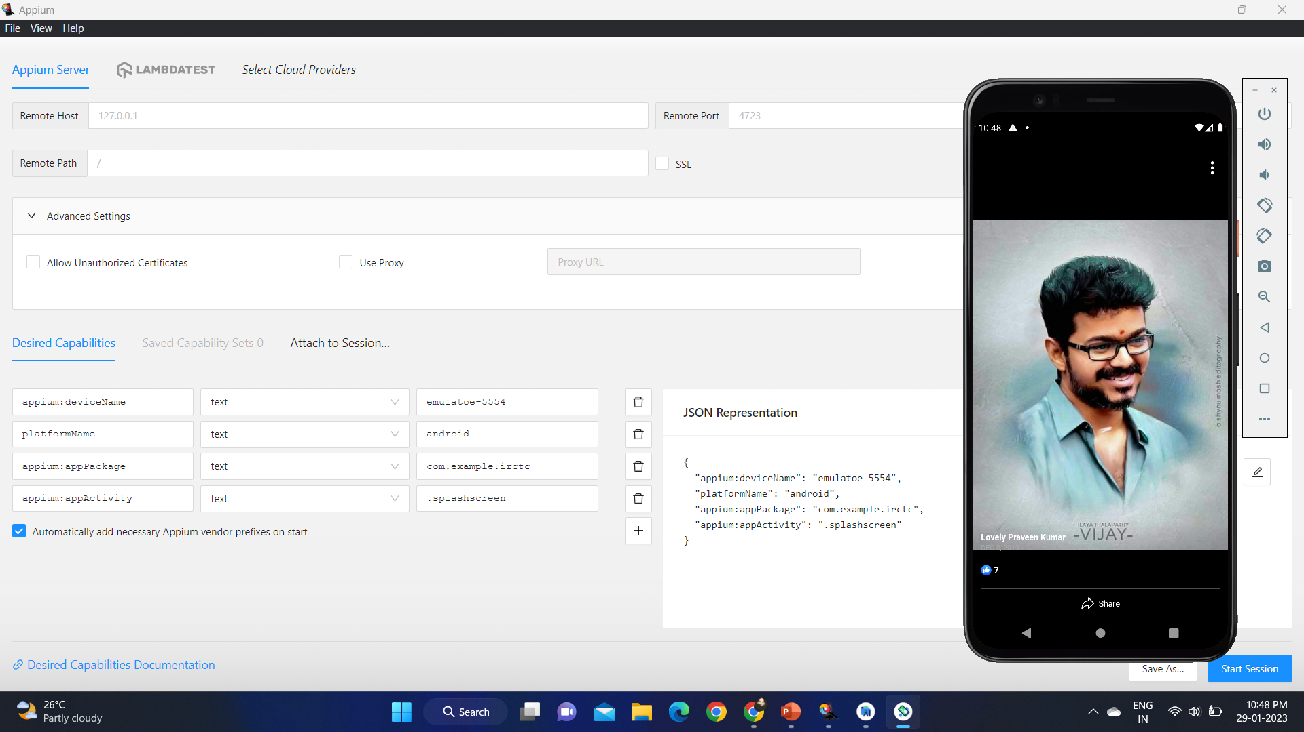
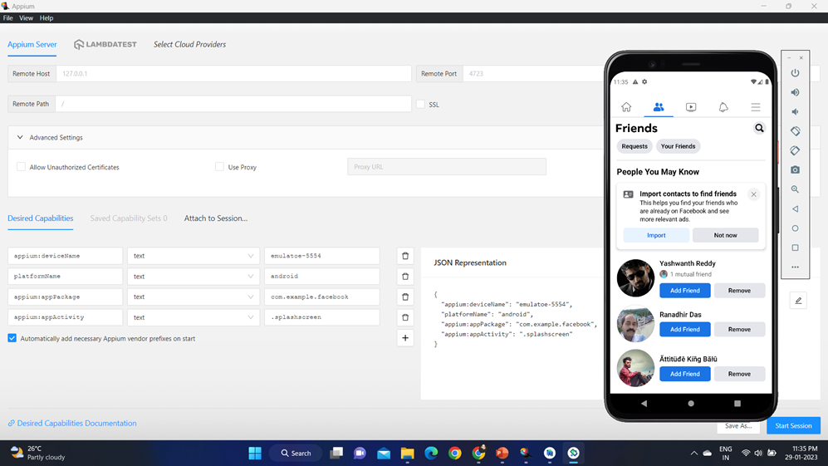
Testing Outputs

Slide 14
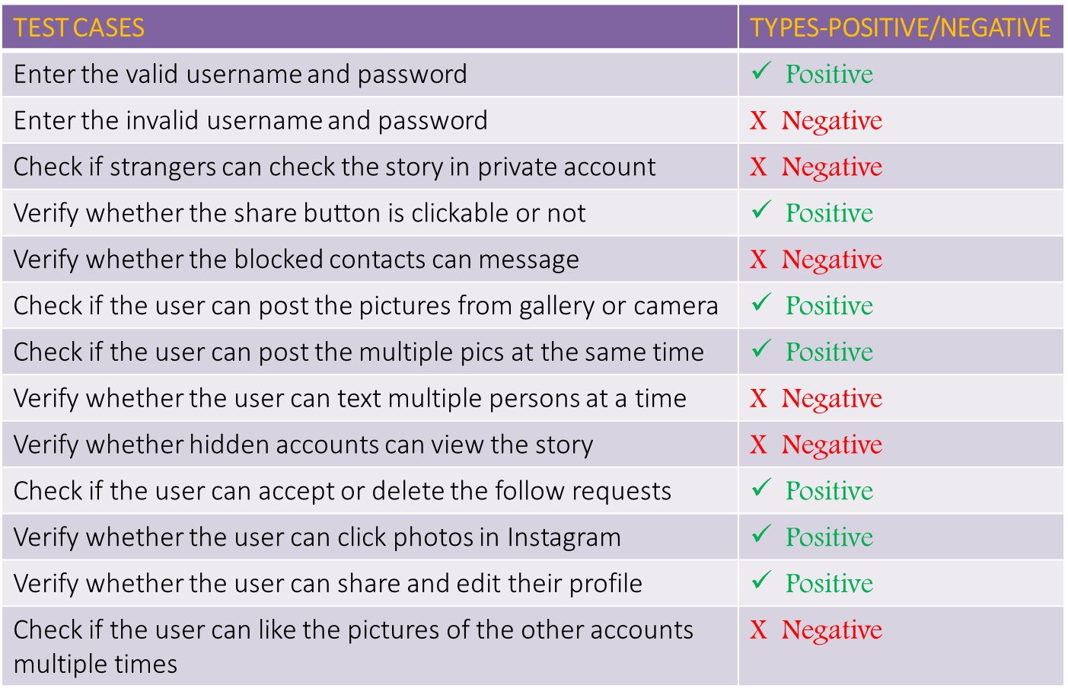
Test Scenarios

Slide 15
Conclusion
Hence , automation of facebook is successfully done using Appium server and inspector with all the possible test scenarios.

Slide 16

Thank you

