Slide 1

MNC Selection Process - Data Visualization using Ext JS –the chart
An ext-js DEMO

Slide 2
PROJECT OVERVIEW
A web application to visualize the recruitment data of an MNC.
Used Ext JS for UI components and layout.
Chart.js for rendering charts to visualize the recruitment stages.
Data shows how candidates progress through the hiring process.

Slide 3
EXTJS OVERVIEW
A JavaScript framework used for building rich web applications with a wide variety of UI components.
Provides powerful tools for creating dynamic layouts, grids, forms, charts, and more.
Key components used in this project:
Ext.create(): Creates components (e.g., windows, panels).
Ext.window.Window: Used to create a window container for the charts.
Ext.panel.Panel: Used to wrap and organize content.

Slide 4
Chart.js Overview
A simple and easy-to-use JavaScript library for creating interactive and customizable charts.
Supports multiple types of charts (Line, Bar, Pie, etc.).
Key components used in this project:
Line Chart: To visualize time taken in hiring process stages.
Bar Chart: To compare the number of selected and rejected candidates at each stage.
Pie Chart: To show the distribution of candidates by source.

Slide 5
Project Structure
HTML: Provides the page structure and canvas for the charts.
Ext JS: Used for layout and UI management (e.g., creating windows and panels).
Chart.js: Used for rendering line, bar, and pie charts.
CSS: Styling for layout, responsiveness, and design of the charts.

Slide 6
Features of the Project
Dynamic chart rendering using Chart.js.
Interactive Ext JS components for better visualization.
Three charts:
Line Chart: Shows time taken for the recruitment stages.
Bar Chart: Compares the selected vs rejected candidates at each stage.
Pie Chart: Displays the candidate source distribution.Responsive design using CSS for mobile and desktop views.

Slide 7
Ext JS & Chart.js Integration
Ext JS provides the layout and containers (Windows, Panels) where Chart.js charts are rendered.
Chart.js charts are embedded in the Ext JS panels, creating a clean and professional dashboard for the user.
Example:Line Chart in an Ext JS panel with labels, data points, and a custom tooltip.
Bar Chart showing the number of selected vs rejected candidates at various stages.

Slide 8
Demo of the Web App
Include screenshots.
Show the different charts:
Line Chart: Recruitment timeline.
Bar Chart: Comparison of candidates.
Pie Chart: Source of candidates.

Slide 9
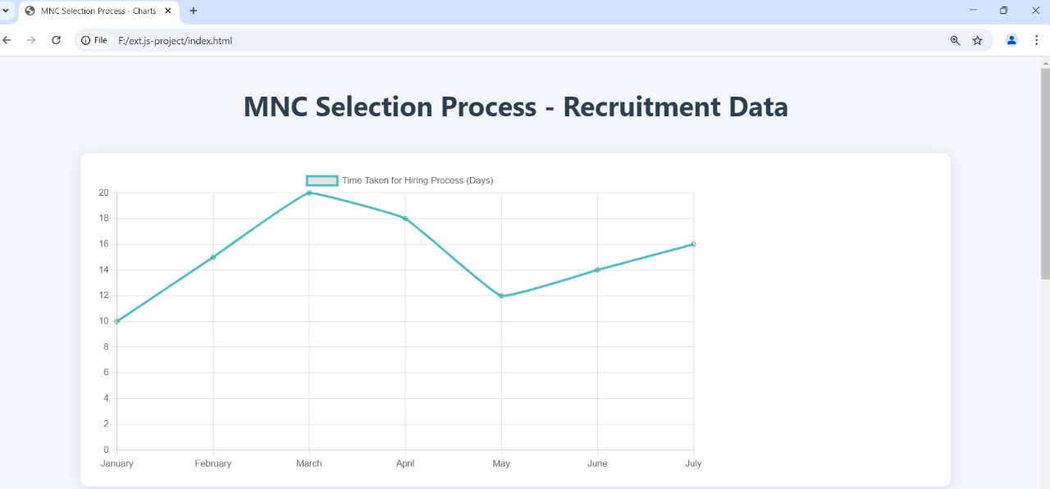
LINE CHART

Slide 10
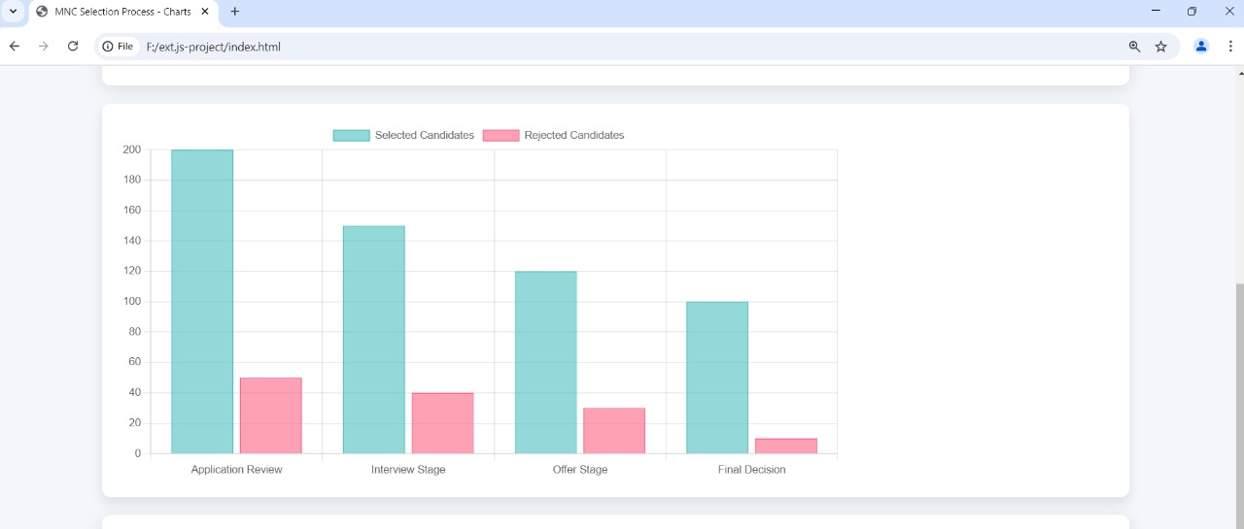
BAR CHART

Slide 11
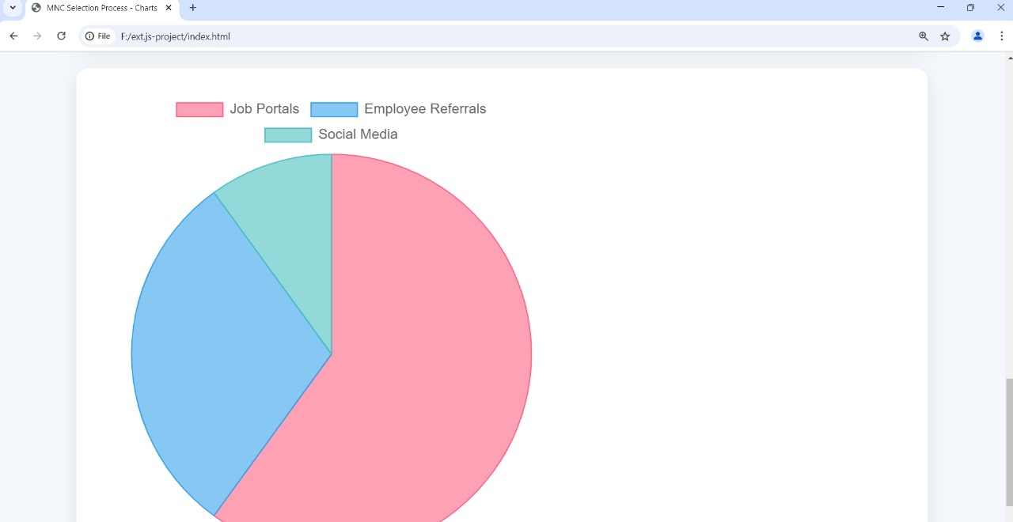
PIE CHART

Slide 12
Technical Implementation
Ext JS Components:A Window is created using Ext.create('Ext.window.Window') to hold the charts.
Panels are created to wrap each chart using xtype: 'panel'.Chart.js Setup:Used the Line, Bar, and Pie chart types from Chart.js.
Data and options are passed to the charts using JavaScript.
CSS: Styled the charts and layout to make it responsive and visually appealing.

Slide 13
Challenges & Solutions
Challenge 1: Integrating Chart.js with Ext JS.
Solution: Used Ext JS panels to organize the charts within a structured layout.
Challenge 2: Making the design responsive.
Solution: Added custom CSS for responsiveness and made charts adapt to screen sizes.

Slide 14
Conclusion
This project demonstrates how to combine Ext JS for UI layout and Chart.js for data visualization to create an informative dashboard.It shows how modern JavaScript frameworks can work together to build dynamic web applications.

Slide 15

Thank You

