Slide 1
Angular Product Inventory Management System
Project Presentation
Prepared by: Gone Jaswanth

Slide 2
Project Overview
An Angular-based Inventory Management System.
Users can manage products: Add, Update, Delete, and Search.
Implements modular design and reusable components.

Slide 3
Technologies Used
Frontend: Angular, TypeScript, HTML, CSS
Backend:Json, NodeJs..
Tools: npm

Slide 4
Key Features
User Authentication (Login, Register)
Manage Inventory (Add, Update, Delete Products)
Search and Filter Products
Responsive UI with Shared Components

Slide 5
Project Architecture
Follows modular structure:
- app.module.ts: Main Module
- app-routing.module.ts: Routing
- features/: Feature modules
- shared/: Shared components and services

Slide 6
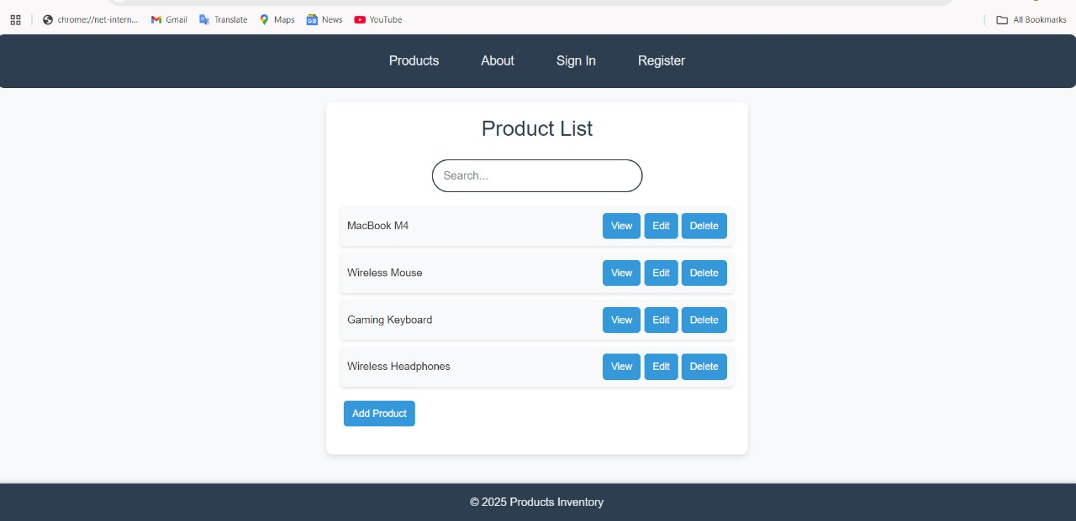
OutPut of Project

Slide 7
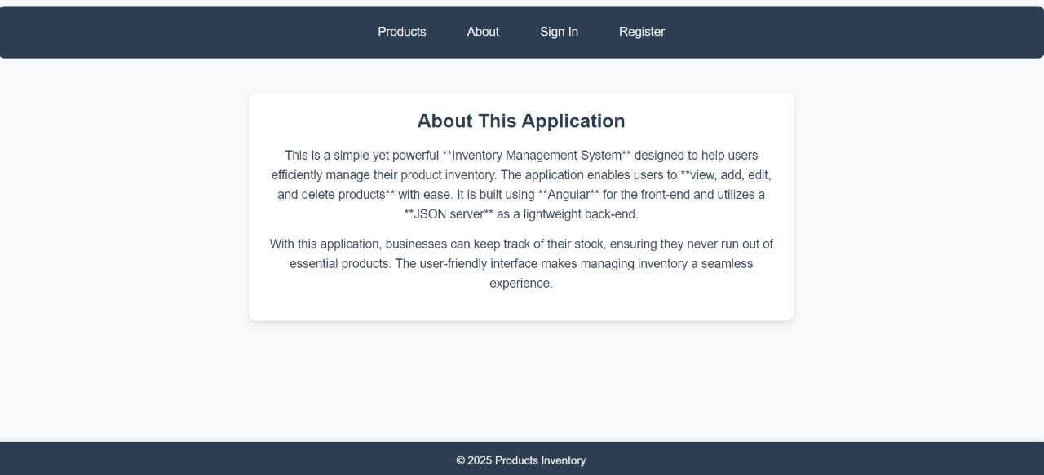
About page

Slide 8
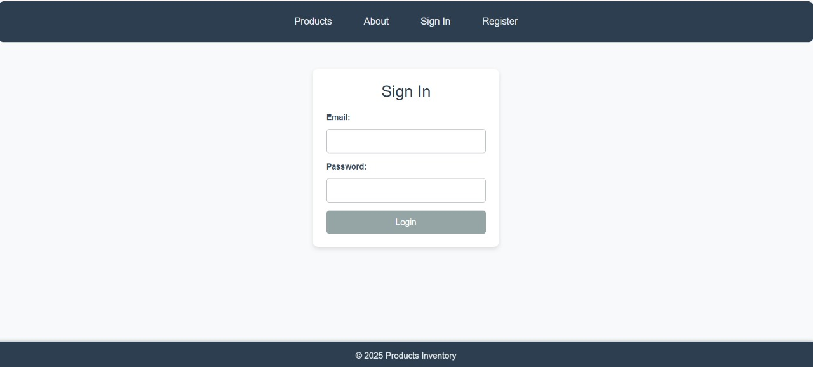
Sign in page

Slide 9
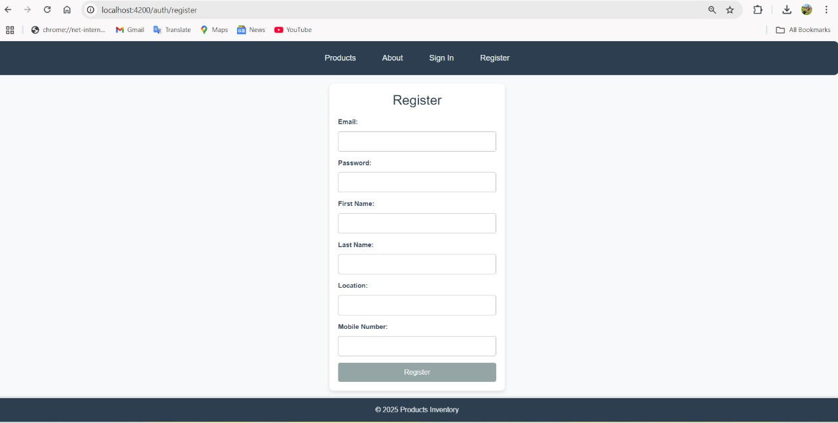
Register page

Slide 10
Conclusion
This project demonstrates a structured Angular inventory management system.
Future improvements: API integration, advanced filtering, analytics.
The application enables users to view, add, edit, and delete products with ease. It is built using Angular for the front-end and utilizes a JSON server as a lightweight back-end.With this application, businesses can keep track of their stock, ensuring they never run out of essential products. The user-friendly interface makes managing inventory a seamless experience.

