Slide 1

MySQL WHERE CLAUSE OPERATORS
OPERATOR | DEFINITION
= | EQUAL
> | GREATER THAN
< | LESS THAN
>= | GREATER THAN OR EQUAL TO
<= | LESS THAN OR EQUAL TO
<> | NOT EQUAL
BETWEEN | BETWEEN A RANGE
LIKE | TEST IS A STRING CONTAINS A SPECIFIED PATTERN
IN | MULTIPLE POTENTIAL VALUES

Slide 2
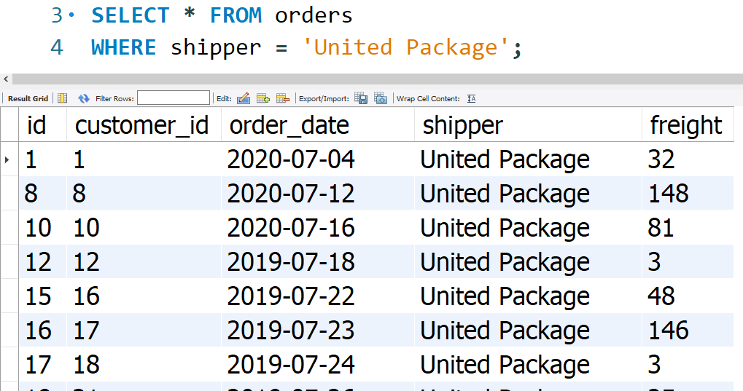
EQUAL =

Slide 3
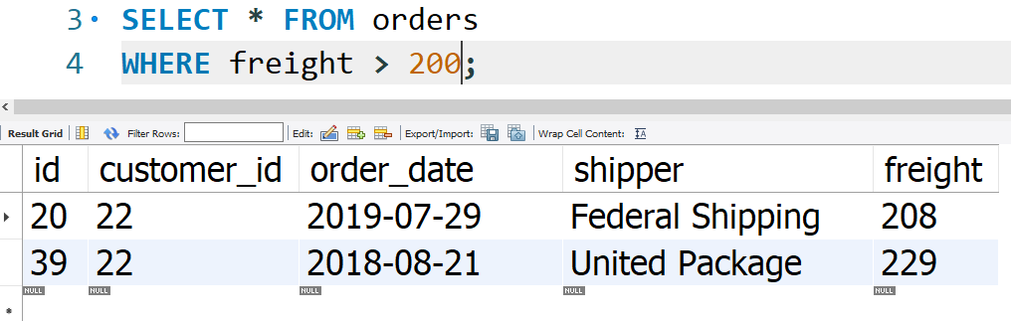
GREATER THAN >

Slide 4
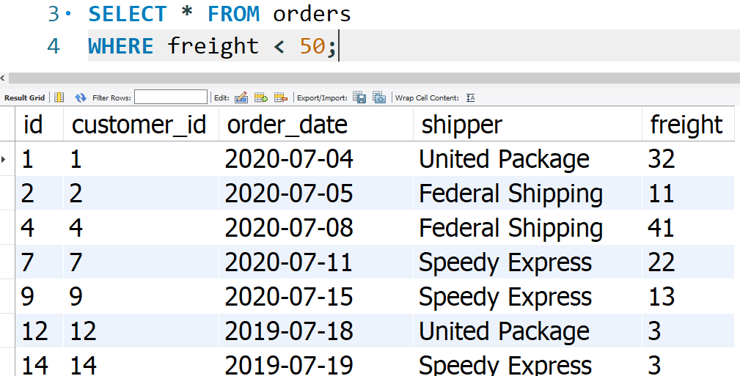
LESS THAN <

Slide 5
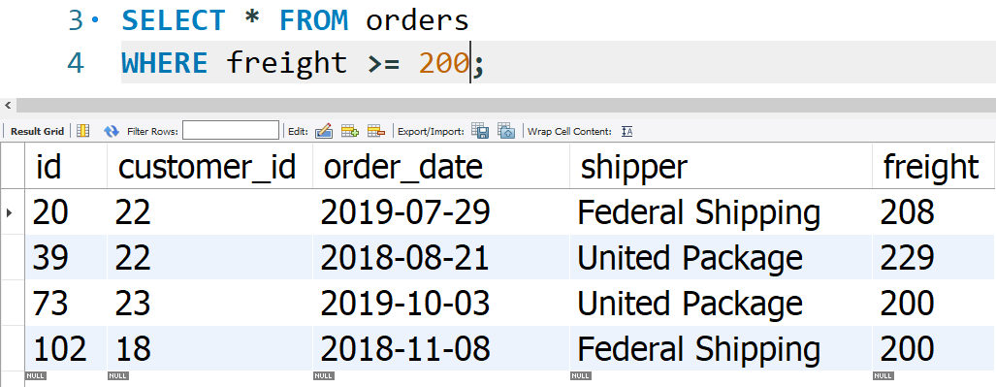
GREATER THAN EQUAL TO >=

Slide 6
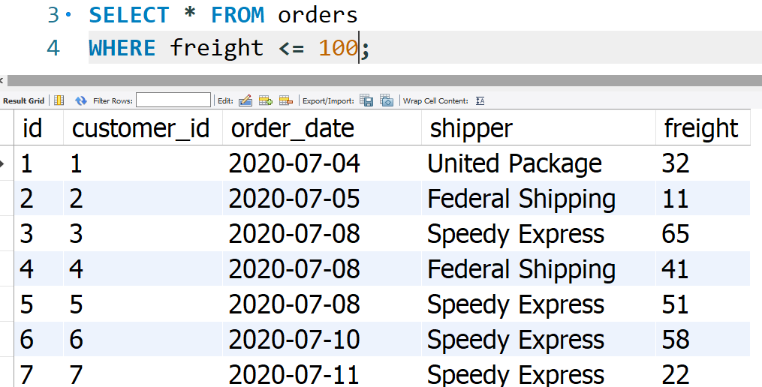
LESS THAN EQUAL TO <=

Slide 7
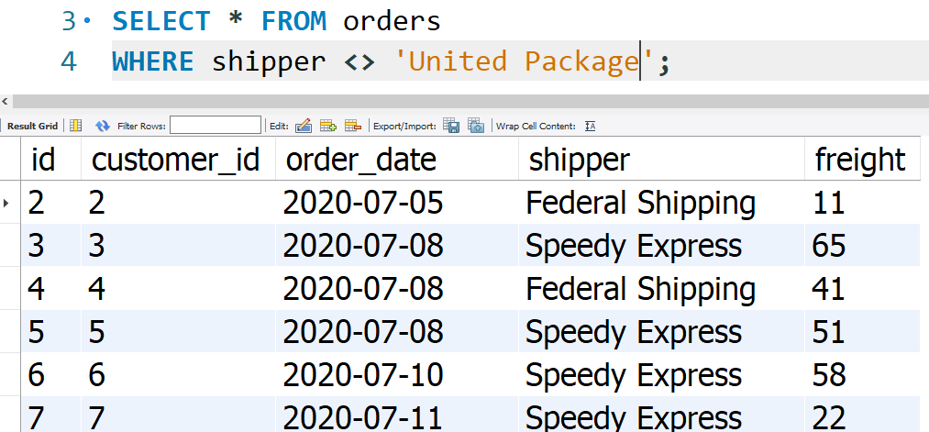
NOT EQUAL <>

Slide 8
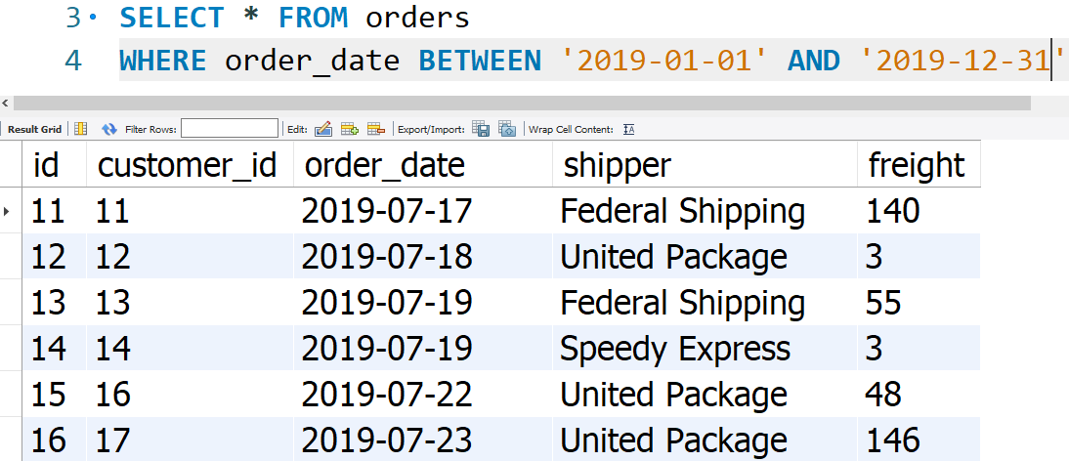
BETWEEN

Slide 9
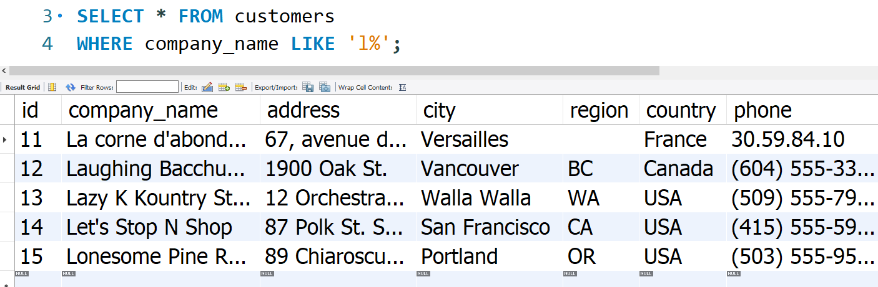
LIKE

Slide 10
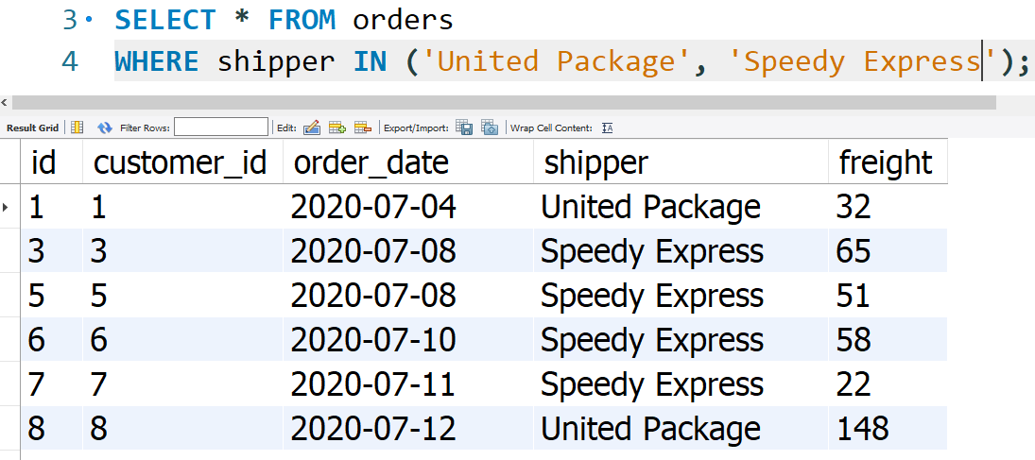
IN

