Slide 1



Farm Assist
2520030503-V Deepak
2520030553-B Jaswanth Bhaskar
Team Number: 20
Section: 8
Under the guidance of
Dr. V. Sireesha
Professor, Department of CSE

Slide 2
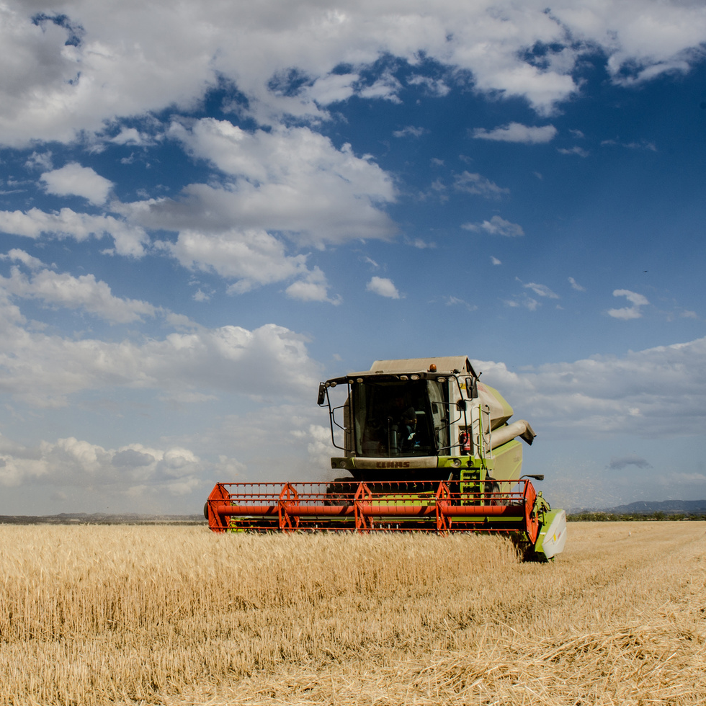
Abstract
Farm Assist is a Java-based application designed to provide farmers with quick access to information about crops, plant diseases, fertilizers, and cultivation techniques.
The project focuses on advanced Data Structures and Algorithms. KMP and Rabin-Karp algorithms enable fast keyword searching, while Dynamic Programming helps generate optimal crop recommendations.
Network flow algorithms can also support efficient fertilizer allocation under limited resources. Overall, Farm Assist demonstrates the practical use of advanced DSA concepts through a simple and user-friendly Java application.
02

Slide 3


Problem Statement:
Farmers face difficulty in quickly finding reliable information about crops, diseases, fertilizers, and cultivation practices.
Searching through large agricultural datasets using basic methods can be slow and inefficient.
Farmers need better support for crop selection and decision-making.
Limited agricultural resources require efficient allocation and optimization.
Farm Assist addresses these problems using advanced algorithms such as KMP, Rabin-Karp, Dynamic Programming, and Network Flow for faster searching, optimization, and resource allocation.
02
03

Slide 4

Proposed Functionalities
  Agricultural Information Search: Allow users to search for crops, diseases, fertilizers, and cultivation techniques using efficient string-matching algorithms such as KMP and Rabin-Karp.
  Crop Recommendation: Recommend suitable crops based on factors such as land area, budget, water availability, and expected yield using Dynamic Programming.
  Disease Identification: Search agricultural symptoms and match them with relevant plant diseases and possible treatments.
  Fertilizer Resource Allocation: Determine an efficient allocation of limited fertilizer resources among different requirements using Network Flow algorithms such as Ford-Fulkerson/Edmonds-Karp.
  Efficient Data Handling: Organize agricultural information using appropriate Java data structures to support fast searching and processing.
  Simple Java Interface: Provide a user-friendly menu-driven interface through which farmers can access the different functionalities
04

Slide 5
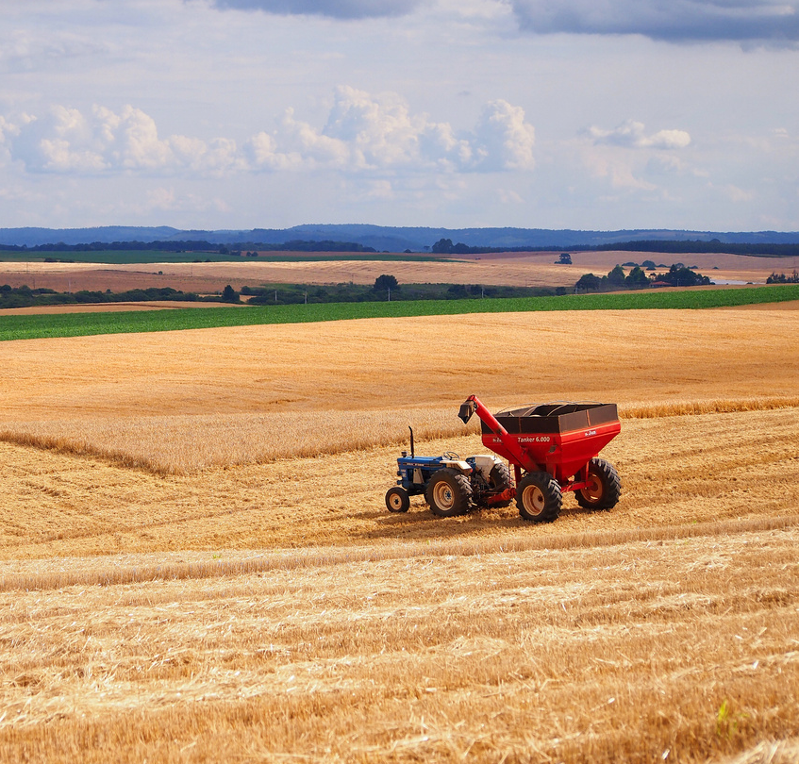
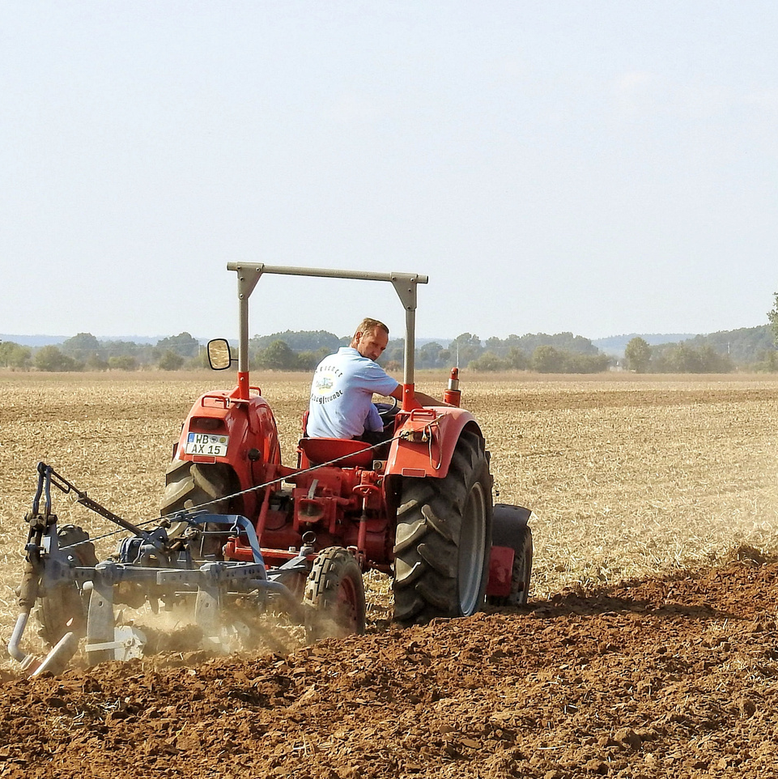
Tools and Technologies to be used
  Programming Language: Java
  JDK: Java Development Kit (JDK 17 or above)
  IDE: IntelliJ IDEA / Eclipse / Visual Studio Code
  Java Collections Framework: ArrayList, HashMap, HashSet, Queue, Stack, PriorityQueue, etc., wherever required
  File Handling: Java File I/O for storing and retrieving agricultural datasets
  String Processing: KMP, Z-Function, and Rabin-Karp with Rolling Hash for efficient pattern matching
  Dynamic Programming: Interval DP, Subset/Bitmask DP, and other suitable DP techniques for optimization
  Graph Algorithms: Graph representation using adjacency lists and Network Flow algorithms such as Ford-Fulkerson/Edmonds-Karp
  Randomized Algorithms: Monte Carlo/Las Vegas techniques where applicable
  Algorithm Analysis: Time and space complexity analysis using Big-O notation
  Version Control: Git and GitHub for source-code management
01
04
05

Slide 6

Expected Outcome
Provides an efficient Java-based platform for agricultural information.
Enables fast searching of crop, disease, fertilizer, and cultivation details.
Uses KMP and Rabin-Karp algorithms for efficient information retrieval.
Provides optimized crop recommendations using Dynamic Programming.
Uses Network Flow algorithms for efficient resource allocation.
Improves search speed, decision-making, and resource management.
Demonstrates the practical application of advanced DSA concepts in agriculture.
06

Slide 7
Thank You
7

