Slide 1
SOFTWARE ENGINEERING

Slide 2
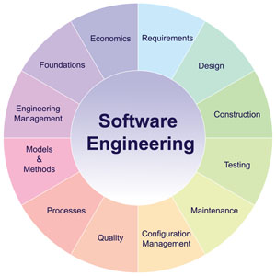

Slide 3
Course Objectives
To familiarize with the software engineering principles to be followed in software development.
To impart knowledge on software project management.

Slide 4
Course Outcomes
Upon successful completion of the course, the students will be able to
apply suitable process model for software development based on stake holder requirements.
estimate cost and schedule required to develop a software.
analyze customer requirements and prepare SRS document.
use software design principles in the design of a software.
test a software using different testing techniques.

Slide 5
Unit-I
Introduction and Software Life Cycle Models

Slide 6
Syllabus
Evolving - From an art form to an Engineering Discipline. Life Cycle Models- Classical waterfall model, Iterative waterfall model, Prototyping model, Agile development models.

Slide 7
SOFTWARE ENGINEERING
SOFTWARE
set of instructions or programs instructing a computer to do specific tasks.
Software is a set of
Instructions that when executed provide desired function and performance,
Data Structures that enable the programs to adequately manipulate information,
Documents that describe the operation and use of the programs.
ENGINEERING
Engineering is the application of mathematics, science, economics, social and practical knowledge to invent, innovate, design, build, maintain and research.

Slide 8
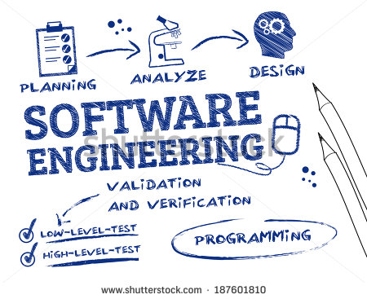
Definition of Software Engineering
“The application of a systematic, disciplined, quantifiable approach to the development, operation, and maintenance of software".

Slide 9
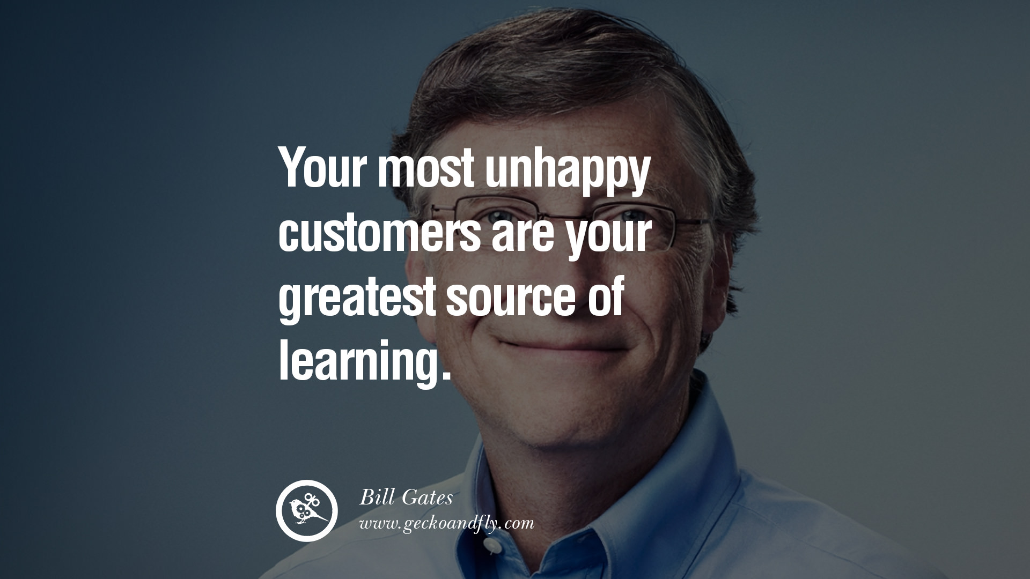

Slide 10
Characteristics of software
1. Software is developed or engineered, it is not manufactured
Hardware is manufactured, but software is developed.
The manufacturing phase for hardware can introduce quality problems that are nonexistent or easily corrected for software.
Both activities are dependent on people, but the relationship between people applied and work accomplished is entirely different.
Both activities require the construction of a "product" but the approaches are different.

Slide 11
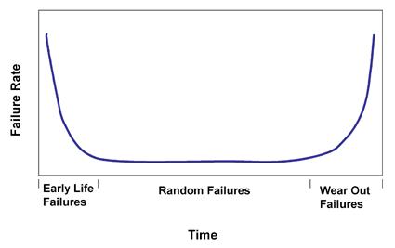
2. Software doesn't "wear out"
Figure represents failure rate as a function of time for hardware.
The relationship is often called the "bathtub curve".

Slide 12
These defects can be corrected and the failure rate drops to a steady-state level (ideally, quite low) for some period of time.
As time passes, however, the failure rate rises again as hardware components suffer from the cumulative effects of dust, vibration, abuse, temperature extremes, and many other environmental maladies, which means that the hardware begins to wear out.

Slide 13
the failure rate curve for software should take the form of the “idealized curve”
Undiscovered defects will cause high failure rates early in the life of a program.
However, these are corrected (ideally, without introducing other errors) and the curve flattens as shown.
The idealized curve is a gross oversimplification of actual failure models for software.
However, the implication is clear—software doesn't wear out. But it does not using forever.

Slide 14
Evolution- From an Art form to an Engineering Discipline
Evolution of an Art into an Engineering Discipline
The early programmers used an exploratory (also called build and fix or code and fix) style.
In the build and fix (exploratory) style, normally a program is quickly developed without making any specifications, plan or design.
The different imperfections that are subsequently noticed are fixed.
The exploratory programming style is informal style in the sense that there are no set of rules or recommendations.
Every programmer evolves his own software development techniques guided by his own intuition, experience and fancies.

Slide 15
Evolution Pattern for Engineering Disciplines
If we analyze the evolution of the software development styles over the last sixty years, we can easily noticed that it has evolved from an esoteric art form to a craft form , and then emerged as an engineering discipline.
Evolution of technology has followed the similar patterns for iron making, paper making, building construction or software development.
Example : Iron making technology

Slide 16
Evolution Pattern for Engineering Disciplines
Engineering
Esoteric Past
Experience
Technology
Craft
Systematic Use of Past
Experience and Scientific Basis
Unorganized Use of
Past Experience
Art
Time

Slide 17
A Solution to Software Crisis
To understand the present software crisis, consider the following graph
Organisations are spending larger portions of their budget on software as compared to that on hardware.
So software products becoming more expensive.

Slide 18
A Solution to Software Crisis
Hw cost
Sw cost
1960
Year
2008
Relative Cost of Hardware and Software

Slide 19
Factors Contributing to the Software Crisis
Larger problems
Lack of adequate training in software engineering
Increasing skill shortage
Low productivity improvements.

Slide 20
Factors Contributing to the Software Crisis
Software products:
Fail to meet user requirements
Frequently crash
Expensive
Difficult to alter, debug, and enhance
Often delivered late
Use resources non-optimally

Slide 21
Why Software Engineering?
To acquire skills to develop large programs.
Ability to solve complex programming problems.
Also learn techniques of:
Specification, design, user interface development, testing, project management, etc.
To acquire skills to be a better programmer:
Higher Productivity
Better Quality Programs

Slide 22
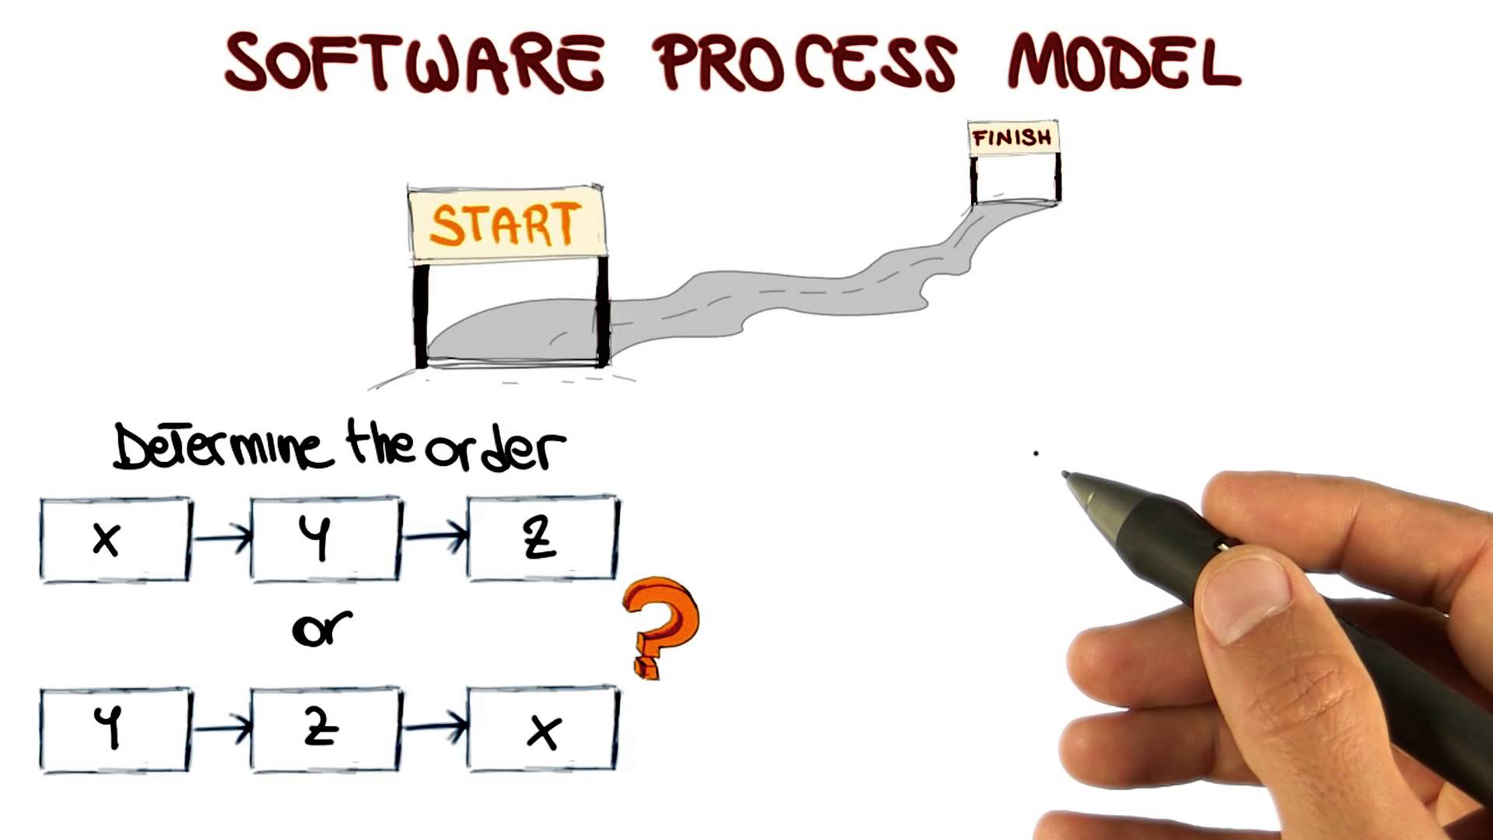
Life Cycle Model or Process model

Slide 23
Software Life Cycle model
A software life cycle model is a descriptive and diagrammatic representation of the software life cycle.
The software engineering approaches emphasize software development through a well-defined and ordered set of activities. If these activities are graphically modeled as well as textually described then it is called as Software Life cycle Model.
Software Life cycle Model is also called as Software Development Life cycle Model or Software Development Process Model.
The life cycle of a software represents the series of identifiable stages through which it evolves during its life time.

Slide 24
The need for a software life cycle model
The development team must identify a suitable life cycle model for the particular project and then adhere to it.
Without using of a particular life cycle model the development of a software product would not be in a systematic and disciplined manner.
When a software product is being developed by a team there must be a clear understanding among team members about when and what to do.
A software life cycle model defines entry and exit criteria for every phase.

Slide 25
Software Life Cycle models
Classical waterfall model
Iterative waterfall model
Prototyping model
Agile Development model
V-model
Spiral Model
Incremental Development Model
RUP process model

Slide 27
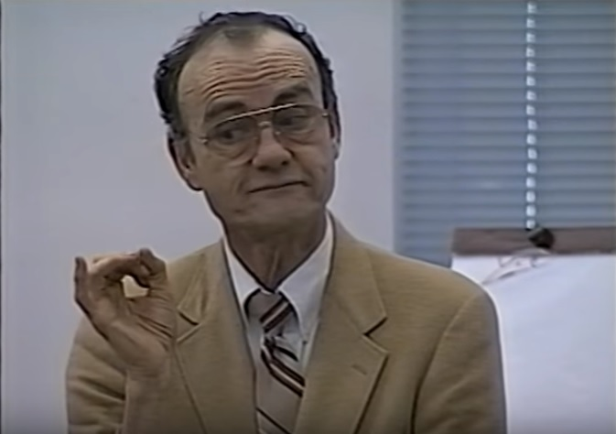
Classical waterfall model
The waterfall model is a classical development process model proposed by Winston Walker Royce in 1970.
The simplest process model is the waterfall model, which states that the phases are linear order.

Slide 28
Classical Waterfall Model
Classical waterfall model divides life cycle into phases:
feasibility study
requirements analysis and specification
design
coding and unit testing
integration and system testing
maintenance

Slide 29
Classical Waterfall Model
Feasibility Study
Req. Analysis and specification
Design
Coding and Unit Testing
Integration and System Testing
Maintenance

Slide 30
Relative Effort distribution among different phases
Phases between feasibility study and testing known as development phases.
Among all life cycle phases
maintenance phase consumes maximum effort.
Among development phases,
testing phase consumes the maximum effort.
Relative Effort

Slide 31
Feasibility Study
Main aim of feasibility study is to determine whether
it would be financially and technically feasible to develop the software.
First roughly understand what the customer wants:
different data which would be input to the system,
processing needed on these data,
output data to be produced by the system,
various constraints on the behavior of the system.

Slide 32
Feasibility Study
Development of an overall understanding of the problem.
Formulation of various possible strategies for solving the problem different solution strategies.
Evolution of different solution strategies in terms of:
resources required,
cost of development, and
development time.

Slide 33
Requirements Analysis and Specification
This phase is to
understand the exact requirements of the customer
document them properly.
Consists of two distinct activities:
requirements gathering and analysis
requirements specification

Slide 34
Requirements Gathering and Analysis
Collect all related data from the customer:
analyze the collected data to clearly understand what the customer wants,
find out any inconsistencies and incompleteness in the requirements,
resolve all inconsistencies and incompleteness.

Slide 35
Requirements Specification
After the requirements gathering and analysis the identified requirements are documented. This is a Software Requirements Specification (SRS) document.

Slide 36
Design
Design phase transforms requirements specification into a form suitable for implementation in some programming language.
During design phase, software architecture is derived from the SRS document.
Two design approaches are used at present:
Procedural Design approach
Object oriented Design approach.

Slide 37
Procedural Design approach
It consists of two activities:
Structured analysis (typically carried out by using DFD )
Structured design

Slide 38
Object Oriented Design
First identify various objects (real world entities) occurring in the problem:
identify the relationships among the objects.
For example, the objects in a pay-roll software may be:
employees,
managers,
pay-roll register,
Departments, etc.

Slide 39
Coding and unit testing
This phase is to translate software design into source code.
This phase is also called as Implementation phase.
During the implementation phase:
each module of the design is coded,
each module is unit tested and debugged.
The purpose of unit testing:
test if individual modules work correctly.
The end product of implementation phase is a set of program modules that have been tested individually.

Slide 40
Integration and System Testing
Different modules are integrated in a planned manner:
During each integration step, the partially integrated system is tested.

Slide 41
Integration and System Testing
M1
M2
M3
M4

Slide 42
System Testing
After all the modules have been successfully integrated and tested system testing is carried out.
Goal of system testing is to ensure that the developed system functions according to its requirements as specified in the SRS document.

Slide 43
Maintenance
Maintenance of any software product requires much more effort than the effort to develop the product itself.
The ratio of development effort to maintenance effort is typically 40:60.
Maintainance is required in three situations.

Slide 44
Maintenance
Corrective maintenance:
Correct errors which were not discovered during the product development phases.
Perfective maintenance:
Improve implementation of the system
enhance functionalities of the system.
Adaptive maintenance:
Port software to a new environment,
e.g. to a new computer or to a new operating system.

Slide 45
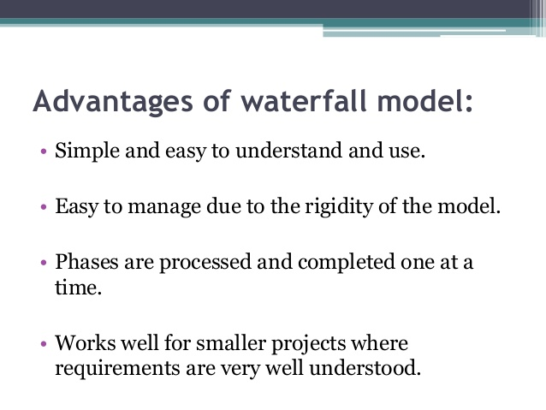

Slide 46
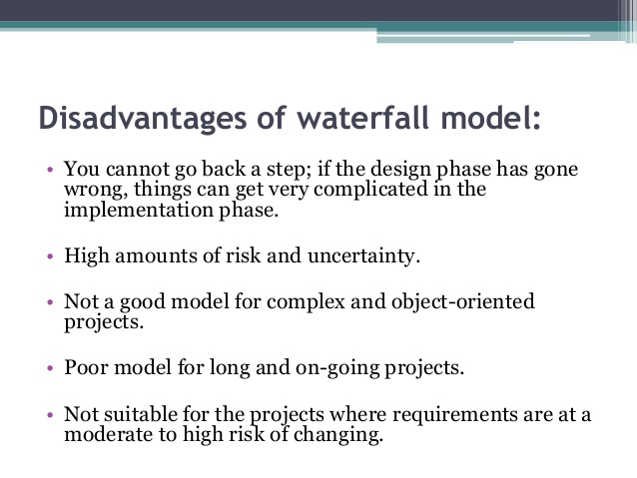

Slide 47
Disadvantages of Waterfall model
No Feedback paths
Difficult to accommodate change requests
Inefficient error corrections
No overlapping of phases

Slide 48
When to use the Waterfall Model?
Requirements are well known and stable
Technology is understood
Development team have experience with similar projects
For small projects

Slide 49
Iterative Waterfall Model
The main change brought about by the Iterative Waterfall model to the Classical Waterfall model is in the form of feedback paths from every phase to its preceding phases.
The feedback paths allow for correcting errors committed by a programmer during some phase , as and when these are detected in a later phase.
For example if during test phase design error is identified, then the feedback pathallows the design to be reworked and the change to be reflected in the design documents
There is no feedback path to the feasibility phase because once a team accepted to take up a project, they does not give up the project easily due to legal and moral reasons.

Slide 50
Iterative Waterfall Model
Feasibility Study
Req. Analysis and specification
Design
Coding and unit testing
Integration and systemTesting
Maintenance

Slide 51
Iterative Waterfall Model
Errors should be detected in the same phase in which they are introduced, so that early detection of errors reduces the effort and time
For example:
if a design problem is detected in the design phase itself, the problem can be taken care of much more easily than if it is identified at the end of the testing phase.

Slide 52
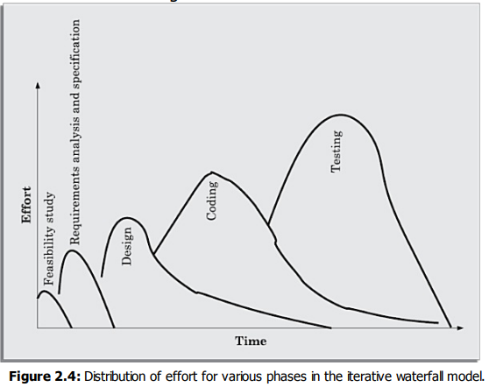
Iterative Waterfall Model

Slide 53
Iterative Waterfall Model
Rework must be carried out not only to the design but also to code and test phases.
The principle of detecting errors as close to their point of commitment as possible is known as phase containment of errors.
Iterative waterfall model is the most widely used model almost every other model is derived from the waterfall model.

Slide 54
Disadvantages of Iterative Waterfall model
Difficult to accommodate change requests
Incremental delivery not supported
Phase overlap not supported
Error correction is expensive
Limited customer interactions
Heavy documentation
No support for risk handling and code reuse.

Slide 55
Prototyping Model
The prototyping model is also an extension of waterfall model.
This model suggests building a working prototype of the system before development of actual software.
A prototype is a toy and implementation of a system. It has limited functional capabilities, low reliability,
inefficient performance as compared to actual software.

Slide 56
Necessity of the prototyping model
This model is advantageous for specific type of projects. We identify three types of projects for which prototyping model is followed:
1. It is advantageous to use the prototyping model for development of the graphical user interface(GUI) part of an application.
Through the use of a prototype, it becomes easier to illustrate the input data formats, messages, reports, and the interactive dialogs to the customer.
The GUI part of a software system is almost always developed using the prototyping model.

Slide 57
Necessity of the prototyping model
2. The prototyping model is especially useful when the exact technical solutions are unclear to the development team.
A prototype can help them to critically examine the technical issues associated with product development.
3. An important reason for developing a prototype is that it is impossible to “get it right” the first time. As advocated by Brooks [1975], one must plan to throw away the software in order to develop a good software later.
Thus, the prototyping model can be deployed when development of highly optimised and efficient software is required.
The prototyping model is considered to be useful for the development of not only the GUI parts of a software, but also for a software project for which certain technical issues are not clear to the development team.

Slide 58
Life cycle activities of prototyping model
In prototyping model software is developed through two major activities
1. prototype construction and
2. Iterative waterfall-based software development
Prototype development:
Prototype development starts with an initial requirements gathering phase.
A quick design is carried out and a prototype is built.
The developed prototype is submitted to the customer for evaluation.
Based on the customer feedback, the requirements are refined and the prototype is suitably modified.
This cycle of obtaining customer feedback and modifying the prototype continues till the customer approves the prototype.

Slide 59
Life cycle activities of prototyping model
Iterative development:
Once the customer approves the prototype, the actual software is developed using the iterative waterfall approach.
In spite of the availability of a working prototype, the SRS document is usually needed to be developed since the SRS document is invaluable for carrying out traceability analysis, verification, and test case design during later phases.
T h e code for the prototype is usually thrown away. However, the experience gathered from developing the prototype helps a great deal in developing the actual system.

Slide 60
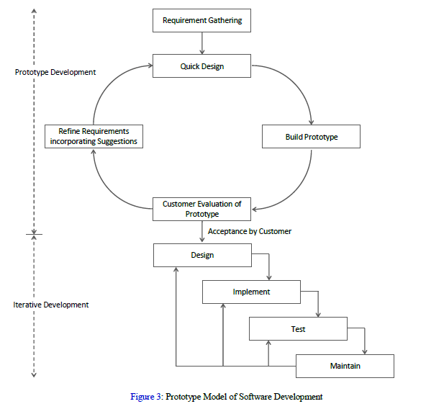
Prototyping Model

Slide 61
Prototyping Model
Even though the construction of a throwaway prototype might involve incurring additional cost, for systems with unclear customer requirements and for systems with unresolved technical issues, the overall development cost usually turns out to be lower compared to an equivalent system developed using the iterative waterfall model.

Slide 62
Strengths of Prototyping Model
This model is the most appropriate for projects that suffer from technical and requirements risks. A constructed prototype helps overcome these risks.
It is cost-cutting measure by reducing testing.
The experience of developing the prototype will reduce the cost entire project.
As requirements will be more stable now due to the feedback from the prototype, there will be fewer changes in the requirements.
Developing the prototype will enable them to create a better design, write better code, and do better testing.

Slide 63
